Slide 1
Handouts and Answers

Slide 2
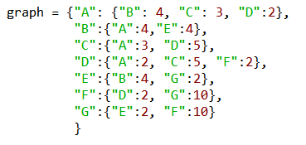
Draw the Graph for this dictionary

Slide 3
Draw the Graph for this dictionary
4
2
3
5
4
2
2
10

Slide 4
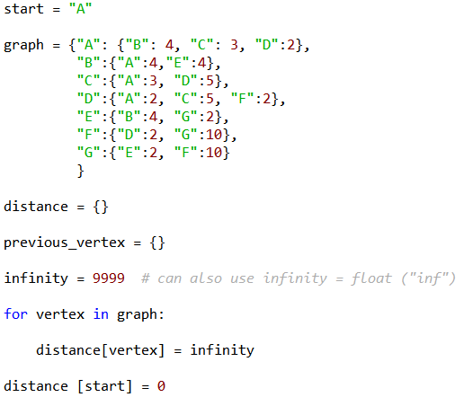
Comment This Code
COMMENTS
#
#
#
#
#
#
What data structures have been initiated?

Slide 5
Fill in the initial values
Vertex | distance | Previous_vertex | Visited
A
B
C
D
E
F
G
How are visited/Non-visited nodes tracked by the code?

Slide 6
Comment This Code
Vertex | distance
A
B
C
D
E
F
G
Fill in the initial values

Slide 7
Comment This Code
Vertex | distance
A | 0
B | 9999
C | 9999
D | 9999
E | 9999
F | 9999
G | 9999
Fill in the initial values - Answer

Slide 8
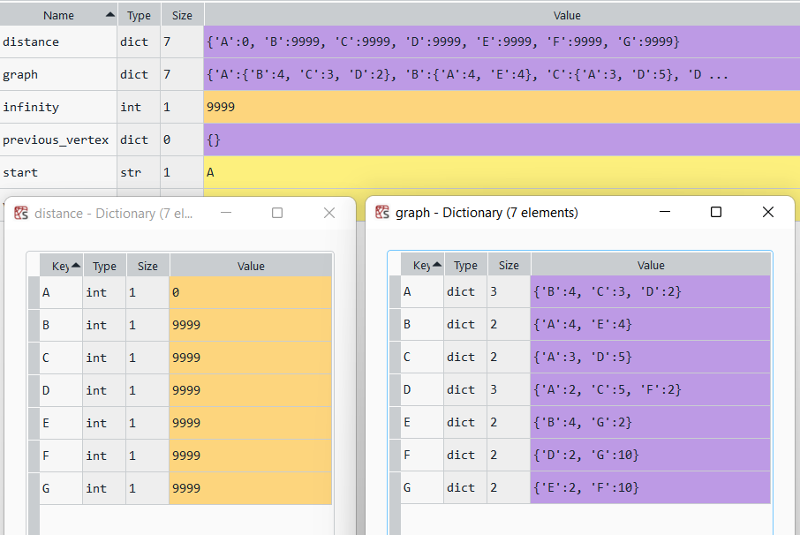
DATA STRUCTURES
(Initial)

Slide 9
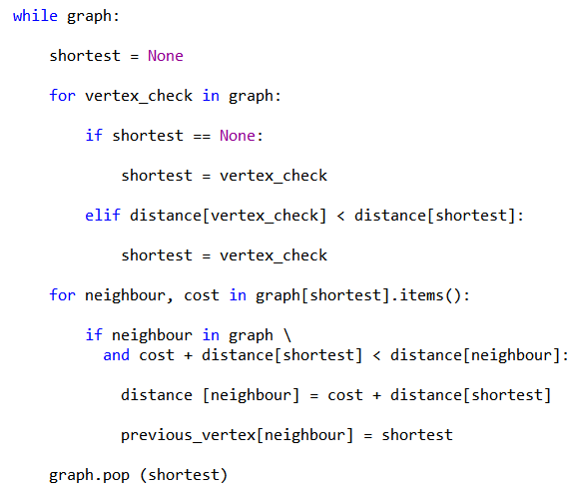
Comment This Code
COMMENTS
# While there are unvisited vertex
#
# Find next vertex
#
#
#
#
# Populate the dictionaries
# #
#
#
# Remove visited vertex from graph

Slide 10
Comment This Code - Answers
COMMENTS
# While there are unvisited vertex
# Initiate variable shortest
# Iterate through neighbour vertexes
# If it is the first neighbour vertex
# set shortest to distance
# if the distance is smaller
# set shortest distance
# Populate the dictionaries
# If neighbour has not been visited # and neighbour closer than shortest
# set the distance
# set the previous vertex
# Remove visited vertex from graph

Slide 11
Fill in the final values
Vertex | distance | Previous_vertex | Visited
A
B
C
D
E
F
G
How are visited/Non-visited nodes tracked by the code?

Slide 12
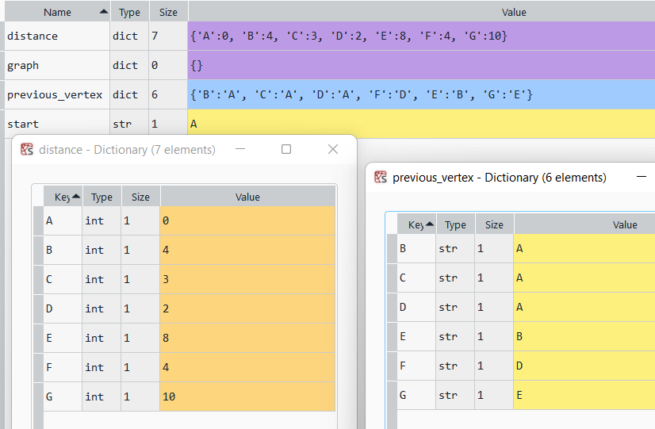
DATA STRUCTURES
(End)
Where is the previous vertex for A?

Slide 13
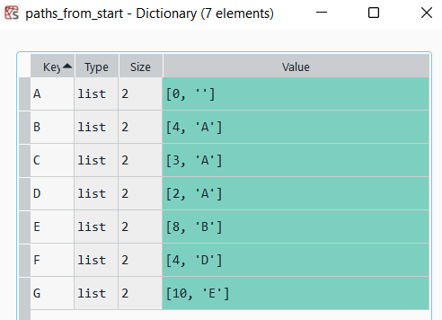
Another Alternative
What is this data structure?
Is this better than the dictionaries that we built? Why?

Slide 14
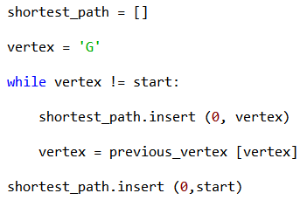
Comment This Code
COMMENTS
#
#
#
#
#
#
Comment the code

Slide 15
Big O notation A*
Time Complexity
Best Case | Average Case | Worst Case
O(E+V logV) | O(E log V) | O(V²)
Linear | Linear | Polynomial

Slide 16
Adapt the code to retrieve the shortest paths:
Path | Shortest Path
A to G
A to E
C to G
G to A
Why do we specify shortest_path.insert (0, vertex)?

