Slide 1
Least Cost Power System for a Remote Station in Campuestohan
Remote research station in the mountains of Campuestohan, Talisay city, Negros island in the Philippines. The station serves as a remote laboratory for biodiversity expeditions in the forests of northern Negros island. The power system needs to supply the basic energy needs of the camp as well as computers, communication systems and research equipment.
Energy demand, solar and wind resources were initially assumed due to the lack of data. The installed system was monitored with a data logger to verify the how close were the assumptions to the actual system performance.
Silverio T.Navarro, Jr.
(Formerly) Project Engineer of
Solar Electric Co.,Inc.
Philippines
Project Manager
RENEW Negros
silvernavarro@yahoo.com

Slide 2
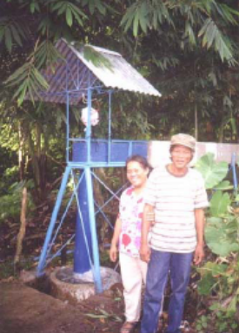
Results
Initially, a 225Wp PV array was installed with a Windseeker 503 wind turbine, a PvStor 2P570 battery bank at 12V and a Trace 612 inverter as preferred by the customer. The solar resource was only 3.82kWh/m2/day because of the fog in the area. The wind resource was not consistent due to the terrain of the camp. The wind turbine power curve was recalculated based on its field performance. The energy demand was found to be at least 0.19kWh/day and growing with more volunteers in the camp.
A year later, the low-head Power Pal pico hydro turbine became available in the Philippines. Its performance was tested and modeled in HOMER to determine if it makes sense to add into the system. The HOMER file Campuestohan.Hmr shows that the least cost option is running the pico hydro with a battery and an inverter to power the AC load of the camp.
Other options were running an 800Wl Honda generator for 4 hours at night and early in the morning. Shown in the picture is the pico hydro turbine mounted on an irrigation canal with water flow at 30 L/sec with a head of 1.5m. For system voltage stability, it is used only as a battery charger. More info on the turbine can be found at www.powerpal.com

