Slide 1
Simulation of off-grid generation options for remote villages in Cameroon
E. M. NFAH a,[1], J.M. NGUNDAM b, M. Vandenbergh c , J. Schmid c
a I.U.T. Fotso Victor, P.O. Box 134, Bandjoun, University of Dschang, Cameroon.
b School of Engineering, P.O. Box 8390, University of Yaoundé I, Cameroon
c ISET e.V., Königstor 59, D-34119, Kassel, Germany.
[1] Corresponding author. Tel. : +237-539-0043; fax : +237-344-2449;
e-mail: em_nfah@yahoo.fr

Slide 2
PLAN
Energy crisis in Cameroon
Remote Area Power Supply (RAPS) systems
AC-bus Configuration
Simulated Off-grid Options
Simulation Data
Results
Conclusion

Slide 3
Energy crisis in Cameroon
In spite of the huge hydroelectric potential of Cameroon, severe power cuts in recent years have a heavy toll on the country’s economy.
Customers supplied by low voltage networks suffer most due to their low energy demands.
The local power authority and government have embarked on hydrothermal expansion as a solution for grid connected areas.
Considering that existing power networks cover only 40% of the country and that the national access rate to electricity is barely 11%, many remote villages will remain without electricity for many years.

Slide 4
Remote Area Power Supply Systems
The energy needs of most remote villages and rural enterprises can be met with off-grid RAPS systems.
In most cases, local generation of electricity from solar energy (3-6 kWh/m²/day), wind energy (5-10 m/s), pico hydro resources and/or fuel generators is often more economical than grid extension.
The components of RAPS systems can be sized with HOMER if the daily village load, power system component sizes and costs are specified as well as other relevant parameters.
The RAPS system model used in this simulation is based on the European AC-bus (single- or three- phase) configuration currently used in 100 systems.

Slide 5
Simulated off-grid options
pico hydro/biogas generator/battery systems (S1)
pico hydro/diesel generator/battery systems (S2)
photovoltaic/biogas generator/battery systems (S3)
photovoltaic/diesel generator/battery systems (S4)
biogas generator/battery systems (S5)
diesel generator/battery systems (S6)
biogas generator systems (S7)
diesel generator systems (S8)

Slide 6
Simulation Data
Typical village power demand
Typical pico hydro resource
Typical solar resource
Financial data

Slide 7
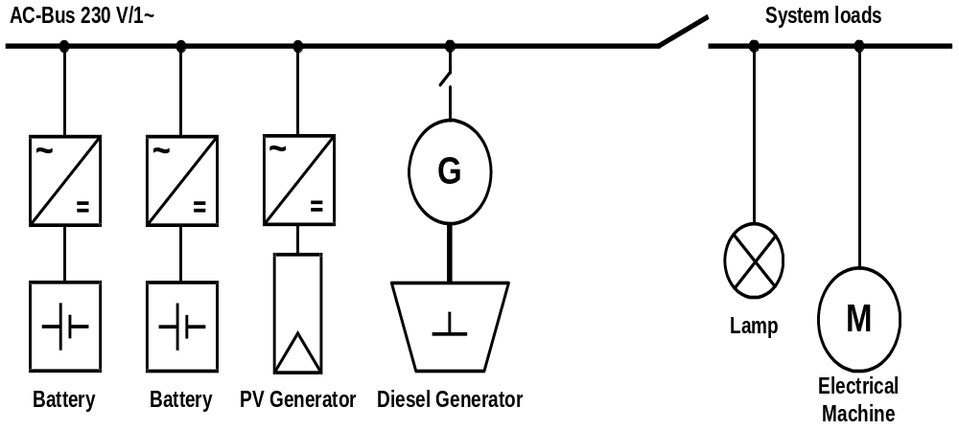
Single phase power system model

Slide 8
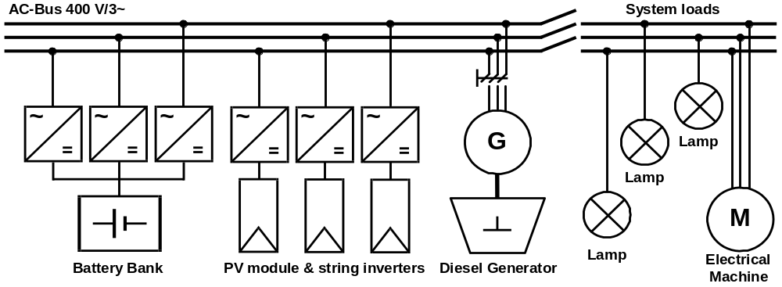
3-phase power system model

Slide 9
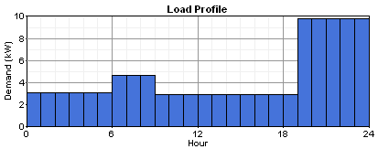
Typical village power demand

Slide 10
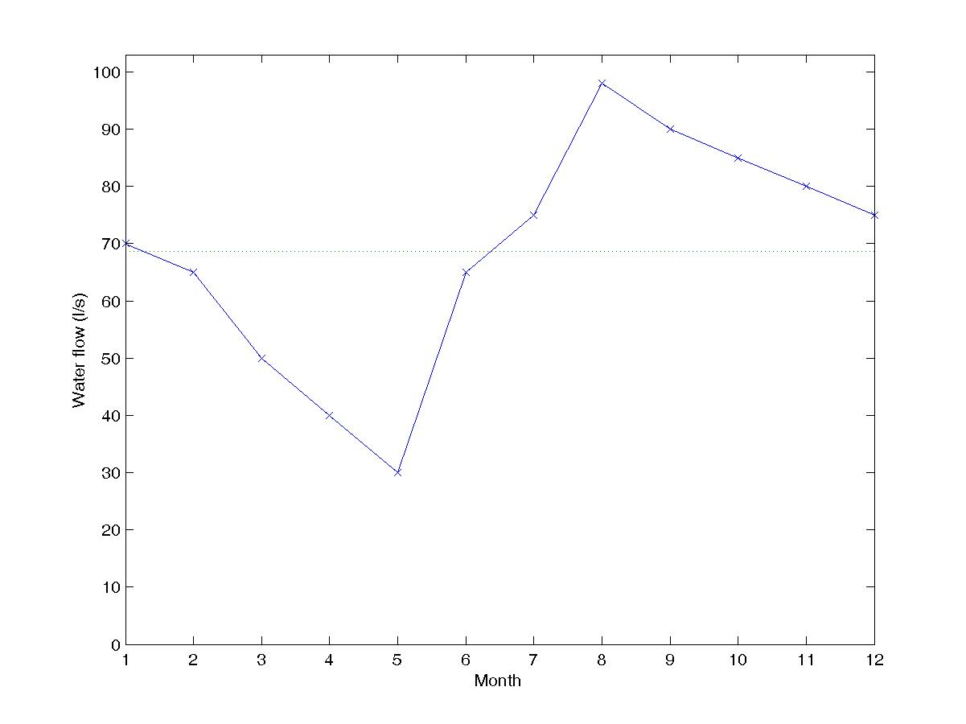
Typical pico hydro resource

Slide 11
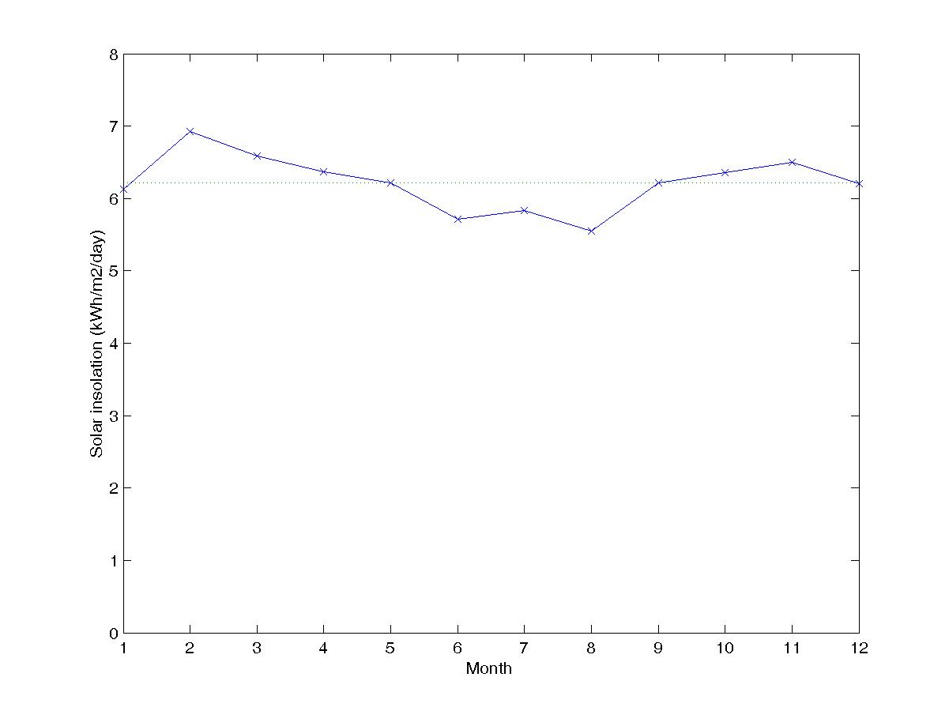
Typical solar resource

Slide 12
Financial Data
3kW AC PV generator capital costs: 15000€
3.3kW bi-directional inverter: 2200€
3kWh Exide OPzV battery: 1020€
O&M costs of battery: 51€/yr
5kW pico hydro capital costs: 20000€
Pico hydro replacement cost: 5500€
Pico hydro O&M : 500€/yr
15 petrol/biogas generator capital costs: 8610€
Petrol costs: 1€/l
LPG costs: 0.7€/m³
Grid extension costs: 5000€/km
Grid O&M costs: 125€/km
Grid power price:0.1€/kWh
Fuel generator lifetime: 30000 hrs
Project lifetime: 25 years

Slide 13
Results
168-hour load profile generated with HOMER with 5% hourly and daily noise.
Configuration of feasible off-grid generation options with a 40% increase in the cost of components imported from Europe.
Energy costs for off-grid options.
Breakeven grid distances for off-grid options.

Slide 14
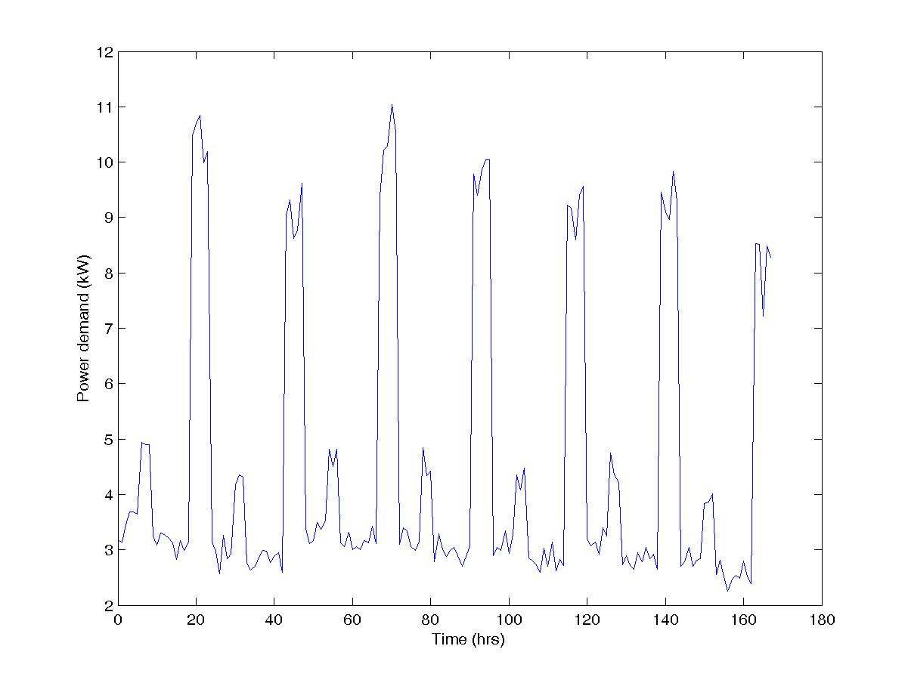
168-hour load profile generated with HOMER

Slide 15
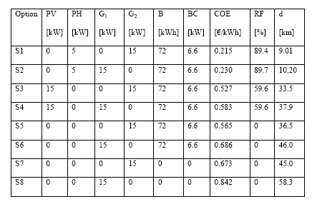
Configurations for off-grid options

Slide 16
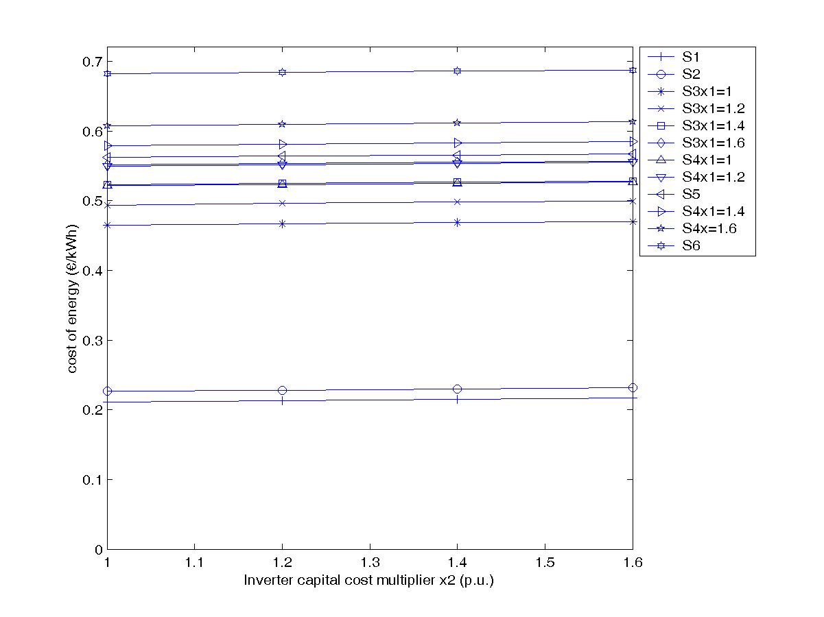
Energy costs for off-grid options

Slide 17
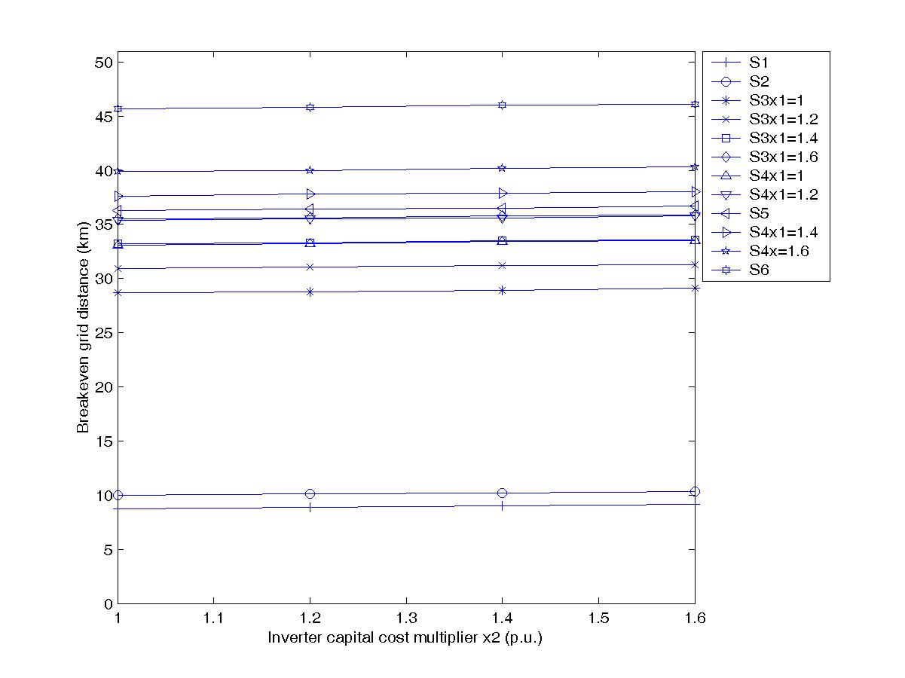
Breakeven grid distances for off-grid options

Slide 18
Conclusion
PV/biogas/battery systems were found to be the most economical option for villages located in the northern parts of Cameroon with at least 6.21kWh/m²/day.
Pico hydro/biogas/battery systems were also found to be the cheapest option for villages in the southern parts of Cameroon with a hydro flow of at least 68l/s.
These options performed better than grid extension for distances greater than 33.5 and 9km respectively and their energy costs were computed as 0.527 and 0.215€/kWh respectively.
These options can be used in the Cameroon’s current energy plan for the provision of energy services to most remote villages located beyond 9 or 33.5km

