Slide 1
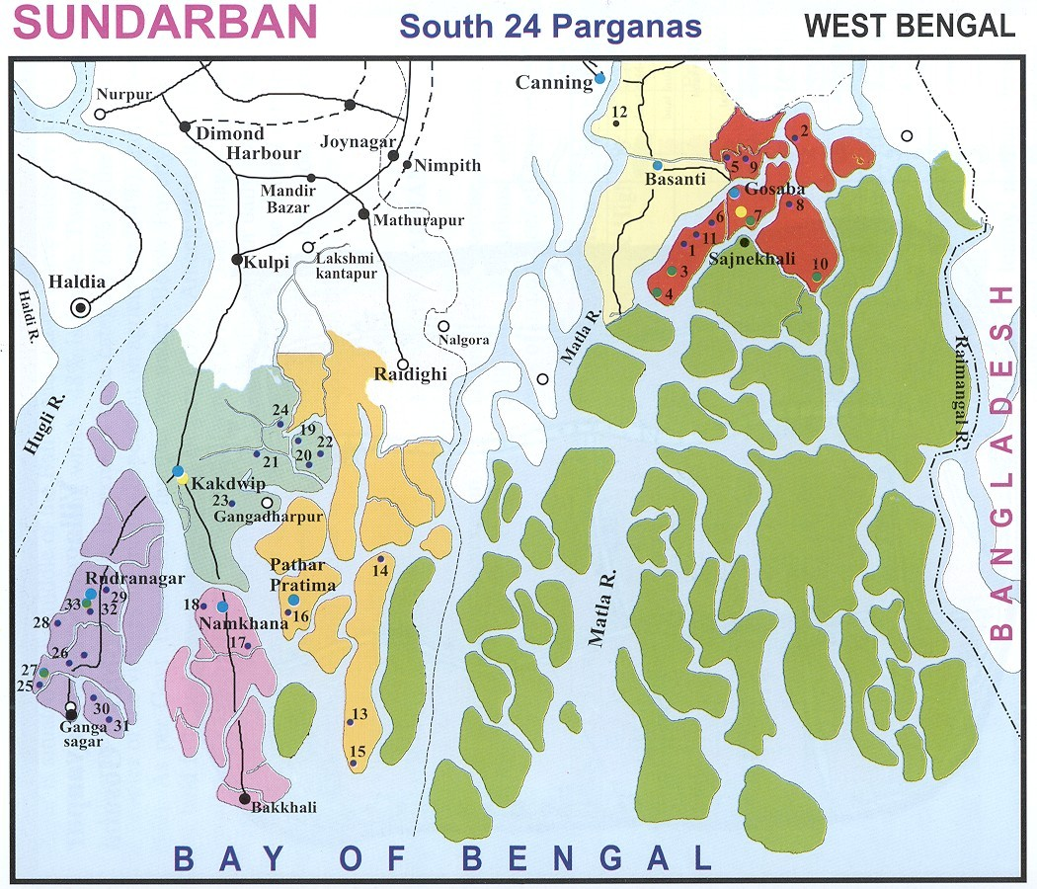
Master Plan of Electricity Supply for off-grid islands in Sundarbans
Indradip Mitra
November 2005

Slide 2
Contents
Background-Sundarbans
Project objective
Major Project components
-Survey
-Analysis through HOMER
-Plant configurations
Proposed Measures

Slide 3
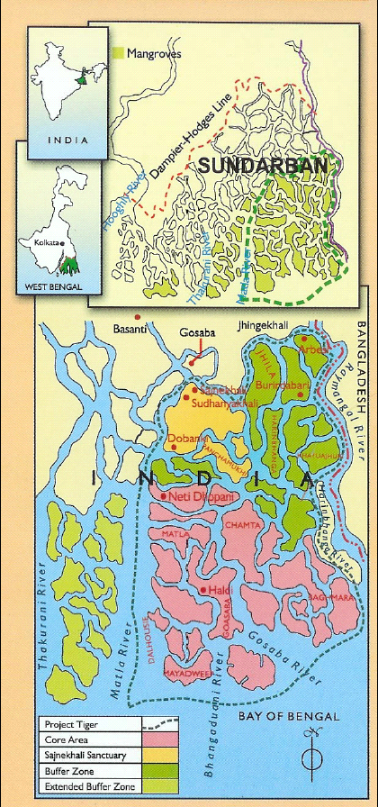
About Sundarbans in India
Worlds largest mangrove forest (10000 sq. km mangrove forest in India & Bangladesh)
4 million population
54 inhabitant islands
Large section of population without electricity(131 villages in 20 islands)

Slide 4
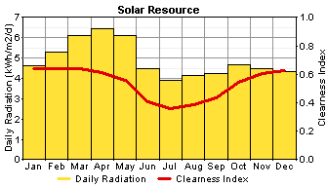
RE Resources
Solar- avg 4.91 kWh/sq. m/day
Wind- avg 4.77m/s at Gangasagar(25m sensor); avg 4.8m/s at Frazerganj(20 m sensor)
Good biomass resource potential

Slide 5
Electricity so far in Islands
(as on November,2005)
RE Projects
Number
Aggregate Capacity
Benefited Household
Population Covered
Solar Power Plant
13
707 kWp
3,450
18,400
Solar Home Lighting System
35,000
35 Wp to 74 Wp
35,000
2,00,000
Biomass Gasifier Power Plant
2
1000 kW
1,500
9,000
Wind Diesel Hybrid System
1
510 kW
1,000
5,000
Total
40,950
232,400

Slide 6
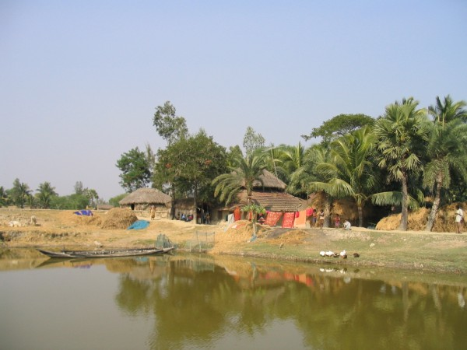
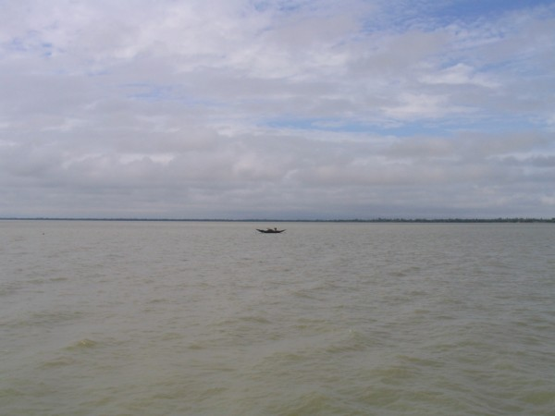
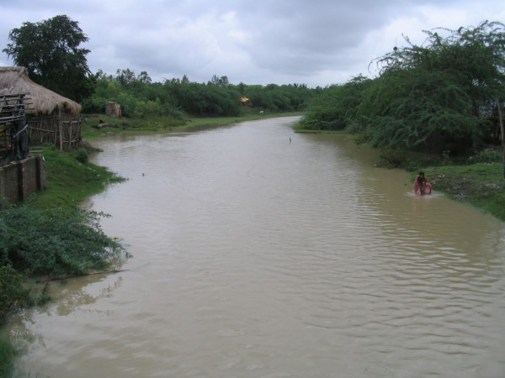
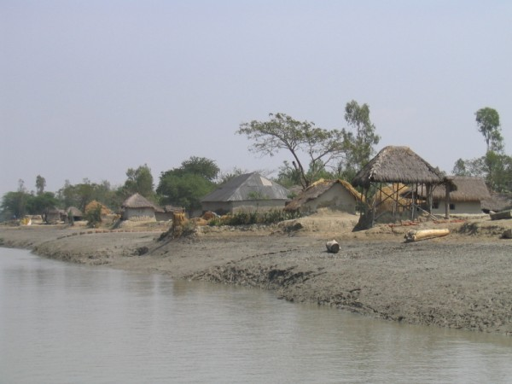
Project Objective
  To formulate the Master Plan for WBREDA for ‘Electrification of off-grid Islands of Sunderbans region through Renewable Sources of Energy’ by 2008

Slide 7
Activities
Secondary information collection
Primary survey of all off-grid islands
  Location and load for power plants
Analysis by HOMER
  Configuration of individual plants
Preparation of project profiles
Tariff, revenue, institutional models
Final report

Slide 8
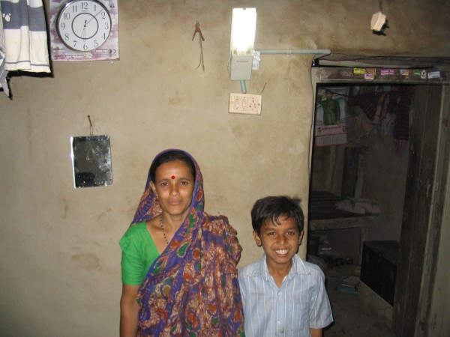
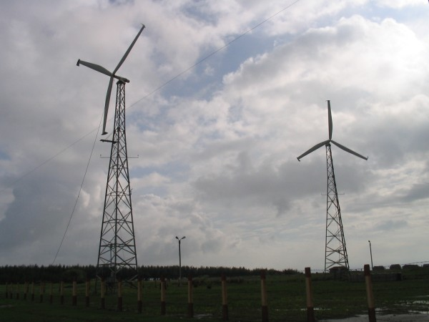
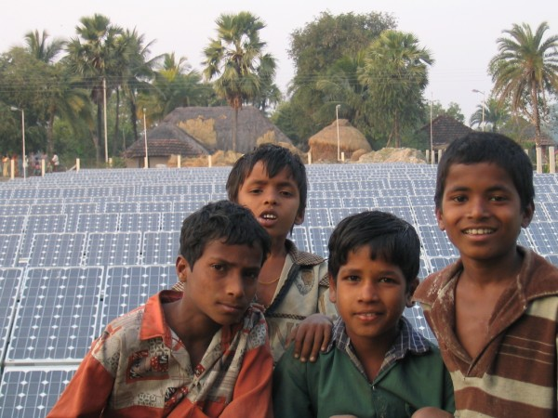
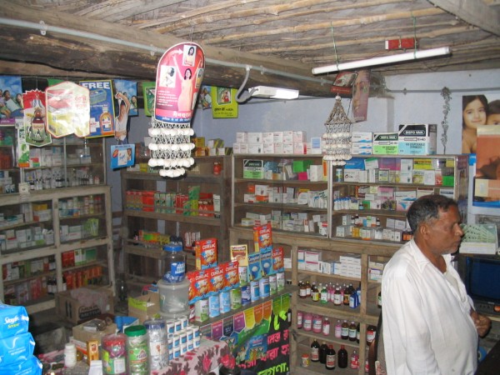
Primary Survey
Primary survey in 31 islands
Finalizing project areas in 20 islands
Estimating load requirements
  Markets
  Households
Estimating load requirements
Narrowing down to proposed plant sites

Slide 9
Finalizing RE Options
Exploring alternative hybrid options
  ->Wind-PV-Biomass-Battery
Usage of HOMER software to arrive at a couple of close alternate scenarios
Feedback from WBREDA with experience in Sundarbans to finalize plant configuration

Slide 10
Plant sizing with HOMER
HOMER Version 2.19 (June 2005)
Software developed by NREL,USA
to evaluate the economic and technical feasibility of a number of technology options
Energy balance calculations performed on hourly basis
results in the least cost combination of components that meet electrical loads by simulating a large number of system configurations.

Slide 11
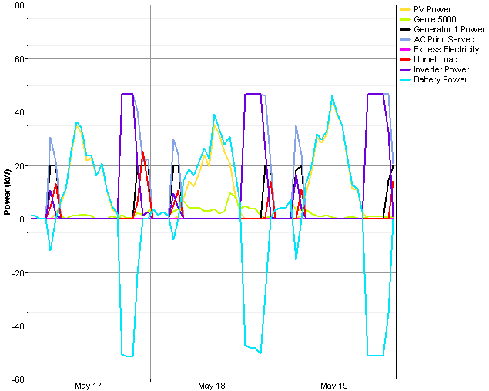
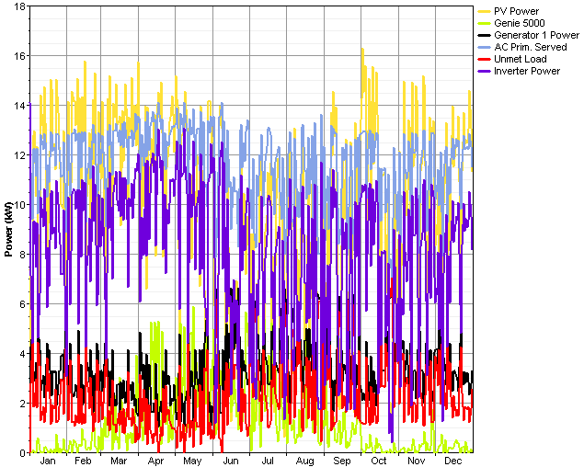
A glimpse

Slide 12
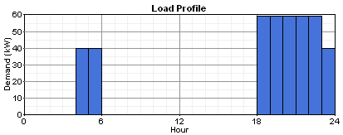
Example-Bally
Total No. of Shops | Total No. of estimated consumers | Estimated annual average electricity demand | Estimated peak load | Estimated load factor
80 | 480 | 417 kWh/day | 59.4 kW | 0.293

Slide 13
Power Plant Configuration
Type of proposed plant | Electricity generating components | Battery bank | Power condition-ing unit | Estimated Annual electricity Delivery (kWh/yr) | Initial capital cost (INR)
PV-Biomass hybrid | 45 kWp PV + 40 kWe biomass electricity generator (100% producer gas) | 240 nos. 2VDC, 800 AH battery | 60 kW Inverter | 142129 | 24849,675

Slide 14
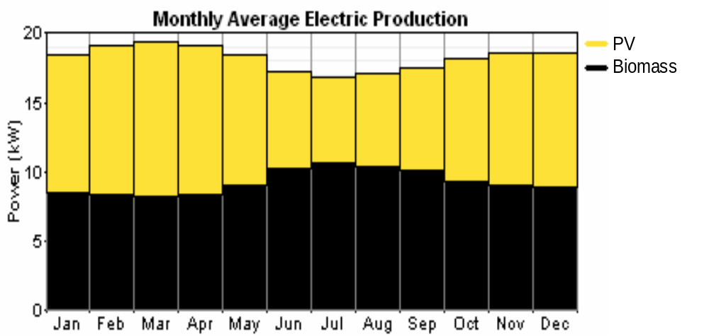
Bally-Contribution from different RE sources
PV 78,418 kWh (48%)
Biomass 85,397 kWh (52%)

Slide 15
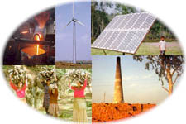
Proposed Measures
35 proposed hybrid power plants
All 131 villages in 20 islands covered
Households covered -11275
Shops covered-3200
PV: 1.59 MWp
Biomass: 1.12 MWe
Wind: 20 KW
SHS(37Wp): 38934 for scattered houses
Capital cost involved-(INR)1316 million

Slide 16
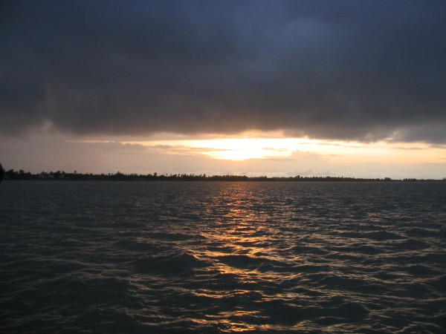
Thank You

