Slide 1
Case study of Wind Energy at National Institute of Technology, Silchar, India
Depletion of conventional energy source.
Alternative Energy Source: Wind Energy
Difficulties: Low wind speed at Assam, North-east zone of India.
Savonius wind turbine is the best suitable -Easy in construction, cost effective
Akash Joshi
National Institute of Technology, Silchar
(Formerly known as REC, Silchar)
akash.joshi@yahoo.com, akash.joshi@rediffmail.com

Slide 2
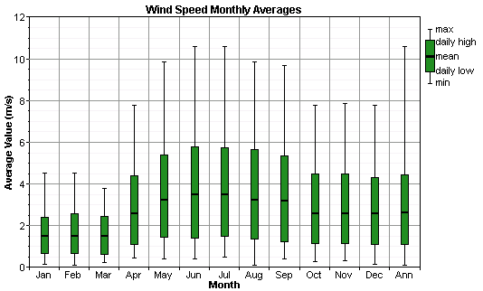
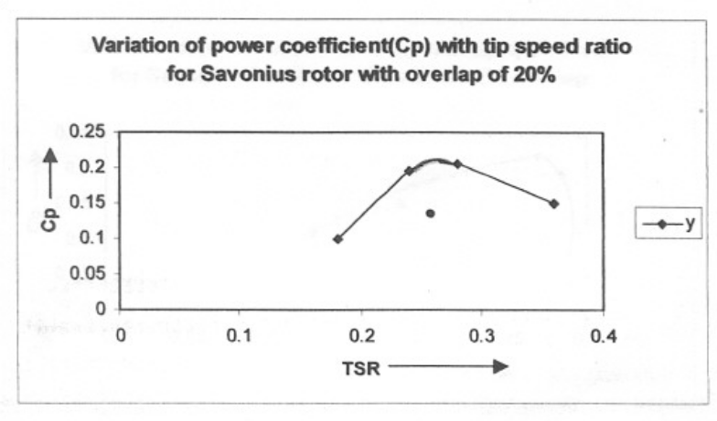
Results
Average wind speed at NIT, Silchar is 2.63 m/s
Savonius Turbine gives best results with 20% overlapping
Co-efficient of performance of S-rotor is 21% at 20% overlapping.
Cost of construction of S-rotor is around Rs.1500 (INR)

