Slide 1
PV/Wind System Configuration Optimization and Cross-subsidy Calculation in Northwest China
System design and finance guidance for China’s Village Electrification Program
Mini-grid or home systems
Vlg.sys:220kWh/hh.yr , hh.sys:200kWh/hh.yr
Supports planned finance mechanism,ie.
  Government grant covers initial capital
  Cross subsidy maintains off-grid rates equal to local grid tariff
  Many factors lead to different cost, so standard is necessary
Qinghai and Gansu provinces as demonstration
David M. Kline
Senior Project Leader
Energy and Environment Applications Office
National Renewable Energy Laboratory
David_Kline@nrel.gov
www.nrel.gov/homer
Yin Huanying
Engineer
Institute of Electrical Engineering,
Chinese Academy of Sciences
hyyin@mail.iee.ac.cn
www.iee.ac.cn

Slide 2
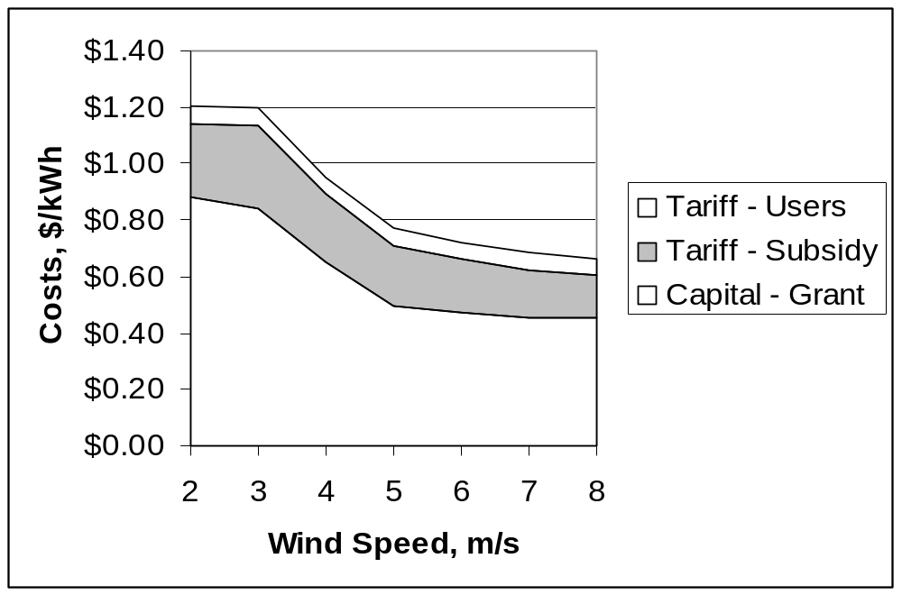
Results
Interface must be as simple as possible.
Optimize mini-grid/home system configuration according to load and renewable resources.
  Configuration changes as solar/wind resource varies
Calculate the grant of initial capital and cross-subsidy according to the tariff policy.
  the mini-grid system are usually more expensive than to solve with home systems
  Cross-subsidy is high to about 6RMB/kWh ($.72) to vlg.sys,5RMB ($.60) to hh.sys

