Slide 1
New Features in HOMER 2.2
New ability to model AC photovoltaic modules
New ability to model flow batteries
Improved grid modeling
  Real-time pricing
  Threshold controls for grid-battery systems
Improved hydrogen load modeling
  Hourly load data
  Levelized cost of hydrogen
Improved graphing
  Click-and-drag zoom in time series graphs
  Manual override for x and y axis scales
  Manual override for line colors
Tom Lambert
Mistaya Engineering Inc.
Calgary, Canada
tomlambert@mistaya.ca

Slide 2
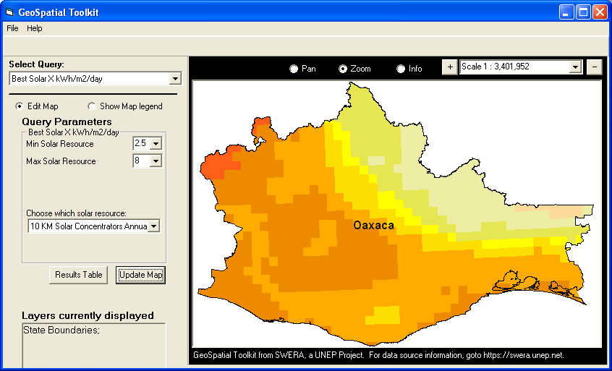
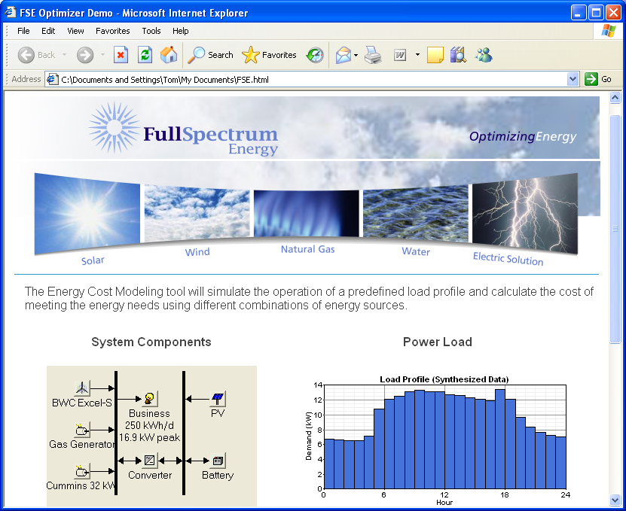
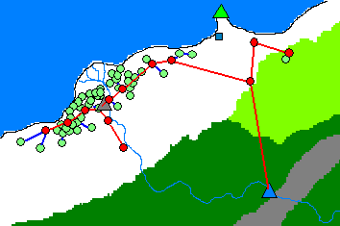
Related Models
GIS applications of HOMER
  Provide map-based interface
  Run HOMER repeatedly
  Three applications: GsT, RPM, HomerGIS
Web application of HOMER
  www.fullspectrumenergy.com
  Runs HOMER in background
  Limited capability, but promising
ViPOR (www.nrel.gov/vipor)
  Minigrid design model
  Works with HOMER
  Less polished than HOMER

Slide 3
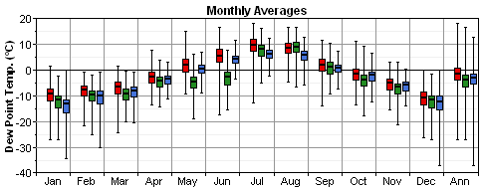
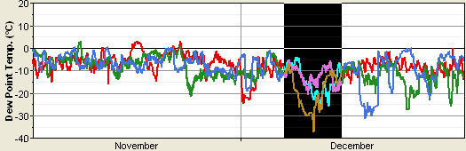
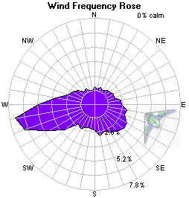
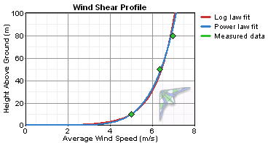
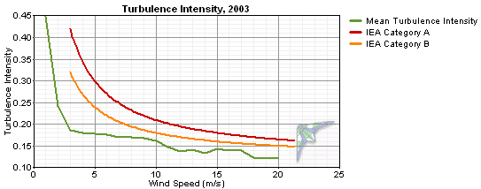
Related Models (continued)
DView (www.mistaya.ca/dview)
  Free utility program with graphics similar to HOMER’s
  For viewing any hourly time series data
  Good for viewing and comparing hourly HOMER results
Windographer (www.mistaya.ca/windographer)
  Wind resource assessment model
  Can fill gaps, analyze shear, turbulence, etc.
  Can export hourly average wind speeds for use in HOMER

