Slide 1
Hinchinbrook Island
Researcher: Gordon Dalton PhD student
Supervisor: Dr David Lockington

Slide 2
Introduction
Case study investigation of non grid-connected tourist resort, that relies on stand-alone power supplied by:
  Diesel generator
  PV arrays
  Inverter and batteries

Slide 3
Objectives
Ascertain operator satisfaction with RES hybrid.
To determine whether the RES hybrid supplies the intended amount of power to site.
To examine the reliability of the RES and the overall hybrid system.
To simulate the optimised RES hybrid configuration, given load and environmental conditions.

Slide 4

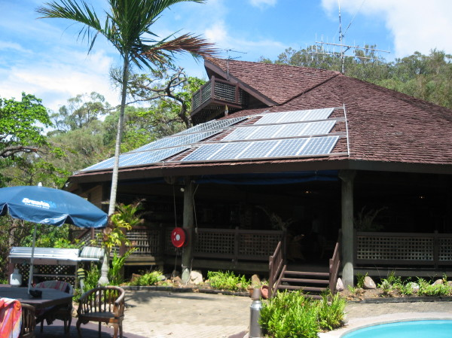
Hinchinbrook Island resort
Resort location
Resort located in tropical
north Queensland, 19° south of equator,
on an island located 50km off the coast

Slide 5
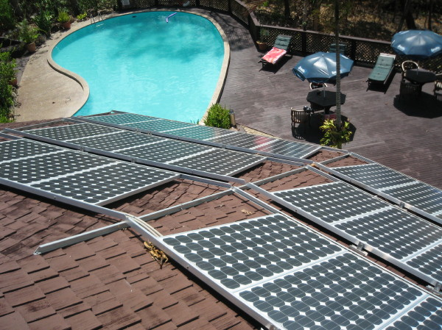
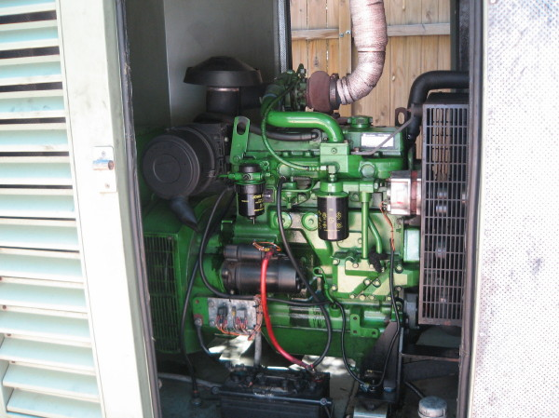
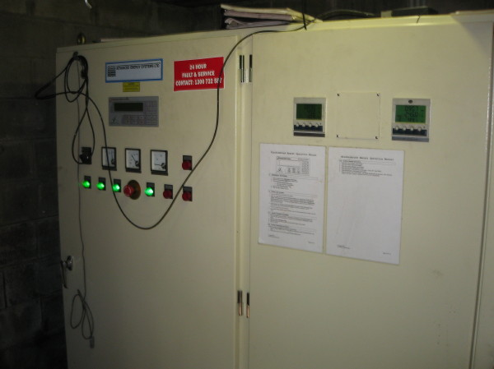
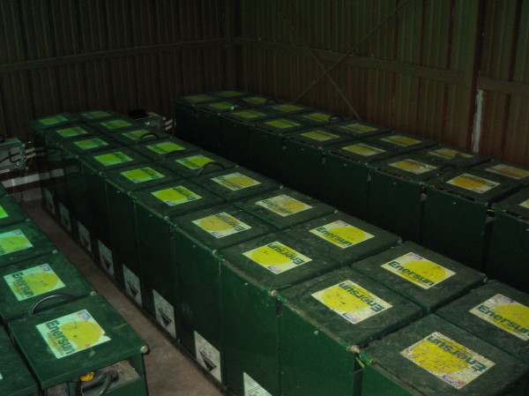
RES system
36 PV panels 160 W panels
120 kW AES inverter
85 kW diesel generator
60 - 1100 Ah Enersun batteries

Slide 6
Methodology
Conduct interview with managers and maintenance personnel.
Collected a 24-hour load consumption at medium occupancy.
Conducted a full energy audit of resort site.
Collect bureau of meteorology location data

Slide 7
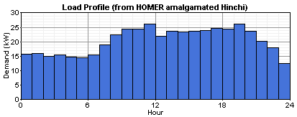
Background data
Average solar irradiance: 5.2 kWh/m²/day
Average wind speed: 5.3 m/s
Load varies from 10–30 kW/day
Average energy consumption: 490kWh/day, peak load estimated to be 52 kW.

Slide 8
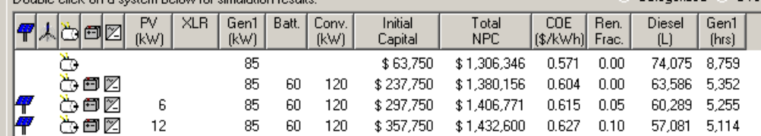
Present scenario results
Diesel readings measured on site
Total diesel fuel used for entire year (L) | 55571
Total number of hours genset operation (hr) | 4169
Genset fuel eff L/ hr | 13.3
Red underlined is actual site scenario HOMER simulation
Diesel only scenario is capable of supplying all power and is the most economical.
Annual fuel consumption between actual and simulated is similar, although number of hours of operation in simulations a lot larger.
PV only provides 5% of the site power.
Full NPC for the set-up is $1.43 million.

Slide 9
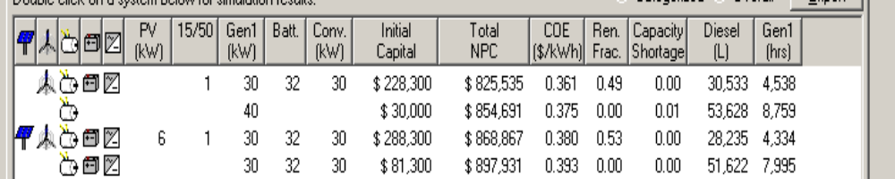
Optimised scenario
HOMER calculates that a 40kW diesel running non-stop could satisfy power demand, consuming 53000 lts fuel and NPC of $0.8million.
One AOC turbine provides the optimised scenario at same NPC. RF increases to 0.5
Addition of PV makes no real impact to NPC

Slide 10
Conclusion
Small sizing of existing PV set up is ineffectual at .5% of total supply.
Smaller diesel run 24/7 is more economical than larger diesel+batteries run on optimised schedule.
AOC 50kW turbine provides a .5RF , with no increase in NPC.

