Slide 1

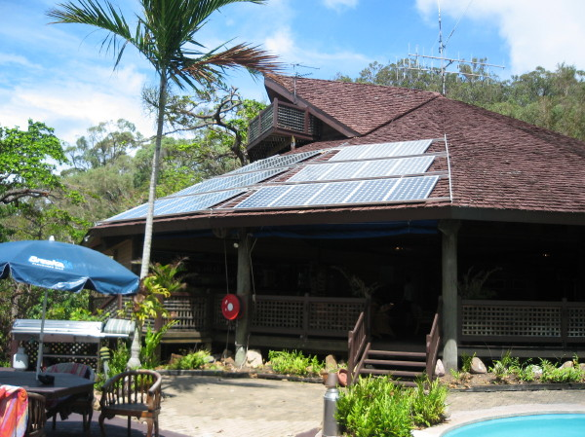
Hinchinbrook Island resort
Researcher: Gordon Dalton PhD student
Supervisor: Dr David Lockington
Resort location
Resort located in tropical
north Queensland, 19° south of equator,
on an island located 50km off the coast

Slide 2
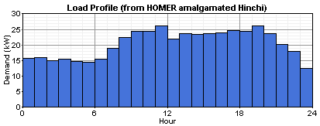
Background data
Average solar irradiance: 5.2 kWh/m²/day
Average wind speed: 5.3 m/s
Load varies from 10–30 kW/day
Average energy consumption: 490kWh/day, peak load estimated to be 52 kW.

Slide 3
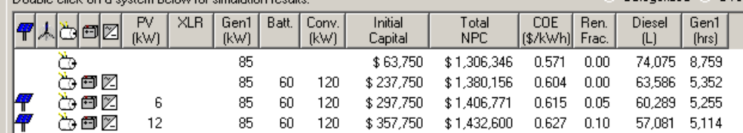
Present scenario results
Diesel readings measured on site
Total diesel fuel used for entire year (L) | 55571
Total number of hours genset operation (hr) | 4169
Genset fuel eff L/ hr | 13.3
Red underlined is actual site scenario and HOMER simulation
Diesel only scenario is capable of supplying all power and is the most economical.
Annual fuel consumption between actual and simulated is similar, although number of hours of operation in simulations a lot larger.
PV only provides 5% of the site power.
Full NPC for the set-up is $1.43 million.

Slide 4
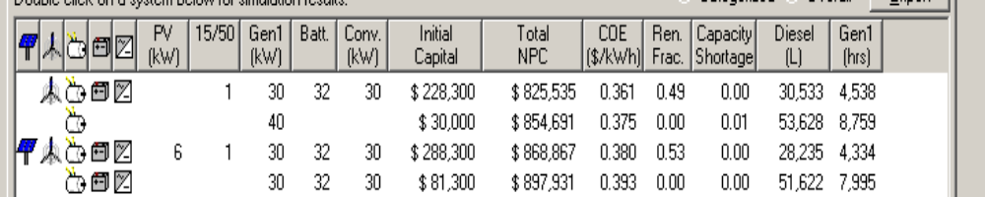
Optimised scenario
HOMER calculates that a 40kW diesel running non-stop could satisfy power demand, consuming 53000 lts fuel and NPC of $0.8million.
One AOC turbine provides the optimised scenario at same NPC. RF increases to 0.5
Addition of PV makes no real impact to NPC

