Slide 1
Simulation of off-grid generation options for remote villages in Cameroon
Pico hydro/Biogas generator/Battery hybrid systems were found to be the cheapest option for villages in south Cameroon with a pico hydro flow of at least 68l/s.
PV/Biogas generator/Battery hybrid systems were found to be the cheapest option for villages in north Cameroon with an annual insolation of at least 6.21kWh/m²/day.
Local market prices of power system components were deduced from European prices using sensitivity values in the range 1-1.6.
Systems were simulated using remote fuel and biogas costs of 1€/l and 0.7€/m³.
E. M. NFAH a,[1], J.M. NGUNDAM b, M. Vandenbergh c , J. Schmid c
a I.U.T. Fotso Victor, P.O. Box 134, Bandjoun, University of Dschang, Cameroon.
b School of Engineering, P.O. Box 8390, University of Yaoundé I, Cameroon
c ISET e.V., Königstor 59, D-34119, Kassel, Germany.
[1] Corresponding author. Tel. : +237-539-0043; fax : +237-344-2449;
e-mail: em_nfah@yahoo.fr

Slide 2
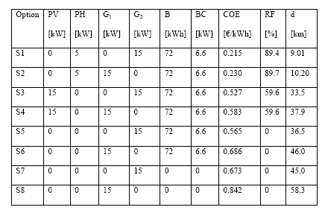
Configurations for off-grid options

