Slide 1

Case study of Wind Energy at
National Institute of Technology, Silchar- India
PRESENTED
BY
Akash Joshi
NATIONAL INSTITUTE OF TECHNOLOGY, SILCHAR, ASSAM
INDIA

Slide 2
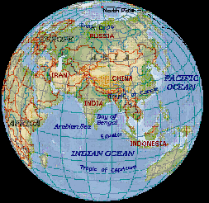
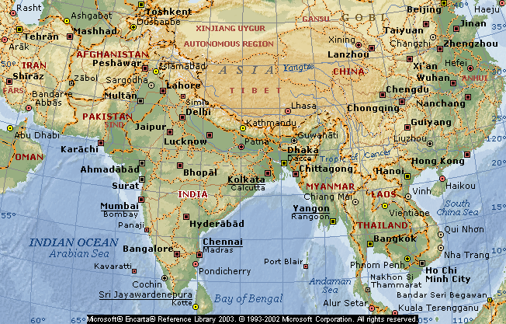
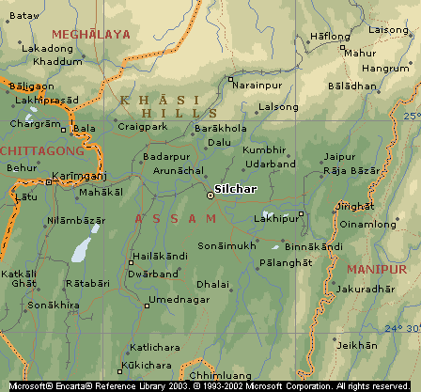
Location of NIT, Silchar
Silchar
Latitude : 24° 49’ N
Longitude : 92° 46’E
Assam, India

Slide 3
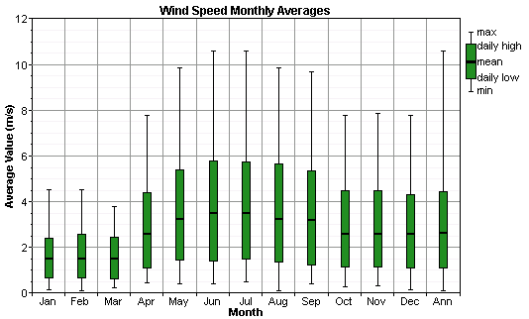
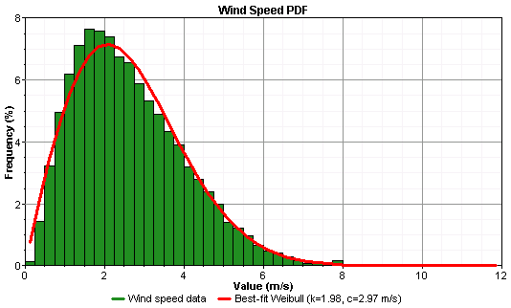
Wind data at NIT, Silchar
Annual average wind speed is 2.63 m/s
Wind speed is maximum in summer

Slide 4
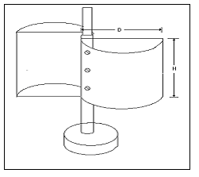
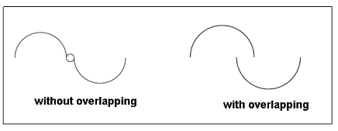
Savonius Turbine
Advantages of S-rotor:
1. Simple and cheap construction
2. Acceptance of wind from any direction thus eliminating the
need for reorientation.
3. High starting torque.
4. Relatively low operating speed (rpm)

Slide 5
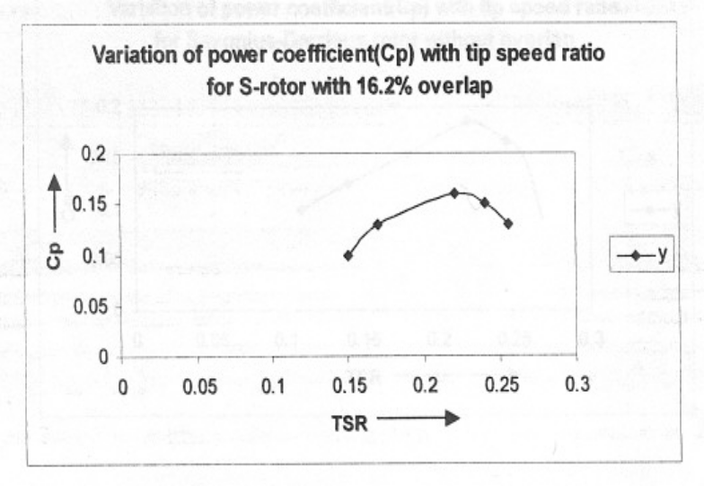
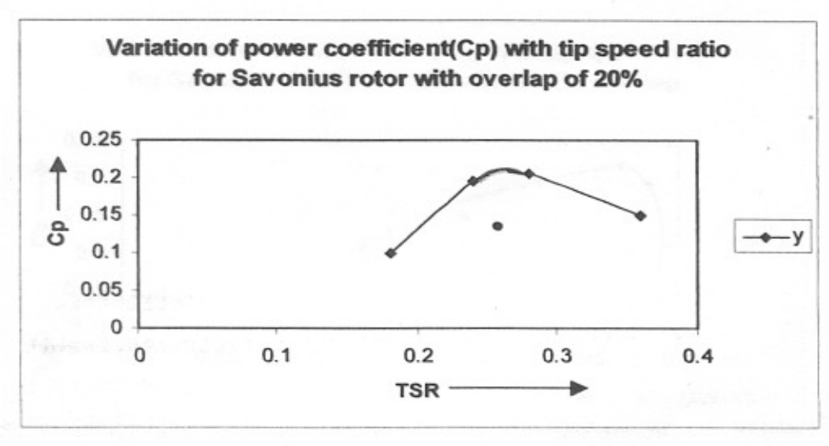
Analysis
The performance of the machine can be expressed in the form of Power Coefficient (Cp) versus tip-speed ratio (λ). For analysis, the following relations were used:-
Co-efficient of Performance, Cp = P_{rotor}/0.5ρV2
Tip speed ratio (λ) = Velocity of blade tip/Free stream velocity
Graphs showing Cp Vs TSR for different overlapping conditions

Slide 6
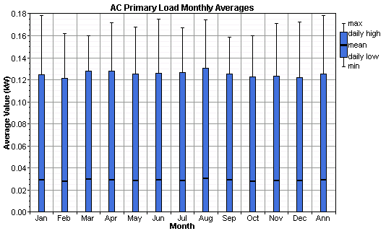
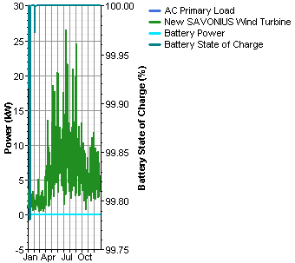
Graphs form HOMER
Sample Graphs form HOMER for 3 SAVONIUS Wind Turbine, 1 Battery and 1 inverter of 2kW for above wind data at NIT, Silchar

Slide 7
Conclusion
Wind speed at Silchar is very low
Savonius turbine is the best suitable option
Savonius turbine with 20% overlapping gives the best results.
Co-efficient of Performance at 20% overlapping is 21%

Slide 8
Thank You !
Author : Akash Joshi
Contact: akash.joshi@yahoo.com,
akash.joshi@rediffmail.com

