Slide 1
First HOMER User Group Webcast
Welcome and Introductions
Focused on Asia
  140 users expressed interest in listening
Wide variety of technologies and applications
Status of HOMER User Group
  ~ 11,000 users total
  Jan – March, 2006
    1335 new users
    330 renewals
Answers to questions will be e-mailed
Feedback requested

Slide 2
HOMER User Group Webcast
0230 GMT May 16, 2006
Welcome and Introduction
  Dr. Peter Lilienthal, NREL
Update on version 2.2 beta
  Tom Lambert, Mistaya Engineering
HOMER Training Activities
  Paul Gilman
Island Electrification in Sri Lanka
  Paul Gilman
Tariff-Subsidy study for off-grid PV-wind in China
  Yin Huanying, IEE Chinese Academy of Sciences
Off-grid PV-wind-hydro in Philippines
  Silverio Navarro, RENEW Negros. Winrock International
Optimal Azimuth for Grid-Connected PV with Time-of-use Tariff in the US
  Mark Mrohs, SunPower Corp.
Hybrid Power for Eco-Tourism in Australia
  Gordon Dalton, University of Queensland
Electrification Planning in the Sunderbans, India
  Peter Lilienthal, NREL for Indradip Mitra, West Bengal Renewable Energy Development Agency
Low speed wind turbines in India
  Akash Joshi, National Institute of Technology
Hybrid Power for Post-Tsunami Maldives
  Ahmad Agus Setiawan, Curtin University of Technology
Cost of Reducing Carbon Emissions
Summary of Additional Submissions
  Wind Home Systems in Bangladesh
  Health Clinics in Algeria
  Off-grid Options in Cameroon
  Energy Planning for a Croatian Island
  GoogleMap Interface for ViPOR

Slide 3
New Features in HOMER 2.2
New ability to model AC photovoltaic modules
New ability to model flow batteries
Improved grid modeling
  Real-time pricing
  Threshold controls for grid-battery systems
Improved hydrogen load modeling
  Hourly load data
  Levelized cost of hydrogen
Improved graphing
  Click-and-drag zoom in time series graphs
  Manual override for x and y axis scales
  Manual override for line colors
Tom Lambert
Mistaya Engineering Inc.
Calgary, Canada
tomlambert@mistaya.ca

Slide 4
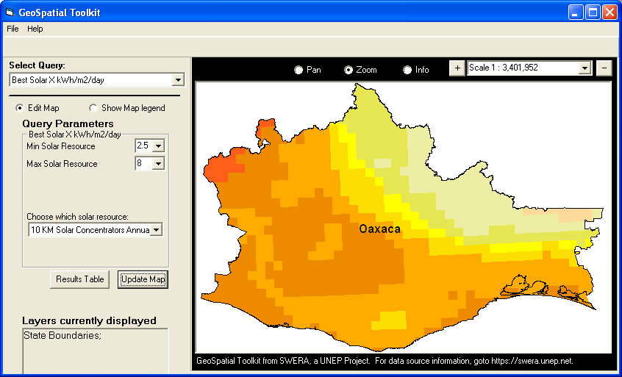

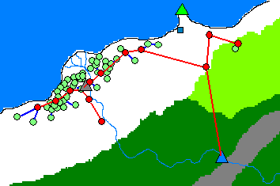
Related Models
GIS applications of HOMER
  Provide map-based interface
  Run HOMER repeatedly
  Three applications: GsT, RPM, HomerGIS
Web application of HOMER
  www.fullspectrumenergy.com
  Runs HOMER in background
  Limited capability, but promising
ViPOR (www.nrel.gov/vipor)
  Minigrid design model
  Works with HOMER
  Less polished than HOMER

Slide 5
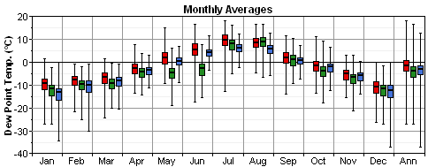
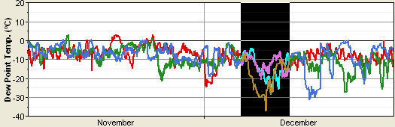
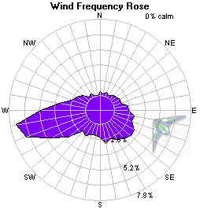
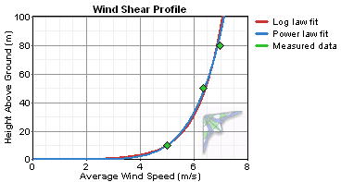
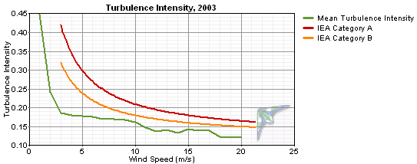
Related Models (continued)
DView (www.mistaya.ca/dview)
  Free utility program with graphics similar to HOMER’s
  For viewing any hourly time series data
  Good for viewing and comparing hourly HOMER results
Windographer (www.mistaya.ca/windographer)
  Wind resource assessment model
  Can fill gaps, analyze shear, turbulence, etc.
  Can export hourly average wind speeds for use in HOMER

Slide 6
HOMER Training
Software overviews
Hands-on prepared exercise
Assistance on individual analyses
Collecting and preparing data
Case studies
Can be integrated into workshops
  Renewable energy technologies
  Rural electrification
  Energy planning

Slide 7
HOMER Training Workshops since 2004
Afghanistan Renewable Energy for Rural Electrification Workshop. USAID SARI/E
HydroTasmania, Hobart, Australia
Research Institute for Sustainable Energy, Perth & Sydney, Australia
Brazil Rural Energy Options Analysis. USDOE, USAID Manaus & Brasilia
Chile Rural Electrification with Renewable energy. GEF, CNE, UNDP
China System and Tariff Design for Rural Electrification. USDOE, Institute of Electrical Engineering
Mexico SENER Rural Electrification Program. USAID, SENER, CFE
World Renewable Energy Conference, Denver USA
University of California, Berkeley, California, USA
University of Colorado, Boulder, Colorado, USA
General Electric Global Research, NY, USA

Slide 8
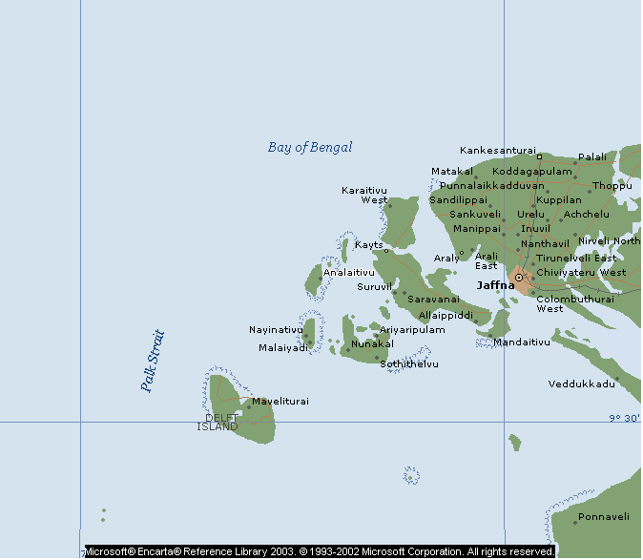
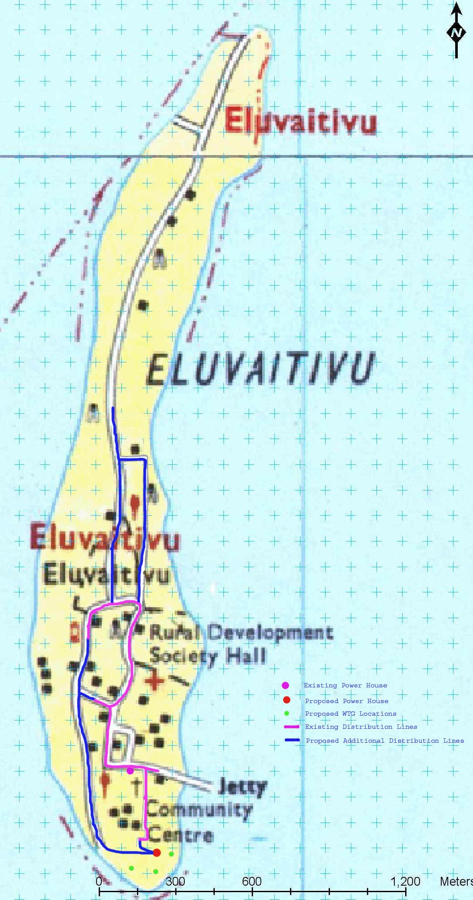

Location of the Eluvaitivu Island in Sri Lanka
Eng.Ratneswaran, BSc (Eng.)
Eng.Amila Wickramasinghe, BSc (Eng.)
Eluvaitivu Island
Proposed Power Plant Location

Slide 9
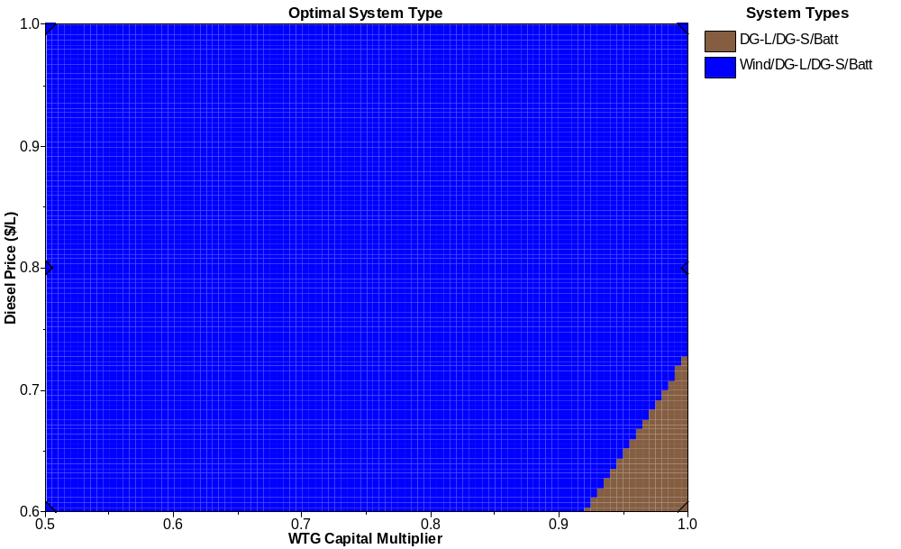
Winning Combination Under Escalating Fuel Price and Reducing WTG Prices
Base Case (Present Situation)

Slide 10
PV/Wind System Configuration Optimization and Cross-subsidy Calculation in Northwest China
System design and finance guidance for China’s Village Electrification Program
Mini-grid or home systems
Vlg.sys:220kWh/hh.yr , hh.sys:200kWh/hh.yr
Supports planned finance mechanism,ie.
  Government grant covers initial capital
  Cross subsidy maintains off-grid rates equal to local grid tariff
  Many factors lead to different cost, so standard is necessary
Qinghai and Gansu provinces as demonstration
David M. Kline
Senior Project Leader
Energy and Environment Applications Office
National Renewable Energy Laboratory
David_Kline@nrel.gov
www.nrel.gov/homer
Yin Huanying
Engineer
Institute of Electrical Engineering,
Chinese Academy of Sciences
hyyin@mail.iee.ac.cn
www.iee.ac.cn

Slide 11
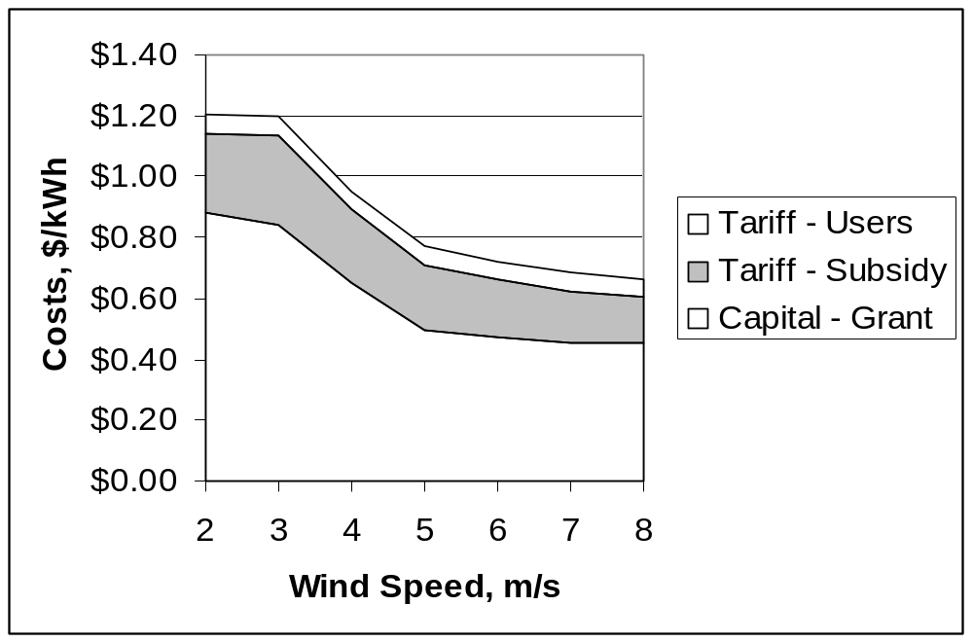
Results
Interface must be as simple as possible.
Optimize mini-grid/home system configuration according to load and renewable resources.
  Configuration changes as solar/wind resource varies
Calculate the grant of initial capital and cross-subsidy according to the tariff policy.
  the mini-grid system are usually more expensive than to solve with home systems
  Cross-subsidy is high to about 6RMB/kWh ($.72) to vlg.sys,5RMB ($.60) to hh.sys

Slide 12
Least Cost Power System for a Remote Station in Campuestohan
Remote research station in the mountains of Campuestohan, Talisay city, Negros island in the Philippines. The station serves as a remote laboratory for biodiversity expeditions in the forests of northern Negros island. The power system needs to supply the basic energy needs of the camp as well as computers, communication systems and research equipment.
Energy demand, solar and wind resources were initially assumed due to the lack of data. The installed system was monitored with a data logger to verify the how close were the assumptions to the actual system performance.
Silverio T.Navarro, Jr.
(Formerly) Project Engineer of
Solar Electric Co.,Inc.
Philippines
Project Manager
RENEW Negros
silvernavarro@yahoo.com

Slide 13

Results
Initially, a 225Wp PV array was installed with a Windseeker 503 wind turbine, a PvStor 2P570 battery bank at 12V and a Trace 612 inverter as preferred by the customer. The solar resource was only 3.82kWh/m2/day because of the fog in the area. The wind resource was not consistent due to the terrain of the camp. The wind turbine power curve was recalculated based on its field performance. The energy demand was found to be at least 0.19kWh/day and growing with more volunteers in the camp.
A year later, the low-head Power Pal pico hydro turbine became available in the Philippines. Its performance was tested and modeled in HOMER to determine if it makes sense to add into the system. The HOMER file Campuestohan.Hmr shows that the least cost option is running the pico hydro with a battery and an inverter to power the AC load of the camp.
Other options were running an 800Wl Honda generator for 4 hours at night and early in the morning. Shown in the picture is the pico hydro turbine mounted on an irrigation canal with water flow at 30 L/sec with a head of 1.5m. For system voltage stability, it is used only as a battery charger. More info on the turbine can be found at www.powerpal.com

Slide 14
Optimal Orientation With
Time-Of-Use Utility Tariff
10kW residential grid connected system
Fresno, CA
Compare non-TOU tariff (tier II, PGE) to TOU tariff
  Vary azimuth and slope
Mark Mrohs
Training Manager, North America
SunPower Corp.
mark.mrohs@sunpowercorp.com

Slide 15
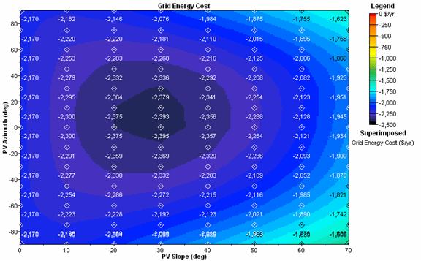
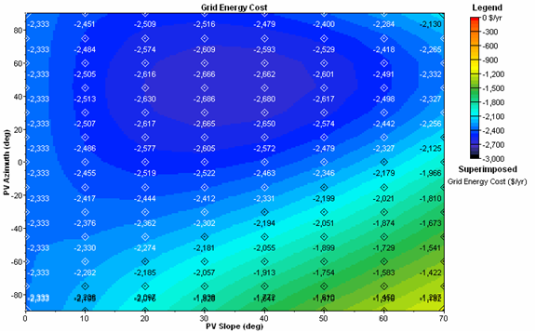
Results
Maximum annual income at azimuth of 45º west of south under TOU tariff
Generate 12.1% more income while producing 2.4% less kWh/year
  $2395 annual income with non-TOU at 18,953 kWh generated
  $2686 income with TOU at 18,495 kWh generated
Benefit is highly dependent on details of the TOU tariff
Recommend future HOMER capability to better model tiered non-TOU rates

Slide 16

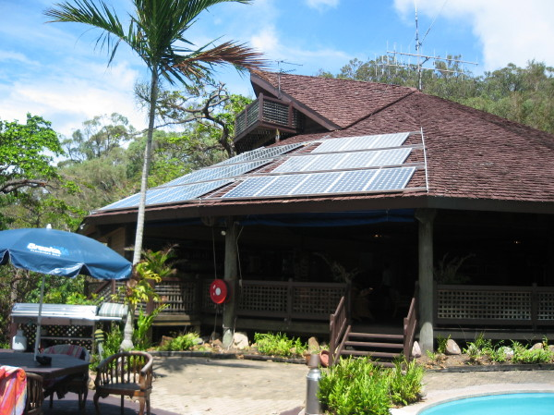
Hinchinbrook Island Resort
Researcher: Gordon Dalton PhD student
Supervisor: Dr David Lockington
University of Queensland
Resort location
Average solar irradiance: 5.2 kWh/m2/day
Average wind speed: 5.3 m/s
490kWh/day average: 52 kW peak
Island 50km off the coast in tropical north Queensland
19° south of equator,

Slide 17
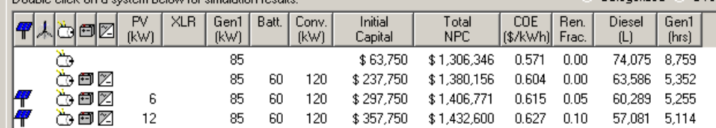
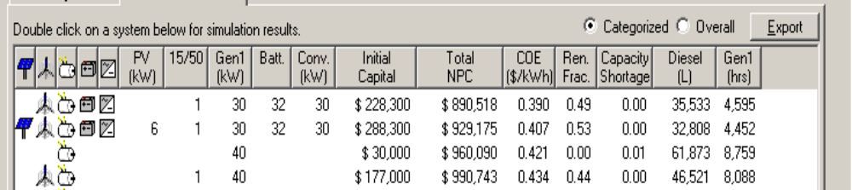
Present System
36 PV panels 160 W panels, 120 kW AES inverter, 85 kW diesel generator, 60 - 1100 Ah Enersun batteries
Optimized System
HOMER calculates a 40kW diesel running non-stop could satisfy 99% of power demand consuming 53,000 litres of fuel with a NPC of ~ $960,000
One AOC turbine increases reliability and lowers NPC 9.2 %. RF increases to 50%
Addition of 6 kW PV has small impact

Slide 18
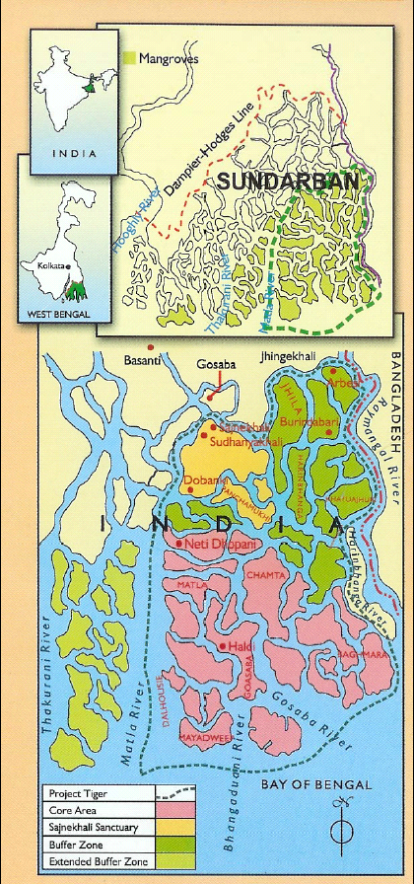
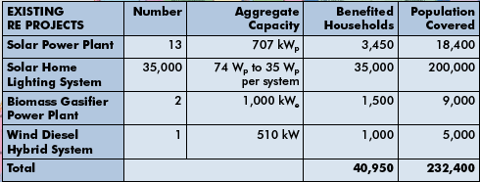
Master Plan of Electricity Supply for off-grid islands in Sundarbans
- Worlds largest mangrove forest
- 4 million population
131 unelectrified villages in 20 islands
Solar- avg 4.91 kWh/sq. m/day
Wind- avg 4.8 m/s
Good biomass resource potential
Indradip Mitra
November 2005

Slide 19

Proposed Measures
Analysis by HOMER
35 proposed hybrid power plants
All 131 villages in 20 islands covered
Households covered - 11,275
Shops covered - 3200
PV: 1.59 MWp
Biomass: 1.12 MWe
Wind: 20 KW
SHS(37Wp): 38,934 for scattered houses
Capital cost involved-(INR)1316 million

Slide 20
Case study of Wind Energy at National Institute of Technology, Silchar, India
Depletion of conventional energy source.
Alternative Energy Source: Wind Energy
Difficulties: Low wind speed at Assam, North-east zone of India.
Savonius wind turbine is the best suitable -Easy in construction, cost effective
Akash Joshi
National Institute of Technology, Silchar
(Formerly known as REC, Silchar)
akash.joshi@yahoo.com, akash.joshi@rediffmail.com

Slide 21
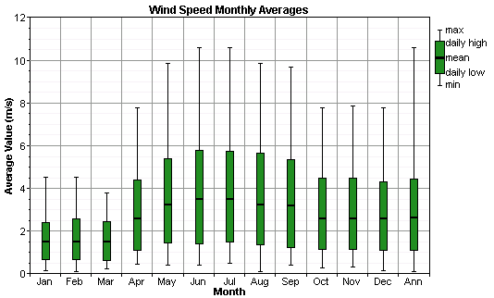
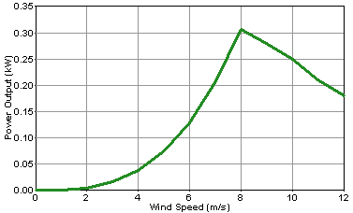
Results
Average wind speed at NIT, Silchar is 2.63 m/s
Savonius Turbine gives best results with 20% overlapping
Co-efficient of performance of S-rotor is 21% at 20% overlapping.
Cost of construction of S-rotor is around Rs.1500 (INR)

Slide 22
Hybrid Power System for Maldives - Post Tsunami
Hybrid power system with reverse osmosis desalination unit for post-Tsunami
Remote island’s village with 300 people
298 kWh/day primary and 20 kWh/day deferrable load
Wind/PV/diesel design to replace diesel only system
Ahmad Agus Setiawan
PhD Student
Dept. of Electrical & Computer Engineering Curtin University of Technology
setiawaa@vesta.curtin.edu.au
Chem. V. Nayar
Professor
Dept. of Electrical & Computer Engineering Curtin University of Technology
c.v.nayar@curtin.edu.au
www.ece.curtin.edu.au/academic.cfm
Chairman of REGEN POWER PTY. LTD.
www.regenpower.com

Slide 23
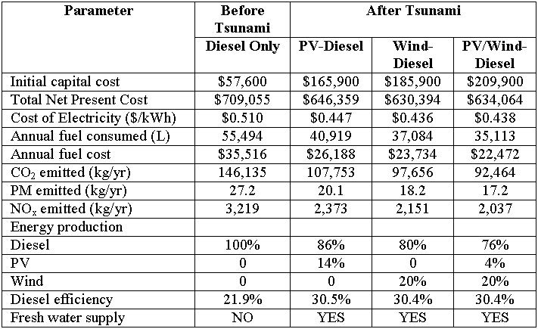
Results
Diesel only system has higher operational costs and emits more greenhouse gases and particulate matters.
Diesel genset operated in lower efficiency for diesel only system.
Hybrid power systems offer lower operational costs and less greenhouse gases/PM emissions
Diesel genset operated in higher efficiency for hybrid system.

Slide 24
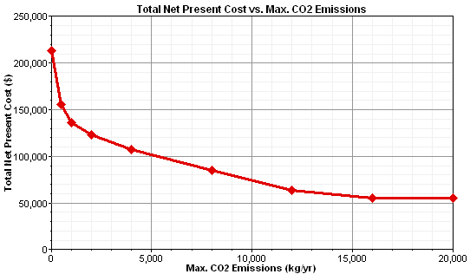
Cost of Reducing Carbon Emissions
Off-grid 35 kWh per day village in the Philippines
PV-Diesel
Results
  20% reduction at very little cost
  80% reduction at 2x cost premium
  Last 10% reduction very costly
  Debate should be about which intermediate point, not about the extreme points

Slide 25
Summary of Additional Submissions
Wind Home Systems in Coastal Bangladesh
  Small wind competitive with SHS
Health Clinics in Algeria
  PV-wind-generator systems for health clinics
Off-grid Options in Cameroon
  Pico hydro/biogas/battery systems in South
  PV/biogas/battery systems
Energy Planning for a Croatian Island
  300 km² island, 11,000 residents, 200,000 tourists
  Wind, PV, Biomass
GoogleMap Interface for ViPOR
  http://www.windwavesandsun.com/ViPOR.html

Slide 26


Thank You

