Slide 1
Fixed Income Student Intern Report
Rick Hui (SPOMS Team) – June 2017

Slide 2

Agenda
What am I going to say?
Self-Introduction
Projects
Comparison
Comments

Slide 3
Agenda
What am I going to say?
Self-Introduction
Projects
Comparison
Comments

Slide 4
About Me
Who am I?
Education Background
Bachelor of Engineering
  Major in Electronic Engineering
  Double minors in Computer Science & Economics
Graduated from the Chinese University of Hong Kong this July
Internship Information
Started Internship from Early September (~10 Months)
Worked at HBT most of the time
Supervised by Jason Tam, under Clifford Hui (E-Trading Team)
Rotation
SPOMS
FI Architecture
FO Support

Slide 5
Projects
What’s next?
Self-Introduction
Projects
Comparison
Comments

Slide 6








Summary
What I have done?
1
2
3
MY Termsheet
Automation
DevOps
POC
For Banking Use
6
5
4
ELI Online
Files Loader
Code Signing
7
8
Seoul Desk Risk Cockpit
Global Risk Cockpit Load from Summit
SPOMS
FO Support
FI Architecture

Slide 7
DevOps POC
What is it?
DevOps
Agile Methodology
Scrum
Kanban
DevOps Tools
Culture
Dev Team
Ops Team

Slide 8







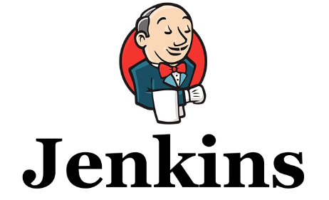


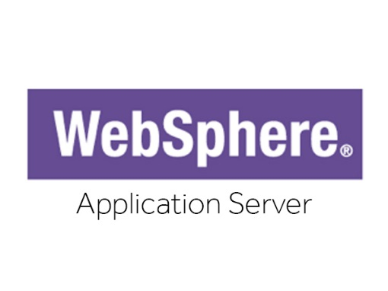


DevOps Tools
How to implement?

Slide 9



DevOps Projects
How do they generate values?
Project | Malaysia Termsheet Automation
Objective | Increase sales productivity by automating the product creation / term sheet generation process
Business Value | FTE GM Sales productivity pick-up
Project | For Banking Use
Objective | Improve 50% efficiency to place an order for Branch RM
Business Value | Save US $1m per year for RBWM US$400k goes to Wealth Ecommerce Team
Project | ELI Online
Objective | Digitization of ELI products RM time spent on rollover will be alleviated with online channel
Business Value | Gain US $5.6 million for 3 years
1
3
6

Slide 10
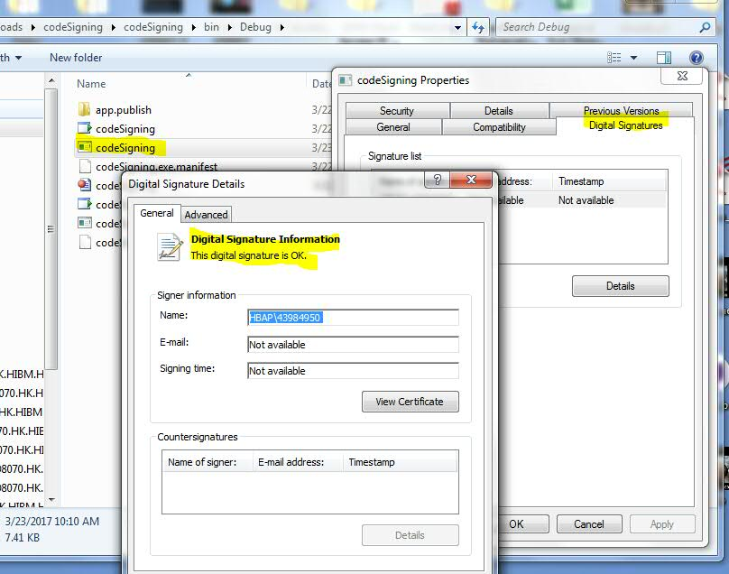
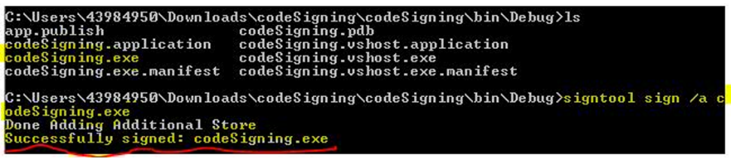
Code Signing
How does it work?
Why?
Fulfill the regulations in Citrix Application
Automate the manual code signing method in Visual Studio
Join the Continuous Integration using Jenkins
How?
What I Learnt?
Understood regulatory rule behind
How to use Tech to realize
Experienced Industry Practice
Does the HSBC Env support this? No guidelines?
Service Level Agreement?

Slide 11



Files Loader
How does it work?
Upload
Python
Script
Oracle DB
1 Cycle (SIT/UAT)
> 2800+ Flat Files
7 Locations
Business Scenario
Global Business Analysts struggled in dealing with data in loads of flat files
Heavy time burden on organizing or sorting big data in daily works
Solution
Use SQL to analyze millions of data in 1 minute
Upload ~10,000 records of data to DB in 1 minute
Analysis efficiency improves up to 15 times than using simple Excel functions

Slide 12
Agenda
What’s next?
Self-Introduction
Projects
Comparison
Comments

Slide 13
Comparison
How do they differ?
 | SPOMS | FI Architecture | FO Support
Work Nature | Wealth Ecommerce | Design and build up system prototypes | Prepare market risk reports to trading desks
Target Audience | Mainly Hong Kong, and serving other APAC countries | Coordinated with APAC Teams | Globally Support
Atmosphere | Startup-like Cheerful Team Internal sharing Embraces new Tech | Innovative Rapid Development Solid Control Diversified team structure | Intense but exciting Conservative Precise computing Adaptive to Prod Issues
DevOps Progress | Mature | Technically mature | Started

Slide 14
Agenda
What’s next?
Self-Introduction
Projects
Comparison
Comments

Slide 15
Comments
How’s being an Intern in HSBC?
Intern Experience
Stepped into the real business world
Experienced the Investment Banking business
Appreciated rotation training
Acquired Middle to Back Office experience
Learnt Time Management
Comments
Seems not Agile enough in development and operations. Sometimes the communication between teams is not efficient
due to distance. For example, AD / ALDS registration in India.
Place some human resources in HK or China office or set up a confluence page including contacts of supporting staff.
Seems not enough sharing in tech news and skills.
Good to have volunteers in teams to share tech feeds or knowledge. If there is no spare time for internal team members,
we may find some consultants outside like GZ or invite another department to share with us.
Rotation is a very good concept for students. However, adaptation time is doubled when handling different kinds of projects
at the same time.
We may consider the rotation running team by team. For example, three months in SPOMS team, three months in FO
Support team and so on.
Seems the communication between teams is not enough.
We may learn from other teams’ experience in order to shorten problem-solving time. Sitting closely or packing teams
in one or two working location can facilitate the communication between teams in FI.

