Slide 1
Fixed Income Student Intern Report
Rick Hui (SPOMS Team) – April 2017

Slide 2

Agenda What am I going to say?
Self-Introduction
Projects
Business Value
Comments

Slide 3
Agenda What am I going to say?
Self-Introduction
Projects
Business Value
Comments

Slide 4
Hierarchy Who am I?
Keru LIU
REG HD
FIXED INCOME IT, ASP
Clifford HUI
AD
FIXED INCOME IT, DEV
Jason Tam
Associate
FIXED INCOME IT, DEV
Rick Hui
Placement Student
FXD INCM IT-DERI&RSK IT

Slide 5
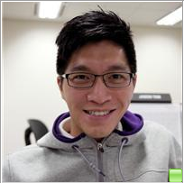
Hierarchy Who am I?
Jason Tam
Associate
FIXED INCOME IT, DEV

Slide 6
Hierarchy Who am I?
Keru LIU
REG HD
FIXED INCOME IT, ASP
Clifford HUI
AD
FIXED INCOME IT, DEV
Jason TAM
Associate
FIXED INCOME IT, DEV
Rick HUI
Placement Student
FXD INCM IT-DERI&RSK IT

Slide 7



SPOMS TEAM How does it work?
Buy/Sell
Branch
Sales
Pricing
Engine
SPOMS
Sell
Quotes
Trader
Wealth
E-Commerce
Buy/Sell
Client

Slide 8
SPOMS TEAM What is its client?

Slide 10
Projects What’s next?
Self-Introduction
Projects
Business Value
Comments

Slide 11








