Slide 1
Fixed Income Student Intern Report
Rick Hui (SPOMS Team) – June 2017

Slide 2

Agenda What am I going to say?
Self-Introduction
Projects
Comparison
Comments

Slide 3
Agenda What am I going to say?
Self-Introduction
Projects
Comparison
Comments

Slide 4
About Me Who am I?
Education Background
Bachelor of Engineering
Major in Electronic Engineering
Double minors in Computer Science & Economics
Graduated from the Chinese University of Hong Kong this July
Internship Information
Started Internship from Early September (~10 Months)
Worked at HBT most of the time
Supervised by Jason Tam, under Clifford Hui (E-Trading Team)
Rotation
SPOMS
FI Architecture
FO Support

Slide 5




SPOMS TEAM How does it work?
Wealth
Sales
Control
Buy/Sell
Branch
Sales
SPOMS
Pricing
Engine
Sell
Quotes
Trader
Wealth
E-Commerce
Buy/Sell
Client

Slide 6
Projects What’s next?
Self-Introduction
Projects
Comparison
Comments

Slide 7









Summary What I have done?
1
2
3
MY Termsheet
Automation
DevOps POC
For Banking Use
4
5
6
Code Signing
Files Loader
ELI Online
7
8
9
Seoul Desk Risk Cockpit
Trade Compression in Google Cloud
Global Risk Cockpit Load from Summit
SPOMS
FO Support
FI Architecture

Slide 8
DevOps POC What is it?
DevOps
Agile Methodology
Scrum
Kanban
DevOps Tools
Culture
Dev Team
Ops Team

Slide 9








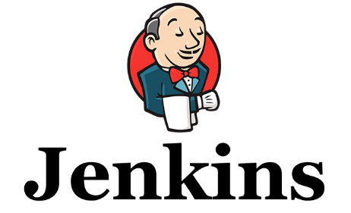


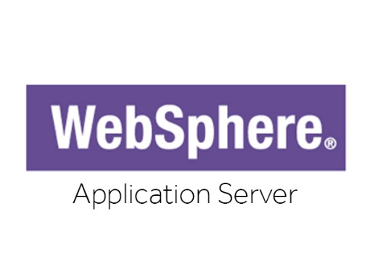


DevOps Tools How to implement?

Slide 10



DevOps Projects How do they generate values?
Project | Malaysia Termsheet Automation
Objective | Increase sales productivity by automating the product creation/term sheet generation process
Business Value | FTE GM Sales productivity pick-up
Project | For Banking Use
Objective | Improve 50% efficiency to place an order for Branch RM
Business Value | Save US $1m per year for RBWM US$400k goes to Wealth Ecommerce Team
Project | ELI Online
Objective | Digitization of ELI products RM time spent on rollover will be alleviated with online channel
Business Value | Gain US $5.6 million for 3 years
1
3
6

Slide 11
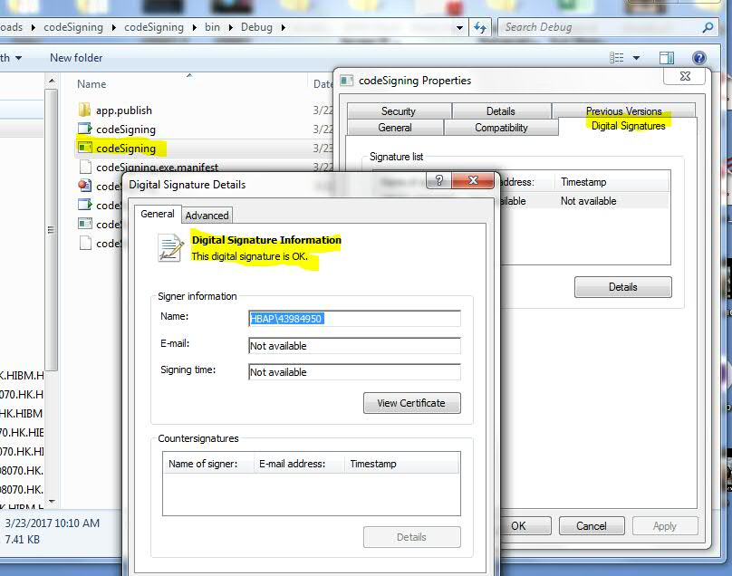
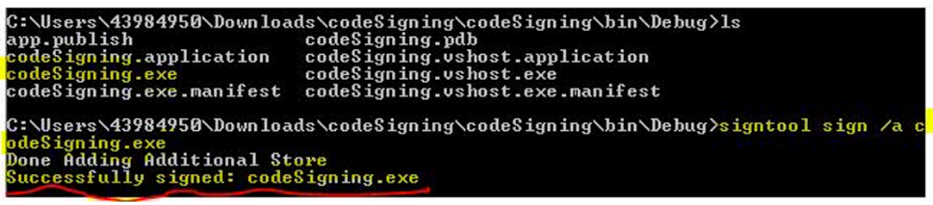
Code Signing How does it work?
Why?
Fulfill the regulations in Citrix Application
Automate the manual code signing method in Visual Studio
Join the Continuous Integration using Jenkins
How?
What I Learnt?
Windows Environment
C# Language
Encryption method (Private-public key)

Slide 12

Files Loader Why do we need it?
MARS
SPEAR
Error
Summit
Bond Forward
Trade
Risk
7 Locations
Bond
Conclusion
1 Cycle (SIT/UAT)
=> 400+ Flat Files
Bond Future
TREATS

Slide 13


Files Loader How does it work?
Upload
Python Script
Oracle DB
Features
Upload large amount of files for data analysis in minutes
Use SQL to extract data in forms of what they want
Categorize flat files into different kinds intelligently
Benefit for Business Analysts globally

Slide 14
Agenda What’s next?
Self-Introduction
Projects
Comparison
Comments

Slide 15
Comparison How do they differ?
 | SPOMS | FI Architecture | FO Support
Work Nature | Wealth Ecommerce | Design and build up system prototypes | Prepare market risk reports to trading desks
Target Audience | Mainly Hong Kong, and serving other APAC countries | Coordinated with APAC Teams | Globally Support
Atmosphere | Startup-like Cheerful Internal sharing Embraces new Tech | Innovative Rapid Development Solid Control Diversified team structure | Intense but exciting Conservative Precise computing Adaptive to Prod Issues
DevOps Progress | Mature | Technically mature | Started

Slide 16
Agenda What’s next?
Self-Introduction
Projects
Comparison
Comments

Slide 17
Comments How’s being an Intern in HSBC?
Intern Experience
Stepped into the real business world
Experienced the Investment Banking business
Appreciated rotation training
Acquired Middle to Back Office experience
Learnt Time Management
Comments
Seems not Agile enough in development and operations. Sometimes the communication between teams is not efficient due to distance. For example, AD / ALDS registration in India.
Place some human resources in HK or China office or set up a confluence page including contacts of supporting staff.
Seems not enough sharing in tech news and skills.
Good to have volunteers in teams to share tech feeds or knowledge. If there is no spare time for internal team members, we may find some consultants outside like GZ or invite another department to share with us.
Rotation is a very good concept for students. However, adaptation time is doubled when handling different kinds of projects at the same time.
We may consider the rotation running team by team. For example, three months in SPOMS team, three months in FO Support team and so on.
Seems the communication between teams is not enough.
We may learn from other teams’ experience in order to shorten problem-solving time. Sitting closely or packing teams in one or two working location can facilitate the communication between teams in FI.

