Slide 1
Three Approaches to Improve Inferences Based on
Survey Data Collected with Mixed-Mode Designs
Reporter: YUNG-CHUN LAN, YUE-CHEN WU

Slide 2
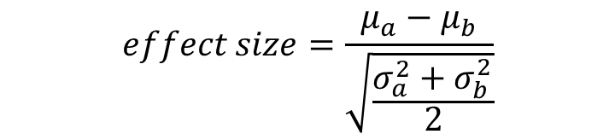
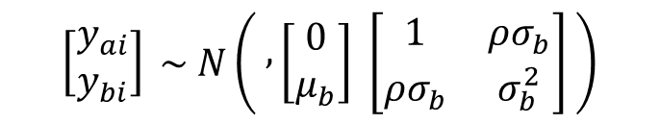
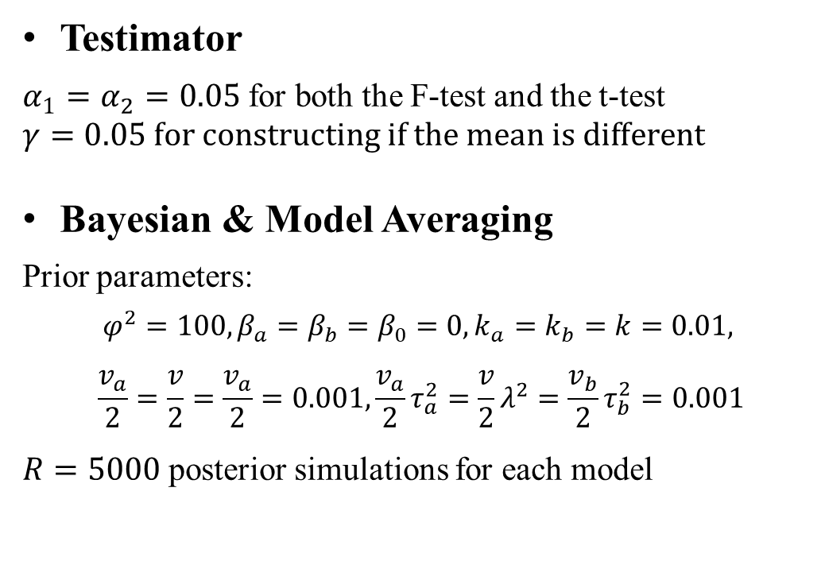
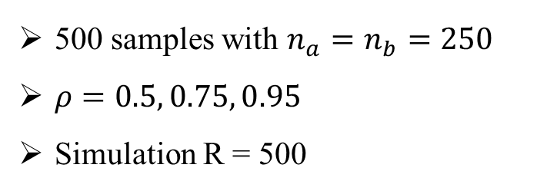
Intro
Methods
Simulation
Replication
Application
Conclusion
Simulation Design
$$\left[\begin{matrix}y_{ai} \\ y_{bi}\end{matrix}\right] \sim N\left( , \left[\begin{matrix}0 \\ μ_{b}\end{matrix}\right] \left[\begin{matrix}1 & ρσ_{b} \\ ρσ_{b} & σ_{b}^{2}\end{matrix}\right] \right)$$
Testimator
$α_{1}=α_{2}=0.05$for both the F-test and the t-test
$$γ=0.05 for constructing if the mean is different$$
Bayesian & Model Averaging
Prior parameters:
$$φ^{2}=100, β_{a}=β_{b}=β_{0}=0, k_{a}=k_{b}=k=0.01,$$
$$\frac{v_{a}}{2}=\frac{v}{2}=\frac{v_{a}}{2}=0.001, \frac{v_{a}}{2}τ_{a}^{2}=\frac{v}{2}λ^{2}=\frac{v_{b}}{2}τ_{b}^{2}=0.001$$
$R=5000$ posterior simulations for each model
$$effect size=\frac{μ_{a}−μ_{b}}{\sqrt{\frac{σ_{a}^{2}+σ_{b}^{2}}{2}}}$$
500 samples with $n_{a}=n_{b}=250$
$ρ=0.5, 0.75, 0.95$
Simulation R = 500

Slide 3
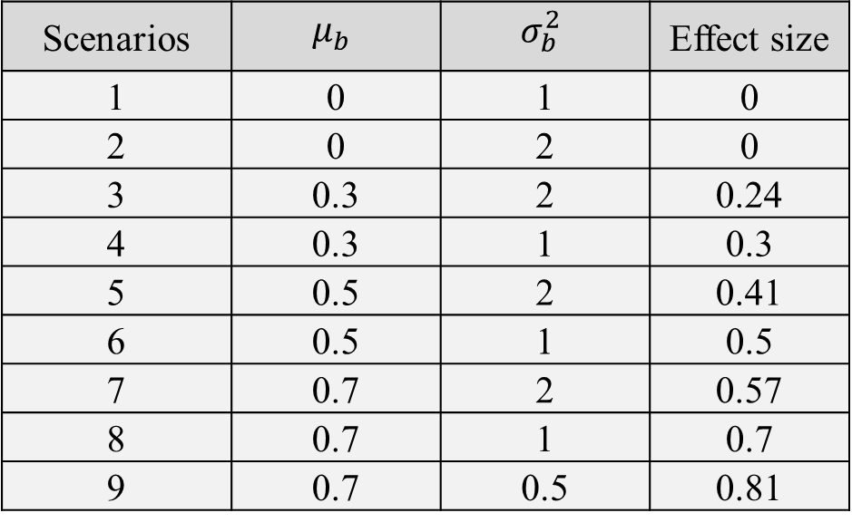
Intro
Methods
Simulation
Replication
Application
Conclusion
Simulation Design
(1) The preferred direction is known (smaller mean is preferred)
(2) The preferred direction is unknown.
Scenarios | $$μ_{b}$$ | $$σ_{b}^{2}$$ | Effect size
1 | 0 | 1 | 0
2 | 0 | 2 | 0
3 | 0.3 | 2 | 0.24
4 | 0.3 | 1 | 0.3
5 | 0.5 | 2 | 0.41
6 | 0.5 | 1 | 0.5
7 | 0.7 | 2 | 0.57
8 | 0.7 | 1 | 0.7
9 | 0.7 | 0.5 | 0.81

Slide 4
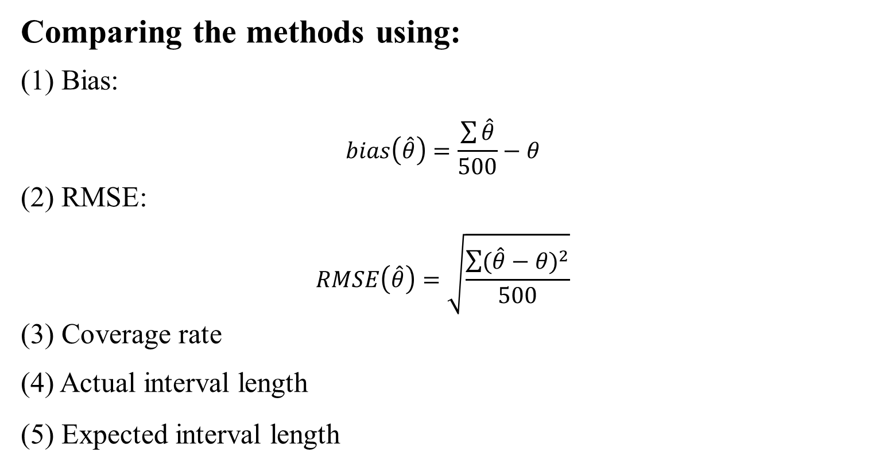
Intro
Methods
Simulation
Replication
Application
Conclusion
Comparing the methods using:
(1) Bias:
$$bias\left(\hat{θ}\right)=\frac{\sum{\hat{θ}}}{500}−θ$$
(2) RMSE:
$$RMSE\left(\hat{θ}\right)=\sqrt{\frac{\sum{{(\hat{θ}−θ)}^{2}}}{500}}$$
(3) Coverage rate
(4) Actual interval length
(5) Expected interval length

Slide 5
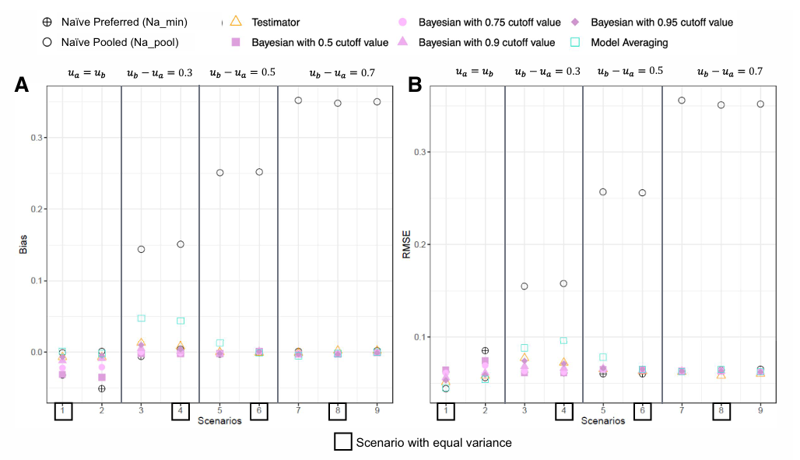
Intro
Methods
Simulation
Replication
Application
Conclusion
smaller mean is preferred

Slide 6
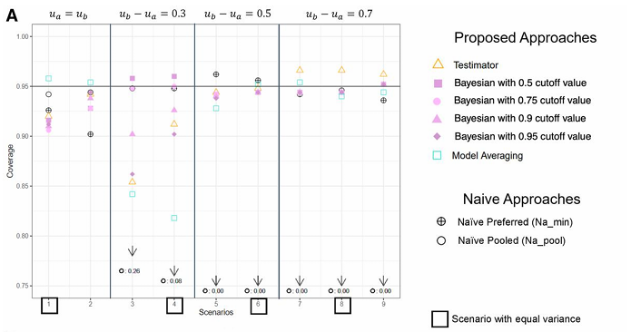
Intro
Methods
Simulation
Replication
Application
Conclusion
smaller mean is preferred

Slide 7
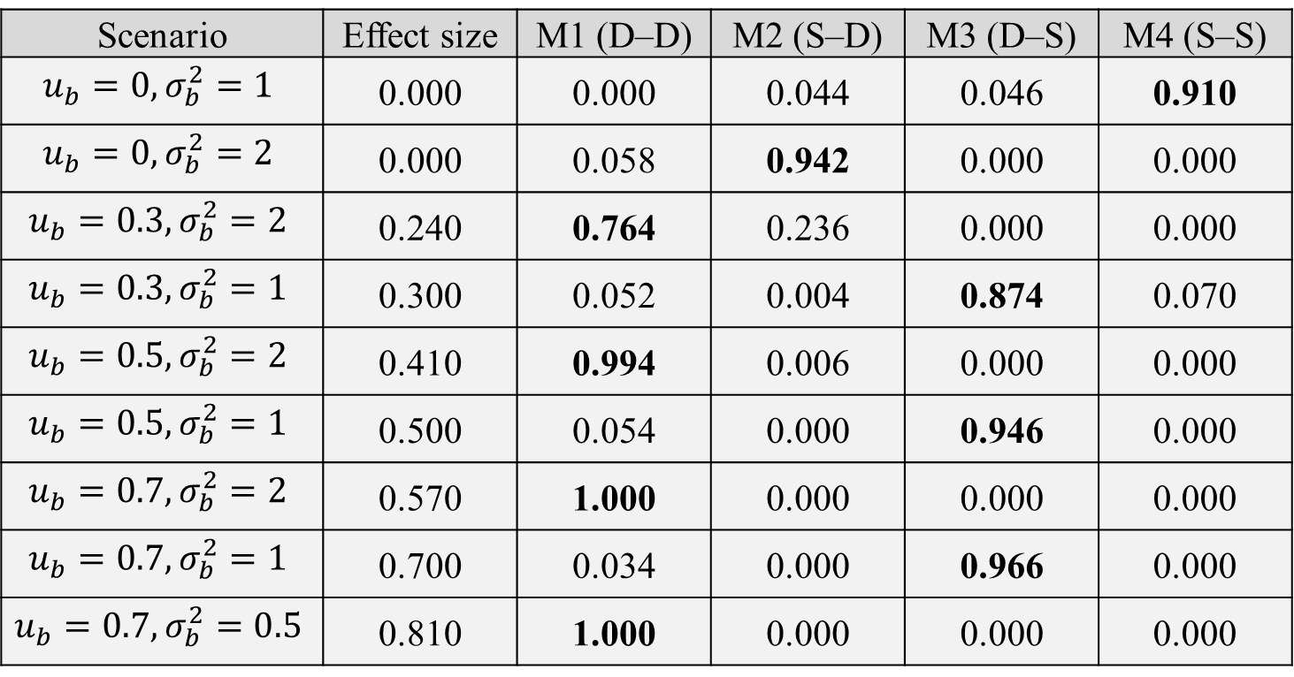
Intro
Methods
Simulation
Replication
Application
Conclusion
Scenario | Effect size | M1 (D–D) | M2 (S–D) | M3 (D–S) | M4 (S–S)
$$u_{b}=0,σ_{b}^{2}=1$$ | 0.000 | 0.000 | 0.044 | 0.046 | 0.910
$$u_{b}=0,σ_{b}^{2}=2$$ | 0.000 | 0.058 | 0.942 | 0.000 | 0.000
$$u_{b}=0.3,σ_{b}^{2}=2$$ | 0.240 | 0.764 | 0.236 | 0.000 | 0.000
$$u_{b}=0.3,σ_{b}^{2}=1$$ | 0.300 | 0.052 | 0.004 | 0.874 | 0.070
$$u_{b}=0.5,σ_{b}^{2}=2$$ | 0.410 | 0.994 | 0.006 | 0.000 | 0.000
$$u_{b}=0.5,σ_{b}^{2}=1$$ | 0.500 | 0.054 | 0.000 | 0.946 | 0.000
$$u_{b}=0.7,σ_{b}^{2}=2$$ | 0.570 | 1.000 | 0.000 | 0.000 | 0.000
$$u_{b}=0.7,σ_{b}^{2}=1$$ | 0.700 | 0.034 | 0.000 | 0.966 | 0.000
$$u_{b}=0.7,σ_{b}^{2}=0.5$$ | 0.810 | 1.000 | 0.000 | 0.000 | 0.000
Probability of the Model Being Selected in the Testimator Approach (ρ=0.95,n=500)
smaller mean is preferred

Slide 8
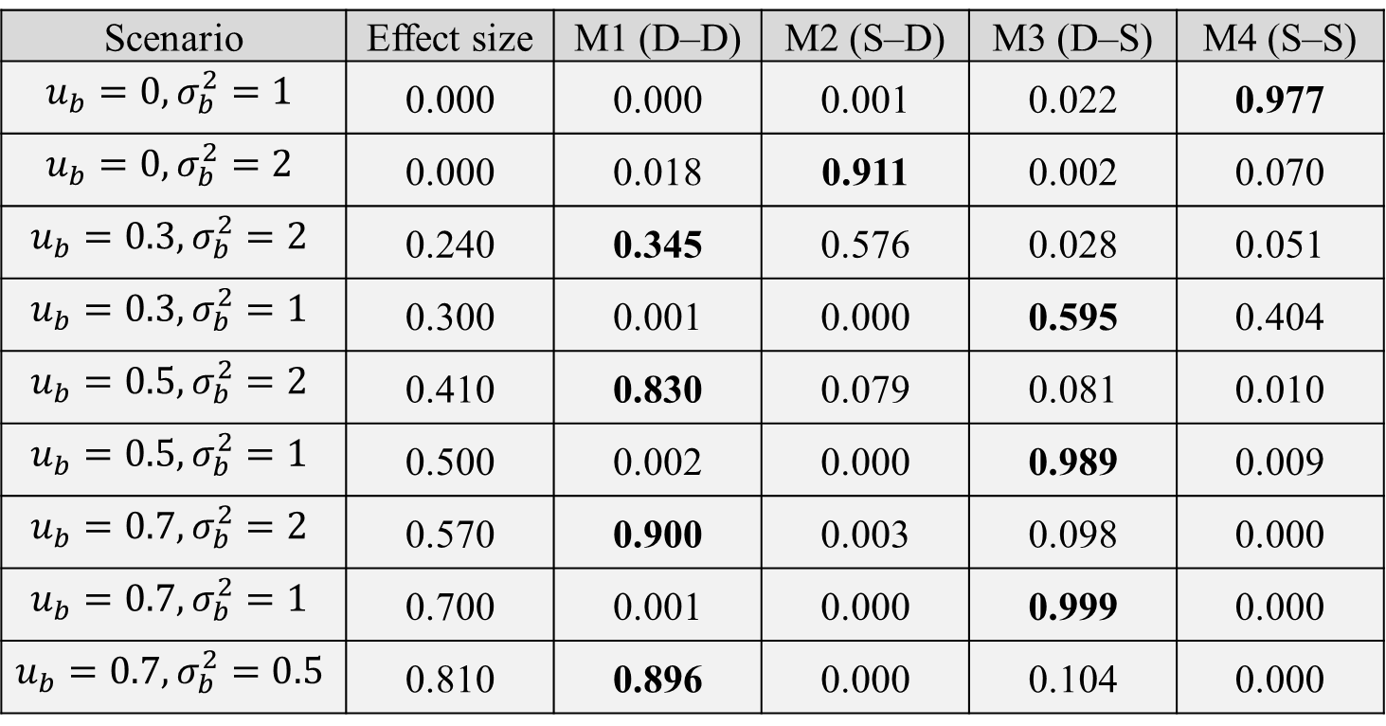
Intro
Methods
Simulation
Replication
Application
Conclusion
Scenario | Effect size | M1 (D–D) | M2 (S–D) | M3 (D–S) | M4 (S–S)
$$u_{b}=0,σ_{b}^{2}=1$$ | 0.000 | 0.000 | 0.001 | 0.022 | 0.977
$$u_{b}=0,σ_{b}^{2}=2$$ | 0.000 | 0.018 | 0.911 | 0.002 | 0.070
$$u_{b}=0.3,σ_{b}^{2}=2$$ | 0.240 | 0.345 | 0.576 | 0.028 | 0.051
$$u_{b}=0.3,σ_{b}^{2}=1$$ | 0.300 | 0.001 | 0.000 | 0.595 | 0.404
$$u_{b}=0.5,σ_{b}^{2}=2$$ | 0.410 | 0.830 | 0.079 | 0.081 | 0.010
$$u_{b}=0.5,σ_{b}^{2}=1$$ | 0.500 | 0.002 | 0.000 | 0.989 | 0.009
$$u_{b}=0.7,σ_{b}^{2}=2$$ | 0.570 | 0.900 | 0.003 | 0.098 | 0.000
$$u_{b}=0.7,σ_{b}^{2}=1$$ | 0.700 | 0.001 | 0.000 | 0.999 | 0.000
$$u_{b}=0.7,σ_{b}^{2}=0.5$$ | 0.810 | 0.896 | 0.000 | 0.104 | 0.000
Average weight in the Model Averaging approach ($ρ=0.95,n=500$)
smaller mean is preferred

Slide 9
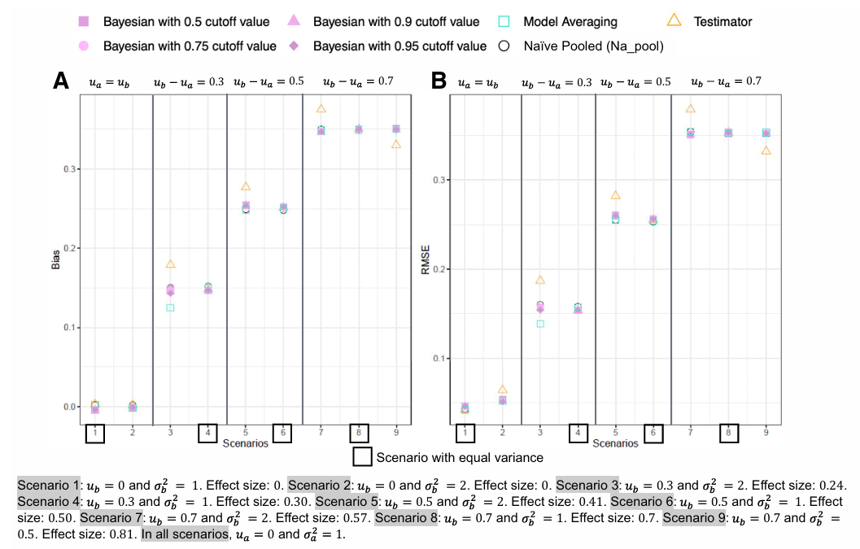
Intro
Methods
Simulation
Replication
Application
Conclusion
No information about preferred direction

Slide 10
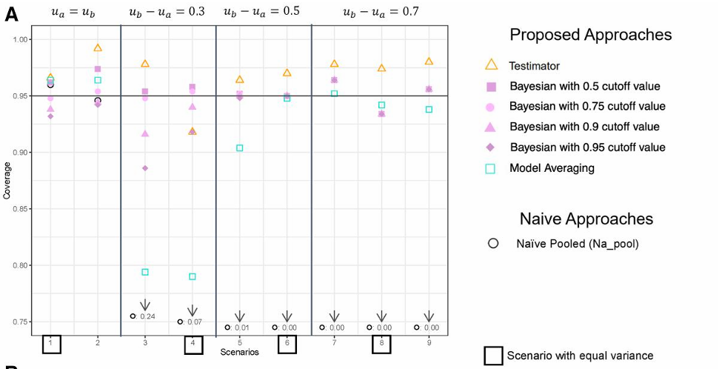
Intro
Methods
Simulation
Replication
Application
Conclusion
No information about preferred direction

Slide 11
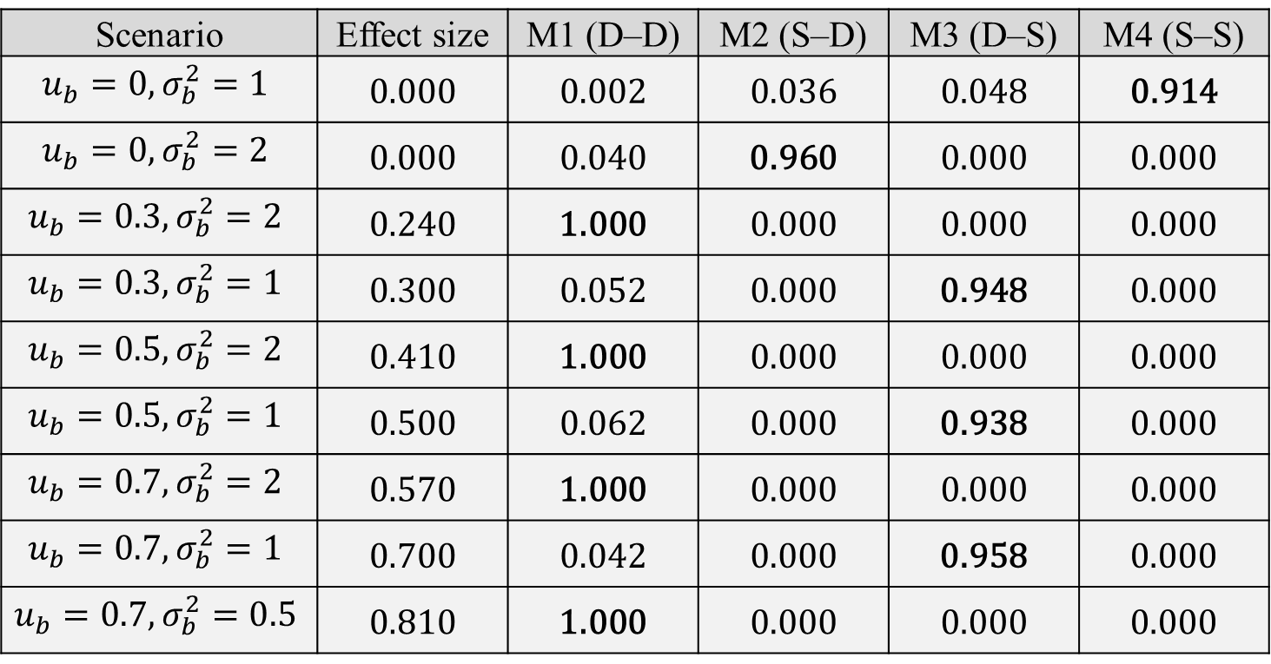
Intro
Methods
Simulation
Replication
Application
Conclusion
Scenario | Effect size | M1 (D–D) | M2 (S–D) | M3 (D–S) | M4 (S–S)
$$u_{b}=0,σ_{b}^{2}=1$$ | 0.000 | 0.002 | 0.036 | 0.048 | 0.914
$$u_{b}=0,σ_{b}^{2}=2$$ | 0.000 | 0.040 | 0.960 | 0.000 | 0.000
$$u_{b}=0.3,σ_{b}^{2}=2$$ | 0.240 | 1.000 | 0.000 | 0.000 | 0.000
$$u_{b}=0.3,σ_{b}^{2}=1$$ | 0.300 | 0.052 | 0.000 | 0.948 | 0.000
$$u_{b}=0.5,σ_{b}^{2}=2$$ | 0.410 | 1.000 | 0.000 | 0.000 | 0.000
$$u_{b}=0.5,σ_{b}^{2}=1$$ | 0.500 | 0.062 | 0.000 | 0.938 | 0.000
$$u_{b}=0.7,σ_{b}^{2}=2$$ | 0.570 | 1.000 | 0.000 | 0.000 | 0.000
$$u_{b}=0.7,σ_{b}^{2}=1$$ | 0.700 | 0.042 | 0.000 | 0.958 | 0.000
$$u_{b}=0.7,σ_{b}^{2}=0.5$$ | 0.810 | 1.000 | 0.000 | 0.000 | 0.000
Probability of the Model Being Selected in the Testimator Approach (ρ=0.95,n=5000)
Increase sample size to 5000 (prefer smaller mean)

Slide 12
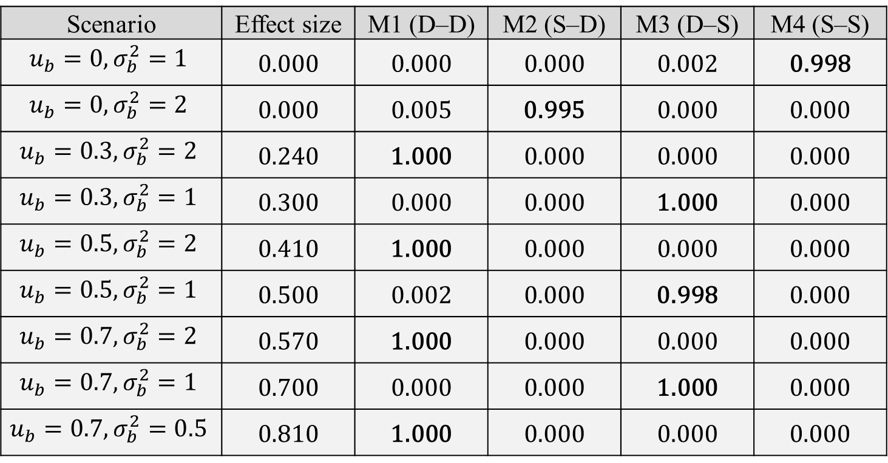
Intro
Methods
Simulation
Replication
Application
Conclusion
Scenario | Effect size | M1 (D–D) | M2 (S–D) | M3 (D–S) | M4 (S–S)
$$u_{b}=0,σ_{b}^{2}=1$$ | 0.000 | 0.000 | 0.000 | 0.002 | 0.998
$$u_{b}=0,σ_{b}^{2}=2$$ | 0.000 | 0.005 | 0.995 | 0.000 | 0.000
$$u_{b}=0.3,σ_{b}^{2}=2$$ | 0.240 | 1.000 | 0.000 | 0.000 | 0.000
$$u_{b}=0.3,σ_{b}^{2}=1$$ | 0.300 | 0.000 | 0.000 | 1.000 | 0.000
$$u_{b}=0.5,σ_{b}^{2}=2$$ | 0.410 | 1.000 | 0.000 | 0.000 | 0.000
$$u_{b}=0.5,σ_{b}^{2}=1$$ | 0.500 | 0.002 | 0.000 | 0.998 | 0.000
$$u_{b}=0.7,σ_{b}^{2}=2$$ | 0.570 | 1.000 | 0.000 | 0.000 | 0.000
$$u_{b}=0.7,σ_{b}^{2}=1$$ | 0.700 | 0.000 | 0.000 | 1.000 | 0.000
$$u_{b}=0.7,σ_{b}^{2}=0.5$$ | 0.810 | 1.000 | 0.000 | 0.000 | 0.000
Average weight in the Model Averaging approach ($ρ=0.95,n=5000$)
Increase sample size to 5000 (prefer smaller mean)

Slide 13
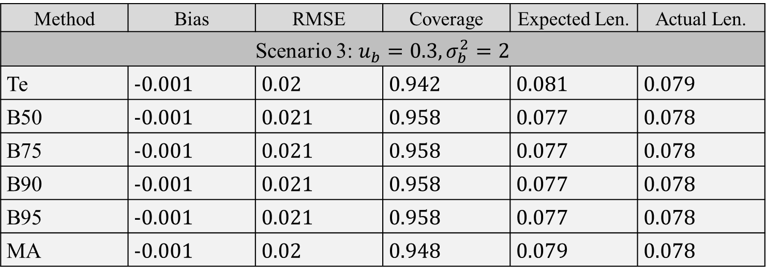
Intro
Methods
Simulation
Replication
Application
Conclusion
Method | Bias | RMSE | Coverage | Expected Len. | Actual Len.
Scenario 3: $u_{b}=0.3,σ_{b}^{2}=2$
Te | -0.001 | 0.02 | 0.942 | 0.081 | 0.079
B50 | -0.001 | 0.021 | 0.958 | 0.077 | 0.078
B75 | -0.001 | 0.021 | 0.958 | 0.077 | 0.078
B90 | -0.001 | 0.021 | 0.958 | 0.077 | 0.078
B95 | -0.001 | 0.021 | 0.958 | 0.077 | 0.078
MA | -0.001 | 0.02 | 0.948 | 0.079 | 0.078
Performance in normal outcomes when smaller estimates are preferred ($ρ=0.95,n=5000$)
Increase sample size to 5000 (prefer smaller mean)

Slide 14
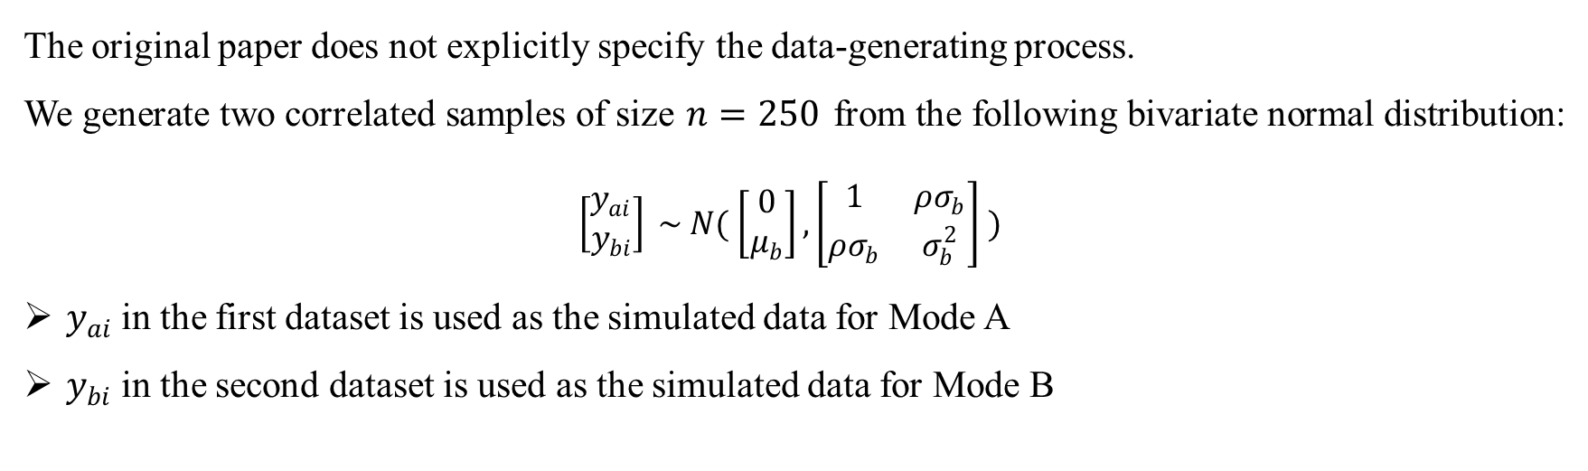
Intro
Methods
Simulation
Replication
Application
Conclusion
Replication: Data generation
The original paper does not explicitly specify the data-generating process.
We generate two correlated samples of size $n=250$ from the following bivariate normal distribution:
$$\left[\begin{matrix}y_{ai} \\ y_{bi}\end{matrix}\right] \sim N( \left[\begin{matrix}0 \\ μ_{b}\end{matrix}\right], \left[\begin{matrix}1 & ρσ_{b} \\ ρσ_{b} & σ_{b}^{2}\end{matrix}\right] )$$
$y_{ai}$ in the first dataset is used as the simulated data for Mode A
$y_{bi}$ in the second dataset is used as the simulated data for Mode B
$n=500$, $ρ=0.95$, and the case where a smaller mean is preferred

Slide 15
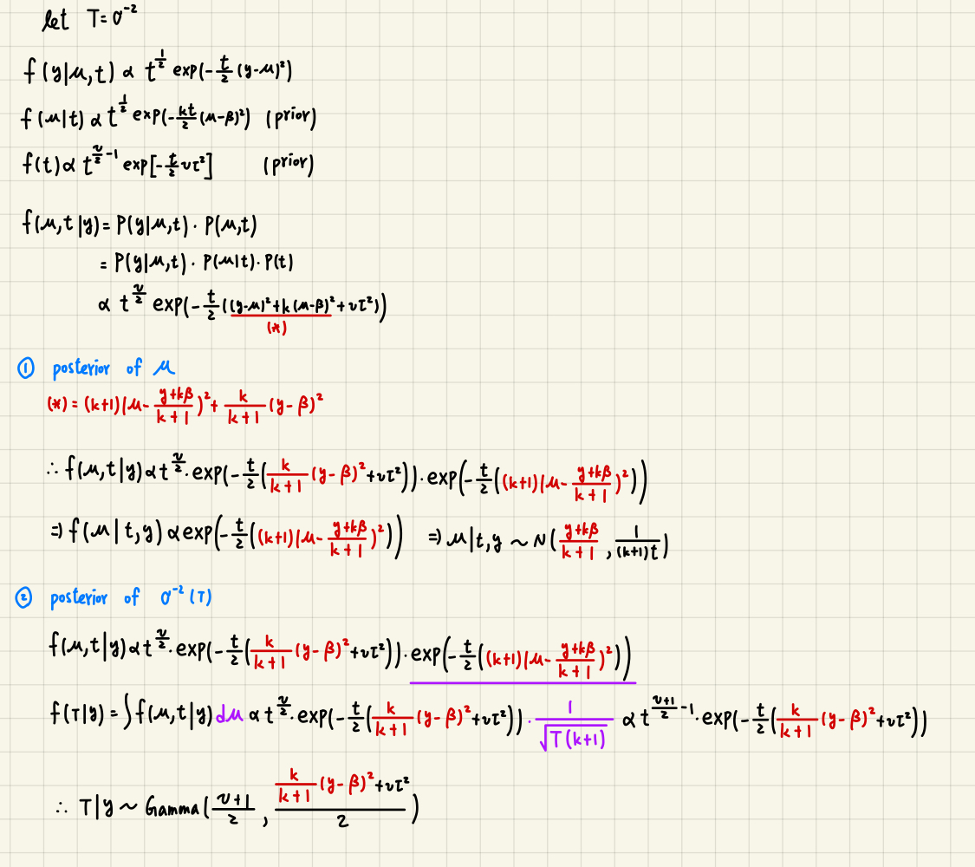
Intro
Methods
Simulation
Replication
Application
Conclusion
Replication: Posterior Distribution of Bayes Approach & Model Averaging
Different means model:
The posterior parameters of the different means model are not described in the paper, we derive them assuming a single sample for simplicity.
Common means model:
We use Gibbs sampling to generate posterior draws.

Slide 16
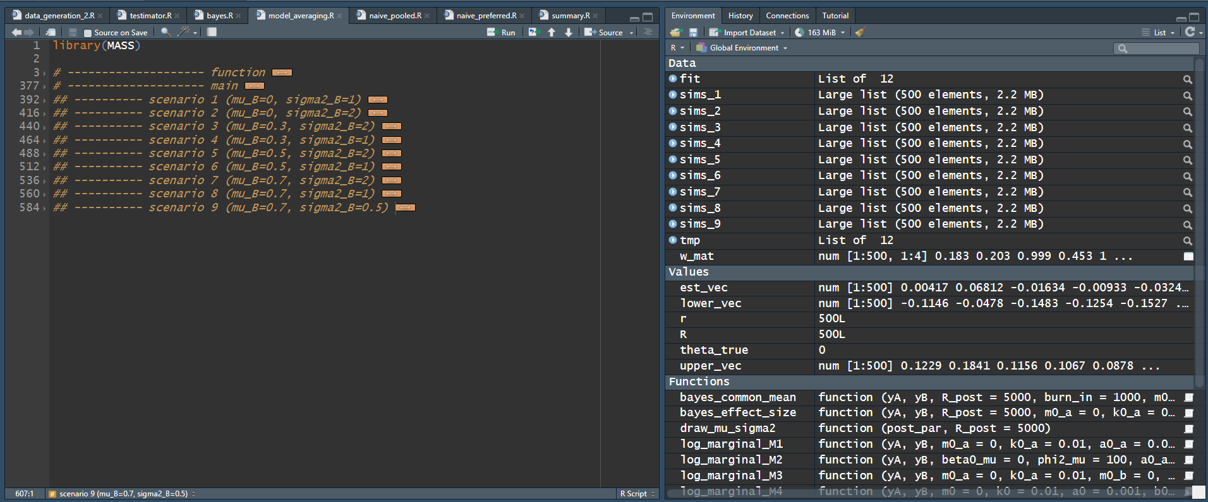
Intro
Methods
Simulation
Replication
Application
Conclusion
Structure of our code

Slide 17
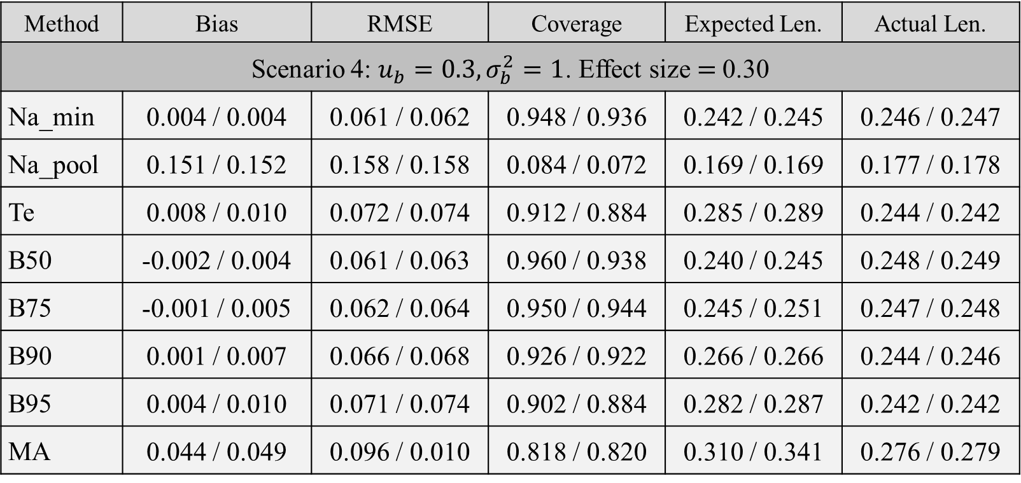
Intro
Methods
Simulation
Replication
Application
Conclusion
Proposed Method (Original Paper Results / Our Results):
Method | Bias | RMSE | Coverage | Expected Len. | Actual Len.
Scenario 4: $u_{b}=0.3,σ_{b}^{2}=1$. Effect size = 0.30
Na_min | 0.004 / 0.004 | 0.061 / 0.062 | 0.948 / 0.936 | 0.242 / 0.245 | 0.246 / 0.247
Na_pool | 0.151 / 0.152 | 0.158 / 0.158 | 0.084 / 0.072 | 0.169 / 0.169 | 0.177 / 0.178
Te | 0.008 / 0.010 | 0.072 / 0.074 | 0.912 / 0.884 | 0.285 / 0.289 | 0.244 / 0.242
B50 | -0.002 / 0.004 | 0.061 / 0.063 | 0.960 / 0.938 | 0.240 / 0.245 | 0.248 / 0.249
B75 | -0.001 / 0.005 | 0.062 / 0.064 | 0.950 / 0.944 | 0.245 / 0.251 | 0.247 / 0.248
B90 | 0.001 / 0.007 | 0.066 / 0.068 | 0.926 / 0.922 | 0.266 / 0.266 | 0.244 / 0.246
B95 | 0.004 / 0.010 | 0.071 / 0.074 | 0.902 / 0.884 | 0.282 / 0.287 | 0.242 / 0.242
MA | 0.044 / 0.049 | 0.096 / 0.010 | 0.818 / 0.820 | 0.310 / 0.341 | 0.276 / 0.279
Model performance in different scenarios

Slide 18
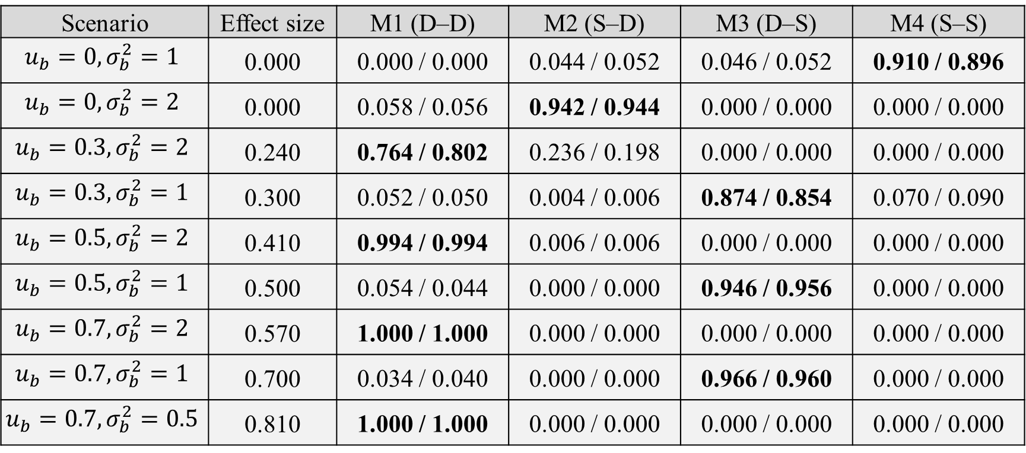
Intro
Methods
Simulation
Replication
Application
Conclusion
Proposed Method (Original Paper Results / Our Results):
Scenario | Effect size | M1 (D–D) | M2 (S–D) | M3 (D–S) | M4 (S–S)
$$u_{b}=0,σ_{b}^{2}=1$$ | 0.000 | 0.000 / 0.000 | 0.044 / 0.052 | 0.046 / 0.052 | 0.910 / 0.896
$$u_{b}=0,σ_{b}^{2}=2$$ | 0.000 | 0.058 / 0.056 | 0.942 / 0.944 | 0.000 / 0.000 | 0.000 / 0.000
$$u_{b}=0.3,σ_{b}^{2}=2$$ | 0.240 | 0.764 / 0.802 | 0.236 / 0.198 | 0.000 / 0.000 | 0.000 / 0.000
$$u_{b}=0.3,σ_{b}^{2}=1$$ | 0.300 | 0.052 / 0.050 | 0.004 / 0.006 | 0.874 / 0.854 | 0.070 / 0.090
$$u_{b}=0.5,σ_{b}^{2}=2$$ | 0.410 | 0.994 / 0.994 | 0.006 / 0.006 | 0.000 / 0.000 | 0.000 / 0.000
$$u_{b}=0.5,σ_{b}^{2}=1$$ | 0.500 | 0.054 / 0.044 | 0.000 / 0.000 | 0.946 / 0.956 | 0.000 / 0.000
$$u_{b}=0.7,σ_{b}^{2}=2$$ | 0.570 | 1.000 / 1.000 | 0.000 / 0.000 | 0.000 / 0.000 | 0.000 / 0.000
$$u_{b}=0.7,σ_{b}^{2}=1$$ | 0.700 | 0.034 / 0.040 | 0.000 / 0.000 | 0.966 / 0.960 | 0.000 / 0.000
$$u_{b}=0.7,σ_{b}^{2}=0.5$$ | 0.810 | 1.000 / 1.000 | 0.000 / 0.000 | 0.000 / 0.000 | 0.000 / 0.000
Model selection proportion of Testimator

Slide 19
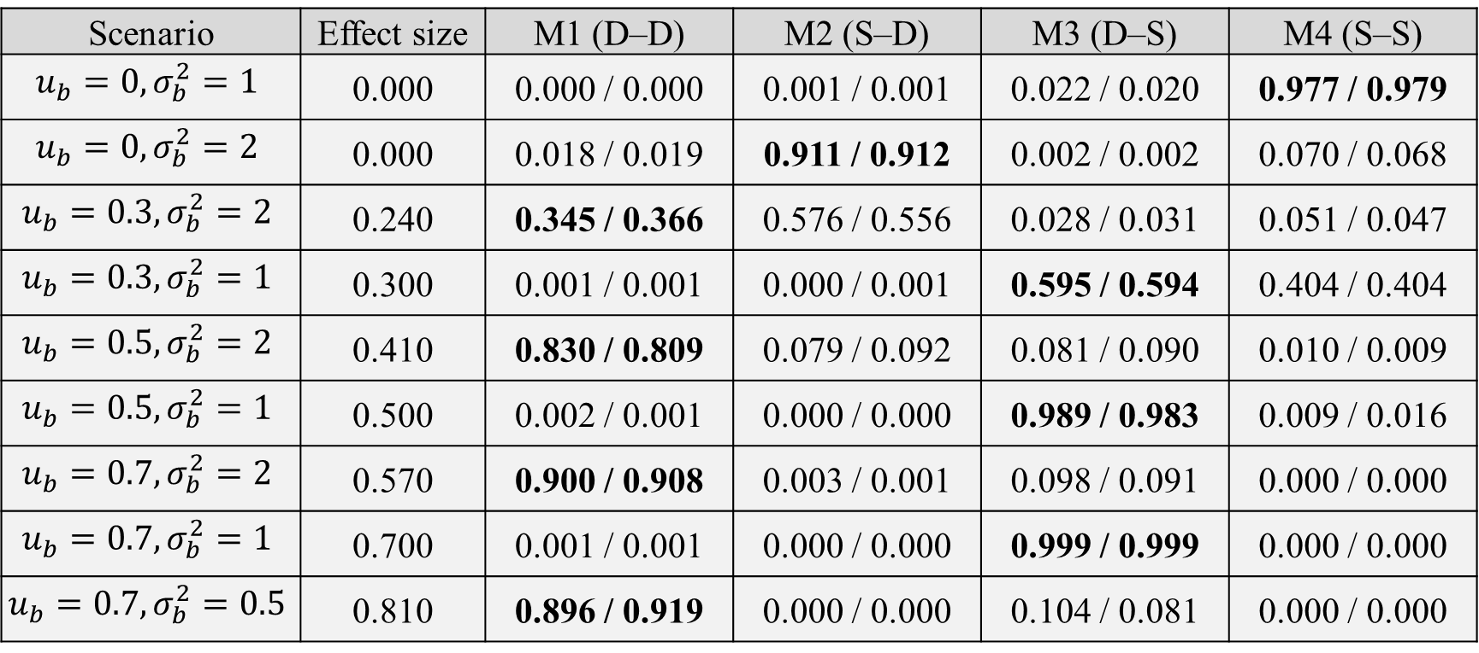
Intro
Methods
Simulation
Replication
Application
Conclusion
Proposed Method (Original Paper Results / Our Results):
Scenario | Effect size | M1 (D–D) | M2 (S–D) | M3 (D–S) | M4 (S–S)
$$u_{b}=0,σ_{b}^{2}=1$$ | 0.000 | 0.000 / 0.000 | 0.001 / 0.001 | 0.022 / 0.020 | 0.977 / 0.979
$$u_{b}=0,σ_{b}^{2}=2$$ | 0.000 | 0.018 / 0.019 | 0.911 / 0.912 | 0.002 / 0.002 | 0.070 / 0.068
$$u_{b}=0.3,σ_{b}^{2}=2$$ | 0.240 | 0.345 / 0.366 | 0.576 / 0.556 | 0.028 / 0.031 | 0.051 / 0.047
$$u_{b}=0.3,σ_{b}^{2}=1$$ | 0.300 | 0.001 / 0.001 | 0.000 / 0.001 | 0.595 / 0.594 | 0.404 / 0.404
$$u_{b}=0.5,σ_{b}^{2}=2$$ | 0.410 | 0.830 / 0.809 | 0.079 / 0.092 | 0.081 / 0.090 | 0.010 / 0.009
$$u_{b}=0.5,σ_{b}^{2}=1$$ | 0.500 | 0.002 / 0.001 | 0.000 / 0.000 | 0.989 / 0.983 | 0.009 / 0.016
$$u_{b}=0.7,σ_{b}^{2}=2$$ | 0.570 | 0.900 / 0.908 | 0.003 / 0.001 | 0.098 / 0.091 | 0.000 / 0.000
$$u_{b}=0.7,σ_{b}^{2}=1$$ | 0.700 | 0.001 / 0.001 | 0.000 / 0.000 | 0.999 / 0.999 | 0.000 / 0.000
$$u_{b}=0.7,σ_{b}^{2}=0.5$$ | 0.810 | 0.896 / 0.919 | 0.000 / 0.000 | 0.104 / 0.081 | 0.000 / 0.000
Average model weights of Model Averaging

Slide 20
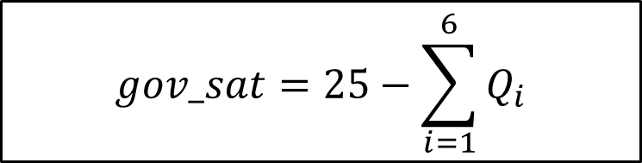
Intro
Methods
Simulation
Replication
Application
Conclusion
Application: Arab Barometer Wave 6 Jordan Experiment
2,531 respondents
FTF: 1,193
FTF(5 mins) + TEL: 1,338
(a) security performance
(b) keeping prices down
(c) response to COVID-19
(d) overall performance
(e) education system
(f) healthcare system
1 = “Completely satisfied”, 2 = “Satisfied”
3 = “Dissatisfied”, 4 = “Completely dissatisfied”
1 = “Very good”, 2 = “Good”
3 = “Bad”, 4 = “Very bad”
$$gov_sat=25−\sum_{i=1}^{6}{Q_{i}}$$

Slide 21
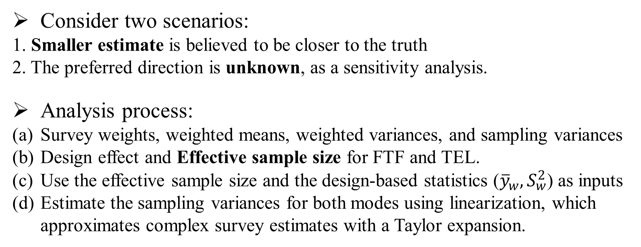
Intro
Methods
Simulation
Replication
Application
Conclusion
Consider two scenarios:
1. Smaller estimate is believed to be closer to the truth
2. The preferred direction is unknown, as a sensitivity analysis.
Analysis process:
Survey weights, weighted means, weighted variances, and sampling variances
Design effect and Effective sample size for FTF and TEL.
Use the effective sample size and the design-based statistics (${\overline{y}}_{w}, S_{w}^{2}$) as inputs
Estimate the sampling variances for both modes using linearization, which approximates complex survey estimates with a Taylor expansion.

Slide 22
Intro
Methods
Simulation
Replication
Application
Conclusion
Results
Method | Estimate | Interval | Interval Len.
Testimator | 7.521 | 7.197, 7.844 | 0.647
Bayesian (50%, 75%, 95%) | 7.519 | 7.193, 7.849 | 0.656
Model Averaging | 7.521 | 7.197, 7.851 | 0.654
Pool data | 8.295 | 8.058, 8.531 | 0.473
FTF | 7.521 | 7.200, 7.841 | 0.642
TEL | 9.088 | 8.825, 9.351 | 0.526
Results when smaller estimates are preferred

Slide 23
Intro
Methods
Simulation
Replication
Application
Conclusion
Results
Method | Estimate | Interval | Interval Len.
Testimator | 8.275 | 7.197, 9.352 | 2.155
Bayesian (50%, 75%, 95%) | 8.293 | 7.254, 9.307 | 2.053
Model Averaging | 8.297 | 7.246, 9.304 | 2.058
Pool data | 8.295 | 8.058, 8.531 | 0.473
FTF | 7.521 | 7.200, 7.841 | 0.642
TEL | 9.088 | 8.825, 9.351 | 0.526
Results when there is no information about preferred direction

Slide 24
Intro
Methods
Simulation
Replication
Application
Conclusion
Core concepts
Testimator
2 stage hypothesis testing
Bayesian Approach
CI of posterior effect size
Mode effect
Selects the model
Model Averaging
Combine 4 models through their posterior weights
Perform inference by averaging across models
Performance
All methods have limited sensitivity to small mode effects when the sample size is small
All methods are more robust than the Naïve approaches.
Increasing the sample size improves performance for all methods.

