Slide 1

In-Memory Database
Competitive Landscape
and
Performance Analysis
Laureando:
Valerio Barbagallo
Relatore:
Paolo Merialdo
Tutor:
Michele Aiello

Slide 2

Context
A database is a structured collection of data
A database management system (DBMS) is computer software that manages databases
An in-memory database (IMDB) is a database management system that primarily relies on main memory
DBMS
Database

Slide 3
Application Scenario
Real time applications with no durability needs (e.g.: router)
Real time applications with durability needs which require high throughput and low latency
Traditional applications during the testing phase

Slide 4
Summary
Comparison Against Traditional DBMS
Adding Durability
Advantages & Disadvantages
Databases’ Performance Analysis
Benchmark Requirements
Functional View
Development View
Real Time Prepaid System Configuration
Results’ Analysis
Conclusion: Contributions
Conclusion: Future Development

Slide 5
Comparison Against Traditional DBMS
Caching
Data-transfer overhead
Transaction processing
Application
Database Runtime
Database Cache
File System
File System Cache
Hard Disk
Notes:
Caching:
cache synchronization
cache lookup
Data-transfer overhead:
file system cache
database API, copy of data in main memory
Transaction processing:
recovery process, veloce e senza file
transaction log file non serve, perché si perde l’immagine in caso di crash

Slide 6
Adding Durability
On-line backup
High availability implementation
Non Volatile RAM
Transaction logging
Durability
Performance
Notes:
Il transaction logging richiede solo 1 scrittura su hard disk, mentre i normali database scrivono anche i dati nelle “tabelle” e gli indici.
NVRAM fanno risparmiare anche i tempi di accesso a disk: hanno latenze minori come i device flash

Slide 7
Advantages & Disadvantages
Advantages:
Lightweight
Robustness
High performance
Disadvantages:
Huge amount of RAM
Durability
Slow startup
Slow snapshot
Notes:
High performance sia in termini di throughput che di latency.

Slide 8
Databases’ Performance Analysis
Databases are only slower or faster given a specific set of criteria in a given benchmark
Execution platform
Test scenario
Test implementation
Load test case: Real Time Prepaid System
Balance check
Service authorization and management
Accounts management

Slide 9
Benchmark Requirements
A benchmark is a point of reference used to measure the performance
Requirements:
Portable
Flexible
Detailed report for each test
Visual report
For both relational and object database
Easy to use

Slide 10
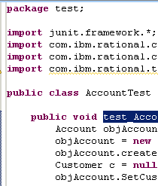






Functional View
tests
graphs
bench-properties.xml
benchmark.pdf
databases

Slide 11
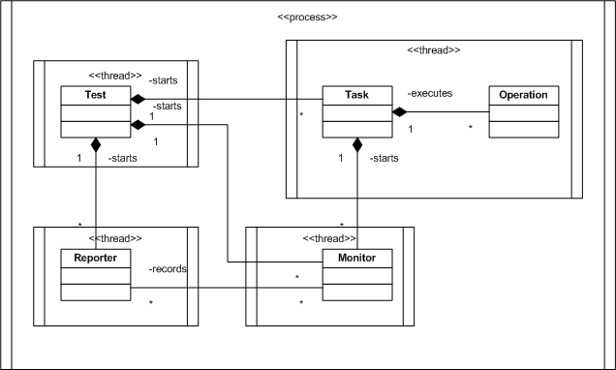
Concurrent View

Slide 12
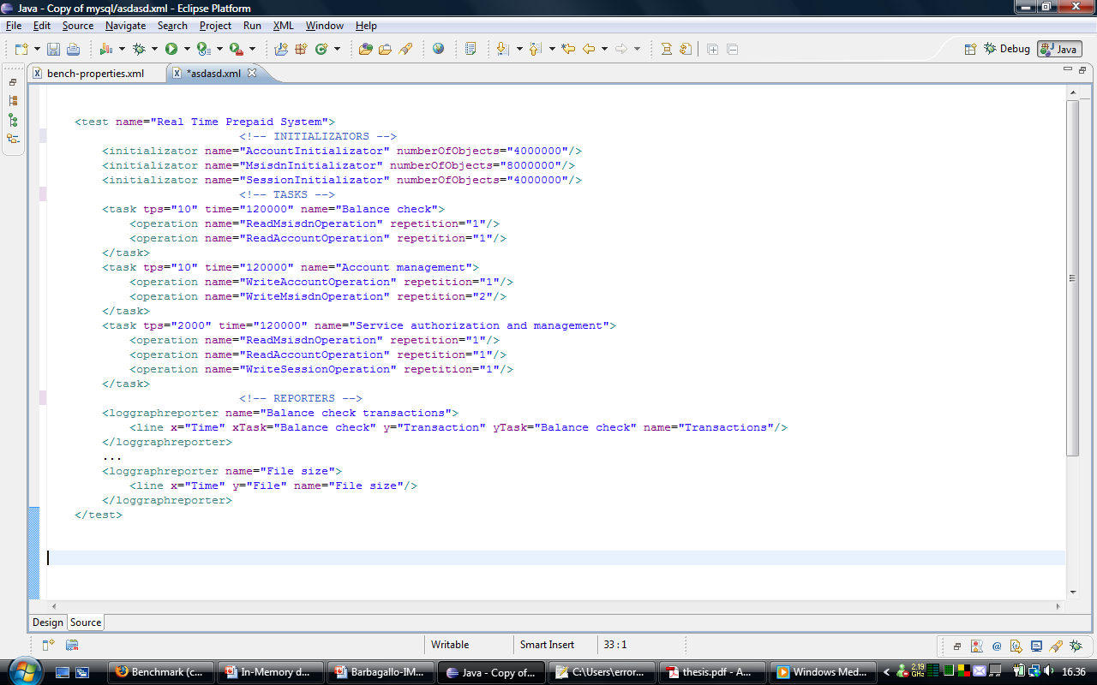
Real Time Prepaid System Configuration

Slide 13
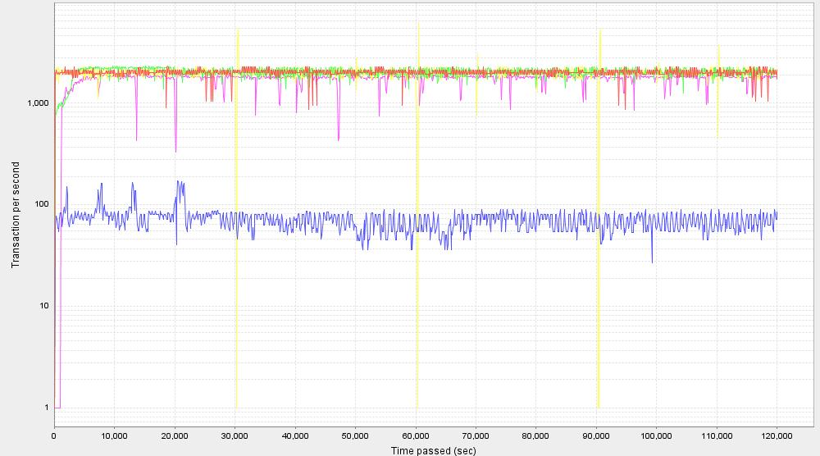
Throughput

Slide 14
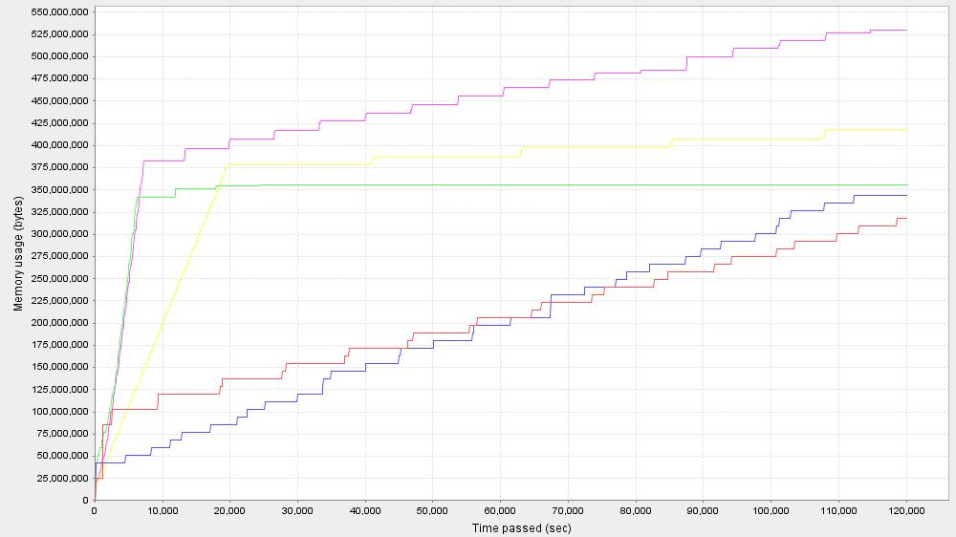
Memory Usage

Slide 15
Conclusion
Contributions:
Introduction to IMDB with an in-depth analysis
Performance analysis problem
Database benchmark framework with powerful graphs
Prevayler, H2, Db4o, HSQLDB, PICO4
For high performance an ad-hoc solution is the best
Future Development:
New tests and databases
New monitors and reporters
Modify the reporting system
Mapping technology layer
Notes:
new mapping layer:
- a further layer in the software may slow down the database's perfor-
mance;
- it's not possible to implement complex test scenarios composed by not
pre-existing operations.

Slide 16
Thanks
for your attention

