Slide 1
Decision Analysis
Chapter 16

Slide 2
Introduction
The focus of previous chapters:
Decision-making when consequences of alternative decisions are known with a reasonable degree of certainty
Testing (experimentation) can reduce level of uncertainty
Decision analysis
Addresses decision-making in the face of great uncertainty
Provides framework and methodology

Slide 3
16.1 A Prototype Example
Goferbroke Company owns land that may contain oil
Geologist reports 25% chance of oil
Another company offers to purchase land for $90k
Goferbroke option: drill for oil at cost of $100k
Potential gross profit $800k (net $700k)
Potential net loss of $100k if land is dry
Need to decide whether to drill or sell

Slide 4
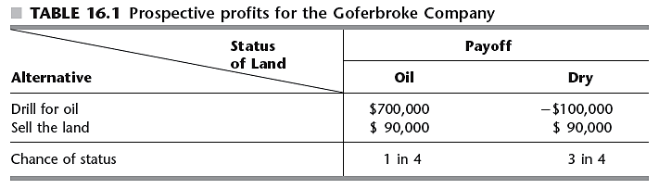
A Prototype Example

Slide 5
16.2 Decision Making Without Experimentation
Decision maker must choose an alternative
From a set of feasible alternatives
State of nature
Factors in place at the time of the decision that affect the outcome
Payoff table shows payoff for each combination of decision alternative and state of nature

Slide 6
Decision Making Without Experimentation
Analogy with game theory
Decision maker is player 1
Chooses one of the decision alternatives
Nature is player 2
Chooses one of the possible states of nature
Each combination of decision and state of nature results in a payoff
Payoff table should be used to find an optimal alternative for the decision maker
According to an appropriate criterion

Slide 7
Decision Making Without Experimentation
Differences from game theory
Nature is not rational or self-promoting
Decision maker likely has information about relative likelihood of possible states of nature
Probability distribution: prior distribution
Probabilities: prior probabilities

Slide 8
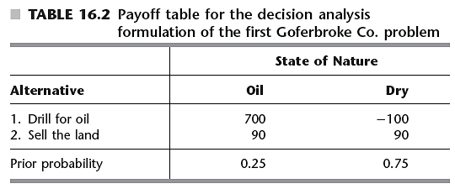
Decision Making Without Experimentation
Formulation of the prototype example
The maximin payoff criterion
Extremely conservative in nature
Assumes nature is a malevolent opponent

Slide 9
Decision Making Without Experimentation
The maximum likelihood criterion
Identify the most likely state of nature
Choose the decision alternative with the maximum payoff for this state of nature
In the example: the decision would be to sell, since the most likely state of nature is dry
Does not permit gambling on a low-probability, big payoff

Slide 10
Decision Making Without Experimentation
Bayes’ decision rule
Commonly used
Using the best available estimates of the probabilities of the states of nature, calculate the payoff value for each decision alternative
Choose the alternative with the maximum expected payoff value
Alternative selected: drill for oil

Slide 11
Decision Making Without Experimentation
Sensitivity analysis with Bayes’ decision rule
Assume prior probability of oil, p, is between 15 and 35 percent
Figure 16.1 shows plot of expected payoff versus p
Crossover point
Point at which decision shifts from one alternative to another

Slide 12
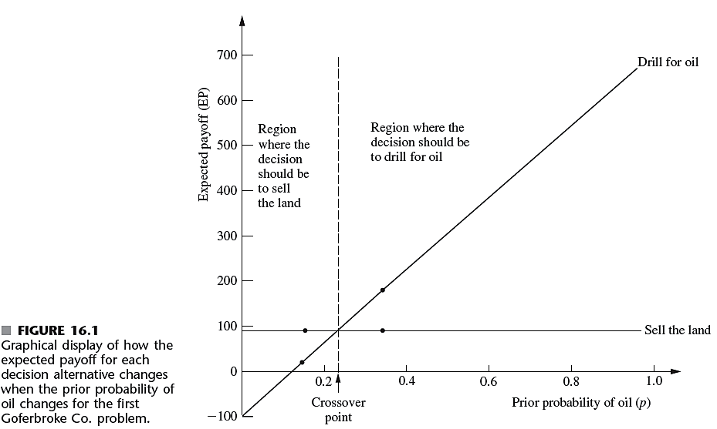

Slide 13
16.3 Decision Making With Experimentation
Additional testing (experimentation)
Frequently used to improve preliminary probability estimates
Improved estimates: posterior probabilities
Continuing with oil drilling example
Seismic survey can refine the probability
Cost of survey is $30,000

Slide 14
Decision Making With Experimentation
Possible survey findings
USS: unfavorable seismic soundings
Indicates oil is unlikely
FSS: favorable seismic soundings
Indicates oil is likely
Based on past experience with seismic soundings:

Slide 15
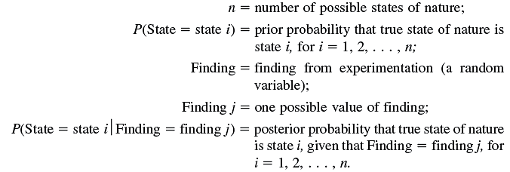
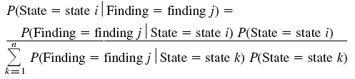
Decision Making With Experimentation
Bayes’ theorem

Slide 16
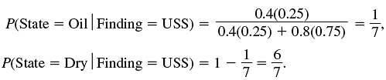
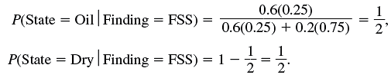
Decision Making With Experimentation
If seismic survey finding is USS:
If finding is FSS:

Slide 17
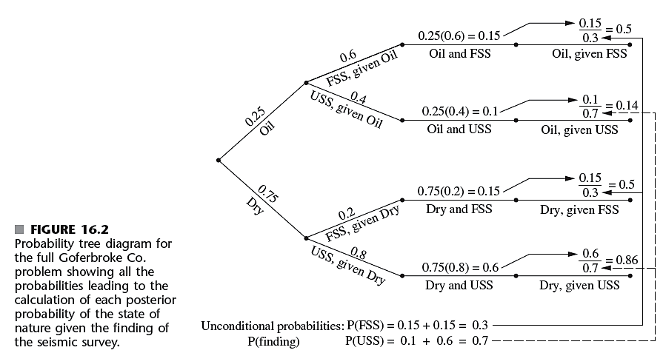
Decision Making With Experimentation

Slide 18
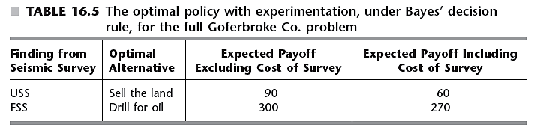
Decision Making With Experimentation
Is it worth it to undertake the cost of the survey?
Need to determine potential value of the information

Slide 19
Decision Making With Experimentation
Expected value of perfect information
Provides an upper bound on the potential value of the experiment
If upper bound is less than experiment cost:
Forgo the experiment
If upper bound is higher than experiment cost:
Calculate the actual improvement in the expected payoff
Compare this improvement with experiment cost

Slide 20
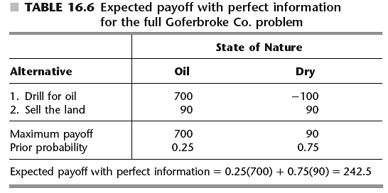
Decision Making With Experimentation

Slide 21
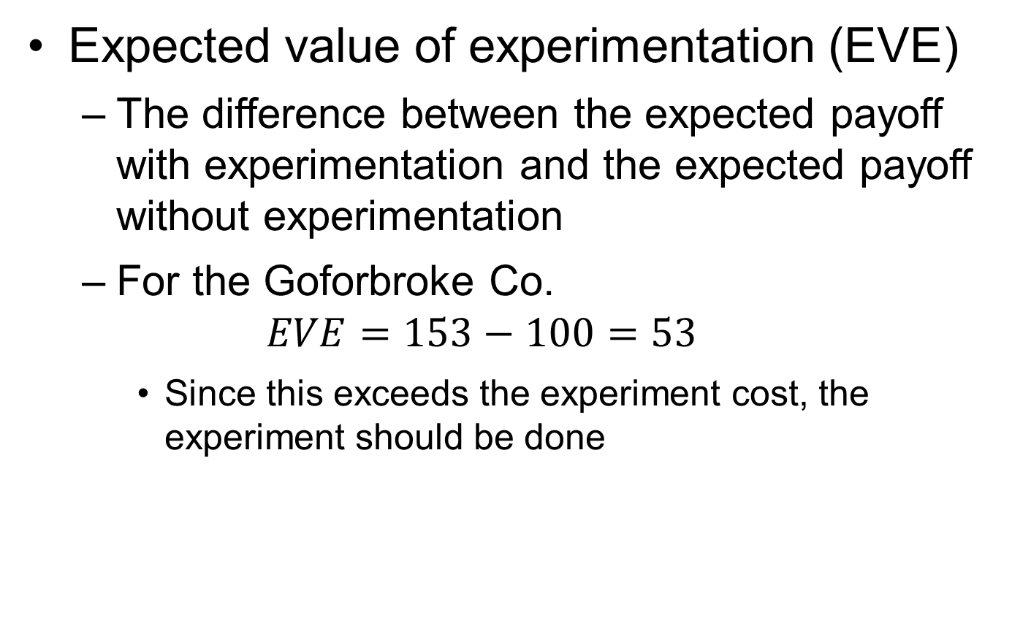
Decision Making With Experimentation
Expected value of experimentation (EVE)
The difference between the expected payoff with experimentation and the expected payoff without experimentation
For the Goforbroke Co.
$$EVE=153−100=53$$
Since this exceeds the experiment cost, the experiment should be done

Slide 22
16.4 Decision Trees
Functions:
Visually displaying a problem
Organizing computational work
Especially helpful when a sequence of decisions must be made
Constructing the decision tree
Should a seismic survey be conducted before a decision is chosen?
Which action (drill for oil or sell land) should be chosen?

Slide 23
Decision Trees
Nodes (forks)
Junction points in the tree
Branches
Lines in the decision tree
Decision node
Indicated by a square
Indicates decision needs to be made at that point

Slide 24
Decision Trees
Event node (chance node)
Indicates random event occurring at that point
Note expected payoff over its decision node
Indicate chosen alternative
Insert a double dash as a barrier through each rejected branch
Backward induction procedure
Leads to optimal policy

Slide 25
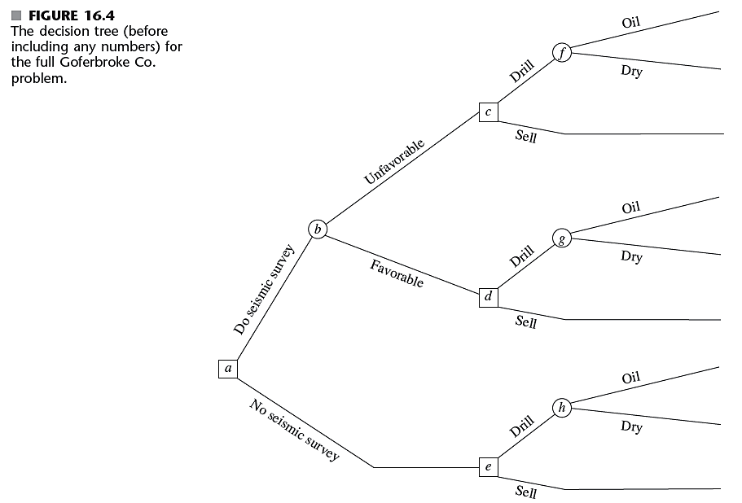

Slide 26
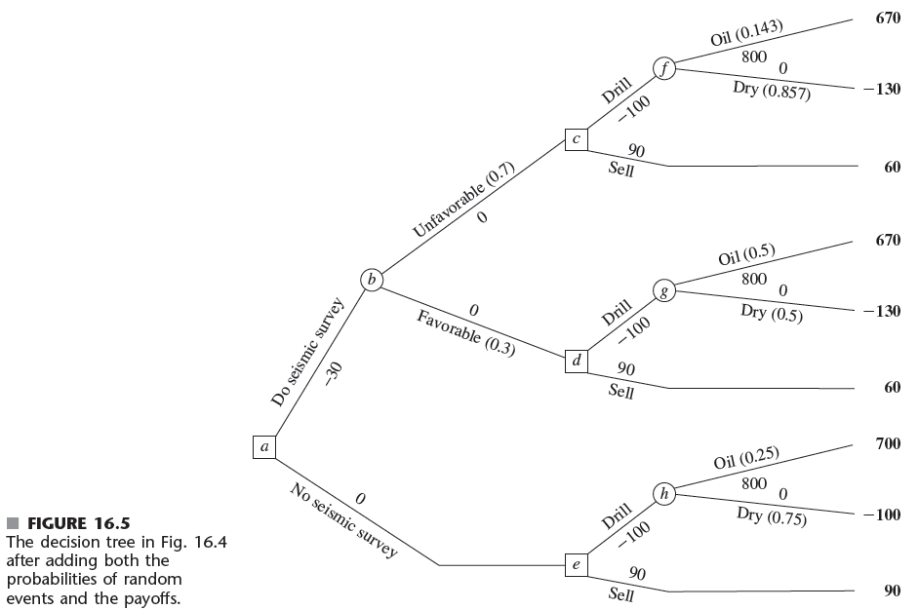

Slide 27
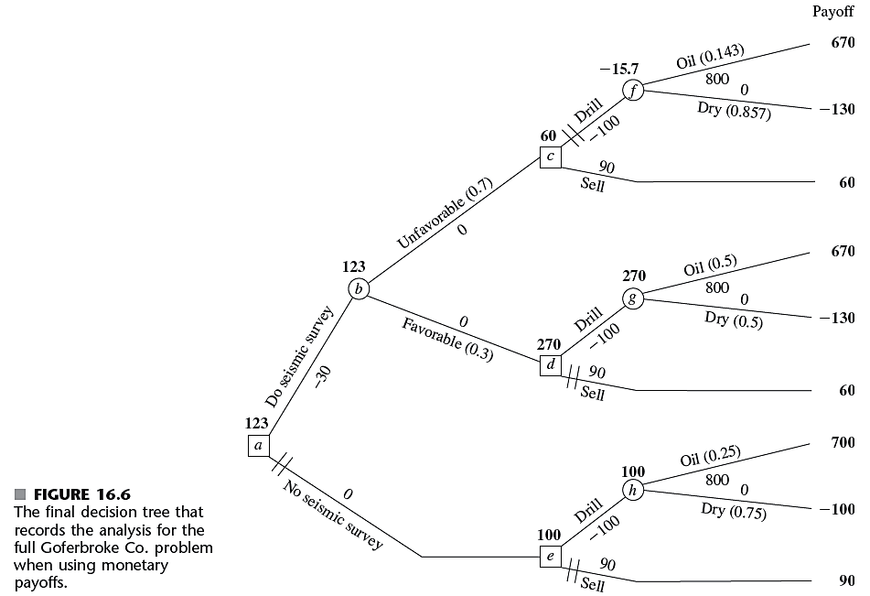

Slide 28
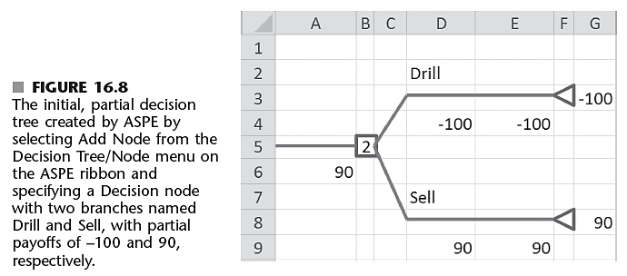
16.5 Using Spreadsheets to Perform Sensitivity Analysis
Create a decision tree using ASPE
Select Add Node from the Decision Tree/Node menu

Slide 29
Using Spreadsheets to Perform Sensitivity Analysis
Full decision tree shown in Figure 16.11
Expand the spreadsheet for performing sensitivity analysis
Consolidate the data and result on the right hand side
Advantage: need to only change data in one place
Approaches
Select new trial values
Consider a range of values

Slide 30
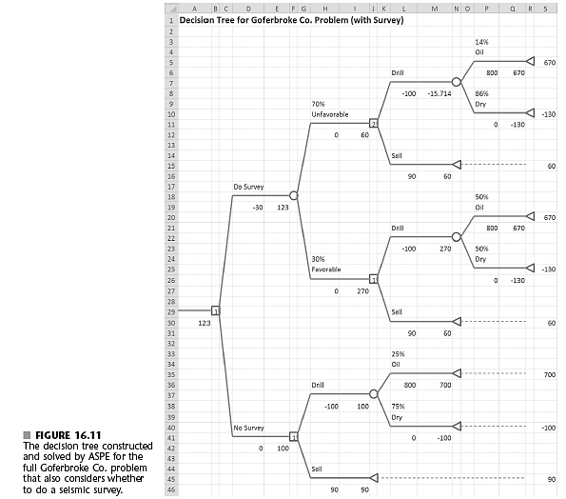

Slide 31
16.6 Utility Theory
Monetary values may not always correctly represent consequences of taking an action
Utility functions for money U(M)
People may have an increasing or decreasing marginal utility for money
Decision maker is indifferent between two courses of action if they have the same utility

Slide 32
Utility Theory
Equivalent lottery method for determining utilities
See Page 710 in the text
Applying utility theory to the full Goforbroke Co. problem
Identify the utilities for all the possible monetary payoffs
Shown in Table 16.7 on next slide

Slide 33
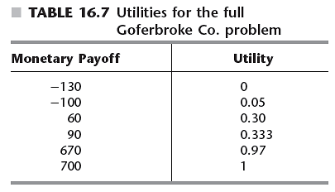

Utility Theory
Exponential utility function
Another approach for estimating U(M)
Involves an individual’s risk tolerance, R

Slide 34
16.7 The Practical Application of Decision Analysis
Real applications involve many more decisions and states of nature:
Than were considered in the prototype example
Decision trees would become large and unwieldy
Several software packages are available
Algebraic techniques being developed and incorporated into computer solvers

Slide 35
The Practical Application of Decision Analysis
Other graphical techniques
Tornado charts
Influence diagrams
Decision conferencing
Technique for group decision making
Group of people work with a facilitator
Analyst builds and solves models on the spot
Consulting firm may be used if company does not have analyst trained in OR techniques

Slide 36
16.8 Conclusions
Decision analysis is an important technique when facing decisions with considerable uncertainty
Decision analysis involves:
Enumerating potential alternatives
Identifying payoffs for all possible outcomes
Quantifying probabilities for random events
Decision trees and utility theory are tools for decision analysis

