Slide 1

Decision Analysis

Slide 2
Introduction to Decision Analysis
Decisions Under Certainty
    State of nature is certain (one state)
    Select decision that yields the highest return
Examples:
    Product Mix
    Blending / Diet
    Distribution
    Scheduling
All the topics we have studied so far!

Slide 3
Decisions Under Uncertainty (or Risk)
    State of nature is uncertain (several possible states)
Examples:
    Drilling for Oil
    Developing a New Product
    News Vendor Problem
    Producing a Movie

Slide 4
Oil Drilling Problem
Consider the problem faced by an oil company that is trying to decide whether to drill an exploratory oil well on a given site. Drilling costs $200,000. If oil is found, it is worth $800,000. If the well is dry, it is worth nothing. However, the $200,000 cost of drilling is incurred, regardless of the outcome of the drilling.
St
a
t
e
o
f
Na
tur
e
De
ci
s
i
o
n
Payoff Table

Slide 5
Which decision is best?
“Optimist”: Maximax
“Pessimist”: Maximin
“Second-Guesser”: Minimax regret
“Joe Average”: Laplace criterion

Slide 6
Expected Value Criterion
Suppose that the oil company estimates that the probability that the site is “Wet” is 40%.
Payoff Table and Probabilities:
State of Nature
Decision
W
et
Dr
y
Drill
600
-200
Do
n
o
t
d
rill
0
0
P
ri
o
r
Probability
0
.
4
0
.
6
All payoffs are in thousands of dollars
Expected value of payoff (Drill) =
Expected value of payoff (Do not drill) =

Slide 7
Features of the Expected Value Criterion
    Accounts not only for the set of outcomes, but also their probabilities.
    Represents the average monetary outcome if the situation were repeated indefinitely.
    Can handle complicated situations involving multiple and related risks.

Slide 8
Problem 1
Manufacturing company is reconsidering its capacity
Future demand is
  Low (.25), Medium (.40), High (.35)
Alternatives:
  Use overtime
  Increase workforce
  Add shift

Slide 9
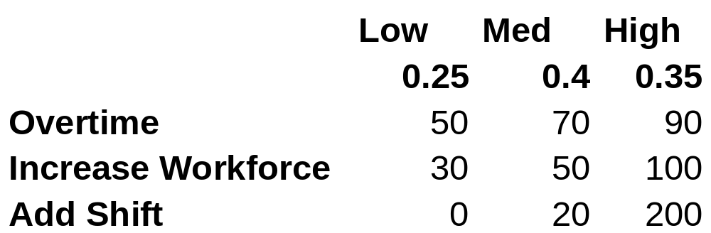
Problem 1: Data
The payoff table is:
Calculate expected values

Slide 10
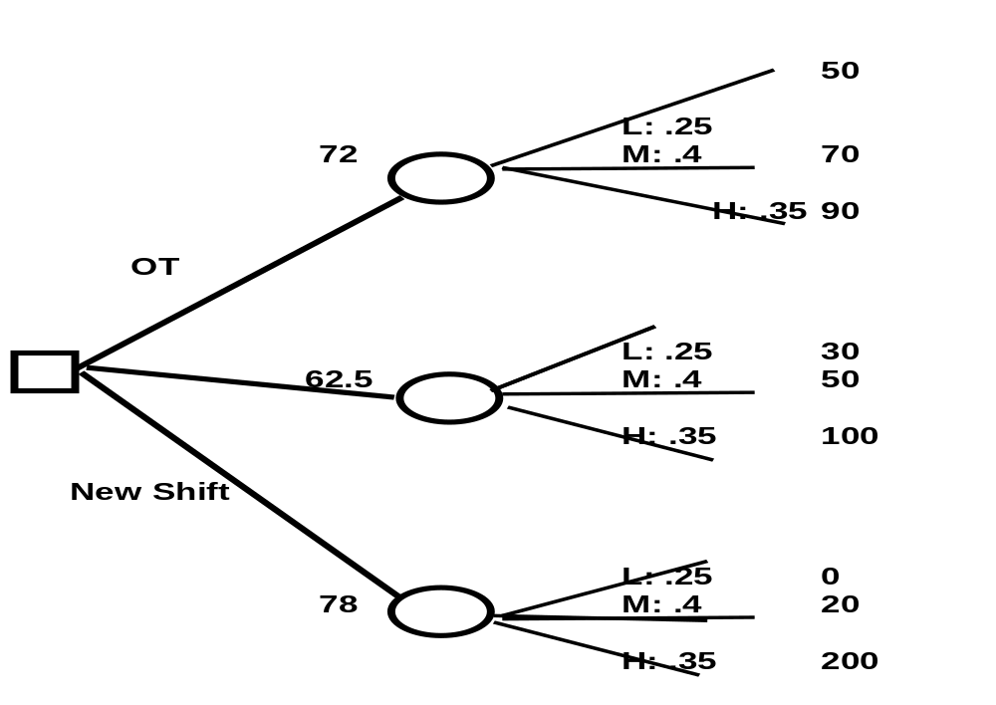
Problem 1: Decision Trees

Slide 11
Problem 2
Owner of a small firm wants to purchase a PC for billing, payroll, client records
Need small systems now -- larger maybe later
Alternatives:
  Small: No expansion capabilities @ $4000
  Small: expansion @6000
  Larger system @ $9000

Slide 12
Problem 2
After 3 years small systems can
  be traded in for a larger one @ $7500
  Expanded @ $4000
Future demand:
  Likelihood of needing larger system later is 0.80
What system should he buy?

Slide 13
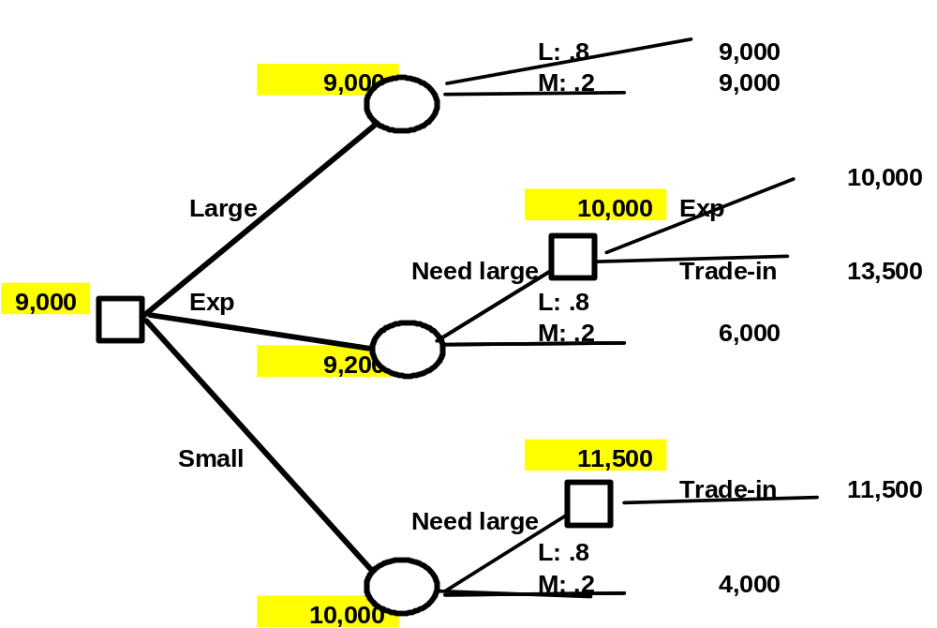
Problem 2

Slide 14
Problem 3
Six months ago Doug Reynolds paid $25,000 for an option to purchase a tract of land he was considering developing. Another investor has offered to purchase Doug's option for $275,000. If Doug does not accept the investor's offer he has decided to purchase the property, clear the land and prepare the site for building. He believes that once the site is prepared he can sell the land to a home builder. However, the success of the investment depends upon the real estate market at the time he sells the property. If the real estate market is down, Doug feels that he will lose $1.5 million. If market conditions stay at their current level, he estimates that his profit will be $1 million; if market conditions are up at the time he sells, he estimates a profit of $4 million. Because of other commitments Doug does not consider it feasible to hold the land once he has developed the site; thus, the only two alternatives are to sell the option or to develop the site. Suppose that the probabilities of the real estate market being down, at the current level, or up are 0.6, 0.3 and 0.1 respectively. Construct a decision tree and use it to recommend an action for Doug to take.

Slide 15
Problem 4
Cutler-Hammer was offered an option (at a cost of $50,000) giving it the chance to obtain a license to produce and sell a new flight safety system. The company estimated that if it purchased the option, there was a 0.30 probability that it would not obtain the license and a 0.70 probability that it would obtain the license. If it obtained the license, it estimated there was an 0.85 probability that it would not obtain a defense contract, in which case it would lose $700,000. There was a 0.15 probability it would obtain the contract, in which case it would gain $5.25 million.
  If Cutler-Hammer wants to maximize its expected return, use a decision tree to show whether or not the company should purchase the option. What is the expected payoff?
  Suppose the company after purchasing the option, can sublicense the system. Suppose there was a 95% chance of zero profit and a 5% chance of a $1,000,000 profit. Would this new alternative change your decision above?

Slide 16

Obtaining and Using Additional Information

Slide 17
Incorporating New Information
Often, a preliminary study can be done to better determine the true state of nature.
Examples:
    Market surveys
    Test-marketing
    Seismic testing (for oil)
Question:
What is the value of this information?

Slide 18
Expected Value of Perfect Information (EVPI)
Consider again the problem faced by an oil company that is trying to decide whether to drill an exploratory oil well on a given site. Drilling costs $200,000. If oil is found, it is worth $800,000. If the well is dry, it is worth nothing. The prior probability that the site is wet is estimated at 40%.
Payoff Table and Probabilities:
S
t
a
te
o
f
Nature
De
c
isi
o
n
W
et
Dr
y
Drill
600
-200
Do
n
o
t
d
rill
0
0
P
ri
o
r
P
robability
0
.
4
0
.
6
All payoffs are in thousands of dollars

Slide 19
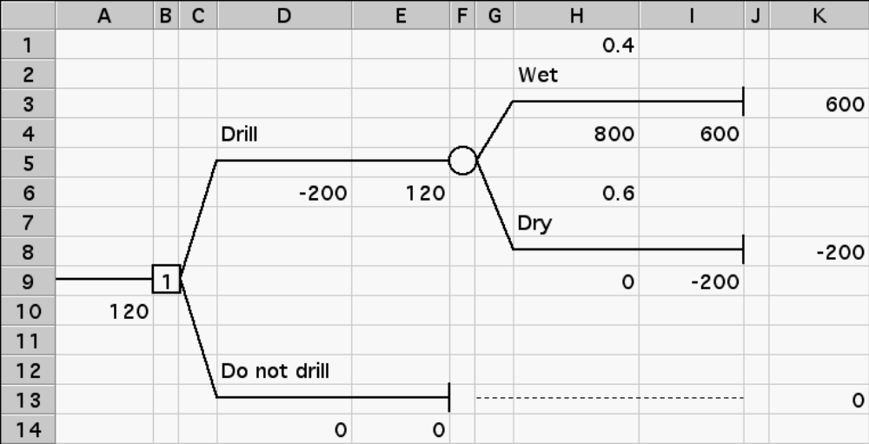
Final Decision Tree

Slide 20
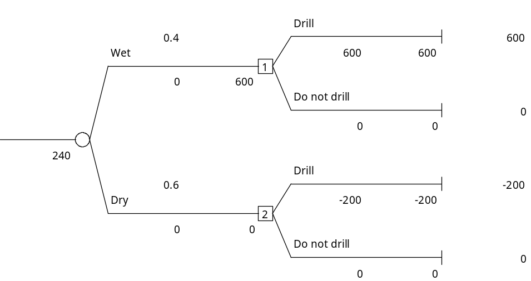
Suppose they knew ahead of time whether the site was wet or dry.
Expected Payoff = 240
Value of Perfect Information = 240 -120 = 120
That is – given the information you always would make the right decision!

Slide 21
Imperfect Information (Seismic Test)
Suppose a seismic test is available that would better indicate whether or not the site was wet or dry.
Record of 100 Past Seismic Test Sites
Ac
tu
a
l
S
ta
t
e of
Na
t
u
re
W
e
t (
W
)
D
ry
(D)
T
o
t
a
l
Seismic
G
o
o
d
(G)
3
0
2
0
5
0
Re
s
u
lt
Ba
d (
B
)
1
0
4
0
5
0
T
o
t
a
l
4
0
6
0
1
0
0

Slide 22
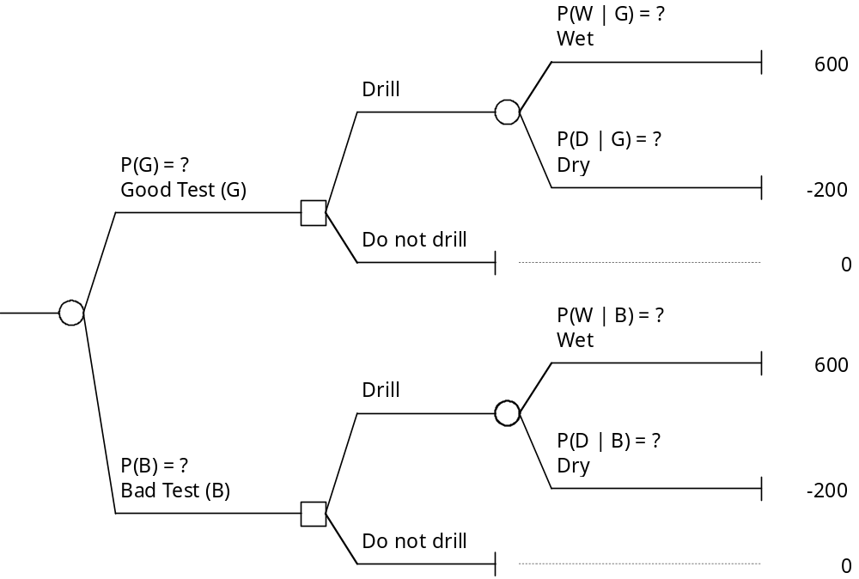
Conditional Probability:
P(W|G) = probability site is “Wet” given that it tested “Good”

Slide 23
Conditional Probabilities
Actual State of Nature
Wet (W) Dry (D) Total
Seismic Good (G) 30 20 50
Result Bad (B) 10 40 50
Total 40 60 100
Need probabilities of each test result:
P(G) = 50/100 = 0.5
P(B) =50/100 = 0.5
Need conditional probabilities of each state of nature, given a test result:
P(W | G) = 30/50 = 0.6
P(D | G) = 20/50 = 0.4
P(W | B) = 10/50 = 0.20
P(D | B) = 40/50 = 0.80

Slide 24
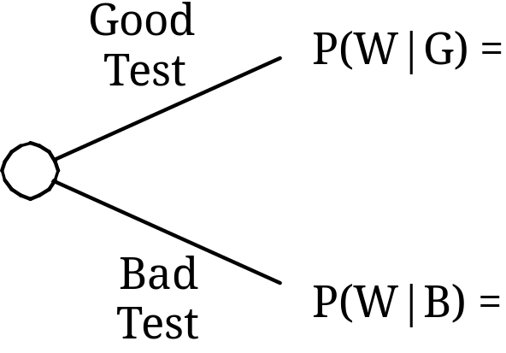
How does the test help?
Before Test After Test
P(W) = 0.4

Slide 25
Revising Probabilities
Suppose partners don’t have the “Record of Past 100 Seismic Test Sites”.
Vendor of test certifies:
    Wet sites test “good” three quarters of the time
    Dry sites test “bad” two thirds of the time.
Is this the information needed in the decision tree?
Actual State of Nature
W
et
(
W)
Dr
y
(
D
)
G
oo
d
(G)
P(
G
| W) =
0
.
75
P(
G
|
D
)
=
0
.
33
Seismic
Re
s
ult
Ba
d
(
B)
P(
B
| W) =
0
.
25
P(
B
|
D
)
= 0
.
67
P
ri
o
r
P(W
)
= 0.4
P(
D)
=
0.6

Slide 26
Joint Probabilities:
Actual State of Nature
W
et
(
W)
Dr
y
(
D
)
G
oo
d
(G)
P(
G
& W) = 0.30
P(
G
&
D
)
= 0.198
Seismic
Re
s
ult
Ba
d
(
B)
P(
B
& W) = 0.10
P(
B
&
D
)
= 0.402
P(G&W) = 0.30 i.e. P(G | W) P(W) = (0.75) * (0.40) = 0.30
P(G&D) = 0.198 i.e. P(G | D) P(D) = (0.33) * (0.60) = 0.198
P(B&W) = 0.10
P(B&D) = 0.402

Slide 27
Revising Probabilities (Step #2—Posterior Probabilities)
Joint Probabilities:
Actual State of Nature
W
et
(
W)
Dr
y
(
D
)
T
o
t
a
l
G
oo
d
(G)
P(
G
&W) =
0
.
3
P(
G
&
D
)
=
0
.
2
P(
G
)
= 0.50
S
eis
m
ic
Re
s
ult
Ba
d
(
B)
P(
B
&W) =
0
.
1
P(
B
&
D
)
= 0.4
P(W
)
=0.50
Posterior Probabilities:
Actual State of Nature
W
et
(
W)
Dr
y
(
D
)
G
oo
d
(G)
P(W
|
G
) = 0.60
P(
D
|
G
)
= 0.40
S
eis
m
ic
Re
s
ult
Ba
d
(
B)
P(W
|
B
) =0.20
P(
D
|
B
) =0.80
P(W | G) = P(W | B) =
P(D | G) = P(D | B) =

Slide 28
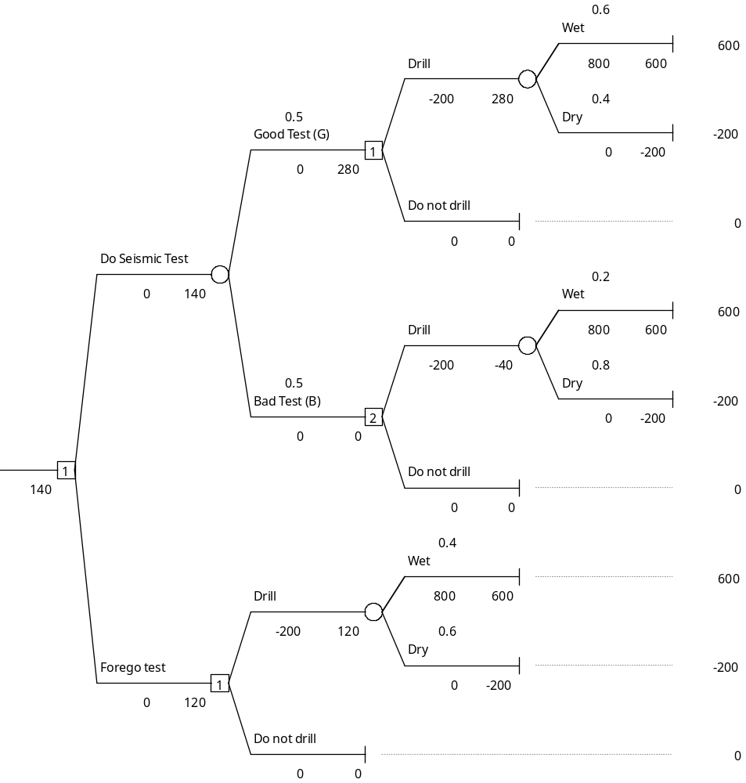
Expected Value of Sample Information (EVSI)
P(G) = 50/100 = 0.5
P(B) =50/100 = 0.5
P(W | G) = 30/50 = 0.6
P(D | G) = 20/50 = 0.4
P(W | B) = 10/50 = 0.20
P(D | B) = 40/50 = 0.80
Expected Value of Sample Information (EVSI) = 140-120 = 20

Slide 29
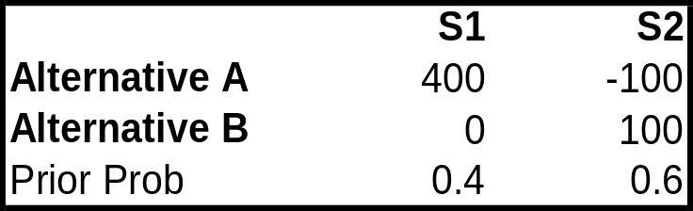
Problem 12.16
Consider the following payoff table (in $$)
You have the option of paying $100 to have research done to better predict which state of nature will occur. When S1 is the true state of nature the research will accurately predict it 60% of the time. When S2 is the true state of nature, the research will accurately predict it 80% of the time
Assume the research is not done – which decision alternative should be chosen?
Use a decision tree to find the Expected Value of Perfect Information.
Using the method discussed in class, develop predictions for:
  P(S1|PS1), P(S1|PS2), P(S1|PS2), P(S2|PS2)
Use these to find the resulting alternative and the expected profit.

Slide 30

Risk Attitude and Utility

Slide 31
Risk Attitude
Consider the following coin-toss gambles. How much would you sell each of these gambles for?
A: Heads: You win $200
Tails: You lose $0
B: Heads: You win $300
Tails: You lose $100
C: Heads: You win $200,000
Tails: You lose $0
D: Heads: You win $300,000
Tails: You lose $100,000

Slide 32
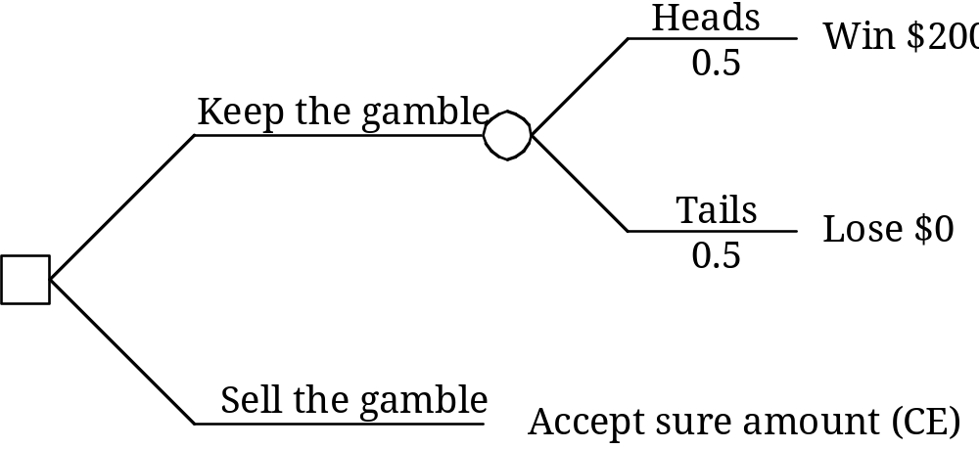
Certainty Equivalent (CE):

Slide 33
Demand for Insurance
House Value = $350,000
Insurance premium = $500
Probability of fire destroying house = 1/1000
Should you buy insurance or self-insure?

Slide 34
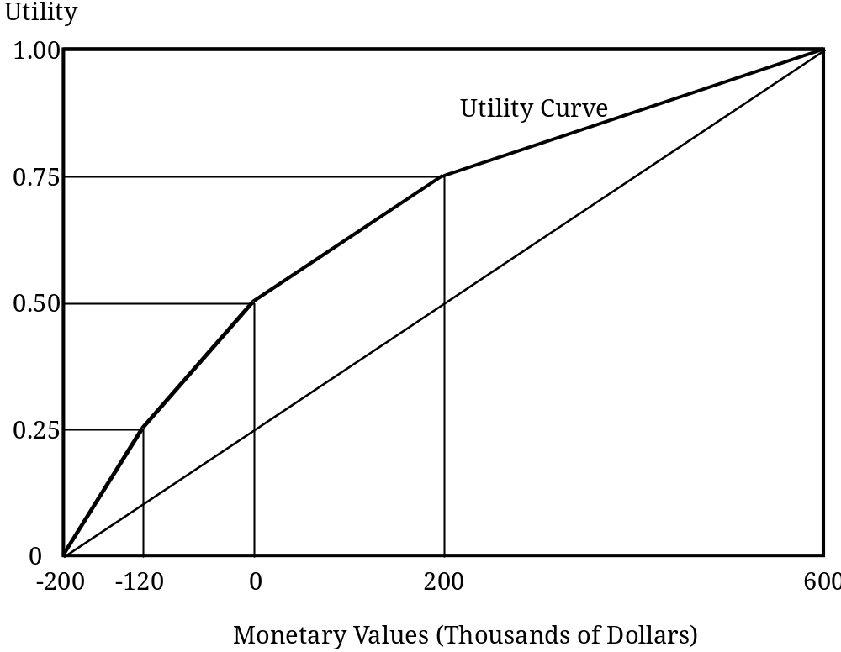
Utility and Risk Aversion
Pay
o
f
f
U
tilit
y
$600
,
000
1
.
0
$200
,
000
0
.
75
$0
0
.
5
-$120
,
000
0
.
25
–$200
,
000
0

Slide 35
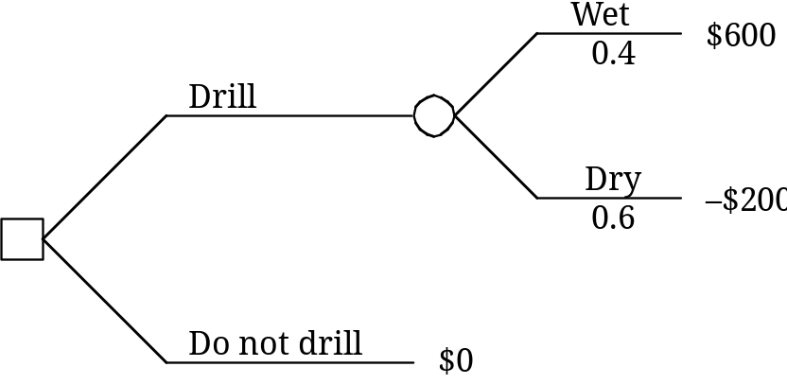
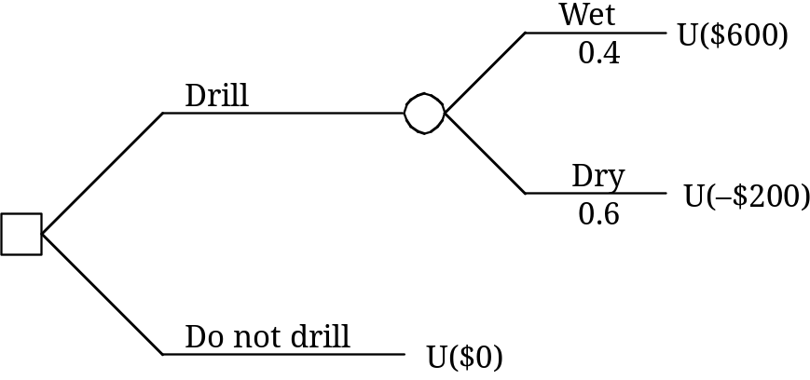
Oil Drilling Problem (Risk Aversion)
Risk Neutral:
Risk Averse:

Slide 36
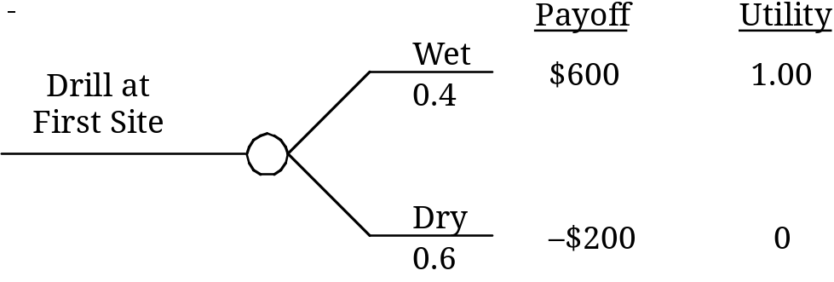
Comparison of Drilling Sites
First Site:
Expected Payoff =
Expected Utility =

Slide 37
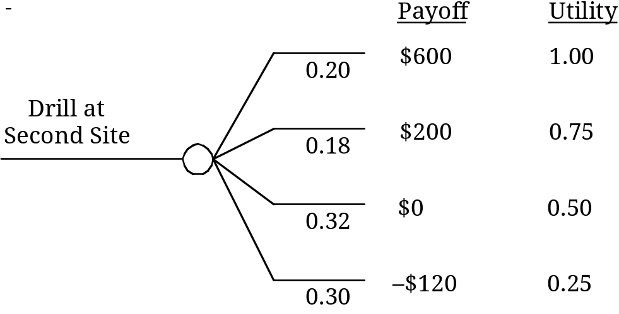
Second Site:
Expected Payoff =
Expected Utility =

Slide 38
Three Methods for Creating a Utility Function
Equivalent Lottery Method #1 (Choose p)
    1. Set U(Min) = 0.
    2. Set U(Max) = 1.
    3. To find U(x):
    Choose p such that you are indifferent between the following:
    a. A payment of x for sure.
      b. A payment of Max with probability p and a payment of Min with probability (1–p).
    Then U(x) = p.

Slide 39
Three Methods for Creating a Utility Function
Dollar Value
Utility
$
0
0
$
400
0.3
$
800
0.4
$
2,000
0.7
$
4,000
0.9
$
6,000
0.98
$
8,000
0.99
$
10,000
1

Slide 40
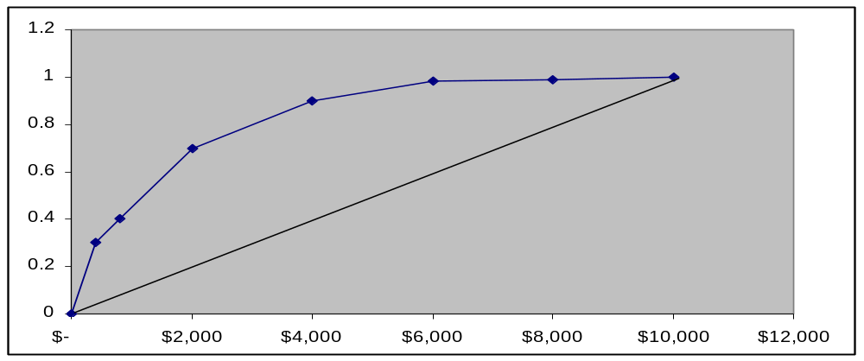
Three Methods for Creating a Utility Function
Dollar Value
Utility
$
-
0
$
400
0.3
$
800
0.4
$
2,000
0.7
$
4,000
0.9
$
6,000
0.98
$
8,000
0.99
$
10,000
1

Slide 41
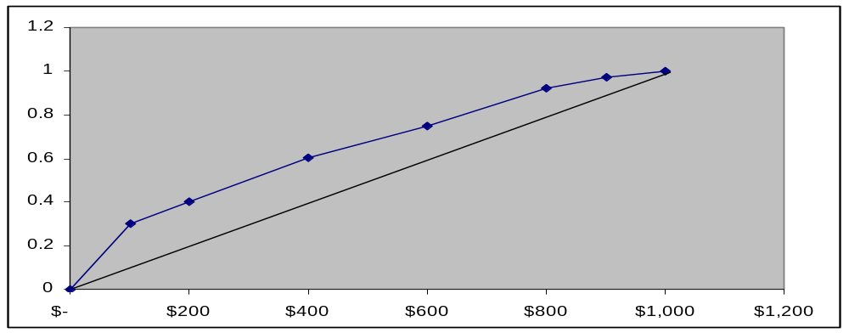
Three Methods for Creating a Utility Function
Dollar Value
Utility
$
-
0
100
0.3
$
200
0.4
$
400
0.6
$
600
0.75
$
800
0.92
$
900
0.97
$
1,000
1

Slide 42
Equivalent Lottery Method #2 (Choose CE)
    1. Set U(Min) = 0.
    2. Set U(Max) = 1.
    3. Given U(A) and U(B):
      Choose x such that you are indifferent between the following:
    a. A 50-50 gamble, where the payoffs are either A or B.
        b. A certain payoff of x.
Then U(x) = 0.5U(A) + 0.5U(B).

Slide 43

Exponential Utility Function
    1. Choose r such that you are indifferent
    between the following:
      a. A 50-50 gamble where the payoffs are either +r or –r/2.
      b. A payoff of zero.
    2. .

Slide 44
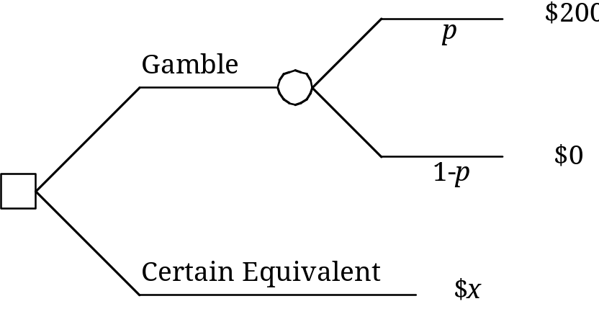
Equivalent Lottery Method #1 (Choose p)
Uncertain situation: $0 in worst case
$200 in best case
    U($100) =
    U($150) =
U($50) =

Slide 45
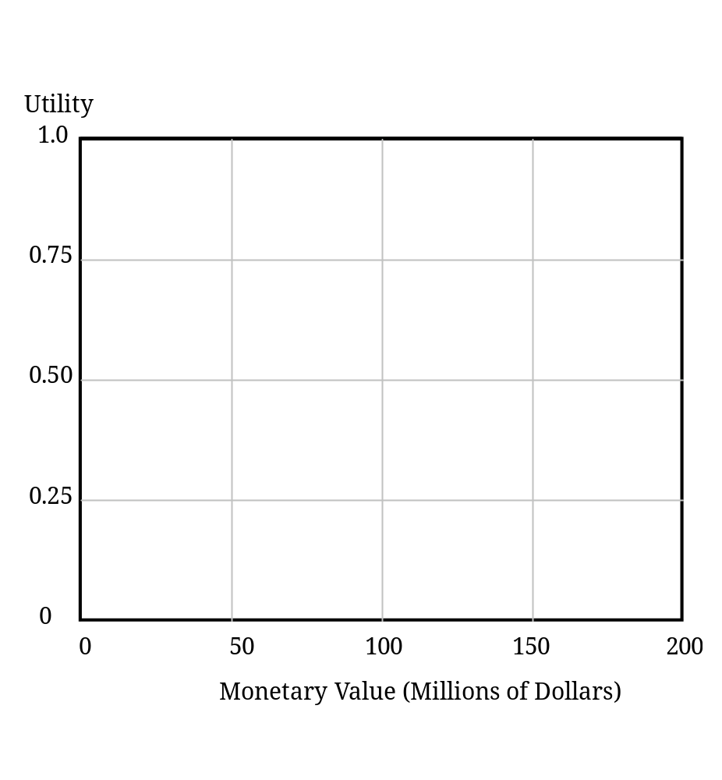
Utility Curve
Advantages: Disadvantages:

Slide 46
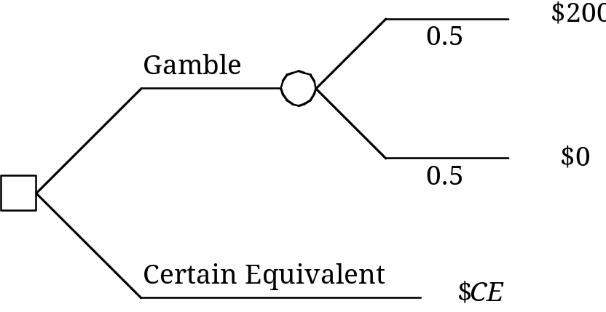
Equivalent Lottery Method #2 (Choose CE)
Uncertain situation: $0 in worst case
$200 in best case

Slide 47
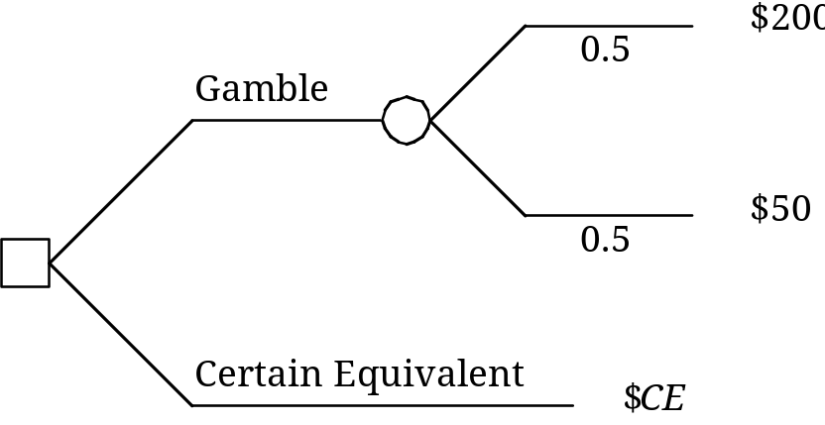

Equivalent Lottery Method #2 (Choose CE)

Slide 48
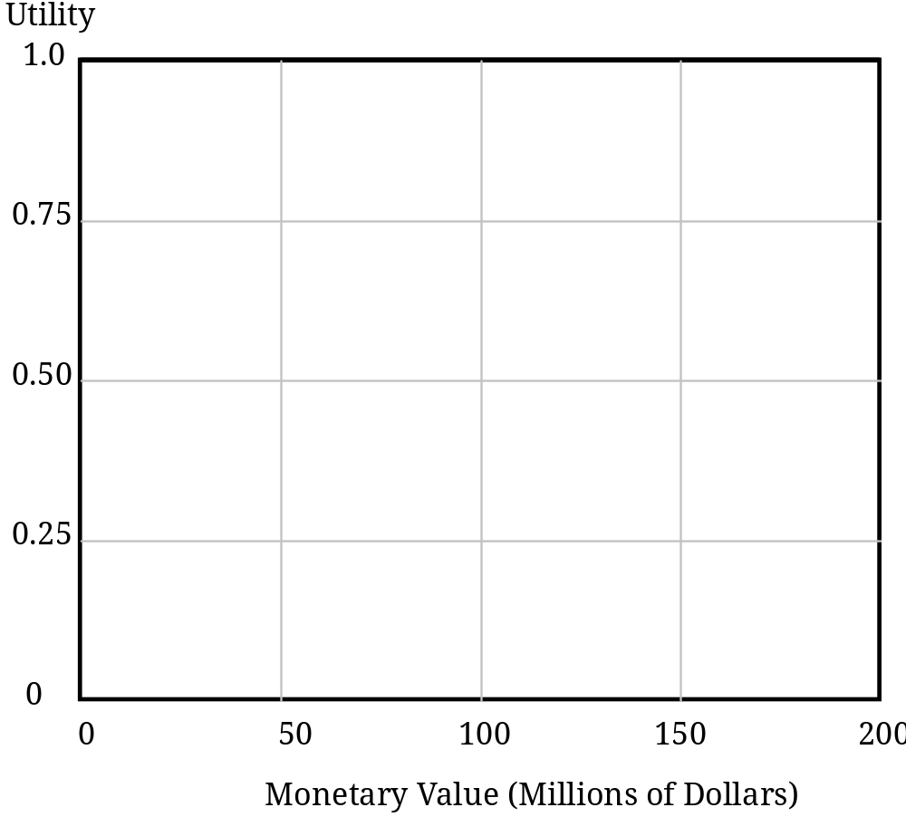
Utility Curve
Advantages: Disadvantages:

Slide 49
Developing an Anticlotting Drug
Recall the Goodhealth Pharmaceutical Company that is considering development of an anticlotting drug. Two approaches are being considered. A biochemical approach would require less R&D and would be more likely to meet with at least some success. Some, however, are pushing for a more radical, biogenetic approach. The R&D would be higher, and the probability of success lower. However, if a biogenetic approach were to succeed, the company would likely capture a much larger portion of the market, and generate much more profit. Some initial data estimates are given below.
P
rofit
R
&
D
C
hoice
Investment
Outcomes
(
excluding
R
&
D)
Probability
Biochemical
$10
m
i
l
lion
Large
success
$90
m
i
l
lion
0
.
7
Small
success
$50
m
i
l
lion
0
.
3
Biogenetic
$20
m
i
l
lion
Success
$200
m
i
l
lion
0
.
2
Fa
ilure
$0
m
i
l
lion
0
.
8

Slide 50
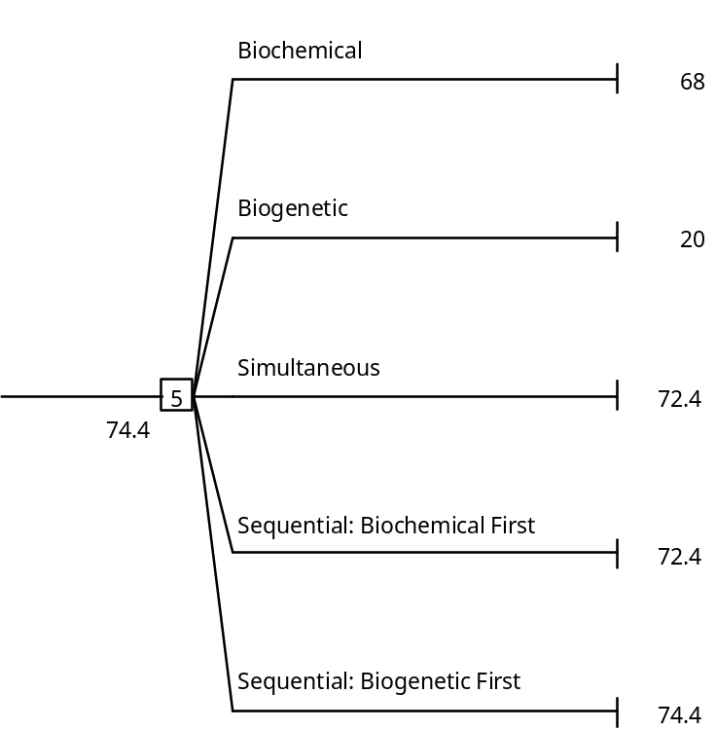

Slide 51
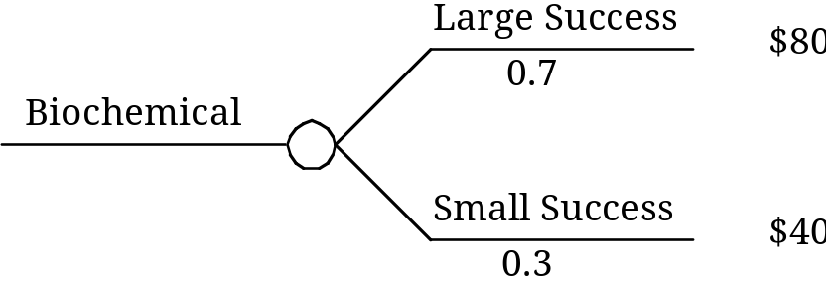
Biochemical Approach
Expected Payoff =
Expected Utility =

Slide 52
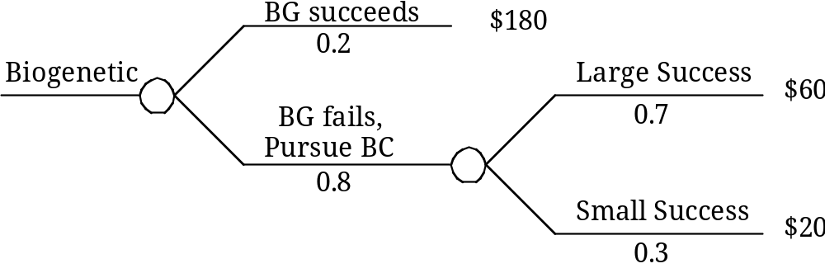
Biogenetic First, Followed by Biochemical
Expected Payoff =
Expected Utility =

Slide 53
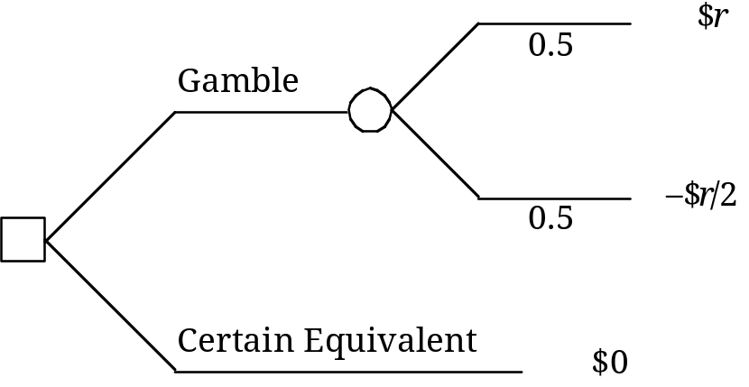

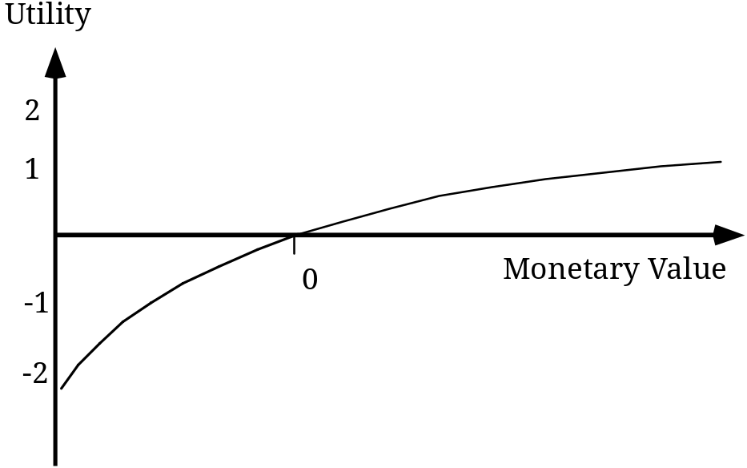
Exponential Utility Function
Choose r so that you are indifferent between the following:
Advantages: Disadvantages:

