Slide 1
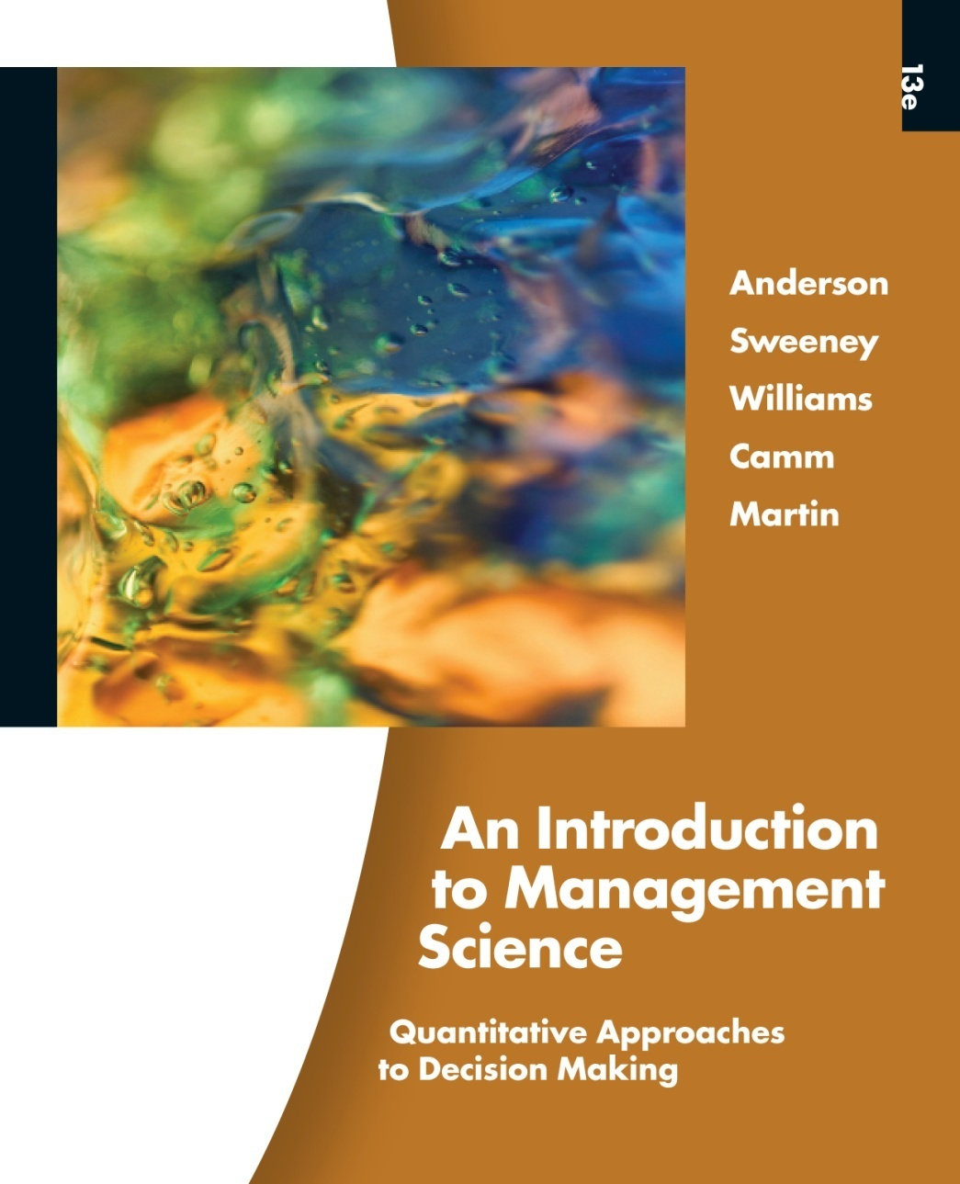
Slides by
John
Loucks
St. Edward’s
University
Modifications by
A. Asef-Vaziri

Slide 2
Chapter 3 Linear Programming: Sensitivity Analysis and Interpretation of Solution
Introduction to Sensitivity Analysis
Graphical Sensitivity Analysis
Sensitivity Analysis: Computer Solution
Limitations of Classical Sensitivity Analysis

Slide 3
Introduction to Sensitivity Analysis
In the previous chapter we discussed:
objective function value
values of the decision variables
reduced costs
slack/surplus
In this chapter we will discuss:
changes in the coefficients of the objective function
changes in the right-hand side value of a constraint

Slide 4
Introduction to Sensitivity Analysis
Sensitivity analysis (or post-optimality analysis) is used to determine how the optimal solution is affected by changes, within specified ranges, in:
the objective function coefficients
the right-hand side (RHS) values
Sensitivity analysis is important to a manager who must operate in a dynamic environment with imprecise estimates of the coefficients.
Sensitivity analysis allows a manager to ask certain what-if questions about the problem.

Slide 5
Graphical Sensitivity Analysis
For LP problems with two decision variables, graphical solution methods can be used to perform sensitivity analysis on
the objective function coefficients, and
the right-hand-side values for the constraints.

Slide 6
Example 1
LP Formulation
Max 5x₁ + 7x₂
s.t. x₁ < 6
2x₁ + 3x₂ < 19
x₁ + x₂ < 8
x₁, x₂ > 0

Slide 7
Example 1
Graphical Solution
x₂
x₁ + x₂ < 8
8
7
6
5
4
3
2
1
Max 5x₁ + 7x₂
x₁ < 6
Optimal Solution:
x₁ = 5, x₂ = 3
2x₁ + 3x₂ < 19
x₁
1 2 3 4 5 6 7 8 9 10

Slide 8
Objective Function Coefficients
Let us consider how changes in the objective function coefficients might affect the optimal solution.
The range of optimality for each coefficient provides the range of values over which the current solution will remain optimal.
Managers should focus on those objective coefficients that have a narrow range of optimality and coefficients near the endpoints of the range.

Slide 9
Example 1
Changing Slope of Objective Function
x₂
Coincides with
x₁ + x₂ < 8
constraint line
8
7
6
5
4
3
2
1
Objective function
line for 5x₁ + 7x₂
5
Coincides with
2x₁ + 3x₂ < 19
constraint line
Feasible
Region
4
3
1
2
x₁
1 2 3 4 5 6 7 8 9 10

Slide 10
Range of Optimality
Graphically, the limits of a range of optimality are found by changing the slope of the objective function line within the limits of the slopes of the binding constraint lines.
Slope of an objective function line, Max c₁x₁ + c₂x₂, is -c₁/c₂, and the slope of a constraint, a₁x₁ + a₂x₂ = b, is -a₁/a₂.

Slide 11
Example 1
Range of Optimality for c₁
The slope of the objective function line is -c₁/c₂. The slope of the first binding constraint, x₁ + x₂ = 8, is -1 and the slope of the second binding constraint, x₁ + 3x₂ = 19, is -2/3.
Find the range of values for c₁ (with c₂ staying 7) such that the objective function line slope lies between that of the two binding constraints:
-1 < -c₁/7 < -2/3
Multiplying through by -7 (and reversing the inequalities):
14/3 < c₁ < 7

Slide 12
Example 1
Range of Optimality for c₁
Would a change in c₁ from 5 to 7 (with c₂ unchanged) cause a change in the optimal solution?
The answer is ‘no’ because when c₁ = 7, the condition 14/3 < c₁ < 7 is satisfied.

Slide 13
Example 1
Range of Optimality for c₂
Find the range of values for c₂ ( with c₁ staying 5) such that the objective function line slope lies between that of the two binding constraints:
-1 < -5/c₂ < -2/3
Multiplying by -1: 1 > 5/c₂ > 2/3
Inverting, 1 < c₂/5 < 3/2
Multiplying by 5: 5 < c₂ < 15/2

Slide 14
Example 1
Range of Optimality for c₂
Would a change in c₂ from 7 to 6 (with c₁ unchanged) cause a change in the optimal solution?
The answer is ‘no’ because when c₂ = 6, the condition 5 < c₂ < 15/2 is satisfied.

Slide 15
Simultaneous Changes
The range of optimality for objective function coefficients is only applicable for changes made to one coefficient at a time.
All other coefficients are assumed to be fixed at their initial values.
If two or more coefficients are changed simultaneously, further analysis is usually necessary.
However, when solving two-variable problems graphically, the analysis is fairly easy.

Slide 16
Simultaneous Changes
Simply compute the slope of the objective function (-C_{x1}/C_{x2} ) for the new coefficient values.
If this ratio is > the lower limit on the slope of the objective function and < the upper limit, then the changes made will not cause a change in the optimal solution.

Slide 17
Example 1
Simultaneous Changes in c₁ and c₂
Would simultaneously changing c₁ from 5 to 7 and changing c₂ from 7 to 6 cause a change in the optimal solution? (Recall that these changes individually did not cause the optimal solution to change.)
Recall that the objective function line slope must lie between that of the two binding constraints:
-1 < -c₁/c₂ < -2/3
The answer is ‘yes’ the optimal solution changes because -7/6 does not satisfy the above condition.

Slide 18
Right-Hand Sides
Let us consider how a change in the right-hand side for a constraint might affect the feasible region and perhaps cause a change in the optimal solution.
The change in the value of the optimal solution per unit increase in the right-hand side is called the dual value.
The range of feasibility is the range over which the dual value is applicable.
As the RHS increases, other constraints will become binding and limit the change in the value of the objective function.

Slide 19
Dual Value
Graphically, a dual value is determined by adding +1 to the right hand side value in question and then resolving for the optimal solution in terms of the same two binding constraints.
The dual value is equal to the difference in the values of the objective functions between the new and original problems.
The dual value for a nonbinding constraint is 0.
A negative dual value indicates that the objective function will not improve if the RHS is increased.

Slide 20
Example 1
Dual Values
Constraint 1: Since x₁ < 6 is not a binding constraint, its dual price is 0.
Constraint 2: Change the RHS value of the second constraint to 20 and resolve for the optimal point determined by the last two constraints: 2x₁ + 3x₂ = 20 and x₁ + x₂ = 8.
The solution is x₁ = 4, x₂ = 4, z = 48. Hence,
the dual price = z_{new} - z_{old} = 48 - 46 = 2.

Slide 21
Example 1
Dual Values
Constraint 3: Change the RHS value of the third constraint to 9 and resolve for the optimal point determined by the last two constraints: 2x₁ + 3x₂ = 19 and x₁ + x₂ = 9.
The solution is: x₁ = 8, x₂ = 1, z = 47.
The dual price is z_{new} - z_{old} = 47 - 46 = 1.

Slide 22
Range of Feasibility
The range of feasibility for a change in the right hand side value is the range of values for this coefficient in which the original dual value remains constant.
Graphically, the range of feasibility is determined by finding the values of a right hand side coefficient such that the same two lines that determined the original optimal solution continue to determine the optimal solution for the problem.

Slide 23
Sensitivity Analysis: Computer Solution
Software packages such as Lingo and Microsoft Excel provide the following LP information:
Information about the objective function:
its optimal value
coefficient ranges (ranges of optimality)
Information about the decision variables:
their optimal values
their reduced costs
Information about the constraints:
the amount of slack or surplus
the dual prices
right-hand side ranges (ranges of feasibility)

Slide 24
Reduced Cost
The reduced cost associated with a variable is equal to the dual value for the non-negativity constraint associated with the variable.
In general, if a variable has a non-zero value in the optimal solution, then it will have a reduced cost equal to 0.

Slide 25
Relevant Cost and Sunk Cost
A resource cost is a relevant cost if the amount paid for it is dependent upon the amount of the resource used by the decision variables.
Relevant costs are reflected in the objective function coefficients.
A resource cost is a sunk cost if it must be paid regardless of the amount of the resource actually used by the decision variables.
Sunk resource costs are not reflected in the objective function coefficients.

Slide 26
Cautionary Note on the Interpretation of Dual Values
Resource cost is sunk
The dual value is the maximum amount you should be willing to pay for one additional unit of the resource.
Resource cost is relevant
The dual value is the maximum premium over the normal cost that you should be willing to pay for one unit of the resource.

Slide 27
Example 1 (Again)
LP Formulation
Max 5x₁ + 7x₂
s.t. x₁ < 6
2x₁ + 3x₂ < 19
x₁ + x₂ < 8
x₁, x₂ > 0

Slide 28
Example 1
Range of Optimality for c₁ and c₂
Adjustable Cells
Final
Reduced
Objective
Allowable
Allowable
Cell
Name
Value
Cost
Coefficient
Increase
Decrease
$B$8
X1
5.0
0.0
5
2
0.33333333
$C$8
X2
3.0
0.0
7
0.5
2
Constraints
Final
Dual
Constraint
Allowable
Allowable
Cell
Name
Value
Value
R.H. Side
Increase
Decrease
$B$13
#1
5
0
6
1E+30
1
$B$14
#2
19
2
19
5
1
$B$15
#3
8
1
8
0.33333333
1.66666667

Slide 29
Example 1
Dual Values
Adjustable Cells
Final
Reduced
Objective
Allowable
Allowable
Cell
Name
Value
Cost
Coefficient
Increase
Decrease
$B$8
X1
5.0
0.0
5
2
0.33333333
$C$8
X2
3.0
0.0
7
0.5
2
Constraints
Final
Dual
Constraint
Allowable
Allowable
Cell
Name
Value
Value
R.H. Side
Increase
Decrease
$B$13
#1
5
0
6
1E+30
1
$B$14
#2
19
2
19
5
1
$B$15
#3
8
1
8
0.33333333
1.66666667

Slide 30
Example 1
Range of Feasibility
Adjustable Cells
Final
Reduced
Objective
Allowable
Allowable
Cell
Name
Value
Cost
Coefficient
Increase
Decrease
$B$8
X1
5.0
0.0
5
2
0.33333333
$C$8
X2
3.0
0.0
7
0.5
2
Constraints
Final
Dual
Constraint
Allowable
Allowable
Cell
Name
Value
Value
R.H. Side
Increase
Decrease
$B$13
#1
5
0
6
1E+30
1
$B$14
#2
19
2
19
5
1
$B$15
#3
8
1
8
0.33333333
1.66666667

Slide 31
Example 2: Olympic Bike Co.
Olympic Bike is introducing two new lightweight
bicycle frames, the Deluxe and the Professional, to be
made from special aluminum and steel alloys. The
anticipated unit profits are $10 for the Deluxe and $15
for the Professional.
The number of pounds of each alloy needed per
frame is summarized on the next slide.

Slide 32
Example 2: Olympic Bike Co.
A supplier delivers 100 pounds of the aluminum alloy and 80 pounds of the steel alloy weekly.
Aluminum Alloy Steel Alloy
Deluxe 2 3
Professional 4 2
How many Deluxe and Professional frames should
Olympic produce each week?

Slide 33
Example 2: Olympic Bike Co.
Model Formulation
Verbal Statement of the Objective Function
Maximize total weekly profit.
Verbal Statement of the Constraints
Total weekly usage of aluminum alloy < 100 pounds.
Total weekly usage of steel alloy < 80 pounds.
Definition of the Decision Variables
x₁ = number of Deluxe frames produced weekly.
x₂ = number of Professional frames produced weekly.

Slide 34
Example 2: Olympic Bike Co.
Model Formulation (continued)
Max 10x₁ + 15x₂ (Total Weekly Profit)
s.t. 2x₁ + 4x₂ < 100 (Aluminum Available)
3x₁ + 2x₂ < 80 (Steel Available)
x₁, x₂ > 0

Slide 35
Example 2: Olympic Bike Co.
Partial Spreadsheet Showing Solution

Slide 36
Example 2: Olympic Bike Co.
Optimal Solution
According to the output:
x₁ (Deluxe frames) = 15
x₂ (Professional frames) = 17.5
Objective function value = $412.50

Slide 37
Example 2: Olympic Bike Co.
Range of Optimality
Question:
Suppose the profit on deluxe frames is increased to $20. Is the above solution still optimal? What is the value of the objective function when this unit profit is increased to $20?

Slide 38
Example 2: Olympic Bike Co.
Sensitivity Report

Slide 39
Example 2: Olympic Bike Co.
Range of Optimality
Answer:
The output states that the solution remains optimal as long as the objective function coefficient of x₁ is between 7.5 and 22.5. Because 20 is within this range, the optimal solution will not change. The optimal profit will change: 20x₁ + 15x₂ = 20(15) + 15(17.5) = $562.50.

Slide 40
Example 2: Olympic Bike Co.
Range of Optimality
Question:
If the unit profit on deluxe frames were $6 instead of $10, would the optimal solution change?

Slide 41
Example 2: Olympic Bike Co.
Range of Optimality
Adjustable Cells
Final
Reduced
Objective
Allowable
Allowable
Cell
Name
Value
Cost
Coefficient
Increase
Decrease
$B$8
Deluxe
15
0
10
12.5
2.5
$C$8
Profess.
17.500
0.000
15
5
8.333333333
Constraints
Final
Dual
Constraint
Allowable
Allowable
Cell
Name
Value
Value
R.H. Side
Increase
Decrease
$B$13
Aluminum
100
3.125
100
60
46.66666667
$B$14
Steel
80
1.25
80
70
30

Slide 42
Example 2: Olympic Bike Co.
Range of Optimality
Answer:
The output states that the solution remains optimal as long as the objective function coefficient of x₁ is between 7.5 and 22.5. Because 6 is outside this range, the optimal solution would change.

Slide 43
Example 2: Olympic Bike Co.
Range of Feasibility and Sunk Costs
Question:
Given that aluminum is a sunk cost, what is the maximum amount the company should pay for 50 extra pounds of aluminum?

Slide 44
Example 2: Olympic Bike Co.
Range of Feasibility and Sunk Costs
Adjustable Cells
Final
Reduced
Objective
Allowable
Allowable
Cell
Name
Value
Cost
Coefficient
Increase
Decrease
$B$8
Deluxe
15
0
10
12.5
2.5
$C$8
Profess.
17.500
0.000
15
5
8.333333333
Constraints
Final
Dual
Constraint
Allowable
Allowable
Cell
Name
Value
Value
R.H. Side
Increase
Decrease
$B$13
Aluminum
100
3.125
100
60
46.66666667
$B$14
Steel
80
1.25
80
70
30

Slide 45
Example 2: Olympic Bike Co.
Range of Feasibility and Sunk Costs
Answer:
Because the cost for aluminum is a sunk cost, the shadow price provides the value of extra aluminum. The shadow price for aluminum is the same as its dual value (for a maximization problem). The shadow price for aluminum is $3.125 per pound and the maximum allowable increase is 60 pounds. Because 50 is in this range, the $3.125 is valid. Thus, the value of 50 additional pounds is = 50($3.125) = $156.25.

Slide 46
Example 2: Olympic Bike Co.
Range of Feasibility and Relevant Costs
Question:
If aluminum were a relevant cost, what is the maximum amount the company should pay for 50 extra pounds of aluminum?

Slide 47
Example 2: Olympic Bike Co.
Range of Feasibility and Relevant Costs
Answer:
If aluminum were a relevant cost, the shadow price would be the amount above the normal price of aluminum the company would be willing to pay. Thus if initially aluminum cost $4 per pound, then additional units in the range of feasibility would be worth $4 + $3.125 = $7.125 per pound.

Slide 48
Limitations of Classical Sensitivity Analysis
Classical sensitivity analysis provided by most computer packages does have its limitations.
It is rarely the case that one solves a model once and makes recommendations.
More often, a series of models is solved using a variety of input data sets before a final plan is adopted.

Slide 49
Limitations of Classical Sensitivity Analysis
Simultaneous Changes
The range analysis for objective function coefficients and the constraint right-hand sides is only applicable for changes in a single coefficient.
We should resolve the model with the new coefficient values.

Slide 50
Limitations of Classical Sensitivity Analysis
Changes in Constraint Coefficients
Classical sensitivity analysis provides no information about changes resulting from a change in a coefficient of a variable in a constraint.
We must simply change the coefficient and rerun the model.

Slide 51
Limitations of Classical Sensitivity Analysis
Non-intuitive Dual Values
Constraints with variables naturally on both the left-hand and right-hand sides often lead to dual values that have a non-intuitive explanation.
This is often the case with constraints that involve percentages.
The model should be resolved with the new percentages.

Slide 52
Example 3
Consider the following linear program:
Min 6x₁ + 9x₂ ($ cost)
s.t. x₁ + 2x₂ < 8
10x₁ + 7.5x₂ > 30
x₂ > 2
x₁, x₂ > 0

Slide 53
Example 3
Computer Output
OBJECTIVE FUNCTION VALUE = 27.000
Variable Value Reduced Cost
x₁ 1.500 0.000
x₂ 2.000 0.000
Constraint Slack/Surplus Dual Value
1 2.500 0.000
2 0.000 -0.600
3 0.000 -4.500

Slide 54
Example 3
Computer Output (continued)
OBJECTIVE COEFFICIENT RANGES
Variable Lower Limit Current Value Upper Limit
x₁ 0.000 6.000 12.000
x₂ 4.500 9.000 No Limit
RIGHTHAND SIDE RANGES
Constraint Lower Limit Current Value Upper Limit
1 5.500 8.000 No Limit
2 15.000 30.000 55.000
3 0.000 2.000 4.000

Slide 55
Example 3
Optimal Solution
According to the output:
x₁ = 1.5
x₂ = 2.0
Objective function value = 27.00

Slide 56
Example 3
Range of Optimality
Question:
Suppose the unit cost of x₁ is decreased to $4. Is the current solution still optimal? What is the value of the objective function when this unit cost is decreased to $4?

Slide 57
Example 3
Computer Output
OBJECTIVE COEFFICIENT RANGES
Variable Lower Limit Current Value Upper Limit
x₁ 0.000 6.000 12.000
x₂ 4.500 9.000 No Limit
RIGHTHAND SIDE RANGES
Constraint Lower Limit Current Value Upper Limit
1 5.500 8.000 No Limit
2 15.000 30.000 55.000
3 0.000 2.000 4.000

Slide 58
Example 3
Range of Optimality
Answer:
The output states that the solution remains optimal as long as the objective function coefficient of x₁ is between 0 and 12. Because 4 is within this range, the optimal solution will not change. However, the optimal total cost will be affected: 6x₁ + 9x₂ = 4(1.5) + 9(2.0) = $24.00.

Slide 59
Example 3
Range of Optimality
Question:
How much can the unit cost of x₂ be decreased without concern for the optimal solution changing?

Slide 60
Example 3
Computer Output
OBJECTIVE COEFFICIENT RANGES
Variable Lower Limit Current Value Upper Limit
x₁ 0.000 6.000 12.000
x₂ 4.500 9.000 No Limit
RIGHTHAND SIDE RANGES
Constraint Lower Limit Current Value Upper Limit
1 5.500 8.000 No Limit
2 15.000 30.000 55.000
3 0.000 2.000 4.000

Slide 61
Example 3
Range of Optimality
Answer:
The output states that the solution remains optimal as long as the objective function coefficient of x₂ does not fall below 4.5.

Slide 62
Example 3
Range of Feasibility
Question:
If the right-hand side of constraint 3 is increased by 1, what will be the effect on the optimal solution?

Slide 63
Example 3
Computer Output
OBJECTIVE COEFFICIENT RANGES
Variable Lower Limit Current Value Upper Limit
x₁ 0.000 6.000 12.000
x₂ 4.500 9.000 No Limit
RIGHTHAND SIDE RANGES
Constraint Lower Limit Current Value Upper Limit
1 5.500 8.000 No Limit
2 15.000 30.000 55.000
3 0.000 2.000 4.000

Slide 64
Example 3
Range of Feasibility
Answer:
A dual value represents the improvement in the objective function value per unit increase in the right-hand side. A negative dual value indicates a deterioration (negative improvement) in the objective, which in this problem means an increase in total cost because we're minimizing. Since the right-hand side remains within the range of feasibility, there is no change in the optimal solution. However, the objective function value increases by $4.50.

Slide 65
End of Chapter 3

