Slide 1

ROBOCON NEW JERSEY 2026
3D PRINTER PLAYGROUND
Presented by FUBAR Labs
Bridgewater Commons
September 26–27, 2026
Notes:
Welcome to the 3D Printer Playground, presented by FUBAR Labs at RoboCon New Jersey 2026.

Slide 2
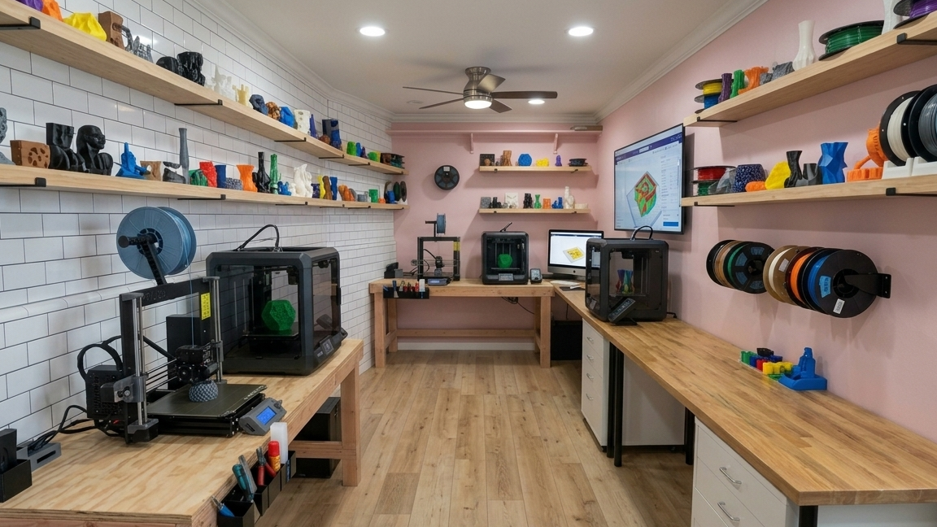
THE PRINTER PLAYGROUND
The ultimate 3D printing pop-up, featuring a step-by-step interactive journey from getting started at home to pro-level creations.
WHERE
Lower Level, next to Time After Time
Notes:
The Playground is on the lower level of Bridgewater Commons, next to Time After Time.

Slide 3
EST. 2009 · NEW BRUNSWICK
NEW JERSEY'S FIRST MAKERSPACE
ABOUT FUBAR LABS
Fair Use Building and Research Labs brings makers, hackers, and tinkerers together to collaborate and share ideas and knowledge.
501(c)(3) non-profit, run by volunteers
1510B Jersey Ave, North Brunswick, NJ
Notes:
FUBAR stands for Fair Use Building and Research. Community-run, volunteer-led, no corporate or institutional affiliation.

Slide 4
INSIDE THE SPACE
3D PRINTERS
LASER CUTTER
METAL SHOP
WOOD SHOP
ELECTRONICS & SOLDERING
LATHES, MILLS & WELDING
Notes:
Members get 24/7 access to all of this equipment, plus a general-purpose area for classes, events, and collaborative projects.

Slide 5
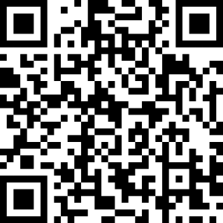
HOSTED AT FUBAR LABS
NEXT MEETUP · MON, OCT 19
NEW JERSEY 3D PRINTERS CLUB
If you have one printer, a few, or are thinking about buying one, this is the place for you.
WHEN
3rd Monday of the month, 7:30–9:30 PM
WHAT
Monthly speakers, contests, printers, filament, print farms
WHERE
1510 Jersey Ave, North Brunswick, NJ
RSVP ON MEETUP
Notes:
Hosted by Leonard C. at FUBAR Labs. Monthly speakers, contests, and discussion topics: new printers, filament, print farms. Facebook group: New Jersey 3d Printers club.

Slide 6
OPEN HACK & EVENTS
Open Hack is when the lab is open to the public, no membership required. Bring a project, learn the machines, and see what we're building.
THURSDAYS
SUNDAYS
7:30–9:30 PM
1:30–3:30 PM
REGULAR MEETUPS
Microcontroller Mondays
AI Study Group
Combat Robotics
Synth / Electronic Music
Notes:
Past classes include Raspberry Pi, soldering, welding, CAD, Arduino, ham radio, and machine learning.

Slide 7
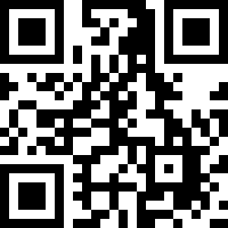
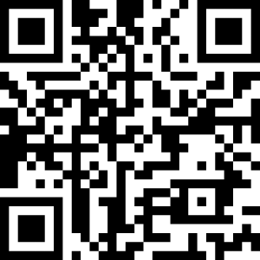
CONNECT WITH FUBAR LABS
WEBSITE
DISCORD
1510B Jersey Avenue, North Brunswick, NJ 08902
info@fubarlabs.org · (908) 223-8227
new.fubarlabs.org
discord.gg/dVs42Xz9Ns
Notes:
Scan to visit the website or join the Discord server.

