Slide 1
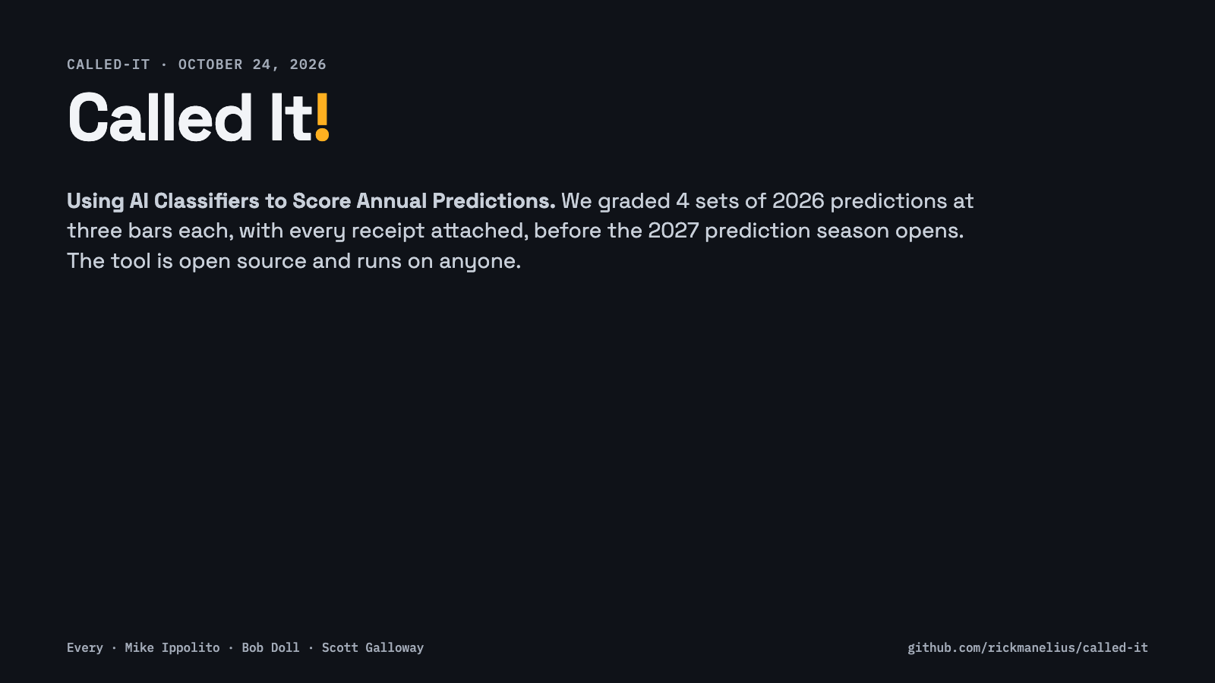
Notes:
Title. Three or four public prediction lists for 2026, graded at three bars by a calibrated classifier over committed evidence. Everything in this deck traces to a run folder anyone can replay.

Slide 2
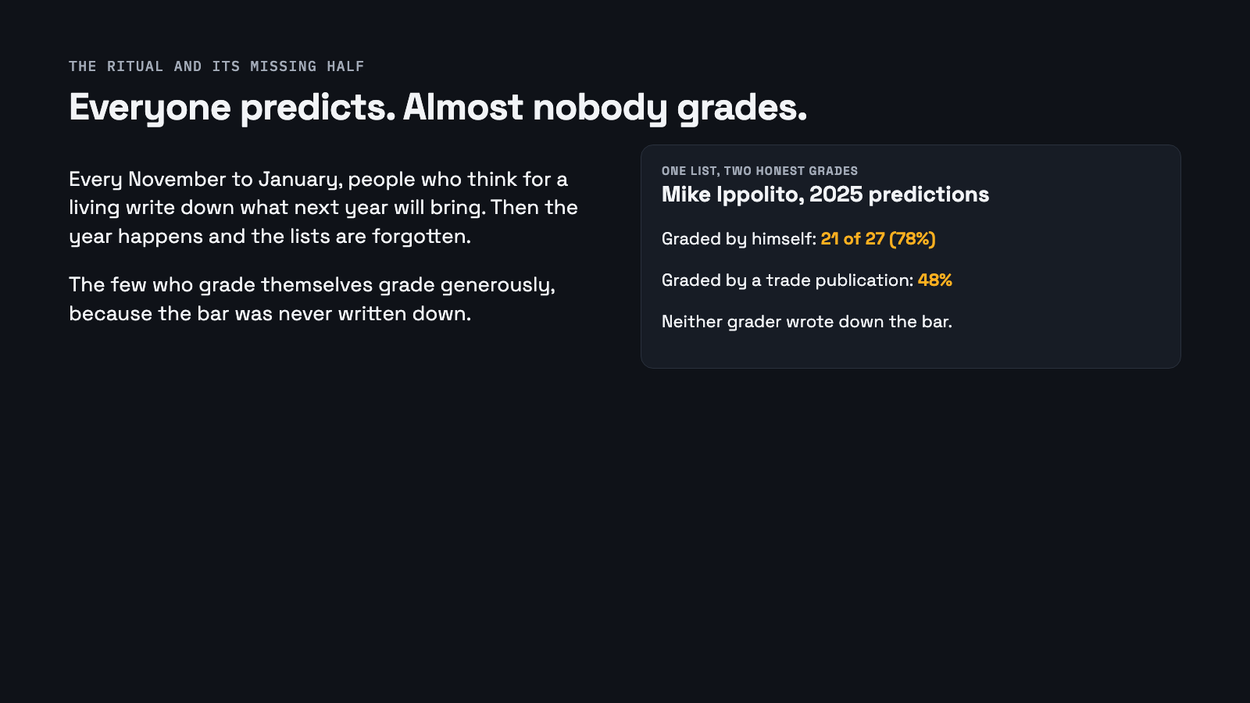
Notes:
The problem is not dishonesty. It is that grading your own work at an unwritten bar produces a generous number every time. Ippolito's 78 versus 48 for the same list is the gap this project measures.

Slide 3
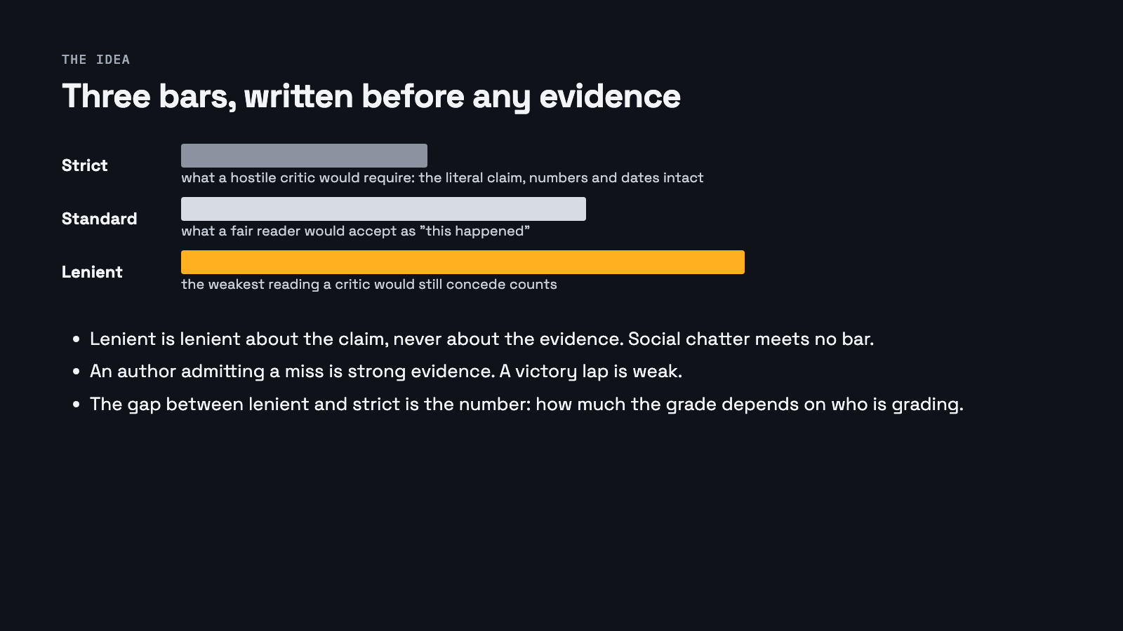
Notes:
Every argument about whether a prediction came true is an argument about the bar. Writing three bars before looking at evidence turns that argument into a measurement. The critic floor keeps lenient from meaning gullible.

Slide 4
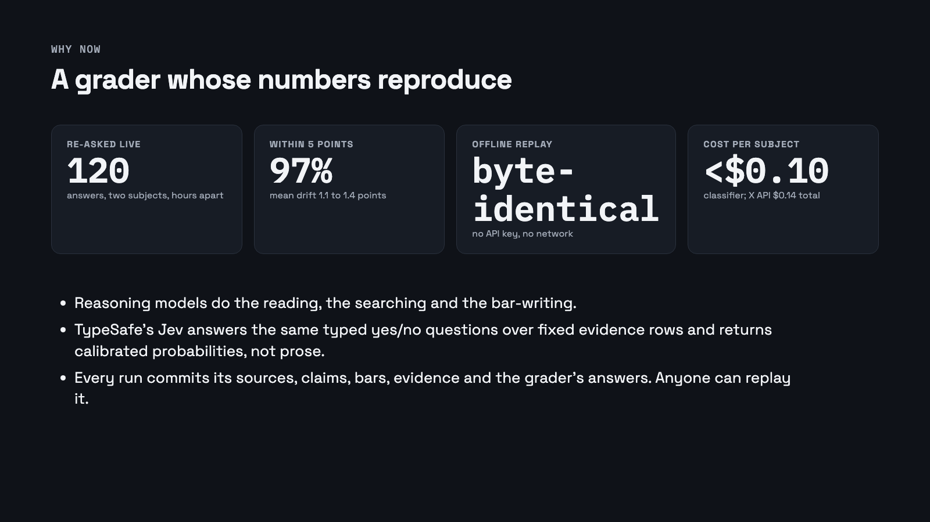
Notes:
Judgement goes to the reasoning model; the repeated yes/no goes to a decision classifier. Drift concentrates where sources disagree, which is where you would want it. The run folder is the unit of publication.

Slide 5
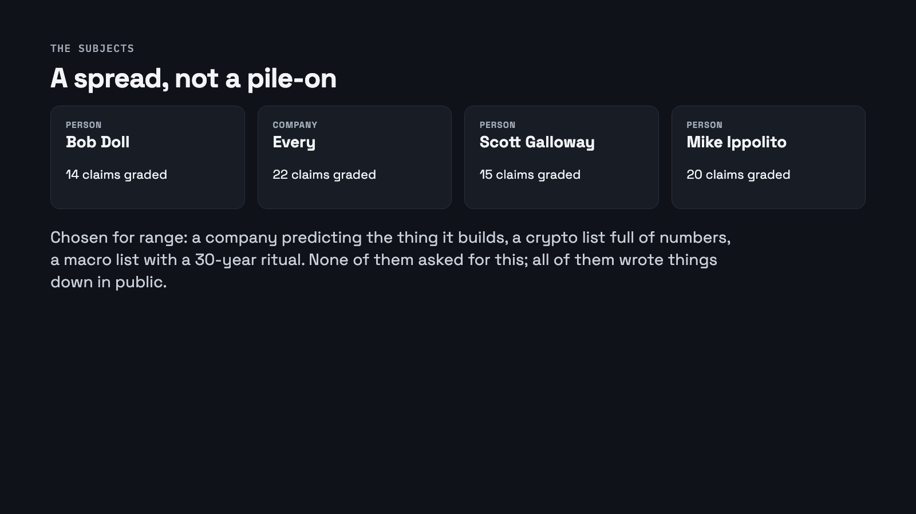
Notes:
The subjects were chosen for a spread from vague to numeric and from company to person. They are not targets.

Slide 6
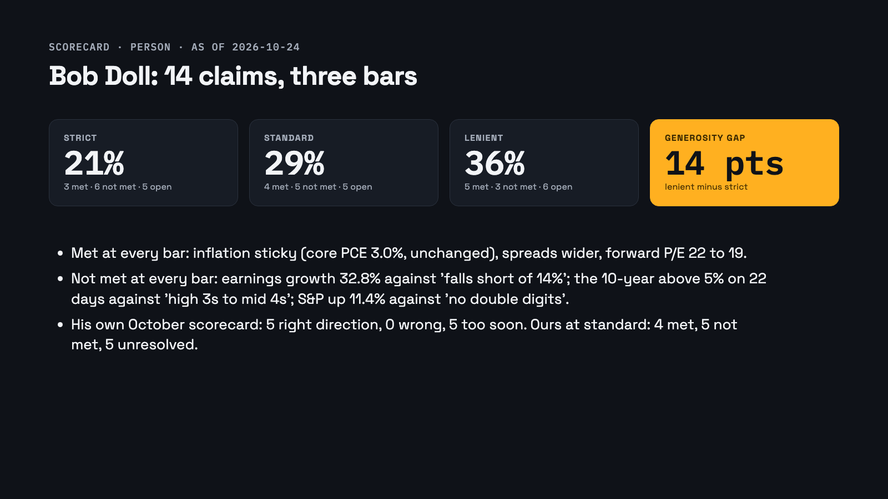
Notes:
Bob Doll: hit rates at the three bars, the gap, and the claims where the bars disagree most. Every cell links to its evidence in the run folder.

Slide 7
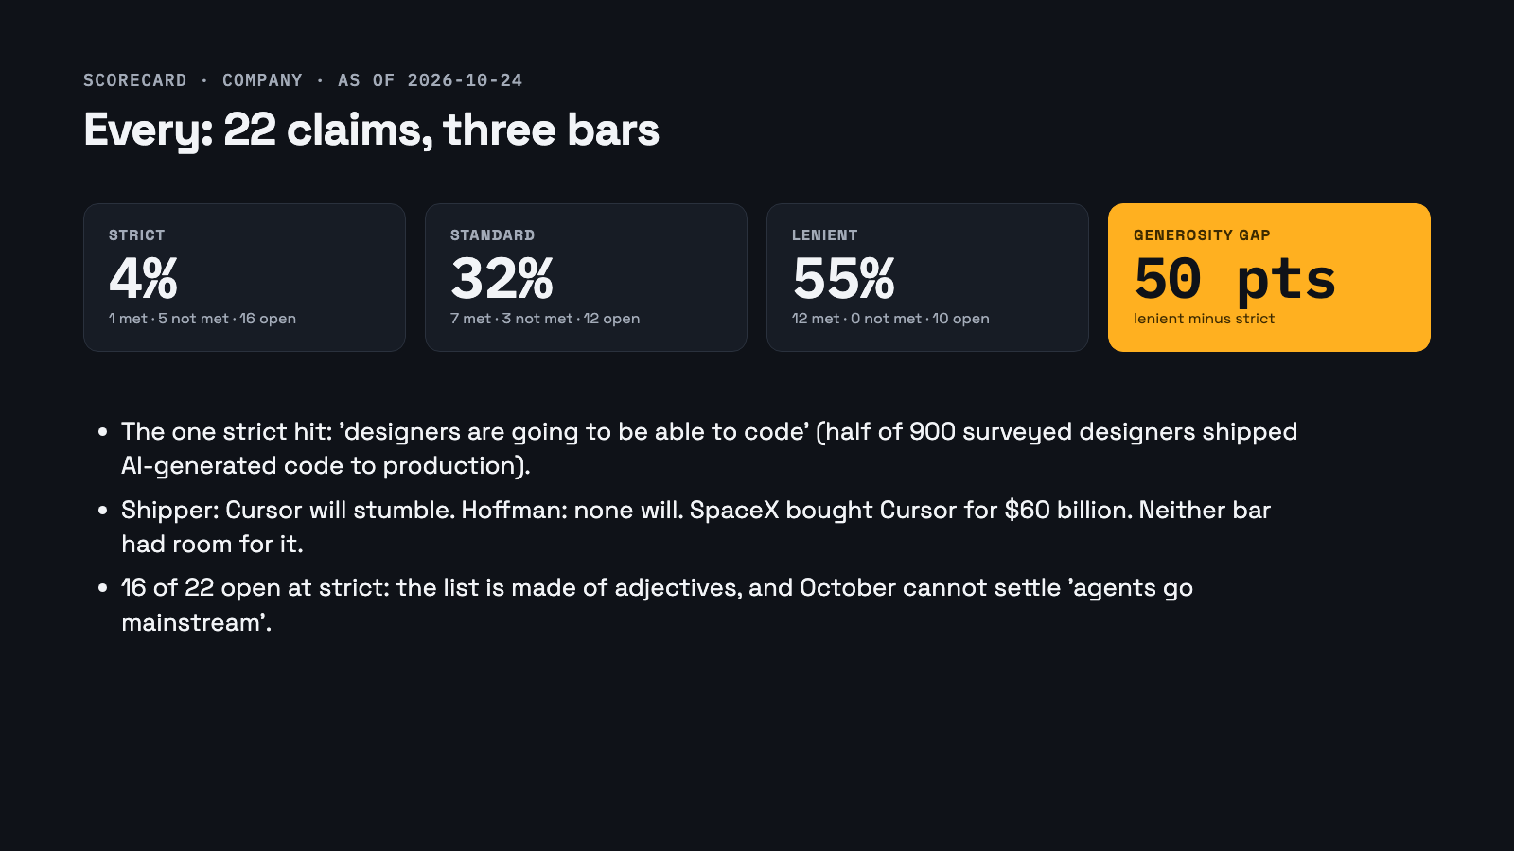
Notes:
Every: hit rates at the three bars, the gap, and the claims where the bars disagree most. Every cell links to its evidence in the run folder.

Slide 8
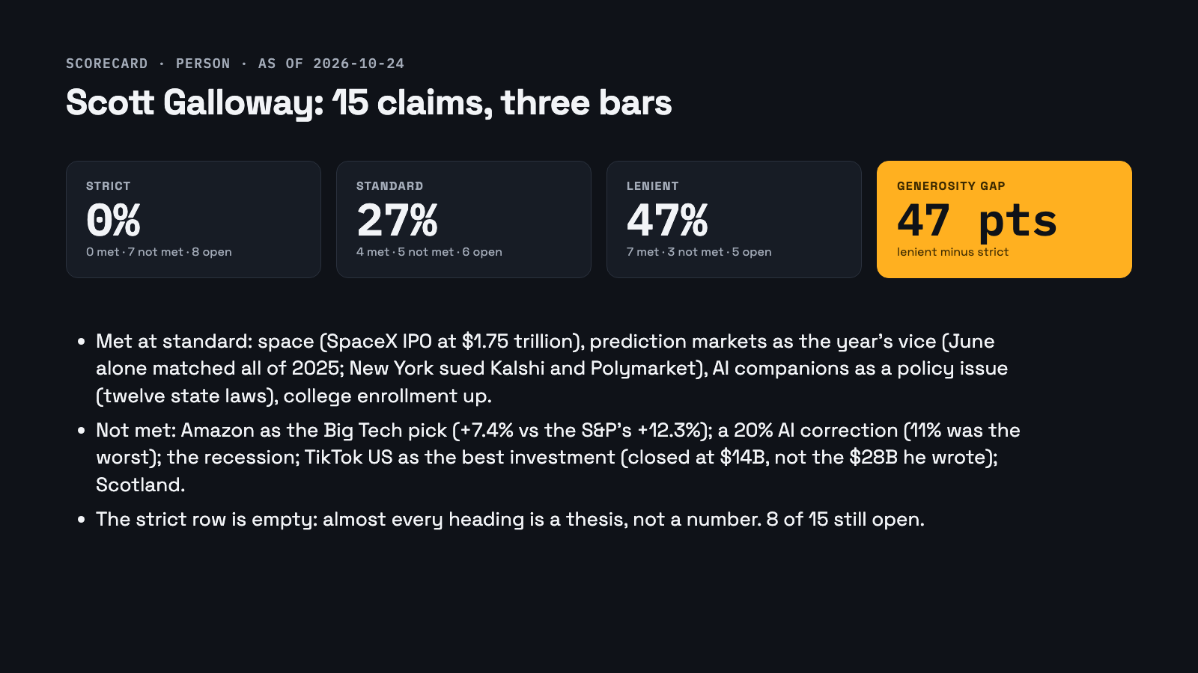
Notes:
Scott Galloway: hit rates at the three bars, the gap, and the claims where the bars disagree most. Every cell links to its evidence in the run folder.

Slide 9

Notes:
Mike Ippolito: hit rates at the three bars, the gap, and the claims where the bars disagree most. Every cell links to its evidence in the run folder.

Slide 10
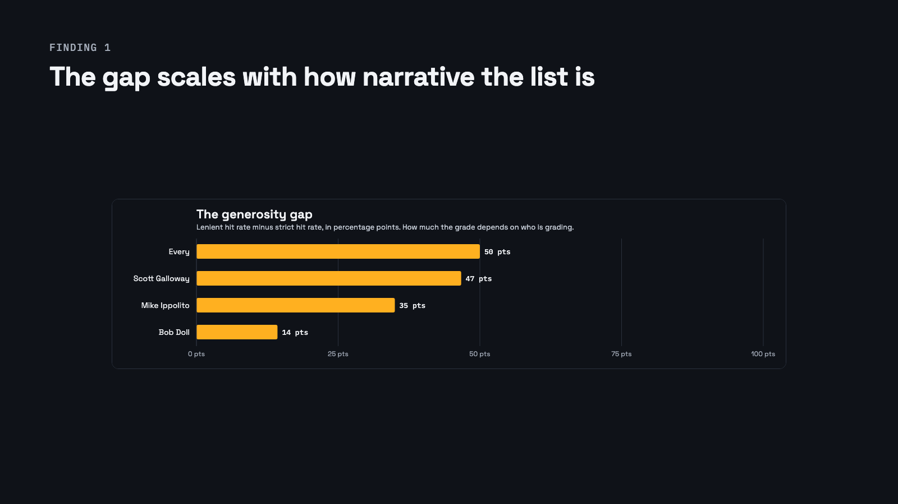
Notes:
Lenient minus strict: Doll 14, Ippolito 35, Every 50. Nobody publishes this because nobody grades at more than one bar.

Slide 11
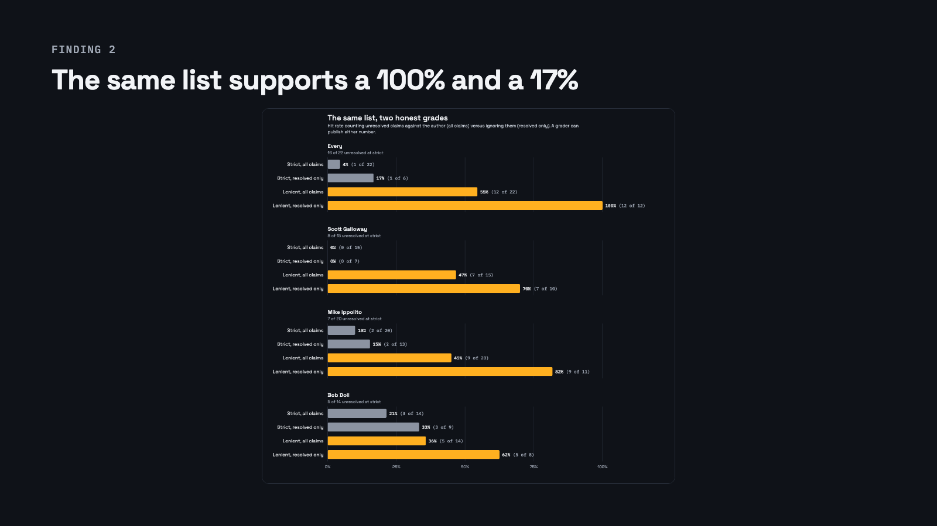
Notes:
Every at lenient, resolved only: 12 of 12. At strict: 1 of 6. Count open claims against the author and lenient is 55%. A scorecard that does not say its convention is not a number.

Slide 12
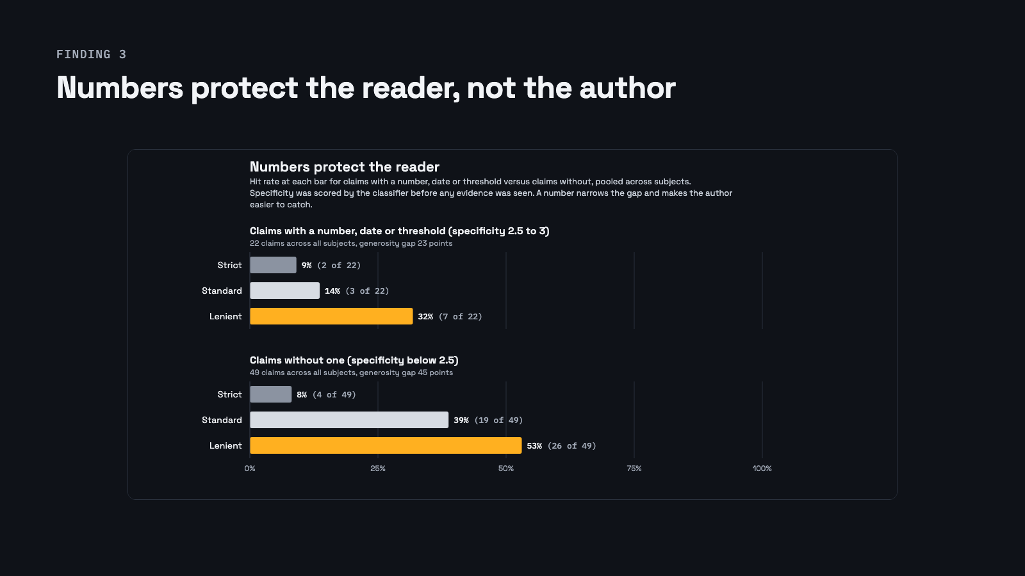
Notes:
Claims with a number have a smaller gap (25 vs 40) and lower hit rates at standard and lenient (19 and 38 vs 38 and 50). A number is a bar written in advance; it makes a miss undeniable.

Slide 13
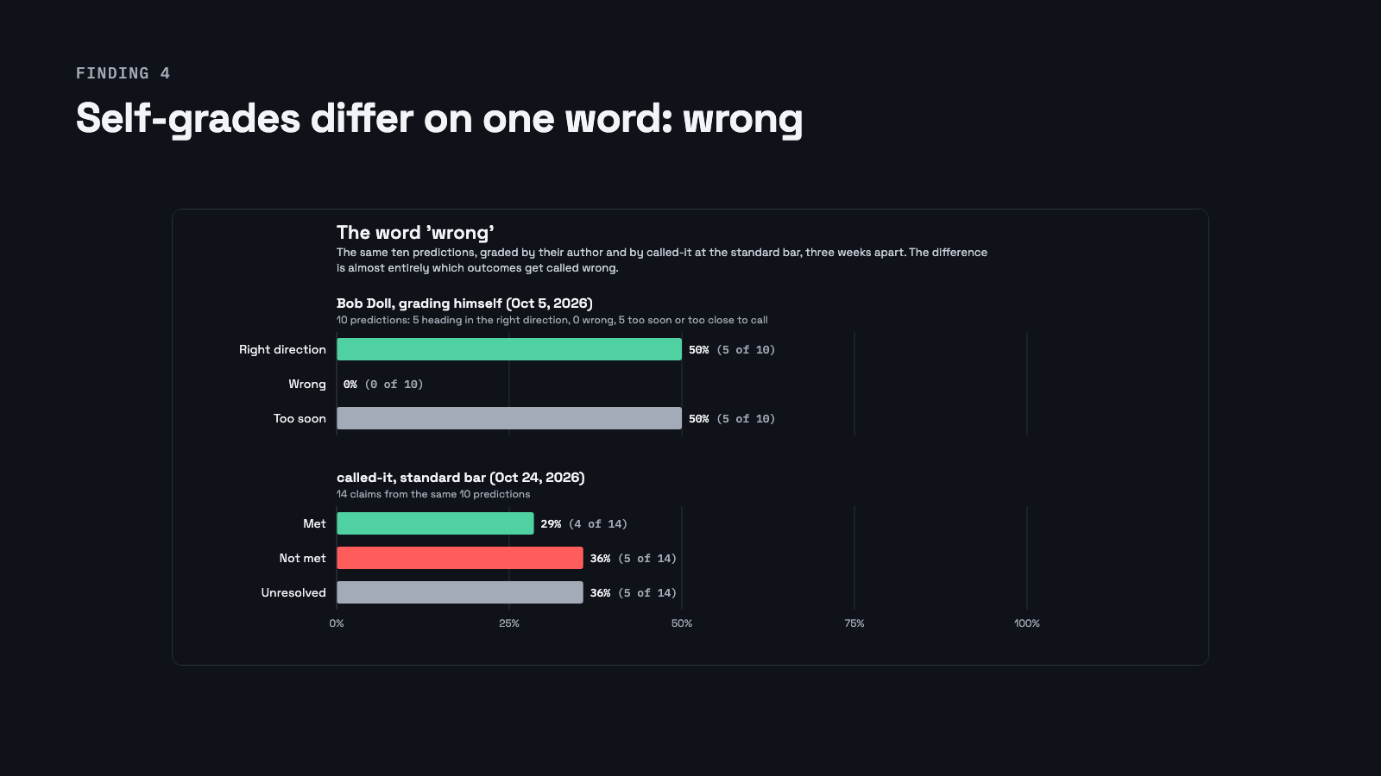
Notes:
Doll's own tally has no 'wrong' column; ours has five at the standard bar. The 'too soon' and 'unresolved' columns nearly agree.

Slide 14
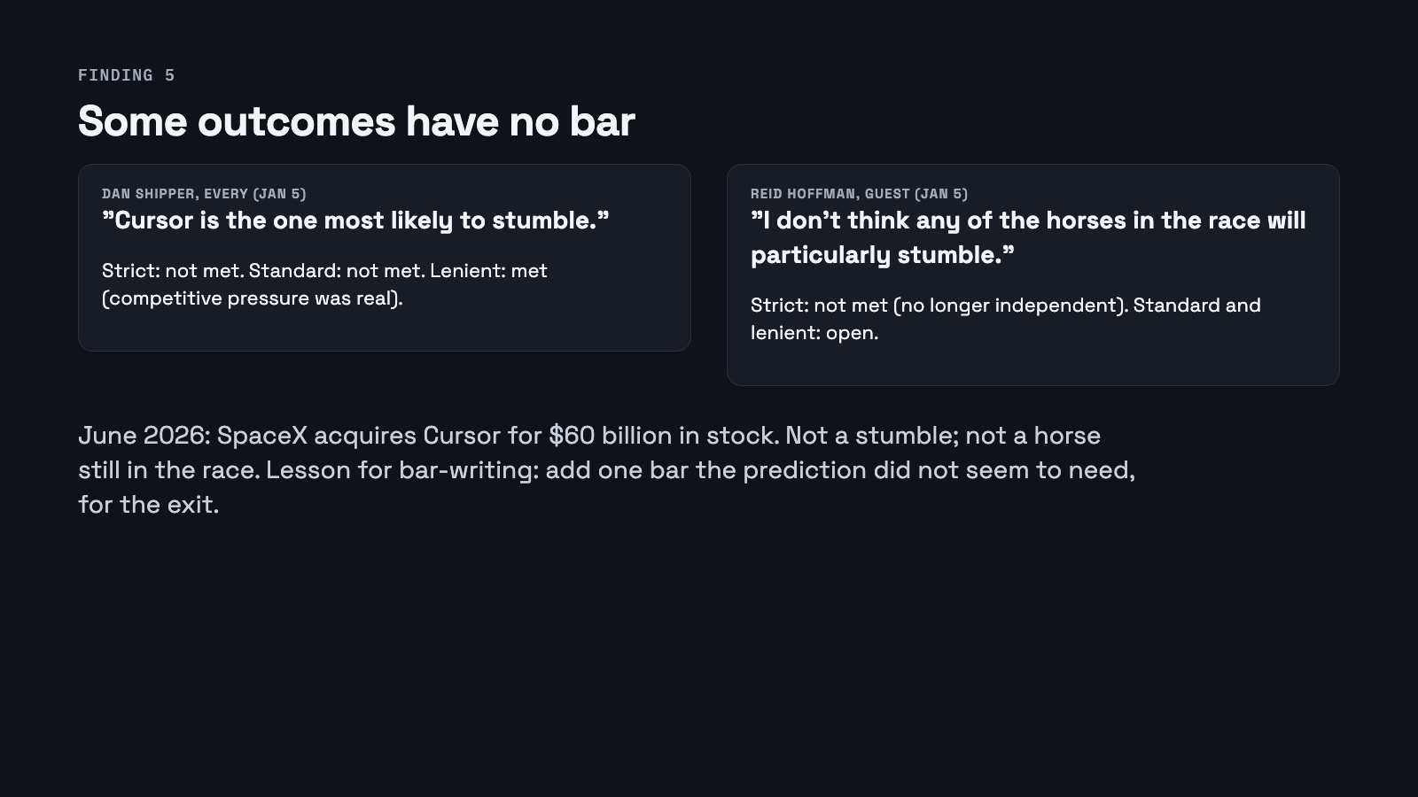
Notes:
The best single pair in the set. Host and guest predicted opposite things and the outcome fit neither. Writing bars in advance teaches you to write one for the exit.

Slide 15
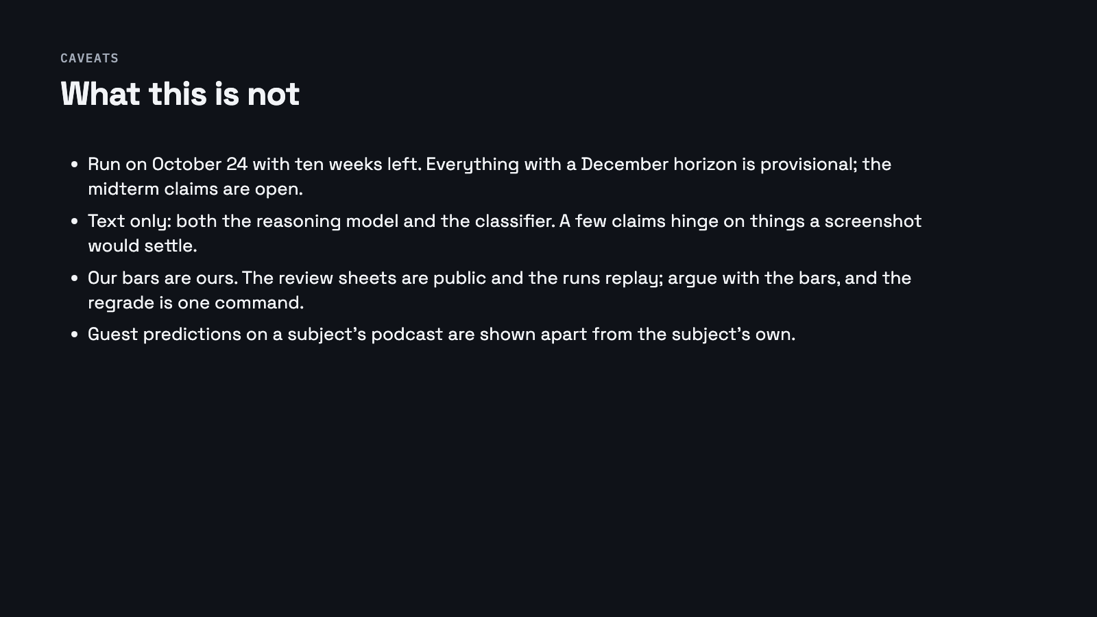
Notes:
The caveats are structural, not apologetic. Provisional grades are labelled; the bars are the thing to argue with.

Slide 16
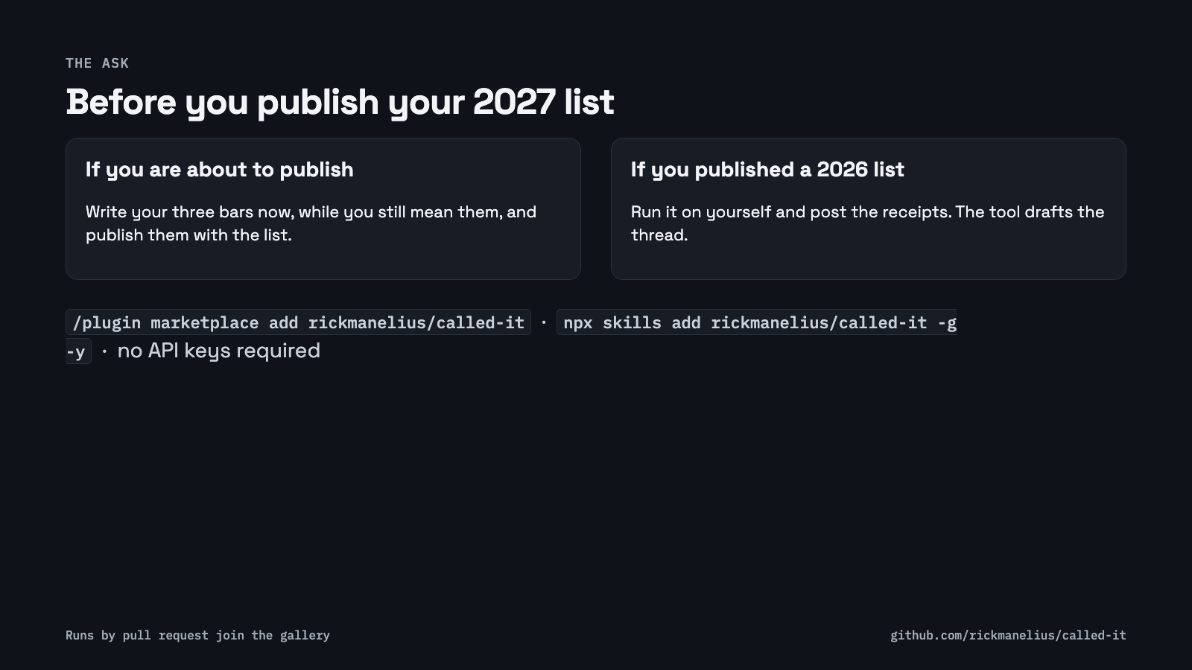
Notes:
The season opens in a week. Pre-register your bars, or grade your last list. Runs come in by pull request and join the gallery.

