Slide 1

for Scalable ETL & Machine Learning
by Rick

Slide 2
Agenda
A brief history of Apache Spark
Overview on Spark Framework
Spark Runtime in cluster mode
Simple, unified APIs
Spark SQL, GraphX, MLlib, Streaming
Spark 2 New Features

Slide 3
Spark History
2002 MapReduce @ Google
2004 MapReduce paper
2006 Hadoop MapReduce@ yahoo
2010 Spark paper
2014 Apache Spark Initial Release
2016 Apache Spark 2.0.0

Slide 4
A Fast Computation Engine
Apache Spark the fastest open source engine for sorting a petabyte (Year 2014)
 | Hadoop | Spark 100 TB * | Spark 1 PB
Data Size | 102.5 TB | 100 TB | 1000 TB
Elapsed Time | 72 mins | 23 mins | 234 mins
Nodes | 2100 | 206 | 190
Cores | 50400 | 6592 | 6080
Reducers | 10,000 | 29,000 | 250,000
Rate | 1.42 TB/min | 4.27 TB/min | 4.27 TB/min
Rate/node | 0.67 GB/min | 20.7 GB/min | 22.5 GB/min
Sort Benchmark Daytona Rules | Yes | Yes | No
Environment | dedicated data center | EC2 (i2.8xlarge) | EC2 (i2.8xlarge)
* not an official sort benchmark record

Slide 5
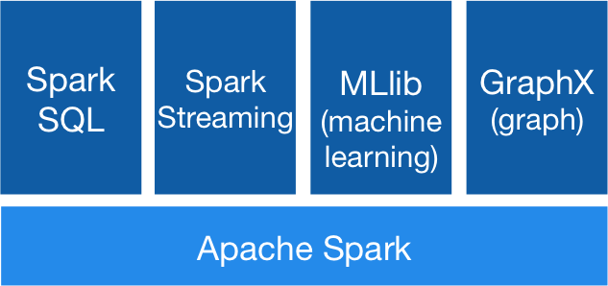
Spark Framework
Scalability achieved by in-memory computing in a cluster
Fault tolerance achieved by DAG
Clusters: standalone cluster, Hadoop, Mesos and Amazon EC2
Unified engine for completed data applications
High-level, user-friendly APIs
in Java, Scala, Python and R

Slide 6

Spark Runtime – Cluster Mode
A driver program is the application main program
A SparkContext has an independent set of processes on a cluster. It connects to several types of cluster manager
The cluster manager can be a standalone cluster, Yarn, Mesos
The executor processes are managed by the cluster manager. The driver program listens and accepts the incoming connections from its executers through its life cycle
The tasks are scheduled by the driver and run in the executer process.

Slide 7
Word Count in Java / Scala
Java
JavaRDD<String> textFile = sc.textFile("hdfs://...");
JavaPairRDD<String, Integer> counts = textFile
.flatMap(s -> Arrays.asList(s.split(" ")).iterator())
.mapToPair(word -> new Tuple2<>(word, 1))
.reduceByKey((a, b) -> a + b);
counts.saveAsTextFile("hdfs://...");
Scala
val textFile = sc.textFile("hdfs://...")
val counts = textFile.flatMap(line => line.split(" "))
.map(word => (word, 1))
.reduceByKey(_ + _)
counts.saveAsTextFile("hdfs://...")

Slide 8
Word Count in Python / R
Python
text_file = sc.textFile("hdfs://...")
counts = text_file.flatMap(lambda line: line.split(" ")) \
.map(lambda word: (word, 1)) \
.reduceByKey(lambda a, b: a + b)
counts.saveAsTextFile("hdfs://...")
R
lines <- textFile(sc, "hdfs://… ")
words <- flatMap(lines,function(line) { strsplit(line, " ")[[1]] })
wordCount <- lapply(words, function(word) { list(word, 1L) })
counts <- reduceByKey(wordCount, "+", 2L)
counts.saveAsTextFile("hdfs://...")

Slide 9
API Essentials
Transformations
map(func)
flatMap(func)
filter(func)
union(otherDataset)
intersection(otherDataset)
distinct([num Tasks])
reduceByKey(func, [num Tasks])
groupByKey([num Tasks])
sorByKey([num Tasks])
aggregateByKey(zeroValue)(seqOp, combOp, [num Tasks])
…
Actions
reduce(func)
collect(func)
count()
first()
take(n)
saveAsTextFile(path)
saveAsSequenceFile(path)
countByKey()
forearch(func)
…

Slide 10
SQL, Datasets and DataFrames
Spark SQL
a Spark module used to execute SQL queries
Read data from Files, Hive, JDBC/ODBC and return a Dataset / DataFrame
Dataset (since Spark 1.6)
“a strongly-typed, immutable collection of objects that are mapped to a relational schema”
Its core is an encoder responsible for converting between JVM objects and tabular representation.
It provides the benefits of RDDs and optimized execution engine (since Spark 2.0)
DataFrame
a subset of Dataset e.g. a Dataset of RowS , equivalent to a table in database or a data frame in R/Python

Slide 11
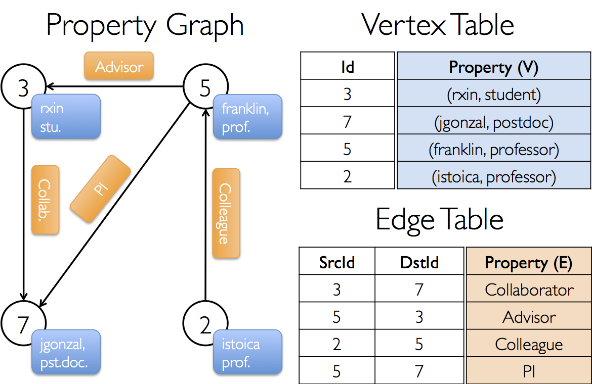
GraphX
Graph
The Graph object contains a collection of routines used to construct graphs from RDDs.
Edge[ED]
A single directed edge consisting of a source id, target id, and the data associated with the edge.
EdgeTriplet[VD, ED]
An edge triplet represents an edge along with the vertex attributes of its neighbouring vertices.
Graph algorithms
ConnectedComponents
PageRank
ShortestPaths
TriangleCount

Slide 12
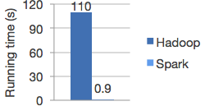
MLIib
MLlib is a scalable machine learning library.
Ease of Use - Usable in Java, Scala, Python, and R.
Performance - High-quality algorithms, 100x faster than MapReduce.
Easy to Deploy - Runs on existing Hadoop clusters and data. Otherwise, Spark is easy to run standalone or on EC2 or Mesos.
Logistic regression in Hadoop and Spark

Slide 13
Algorithms
Classification and Regression
Classification: Logistic regression, Decision tree classifier, Random forest classifier, Naive Bayes, Multilayer Perception Classifier (MLPC)
Regression: Linear regression, Decision tree regression, Random forest regression, Gradient-boost Tree (GBTs)
Clustering
K-Means, Bisecting k-means, Latent Dirichlet allocation (LDA), Gaussian Mixture Model (GMM)
Collaborative filtering
Alternating least square (ALS)

Slide 14
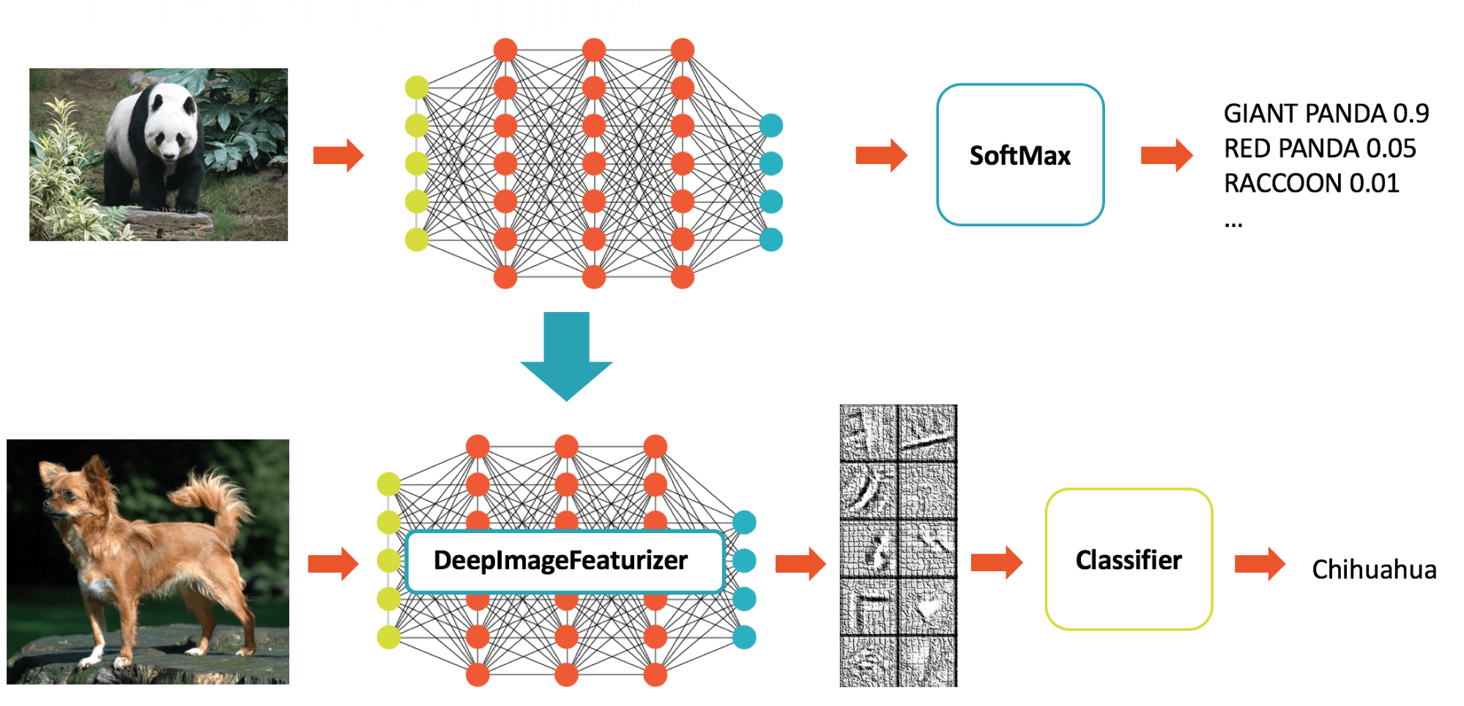
Deep learning pipeline
Simple API for Deep Learning integrated with Mllib
Buiding on Tensorflow, Keras, BigDL
Scale common tasks with transformers and estimators.
Expose models in batch/streaming and Spark SQL
Transfer learning

Slide 15
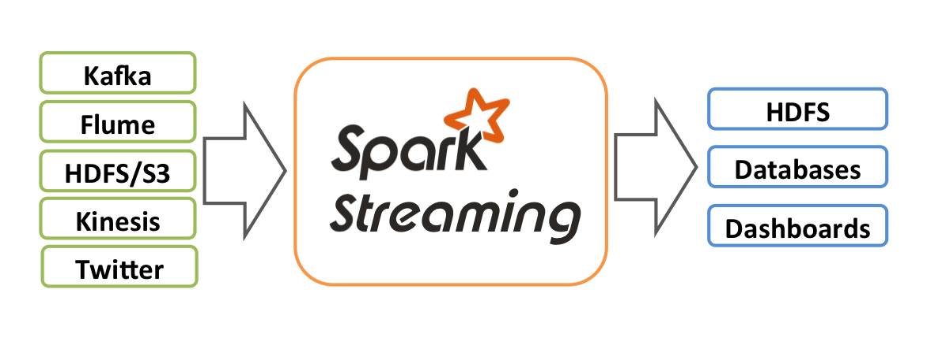
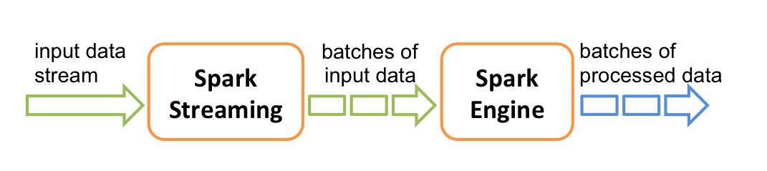
Micro-batch Streaming
It enables scalable, high-throughput, fault-tolerant stream processing of live data streams
Data can be ingested from many data sources such as Kafka, Flume, HDFS/S3, Kinesis, Twitter or TCP sockets
Data can be processed by using APIs in SQL/Dataset, MLlib&ML, and GraphX
The processed data can be pushed out to filesystems, databases, and live dashboards.
Internally, it uses micro batches to process data streams.

Slide 16
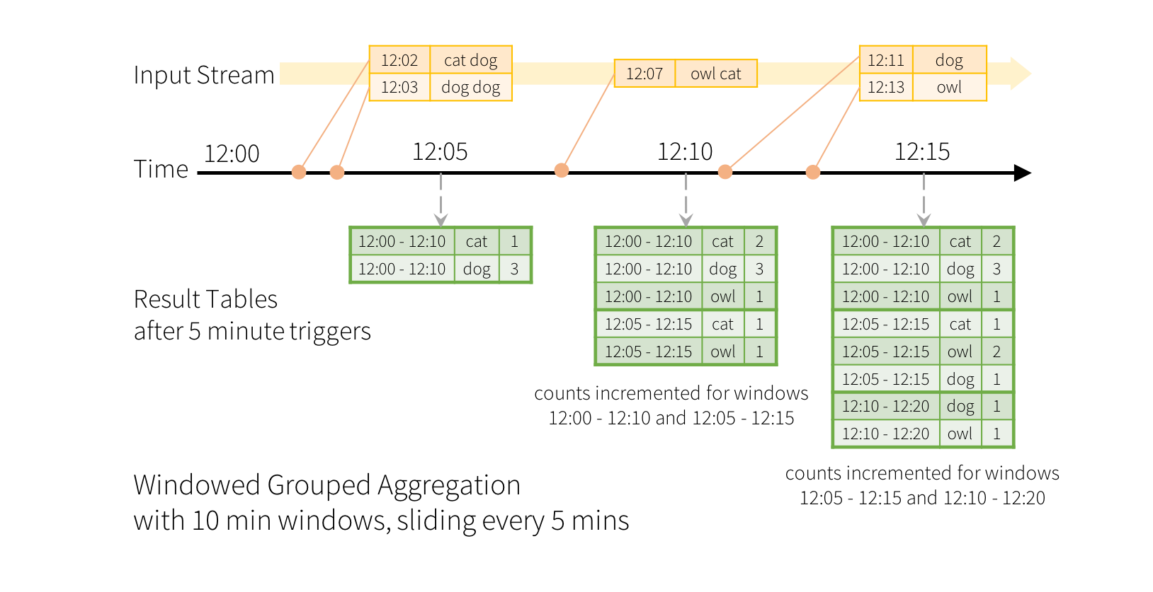
Structured Streaming
High level APIs – dataframe, dataset and SQL, same in streaming and batch
Event-time processing – native support for working with out-of-order and late events
End to end exactly once – transactional both in processing and output

Slide 17
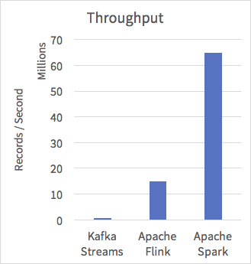
Continuous Streaming
High Performance - 65 millions records / s
Streaming queries use the Catalyst query optimizer and the Tungsten execution engine
Low Latency - users achieve ~ 1m end-to-end latency for many important workloads
Streaming without micobatches,supporting asyn checkpointing
Only available in Spark latest release e.g. 2.2.0
Yahoo! Bechmark
5x or better throughput

Slide 18
Spark 2.0.0 new features
Catalyst Optimizer
Analysing a logical plan
Logical plan optimization
Physical planning
Java bytecode generation
Project Tungsten
substantially improved Spark performance by optimizing CPU and memory efficiency.
Off-Heap Memory Management, Cache Locality, Code Generation by modem compilers
Structured Streaming (experimental)

Slide 19
Spark 2.2.0 new features
ML Pipelines
Provide a uniform set of high-level APIs built on top of DataFrames
Easier to combine multiple algorithms into a single pipeline
Chains multiple Transformers and Estimators together to form a ML workflow
Structured Streaming (GA in Spark 2.2.0)
Built on Spark SQL engine
Provides Dataset/DataFrame APIs for aggregation, join, event-time window, watermark etc.
Handling event-time, late data and fault tolerance semantics
Spark R - Major features
Structured Streaming API for R
Catalog API, Coalesce on DF and column, DF checkpointing, approxQuantile

Slide 20
References
https://spark.apache.org/
https://spark.apache.org/docs/latest/index.html
http://ampcamp.berkeley.edu/big-data-mini-course/graph-analytics-with-graphx.html
https://databricks.com/

Slide 21
Thank you

