Slide 1
Monitoring

Slide 2
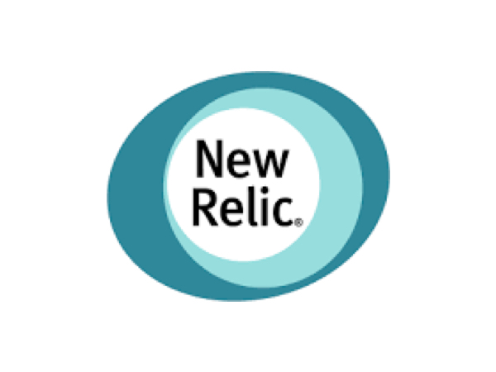
New Relic
SAAS based application performance management product with great UI.
Support for Ruby, PHP, .Net, Java, Python, and Node.js Apps

Slide 3
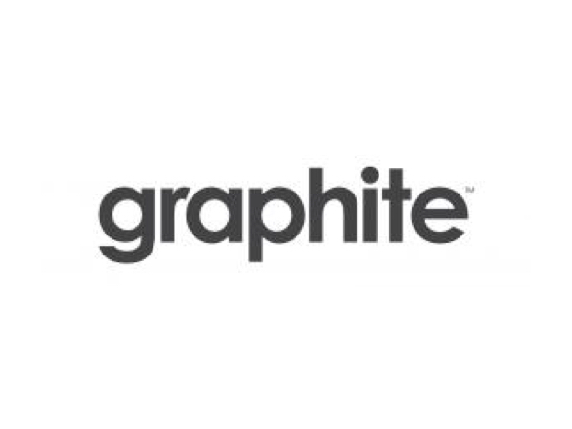
GraphitE
Highly scalable real-time graphing system.
Open-source
Event tracking.
Collects, stores, and displays time series data in real time.

