Slide 1
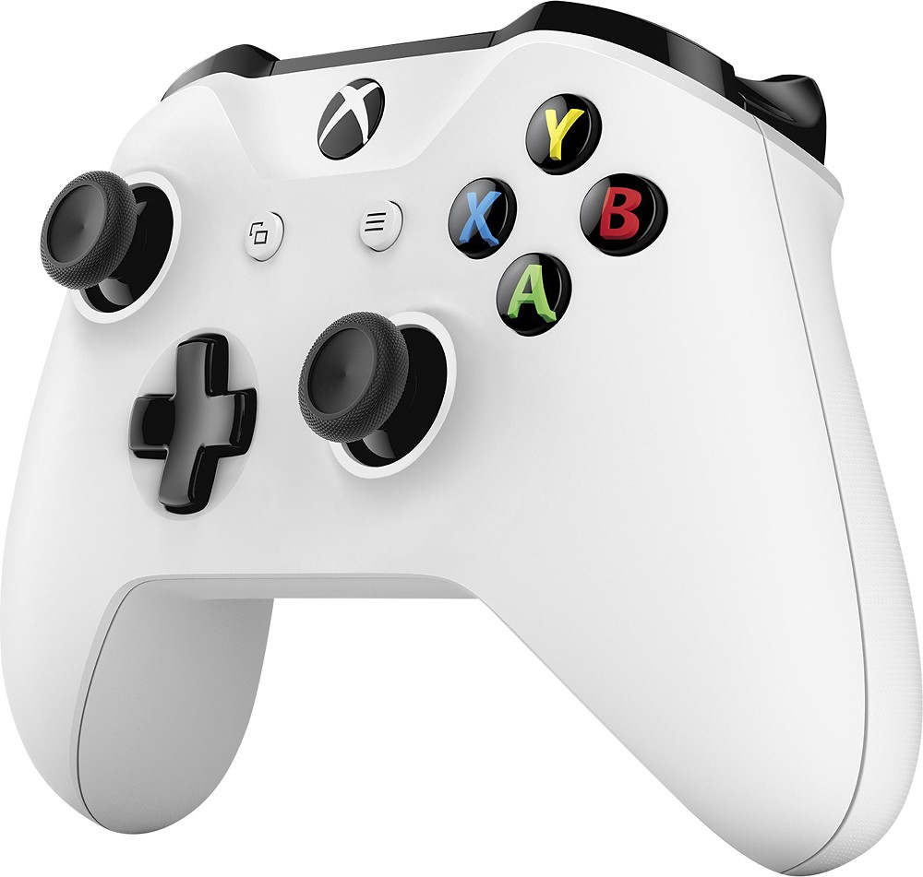
Gamepad Parts and Terms
Stick
Analog,
Dead Zone,
Ramp
Trigger
Analog,
Dead Zone,
Ramp
D-Pad
Digital,
Blocking
Button
Digital,
Non-Blocking

