Slide 1
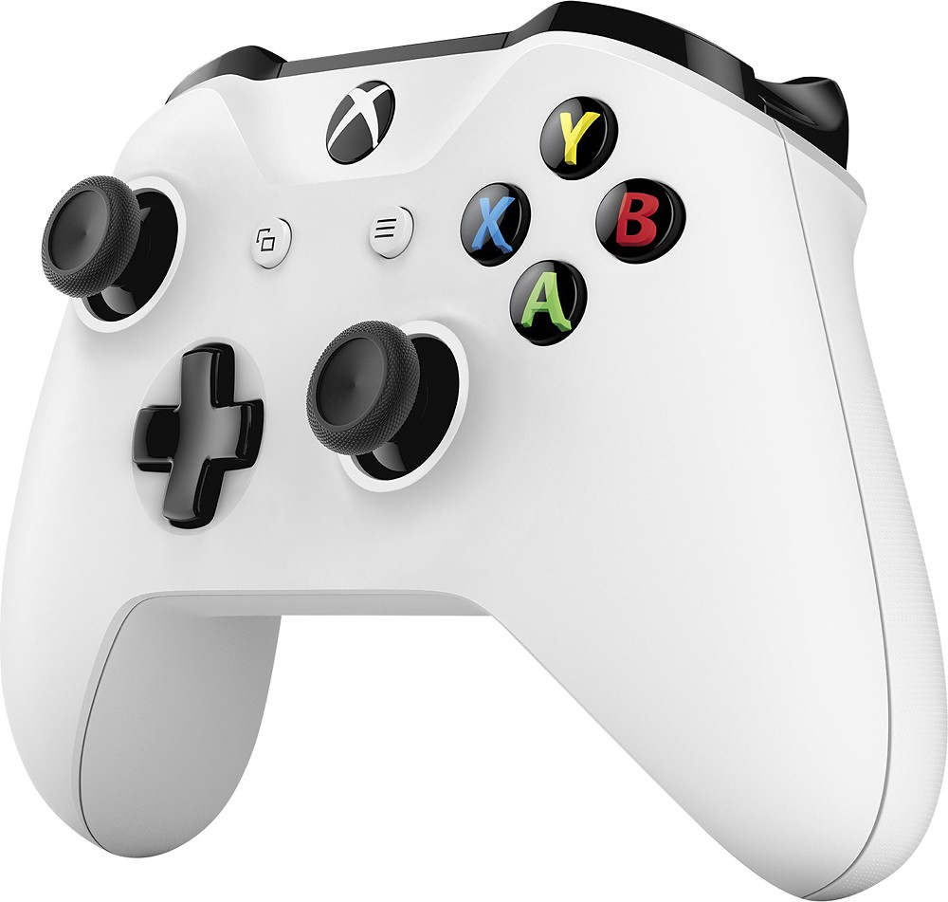
Gamepad Parts and Terms
Stick
Analog,
Dead Zone,
Ramp
Trigger
Analog,
Dead Zone,
Ramp
D-Pad
Digital,
Blocking
Button
Digital,
Non-Blocking

Slide 2
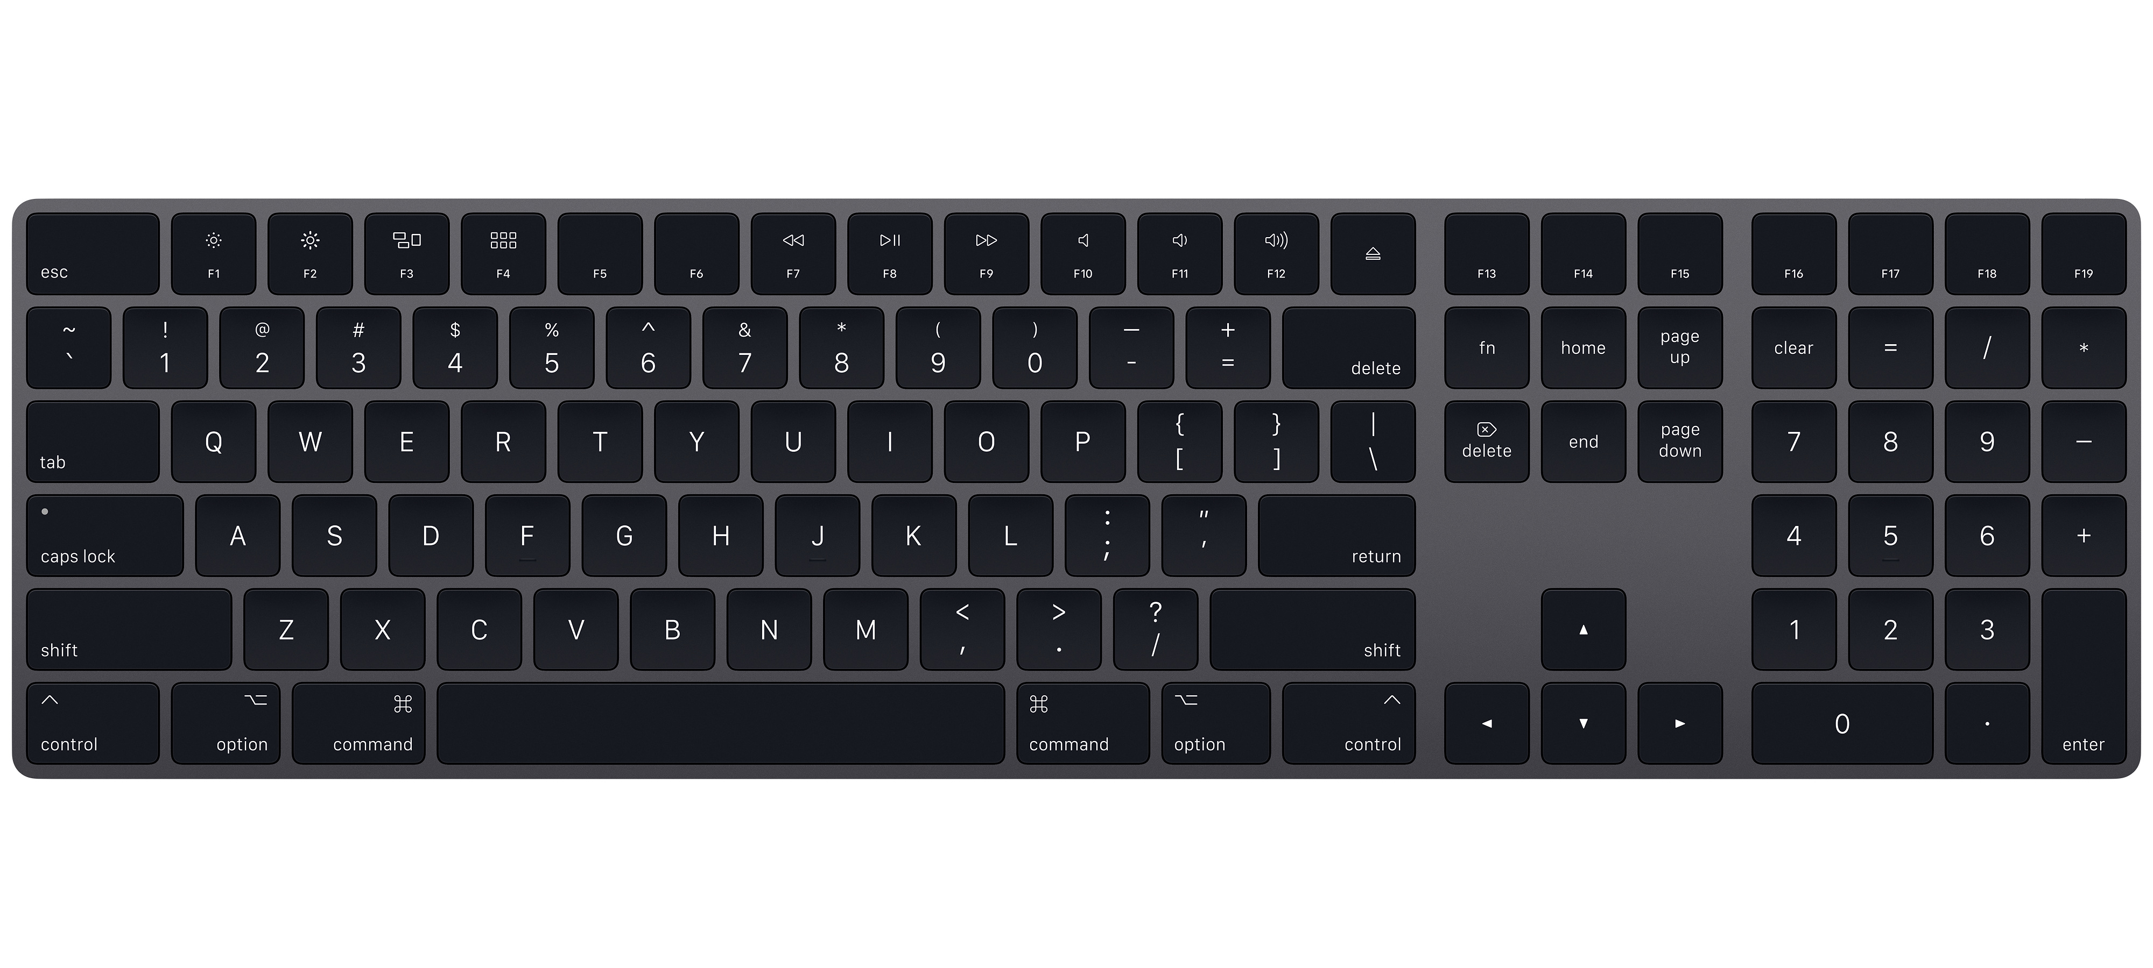
Keyboards in Javascript
KeyboardEvent.key
onKey[Down/Up](event)
Example Values
event.key
KeyboardEvent.key
event.ctrlKey
boolean
event.shiftKey
boolean
event.altKey
boolean
event.metaKey
boolean
“q” or “Q”
“Enter”
“Shift”
“ ”
“ArrowDown”

Slide 3
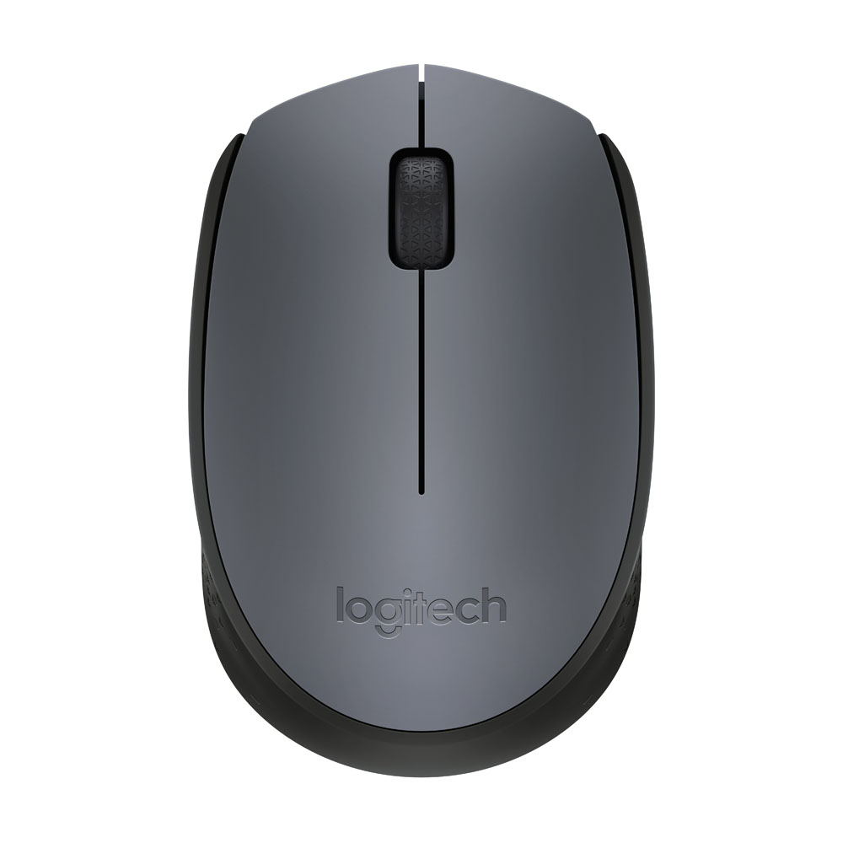
Mice in Javascript
onMouse[Move/*](event)
Mice Button/Wheel Codes
event.screen[X/Y]
Double
event.client[X/Y]
Double
event.offset[X/Y]
Double
event.[ctrl/alt/shift]Key
Boolean
2 (Right)
0 (Left)
1 (Middle Click)
deltaY
onMouse[Down/Up](event)
Up
Negative Value
Down
Positive Value
event.key
Button Code
onMouseWheel(event)
event.deltaY
Double

