Slide 1
The “one and only” calendar.
Seeing a bigger world of calendars and games.

Slide 2
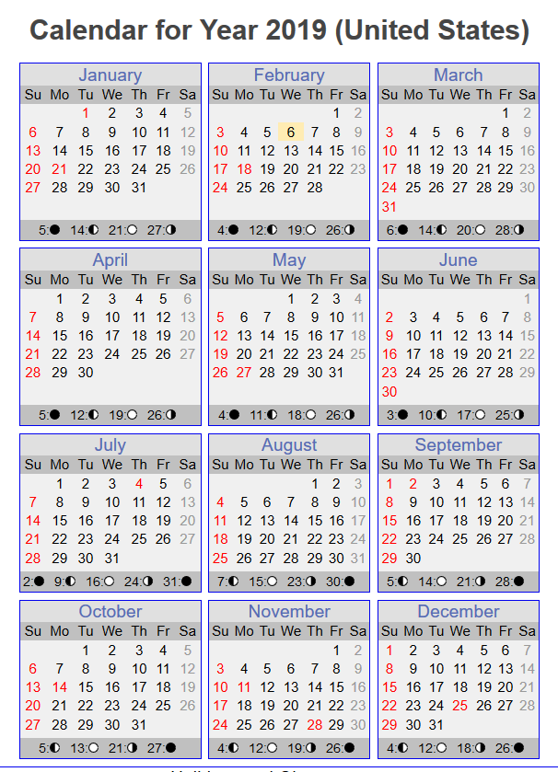
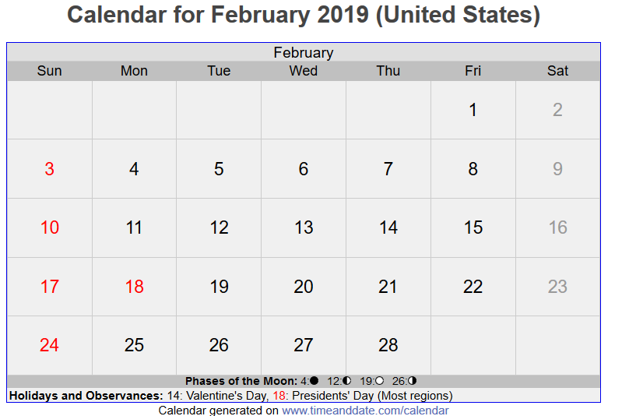
In the US, calendars always look like this:

Slide 3
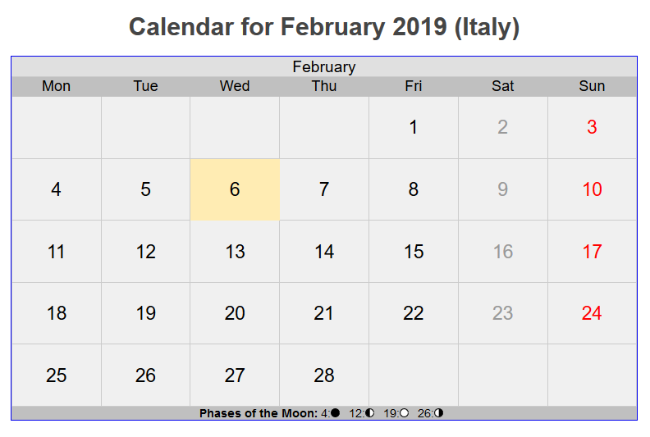
But outside the US, people think differently

Slide 4
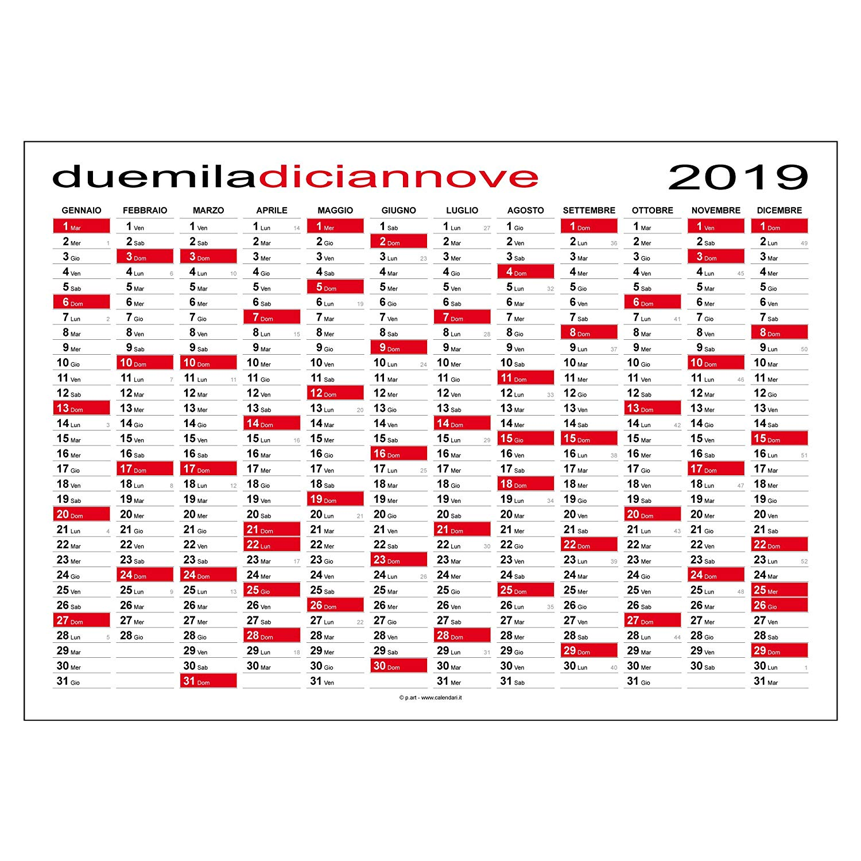
What about this annual calendar?

Slide 5
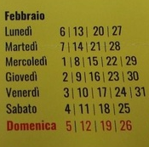
Or this month calendar?

Slide 6
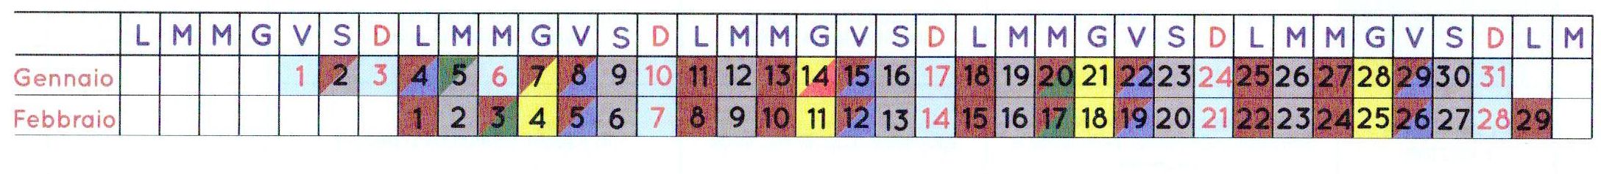
Or this one?

Slide 7
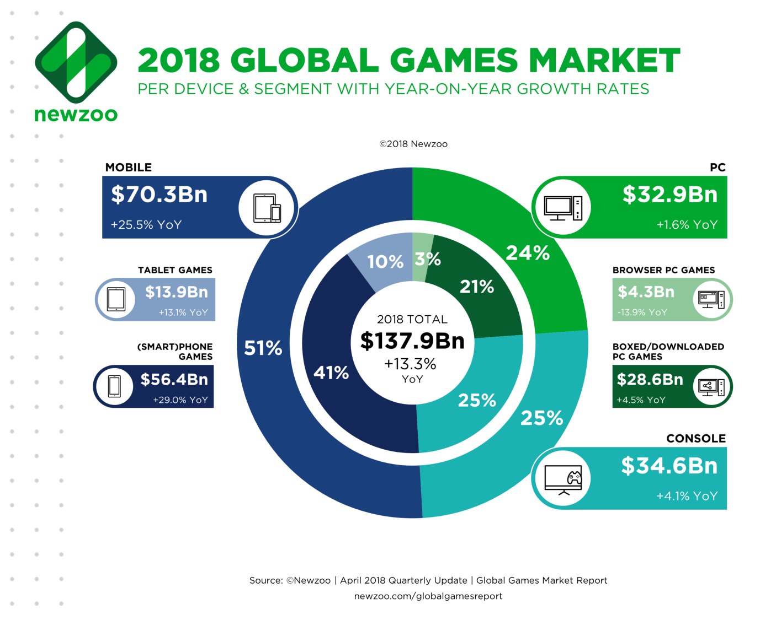
PC/Console is only half the game story

Slide 9
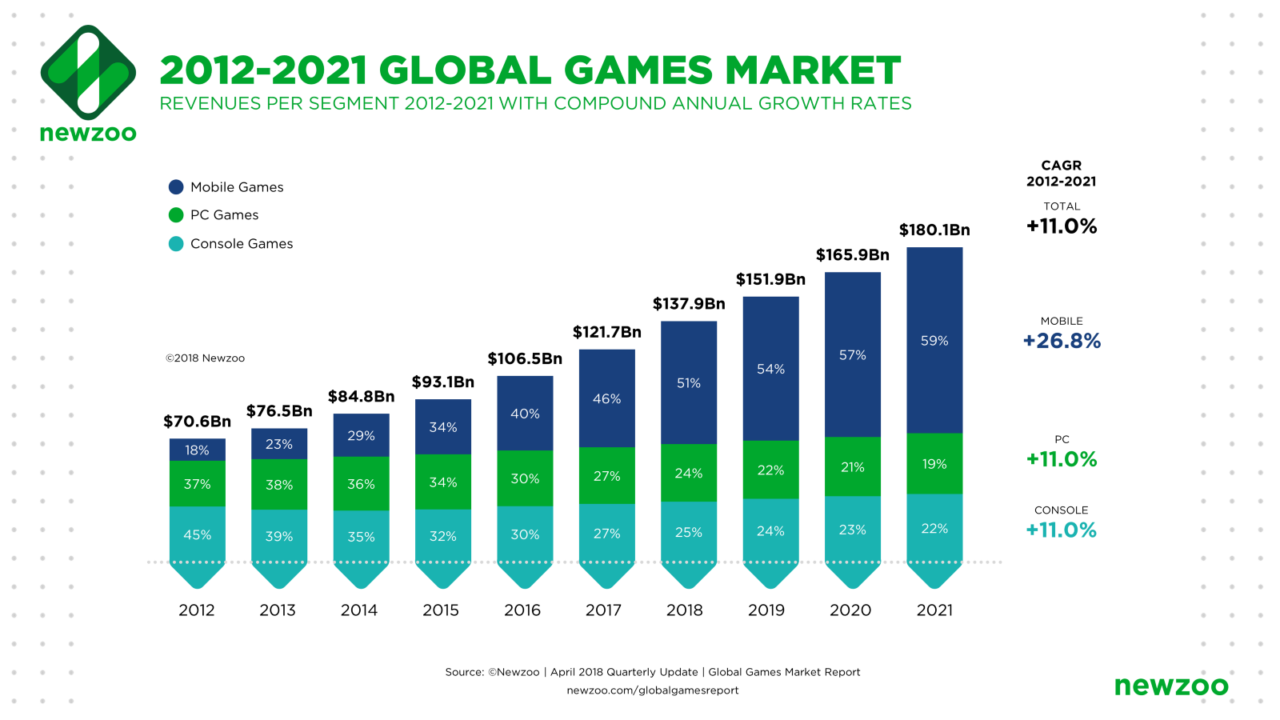

Slide 10
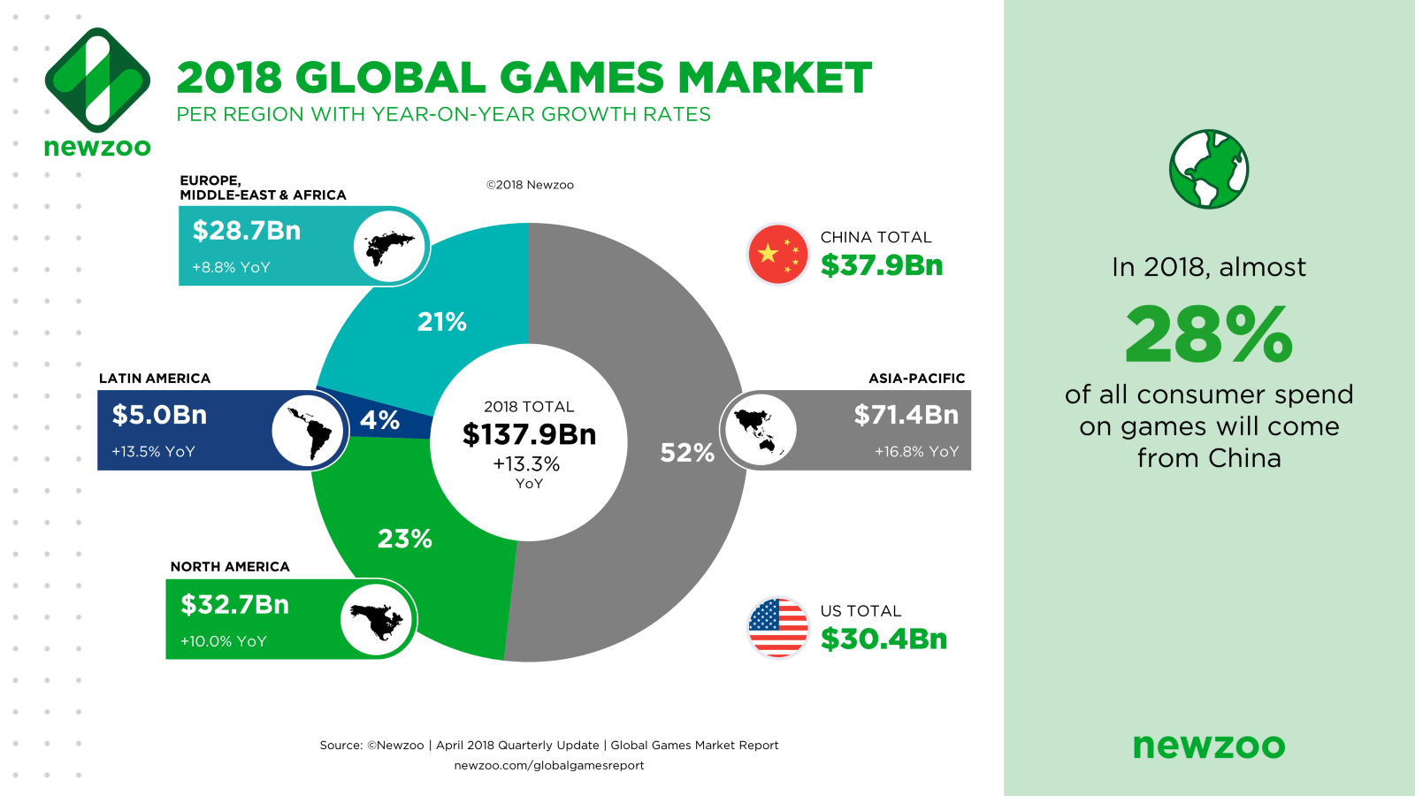

Slide 11
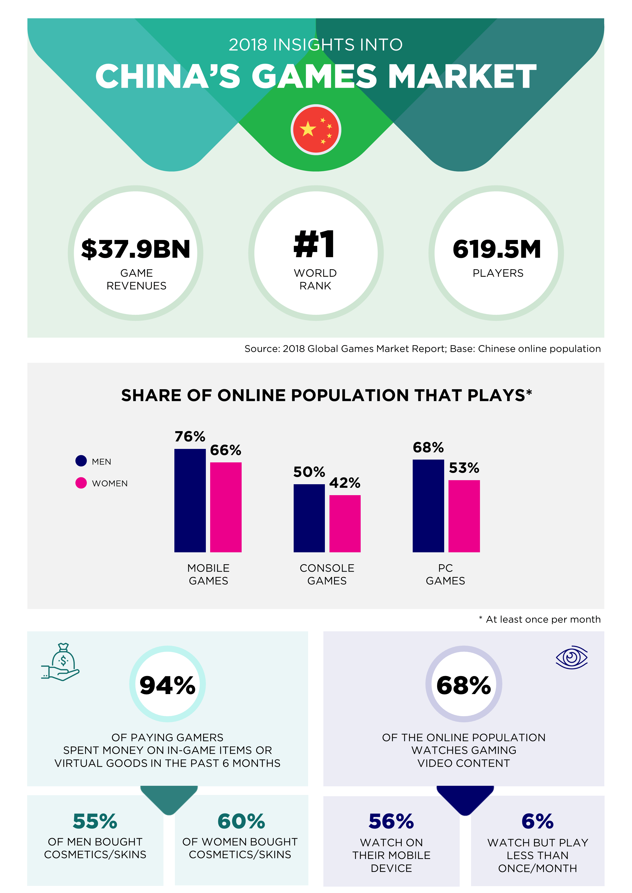
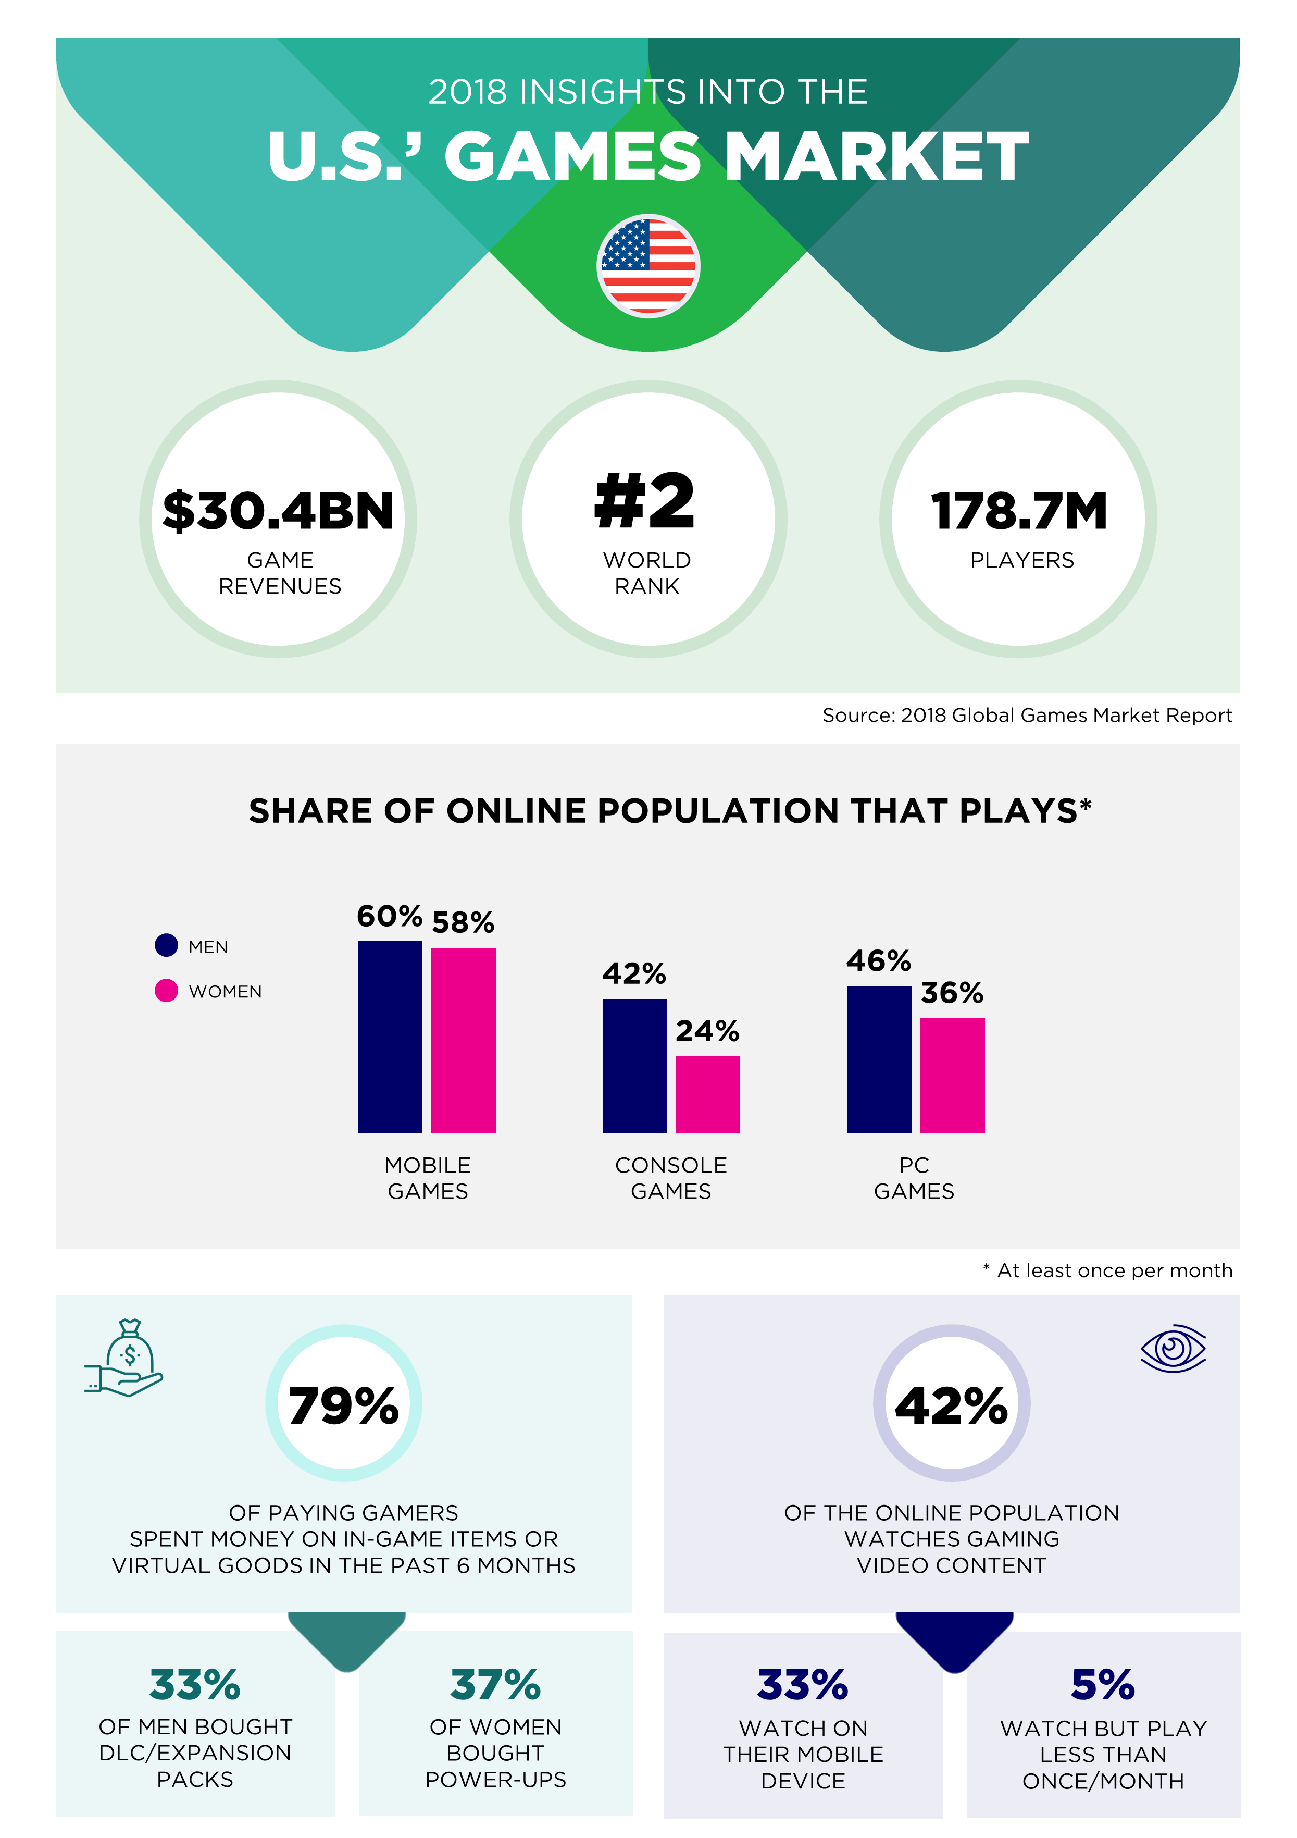

Slide 12
It’s a big, beautiful world…

