Slide 1


Programming Finance
– Team Project
Qing Ou, Rick Shen
Fall 2024

Slide 2


Overview
Our stock simulator, SimTrade.ai, aims to help its clients advance their trading methodologies by experimenting in a virtual stock trading environment.
It provides three types of stock portfolios/ trading methods – manual, strategic, algorithmic.
It allows the user to specify a time window for stock analysis. class StockAnalysis
The metrics from the analysis can be used by the app’s build-in machine learning algorithm to suggest 20 stocks to invest in.
It allows the user to specify number of days to simulate, during which period the app monitors the portfolios’ performance for comparison. class PortfolioAnalysis
Analysis
Monitoring
2019-01-02
2024-09-03
2024-12-05
Trade starts
Portfolios are made

Slide 3
Project Folder Structure
├── input
│ ├── stock_prices.csv --> time series daily stock price data of NASDAQ-100 stocks
│ └── log_returns.csv --> processed log return from the daily prices for portfolio suggestion
├── output
│ └── portfolio_history.csv --> portfolio value movement history
├── public --> front-end files for result display
├── spec
│ └── server.spec.js --> jasmine test file
├── config.js --> global variables: list of NASDAQ-100 stock symbols, simulation parameters
├── utility.js --> all supporting class objects and functions
├── db_setup.sql --> to setup/ initialize MySQL database with tables
├── PCA_LinReg.py --> contains functions to perform machine learning for algorithmic trading
├── server.js --> back-end program to start a local server for result display
├── package.json
├── package-lock.json
└── README.md

Slide 4
Live Demo – Project Overview
config.js
Class StockAnalysis
Notes:
^IXIC is the NASDAQ-100 index
dailyDiffs and Sharpe Ratio are technical analysis and will be used for portfolio recommendations
totalLogReturn will be used for machine learning portfolio

Slide 5
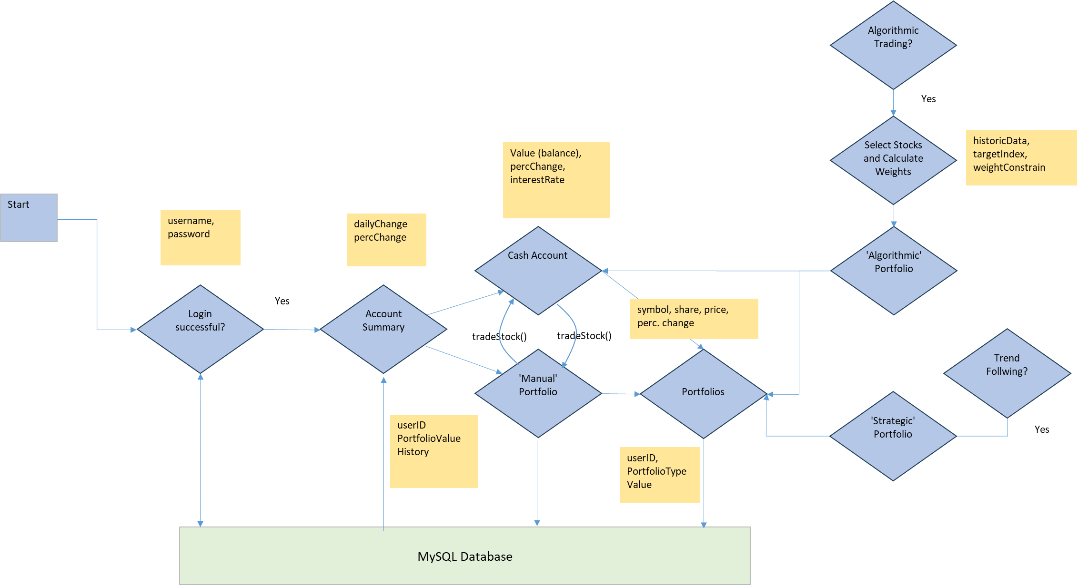
____ _ _____ _ _ ___ / ___|(_)_ __ __|_ _| __ __ _ __| | ___ / \ |_ _| \___ \| | '_ ` _ \| || '__/ _` |/ _` |/ _ \ / _ \ | | ___) | | | | | | | || | | (_| | (_| | __/_ / ___ \ | | |____/|_|_| |_| |_|_||_| \__,_|\__,_|\___(_)_/ \_\___|
Virtual Business Workflow

Slide 6
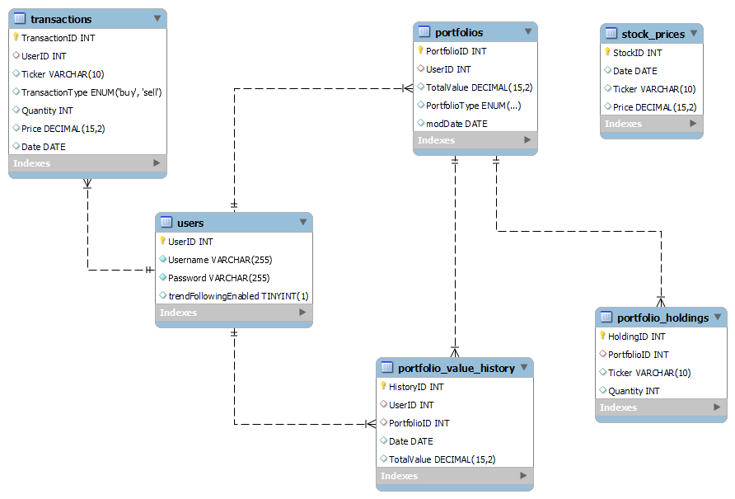
____ _ _____ _ _ ___ / ___|(_)_ __ __|_ _| __ __ _ __| | ___ / \ |_ _| \___ \| | '_ ` _ \| || '__/ _` |/ _` |/ _ \ / _ \ | | ___) | | | | | | | || | | (_| | (_| | __/_ / ___ \ | | |____/|_|_| |_| |_|_||_| \__,_|\__,_|\___(_)_/ \_\___|
MySQL Database Tables and Key Functions
async function updateStockPrices(date)
async function tradeStock(userID, ticker, quantity, date, portType)
async function makePortfolio(userID, lstStocks, initPortVal, trade_date, portType)
async function updatePortfolioValue(userID, date)
Notes:
updateStockPrices: update stock_prices from yahoo finance if necessary,
tradeStock: look up price from stock_prices, check portfolios, create new if needed; check portfolio_holdings, add/ subtract from tickers under the same portfolio, delete if 0; update cash portfolio
makePortfolio: assumes equal weight, invokes tradeStock to trade stocks in a list individually on trade_date
updatePortfolioValue: fetches portoflios under userID, look up holdings and prices, calculate totalvalue of each portfolio, writes a new entry in portfolio_value_history

Slide 7
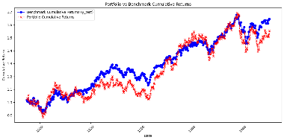
____ _ _____ _ _ ___ / ___|(_)_ __ __|_ _| __ __ _ __| | ___ / \ |_ _| \___ \| | '_ ` _ \| || '__/ _` |/ _` |/ _ \ / _ \ | | ___) | | | | | | | || | | (_| | (_| | __/_ / ___ \ | | |____/|_|_| |_| |_|_||_| \__,_|\__,_|\___(_)_/ \_\___|
Three Types of Stock Portfolios/ Trading
“Manual”: combines market order and limit order, i.e., clients can execute transactions at the day they want and at the price from the data base.
“Strategic”: Trend-Following strategy allows the clients to specify the stock ticker symbol, the number of shares to trade, and the time period when the strategy will be active. Once set, the program will monitor the price movement daily. If buy/ sell signal is triggered, the program will execute the trade orders automatically.
“Algorithmic”: the app selects a subset of stocks from the market and calculates their weights to aim at mimicking a stock index (market). This is known as Index Tracking.
async function tradeStock(userID, ticker, quantity, date, type)
async function trendFollowing(userID, symbol, current_date,
start_date, end_date, numShares, actionAtEnd = 'hold')
async function PCA_analysis(userID, analysis_start_date,
analysis_end_date, totalValue, trade_date)
Notes:
Quantity > 0 => buy; <0 => sell

Slide 8
Dependencies and Assumptions
yahoo-finance2 – download historical and new stock prices
mysql – database connection
child_process – call an external program with machine learning algorithm
express, cors, express-session – server communications
fs, csv-parser, path
Constant interest rate
Market is liquid and frictionless – trade as many shares as the user wants without extra costs
No bid ask spread, no intraday – trade at closing price daily

Slide 9
Live Demo – utility.js
tradeStock
updatePortfolioValue
trendFollowing
PCA_analysis
portfolio_by_PCA

Slide 10

Portfolio Suggestions
run_simulations() makes 3 portfolios
Start with global variable simStartDay: ‘2014-09-03’
Analyze NASDAQ-100 stocks from 1 year ago up to simStartDay
Each portfolio starts with ~$30,000
Suggest 20 stocks by their Sharpe Ratio over the analysis period, assign equal weights on each stock
Randomly select 20 stocks, assign equal weights
Apply PCA to select stocks and Linear Regression for weights
$$Sharpe Ratio= \frac{R_{s}−R_{f}}{σ_{s}}$$
$$R_{s}=return of stock$$
$$R_{f}=risk−free rate$$
$$σ_{s}=standard deviation$$

Slide 11
Live Demo – Front End for Portfolio Performance

Slide 12
Summary
SimTrade.ai is a web-based app to be used by individuals to experiment trading virtually in the stock market with the following characteristics:
The user can specify a time horizon to analyze the stock market
The app provides three portfolio advices, each with 20 stocks based on:
Sharpe ratio ranking (technical analysis)
Trend following strategy (technical analysis)
Principal component analysis and linear regression (machine learning)
By specifying analysis start and end date, the app will analyze the stock prices over different time intervals across the past years.
The machine learning technique aims to select a subset of stocks in the stock market to mimic the behavior of the whole stock market, balancing risk and return.
Portfolios can easily be expanded to try out new techniques/ strategies.
By changing the global variables, the user can use the app to test the portfolios’ performance under various scenarios.

Slide 13


