Slide 1


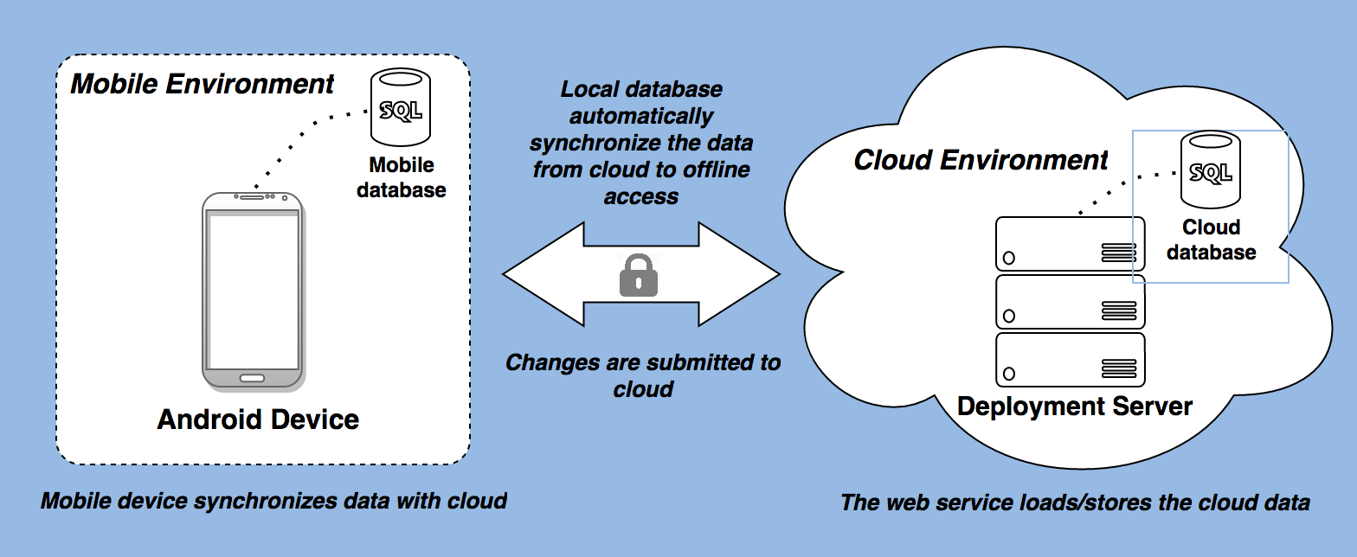
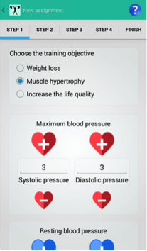
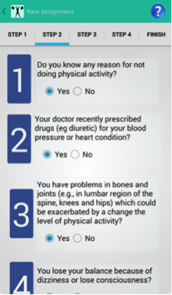
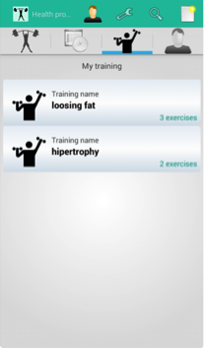
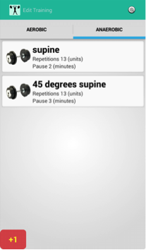
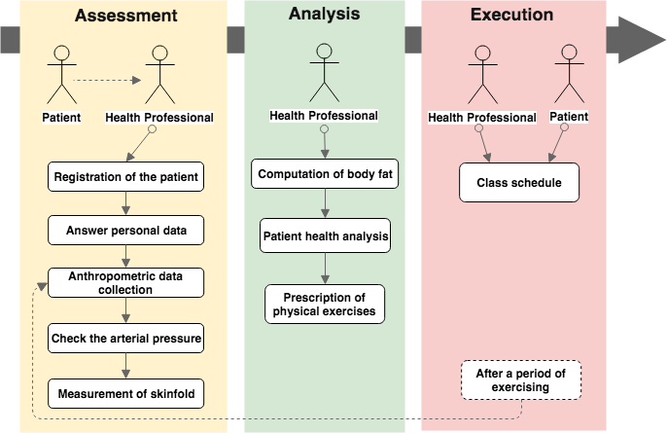
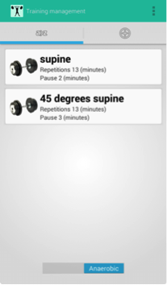
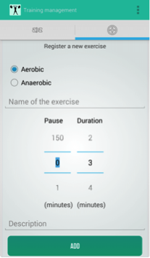
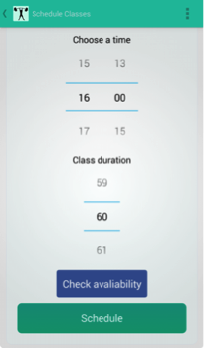
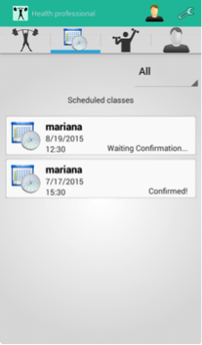

WorkUp: A Mobile Application to Support Health Guidelines
HEALTHINF
2017
10th International Conference on Health Informatics
Vinicius dos Santos¹, Henrique Shishido¹ (shishido@utfpr.edu.br), Francisco Pereira Junior¹ and Gabrielle Jacklin Eler²
¹Department of Computing – Federal University of Paraná
²Collegiate of Nursing – Federal Institute of Paraná
Background
Cloud data synchronization
The percentage of overweight in the global population reached approximately 60%;
Several countries have developed policies and guidelines for supporting health promotion;
Mobile applications is one way to promote the practice of physical activities;
However, fewer mobile apps evaluate patients’ anthropometric data and to prescribe physical exercises.
Features
Results
Training
Collection and monitoring of anthropometric data;
Multiple equations for computing body fat using skinfold;
Support of prescription of physical exercises;
Class scheduling and interaction between health professional and patient.
Assessments
Model of health policy
(a)
(b)
(c)
(d)
Figure 1: Evaluation and training management: (a) Objectives and blood pressure; (b) QPAF Questionnaire; (c) Training; (d) Edit training
Log of Exercises
Scheduling a class
(a)
(b)
(c)
(d)
Figure 2: Evaluation and training management: (a) Objectives and blood pressure; (b) QPAF Questionnaire; (c) Training; (d) Edit training
Evaluation
Health professionals and patients have tested the WorkUp and their overall opinion are summarized in 5 categories:
Interface and applications restrictions: No serious issues were reported by users. However, health professionals suggested a more restrictive application would be interesting for results achievement. “There are many features, but it would be interesting restrict the app functionalities exclusively to the important features.” (Health Professional)
Patient data and activities tracking: Participants emphasized that the control of physical activities is important to establishing goals and analyze if results have achieved them. “I need to know to track if the patient is losing weight and if the goals are being achieved.” (Health Professional)
Conclusion and Outlook
Ability to monitor more patients: Health professionals were receptive when asked about the ability of WorkUp to manage multiple patients. “I see it as an easy way to record my patients data and control more efficiently my schedule.” (Health Professional).
WorkUp can be a base model for supporting government health programs to promote a healthier life in population.
Accessbility of information: Both health professionals and patients pointed out that they feel confused to navigate on WorkUp interface. “In the first moment, I did not find some functionalities. But, once it is explained it was easy to access it.” (Patient).
Ongoing research:
Refine app functionalities to meet users’ requirements only;
Support sensors, as smartwatch and smartbands;
Conduct a pilot project in a health unit using WorkUp to evaluate its adherence and effectiveness as support in reducing obesity.
Information distortion: The health professionals point out that patients can distort the feedback of exercises. “It is not guarantee that the data provided by a patient is really reliable.” (Health Professional).
Virtual Poster
Sources
Acknowledgments
Scan this QR code with your smartphone to see
the poster online version.
Al Ayubi, S. U., Parmanto, B., Branch, R., and Ding, D. (2014). A persuasive and social mhealth application for physical activity: A usability and feasibility study. JMIR mHealth and uHealth.
Knight, E., Stuckey, M. I., Prapavessis, H., and Petrella, R. J. (2015). Public health guidelines for physical activity: is there an app for that? a review of android and apple app stores. JMIR mHealth and uHealth.
Schmidt, M. I., Duncan, B. B., e Silva, G. A., Menezes, A. M., Monteiro, C. A., Barreto, S. M., Chor, D., and Menezes, P. R. (2011). Chronic non-communicable diseases in Brazil: burden and current challenges. The Lancet.
The authors acknowledge BIOSTEC and UTFPR for the funding provided to registration. They are also indebted to UTFPR for revising the paper.

