Slide 1

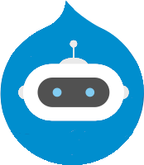
Creating a Custom Rasa Conversational AI Chatbot for Drupal Websites
Rick Torzynski
Senior Drupal Developer, ECS
Sponsored by Esteemed

Slide 2



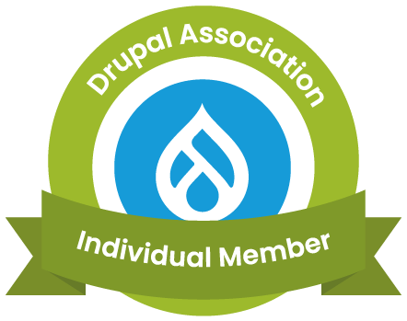
About Me
I've been a Drupal Developer for 13+ years, currently working on United States government agency Drupal websites. I have worked on healthcare Drupal websites, machine learning applications, and Ecommerce websites.
Senior Drupal Developer
Drupal Developer at Florida Blue
Senior Software Engineer
Drupal Username: mandolinrick

Slide 3
Our Agenda
Gentle Introduction to ML and NLP
How Chatbots Work
Brief Discussion of Different Chatbots
Overview of Rasa Conversational AI
Create a Knowledge/Conversation Base
How to Add a Rasa Chatbot to a Drupal Website
Conversation Driven Development
Questions?

Slide 4
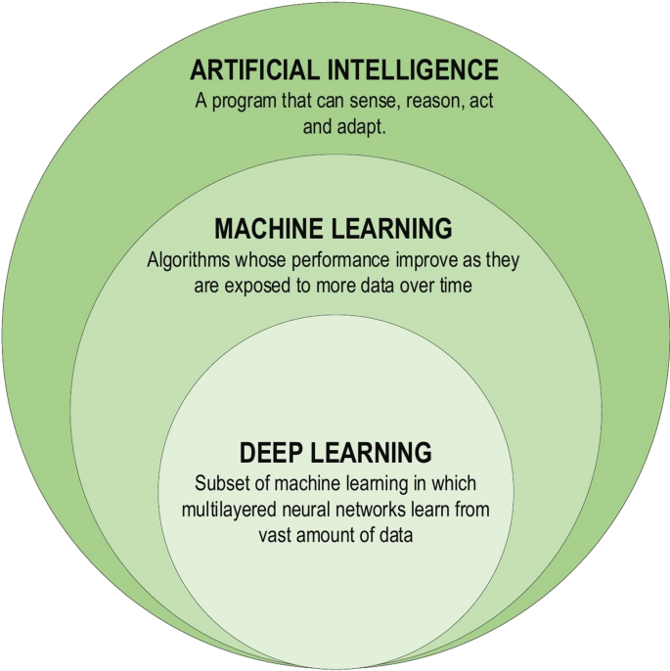
Machine Learning
"Machine learning focuses on applications that learn from experience and improve their decision-making or predictive accuracy over time." - IBM

Slide 5
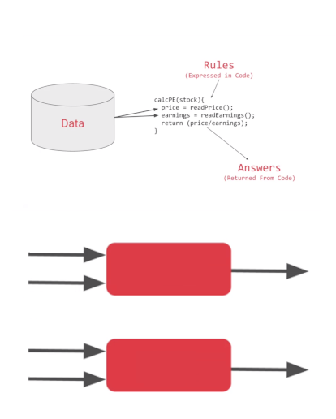
Machine Learning
Types of Machine Learning
Supervised Learning - for a set of data, the outcome is known (linear regression, classification)
Unsupervised Learning
Programming Paradigm
Traditional Programming
Data/Input + Rules = Answers
Machine Learning
Data/Input + Answers = Rules
Rules
Traditional
Programming
Answers
Data
Answers
Data
Machine
Learning
Rules
Diagram: Moroney, L. (2021). AI and Machine Learning for Coders: A Programmer’s Guide to Artificial Intelligence. O’Reilly.

Slide 6
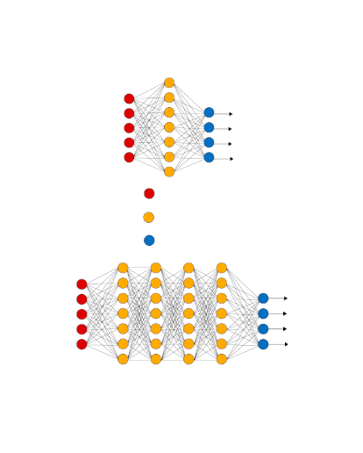
Deep Learning
“A subfield of machine learning concerned with algorithms inspired by the structure and function of the brain called artificial neural networks.”
Input Layer - Images, text, audio, video, numbers, etc. Must be quantifiable.
Hidden Layers - Filters for feature extraction
Output Layer - Classification, prediction
Activation Function - takes in the output signal from the previous cell and converts it into some form that can be taken as input to the next cell.
Sigmoid, ReLU and Softmax
Input Layer
Hidden Layer
Output Layer

Slide 7
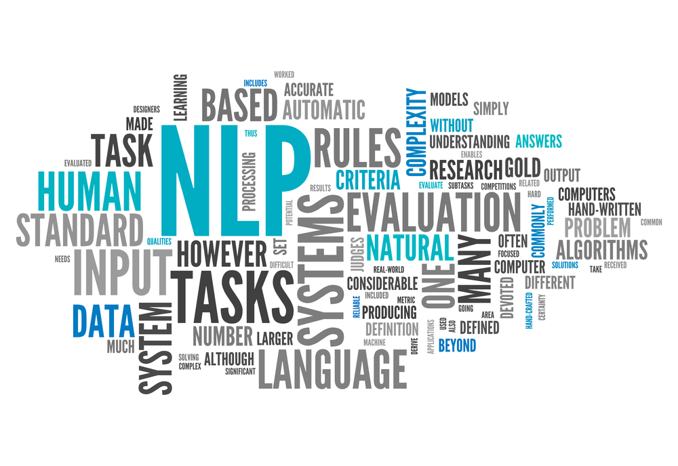
Deep Learning
Components of NLP
Natural Language Processing (NLP)
NLP is a subset of AI and is what happens when computers read language. NLP turns language into structured data.
Parsing, tokenizing, stemming, text summarization, text categorization, wordclouds etc.
Natural Language Understanding (NLU)
NLU is a subset of NLP and is what happens when computers understands language.
Sentiment detection, topic classification, intent classification, and entity detection are examples
Natural Language Generation (NLG)
NLG is what happens when computers write language. NLG turns structured data into language.
Examples include text generation, story generation, music generation and chatbot responses.

Slide 8
How Chatbots Work
Intent Recognition/Classification
What the user wants to do
Raw text in, machine readable information out
Can also be rule-based or regex
Neural Models such as transformer models (BERT, DIET)
Dialogue Management
Dialogue Policy - what should the chatbot do next based on the conversation
Uses some rules
Transformer Embedding Dialogue (TED) Policy - selects which action to take next
Requires training examples
Response and/or Action Taken
Action can be utterance
Action could be an automated process or call to another API
Another step in the conversation

Slide 9
Components of Intent Based Chatbot
Intents
What the user wants to do
Entities
Important pieces of information
Stories
Ways the conservation can go
Training data
Actions
What action the chatbot can take
Slots
Key, value pair acts as memory of the chatbot

Slide 10




Chatbot Providers and Frameworks

Slide 11
Why Choose Rasa?
Pros
Cons
Open source
Uses YAML for configuration and content files
Well documented RESTful API
Active development
Excellent support
Documentation
Active YouTube channel
Office hours
Cutting edge models and pipelines
Graph based development pipeline in 3.0 to greatly reduce training time
Customizable
Written in Python
Model development - Python
Model inference - JavaScript
Requires machine learning education/development
Needed for meaningful development
Complex
Needed for extreme customization
Requires creation of knowledge base/training stories
Single domain chatbot
AnswerThePublic.com
Excellent source material

Slide 12
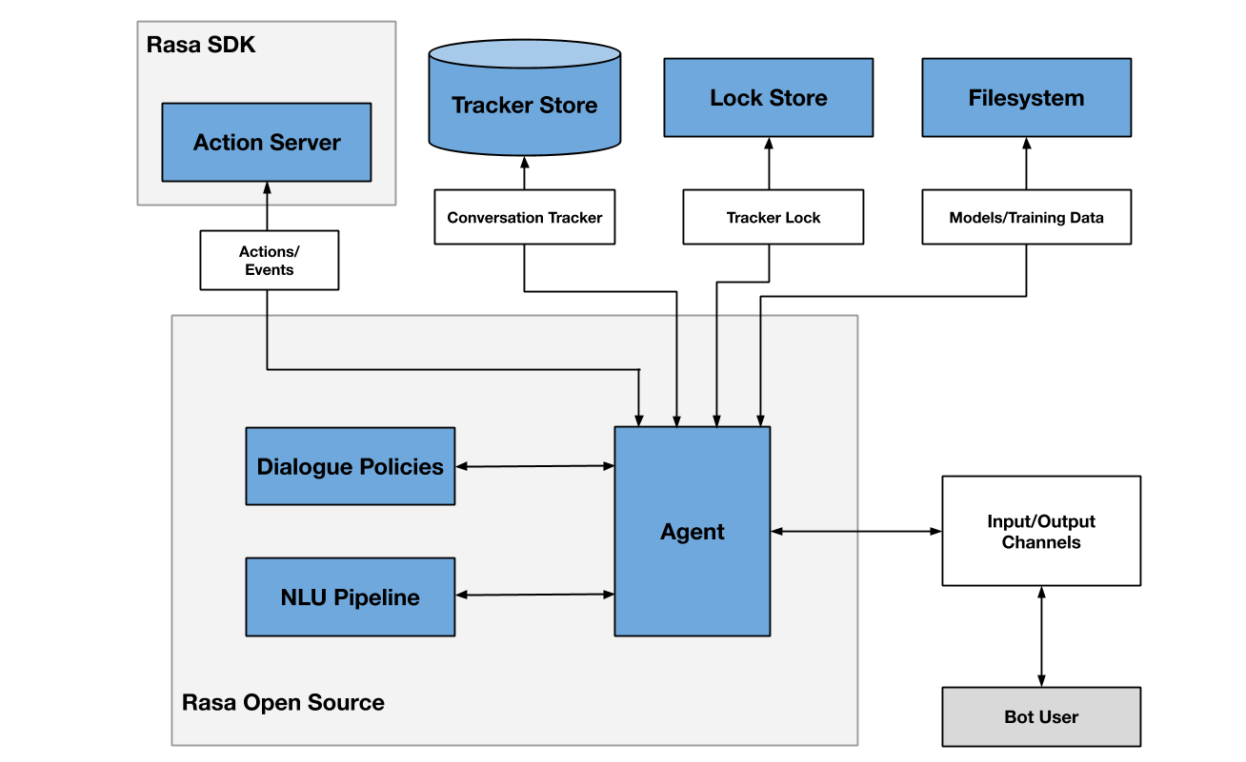
Rasa Architecture

Slide 13
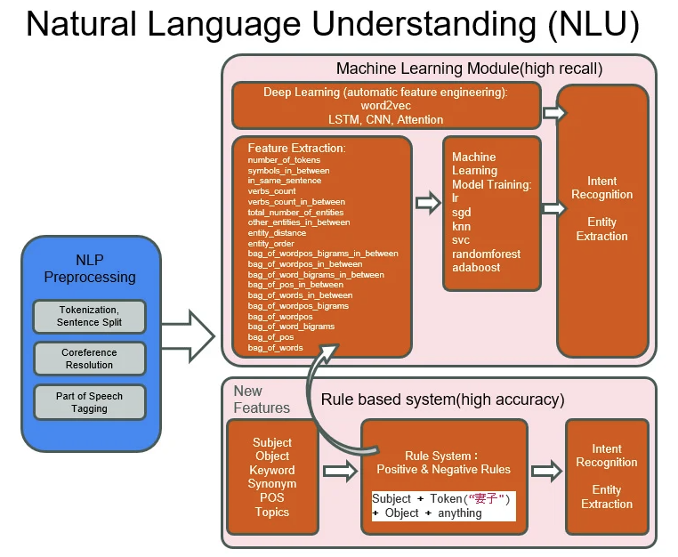
Rasa - NLU

Slide 14
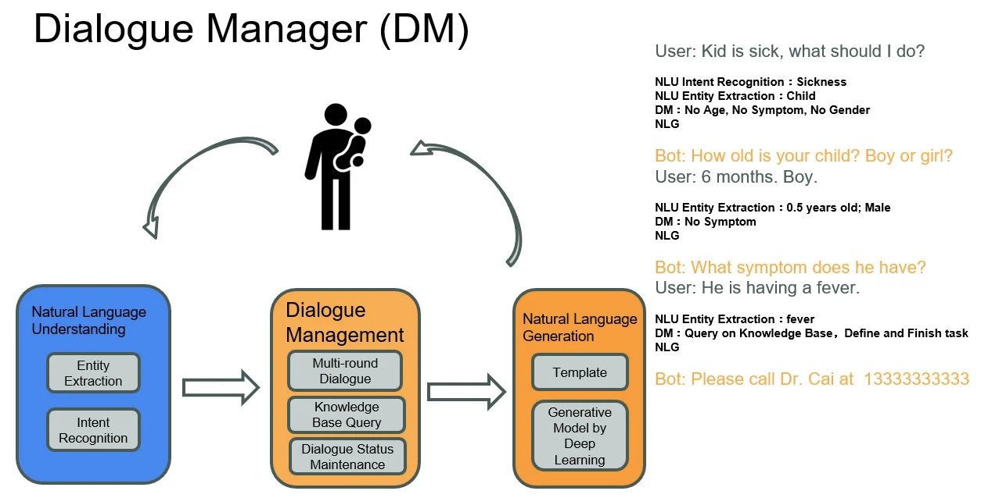
Rasa - DM

Slide 15
Installing Rasa
For Ubuntu
$ sudo apt update
Install python3
$ sudo apt install python3-dev python3
$ sudo apt install python3-venv
Create virtual environment
$ python3 -m venv ./venv
Activate venv environment
$ source ./venv/bin/activate
Install Rasa and Upgrade pip
(venv)$ python -m pip install --upgrade pip rasa
(venv)$ python -m pip install protobuf==3.20.*

Slide 16
Guidelines for First Knowledge Base
~10 Intents to start with
Simple Intents
Use expert knowledge (Business Analyst)
Use AnswerThePublic.com to get list of most popular domain questions

Slide 17
Answer The Public
https://answerthepublic.com
Answer the Public Results
Who
who's online
who uses
who owns drupal
who created drupal
who makes drupal
What
what drupal theme is that
what drupal is used for
what drupal version do i have
what drupal version
what drupal site
Which
which drupal stack is used for installation
which drupal version
which drupal theme is used
which drupal version am i running
drupal which database
Where
where is settings.php
where are the images stored
where is php.ini
where is database configuration
where are pages stored

Slide 18
Creating Knowledge Base for Rasa Chatbot
Create new chatbot
$ rasa init
Create data/nlu.yml
Create data/stories.yml
Create domain.yml
Train Model
$ rasa train
Start up rasa server:
$ rasa run --enable-api --model ./models --endpoints ./endpoints.yml --cors "*"
…/Rasa/chatbot
…/actions
…/actions.py
…/__init.py
…/config.yml
…/credentials.yml
…/data
…/nlu.yml
…/rules.yml
…/stories.yml
…/domain.yml
…/endpoints.yml
…/tests
…/test_stories.yml

Slide 19
Creating Intent and Utterance
Create intent in nlu.yml
Add response in domain.yml
Add the intent to the list of intents in domain.yml
Add story to stories.yml

Slide 20
Installing and Creating Custom Component Module
Create AI Chatbot Rasa Component
Install Component Module
Enable Component Module
Create custom ai_chatbot module
Create Page content type
Add AI Chatbot Comp Rasa block to body section.
File Structure
…/web/modules/custom/ai_chatbot
…/ai_chatbot
…/ai_chatbot.info.yml
…/components
…/comp_rasa
…/comp_rasa.component.yml
…/index.html
…/css
…/Chatroom.css
…/js
…/Chatroom.js
…/rasa.js

Slide 21
What Does the Component Module Do?
Allows easy integration of JavaScript libraries
Create Components as blocks
Auto discovery of custom Components
Configuration through Block Configuration UI
Each component is also available as a library
Key to integrating machine learning into Drupal

Slide 22
Domain Knowledge of DropBot
1. greet - hello
2. goodbye - bye
3. affirm - yes
4. deny - no
5. bot_challenge - who are you?
6. define - what is drupal?
7. creator - who created drupal?
8. creation - when was drupal created?
9. release_7 - when was drupal7 released?
10. release_8 - when was d8 released?
11. release_9 - when was d9 released?
12. release_10 - when will d10 be released?
13. end_of_life_7 - when does d7 reach end of life?
14. end_of_life_8 - when does d8 reach end of life?
15. end_of_life_9 - when is d9 no longer supported?
16. end_of_life_10 - when will d10 reach eol?
17. number_of_sites - number of drupal sites
18. drupal_logo - show drupal logo

Slide 23
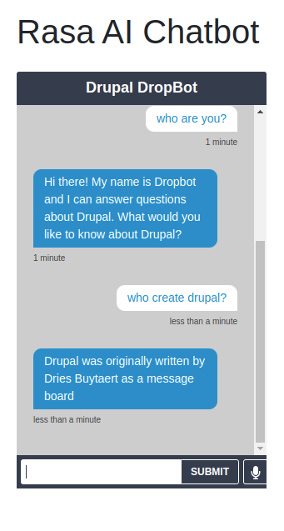
Drupal DropBot
Demo: https://drupalml.com/rasa-chatbot
Sample Questions
Who are you?
Who created Drupal?
When was it created?
When was Drupal7 released?
When was D8 released?
When does D8 reach end of life?
When was d10 released?
Rasa uses port 5005 by default

Slide 24
Looking to the Future
Continue to build up Drupal DropBot’s knowledge base
Add a real front-end to DropBot
I would like to start an initiative for integrating machine learning and AI into Drupal. If you would like to help with this, please let me know: ricktorzynski@gmail.com
I would like to start a YouTube channel featuring tutorials on integrated machine learning into Drupal

Slide 25
Thank You!
Matt Pritchard, Chris McGrath and my colleagues at Esteemed!
Drupal Camp Asheville for allowing me to be a remote presenter

