Slide 1
Workshop GIT
A practical guide for using GIT.
Notes:
<number>

Slide 2
Who am I ?
Rick van Ek
DevOps database engineer/DBA
Working with oracle products since 1992
Independend since 1996
Basetide associate 2017
<number>

Slide 3
Index
Basic of Git.
Git on the client.
Git server.
Multiple repositories.
Git clients
<number>

Slide 4
What is Git?
A distributed source control system
Strong support for non linear development
Different way of versioning files.
Most work is happening locally
It is just as easy to screw up as in any other system.
<number>

Slide 5
GIT, what happens under the hood
Git thinks of its data more like a series of snapshots of a miniature filesystem. With Git, every time you commit, or save the state of your project, Git basically takes a picture of what all your files look like at that moment and stores a reference to that snapshot. To be efficient, if files have not changed, Git doesn’t store the file again, just a link to the previous identical file it has already stored. Git thinks about its data more like a stream of snapshots.
<number>
Notes:
<number>

Slide 6
GIT local repository
<number>
Notes:
<number>

Slide 7
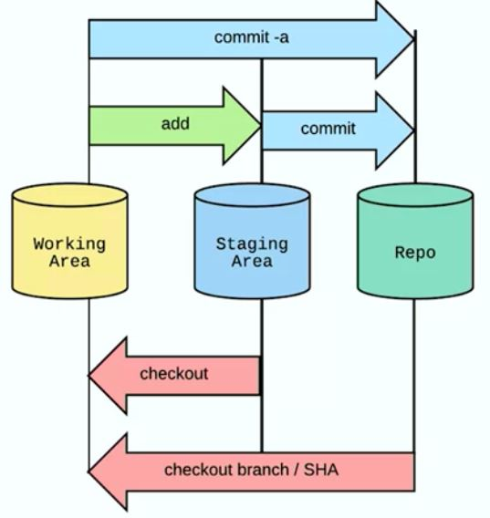
What happens in git.
<number>

Slide 8
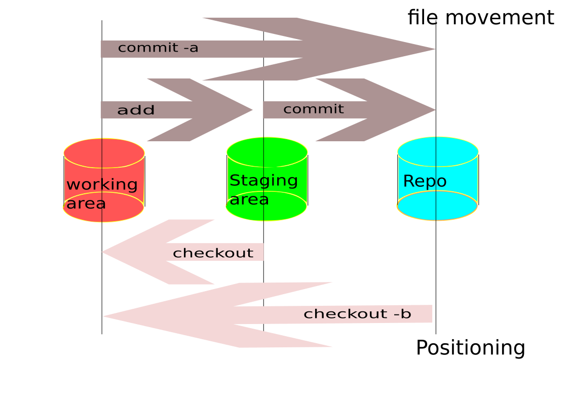
What happens in git?

Slide 9
Creating repository
Commands :
-Git init
Creates :
-.git (directory with config file and index)
-.gitignore (file in root of repository)
.Excluding : logfiles, tmp files, lock files etc…
.templates on internet
<number>
Notes:
.gitignore , needs to be created by yourself. But experience learned me. You cannot do without, it really helps to keep your branch clean.

Slide 10
Git branches
Why we need branches?
How to make branches.
How to clean them up .
This is what we will push to remote repository..
<number>
Notes:
We need to merge code to get changes from different sources aligned. This cannot happen if someone is changing directly on the master.
<number>

Slide 11
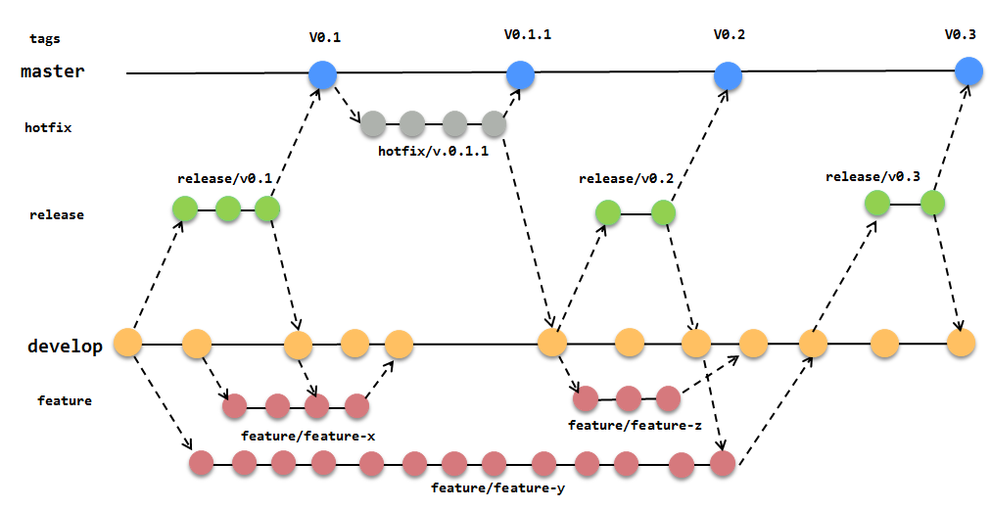
Git branches
<number>

Slide 12
Working with branches
git branch <name>
git checkout <name>
<-- do your work-- >
git add [ . | all | filename ]
git commit -m <comment>
git status
git diff
<number>
Notes:
git branch --list ( listing local branches ) git branch --all ( listing local and remote branches ) git branch -d <name> ( delete branche )
git checkout <name> ( switches to the named branch, see help to create and start in new branch git checkout -b <name > )
git-status - (Show the working tree status)
git-diff - (Show changes between commits, commit and working tree, etc)
!! watchout when using a force, could leave it in a corrupted state.
git add ( Add file contents to the index)
git commit -m <commit> ( Record changes to the repository)
<number>

Slide 13
GIT commit
Basically you cannot commit to much.
<number>
Notes:
DESCRIPTION
Create a new commit containing the current contents of the index and the given log message describing the changes. The new commit is a direct child of HEAD, usually the tip of the
current branch, and the branch is updated to point to it (unless no branch is associated with the working tree, in which case HEAD is "detached" as described in git-checkout(1)).
The content to be committed can be specified in several ways:
1. by using git-add(1) to incrementally "add" changes to the index before using the commit command (Note: even modified files must be "added");
2. by using git-rm(1) to remove files from the working tree and the index, again before using the commit command;
3. by listing files as arguments to the commit command (without --interactive or --patch switch), in which case the commit will ignore changes staged in the index, and instead record
the current content of the listed files (which must already be known to Git);
4. by using the -a switch with the commit command to automatically "add" changes from all known files (i.e. all files that are already listed in the index) and to automatically "rm"
files in the index that have been removed from the working tree, and then perform the actual commit;
5. by using the --interactive or --patch switches with the commit command to decide one by one which files or hunks should be part of the commit in addition to contents in the index,
before finalizing the operation.
If you make a commit and then find a mistake immediately after that, you can recover from it with git reset.
<number>

Slide 14
GIT commit messages
Recommended Guidelines.
1 Separate subject from body with a blank line
2 Limit the subject line to 50 characters
3 Capitalize the subject line
4 Do not end the subject line with a period
5 Use the imperative mood in the subject line
6 Wrap the body at 72 characters
7 Use the body to explain what and why vs. how
<number>
Notes:
<number>

Slide 15
GIT commit message example
$ git log --oneline -5 --author pwebb --before "Sat Aug 30 2014"
5ba3db6 Fix failing CompositePropertySourceTests
84564a0 Rework @PropertySource early parsing logic
e142fd1 Add tests for ImportSelector meta-data
887815f Update docbook dependency and generate epub
ac8326d Polish mockito usage
<number>
Notes:
<number>

Slide 16
Git stash
Saving work in between.
Can be recalled at any time in any branch.
Command:
git stash push
git stash pop
git stash list
man git-stash (documentation)
<number>
Notes:
Use git stash when you want to record the current state of the working directory and the index, but want to go back to a clean working directory. The command saves your local
modifications away and reverts the working directory to match the HEAD commit.
The modifications stashed away by this command can be listed with git stash list, inspected with git stash show, and restored (potentially on top of a different commit) with git stash
apply. Calling git stash without any arguments is equivalent to git stash push. A stash is by default listed as "WIP on branchname ...", but you can give a more descriptive message on
the command line when you create one.
The latest stash you created is stored in refs/stash; older stashes are found in the reflog of this reference and can be named using the usual reflog syntax (e.g. stash@{0} is the most
recently created stash, stash@{1} is the one before it, stash@{2.hours.ago} is also possible). Stashes may also be referenced by specifying just the stash index (e.g. the integer n is
equivalent to stash@{n}).

Slide 17
GIT TAG
git tag <name>
- Create, list, delete or verify a tag object
Gives your references a readable, meaning full tag.
<number>
Notes:
DESCRIPTION
Add a tag reference in refs/tags/, unless -d/-l/-v is given to delete, list
or verify tags.
Unless -f is given, the named tag must not yet exist.
If one of -a, -s, or -u <keyid> is passed, the command creates a tag object,
and requires a tag message. Unless -m <msg> or -F <file> is given, an editor
is started for the user to type in the tag message.
If -m <msg> or -F <file> is given and -a, -s, and -u <keyid> are absent, -a
is implied.
Otherwise, a tag reference that points directly at the given object (i.e., a
lightweight tag) is created.
A GnuPG signed tag object will be created when -s or -u <keyid> is used.
When -u <keyid> is not used, the committer identity for the current user is
used to find the GnuPG key for signing. The configuration variable
gpg.program is used to specify custom GnuPG binary.
Tag objects (created with -a, -s, or -u) are called "annotated" tags; they
contain a creation date, the tagger name and e-mail, a tagging message, and
an optional GnuPG signature. Whereas a "lightweight" tag is simply a name
for an object (usually a commit object).
Annotated tags are meant for release while lightweight tags are meant for
private or temporary object labels. For this reason, some git commands for
naming objects (like git describe) will ignore lightweight tags by default.
<number>

Slide 18
GIT demo time
<number>
Notes:
<number>

Slide 19
Git branches
<number>

Slide 20
What are the consequences?
Just about any file type can be used.
Almost all work is done locally.
Although it is very flexible, you need to use a structure.
<number>
Notes:
<number>

Slide 21
Working with remote repository
<number>
Notes:
<number>

Slide 22
Remote repository
Setting up
Configuration
Ssh keys
Pushing branches
Cloning

Slide 23
Setting up server site
git-shell for limited access
gitweb, standard cgi scripts for basic webservice. ( for use with apache )
bitbucket
Hosted :
github, gitlab, bitbucket, etc
<number>
Notes:
<number>

Slide 24
Configure server
$ cd /u01/git
$ mkdir <myproject>
$ cd <myproject>
$ git init --bare
<number>
Notes:
--bare
Create a bare repository. If GIT_DIR environment is not set, it is set to the
current working directory.
<number>

Slide 25
SSH keys
If you do not want to enter username/password all the time , user ssh keys.
Place the public key in the .ssh directory in the home of the user git on the server .
<number>
Notes:
<number>

Slide 26
Initial commit , pushing master
$ cd <myproject>
$ git init
$ git add .
$ git commit -m 'initial commit'
$ git remote add origin user@gitserver:/u01/git/<myproject>
$ git push origin master
<number>
Notes:
<number>

Slide 27
Starting local based on remote repository
$ mkdir <myproject>
$ cd <myproject>
$ git clone user@gitserver:/u01/git/<myproject>
<number>
Notes:
<number>

Slide 28
Clone repository
Easiest way of starting
Make an empty directory
Do git clone <remote repository> [ --branch <branch name>]
Notes:
Clones a repository into a newly created directory, creates remote-tracking branches for each branch in the cloned repository (visible using git branch --remotes), and creates and checks
out an initial branch that is forked from the cloned repository’s currently active branch.
After the clone, a plain git fetch without arguments will update all the remote-tracking branches, and a git pull without arguments will in addition merge the remote master branch into
the current master branch, if any (this is untrue when "--single-branch" is given; see below).
This default configuration is achieved by creating references to the remote branch heads under refs/remotes/origin and by initializing remote.origin.url and remote.origin.fetch
configuration variables.

Slide 29
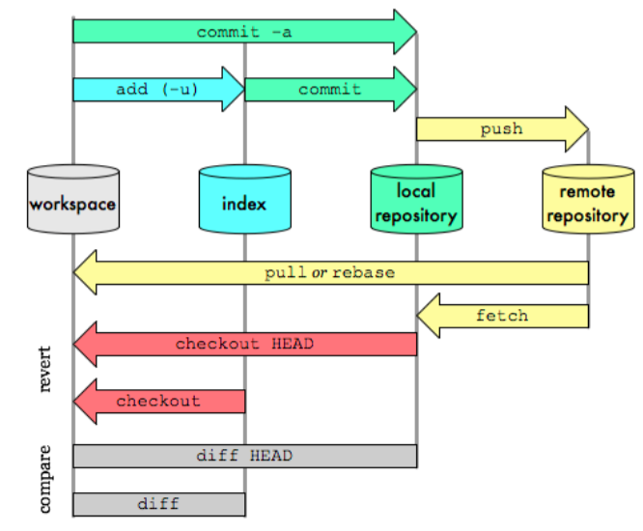
How Git works with remote.
<number>

Slide 30
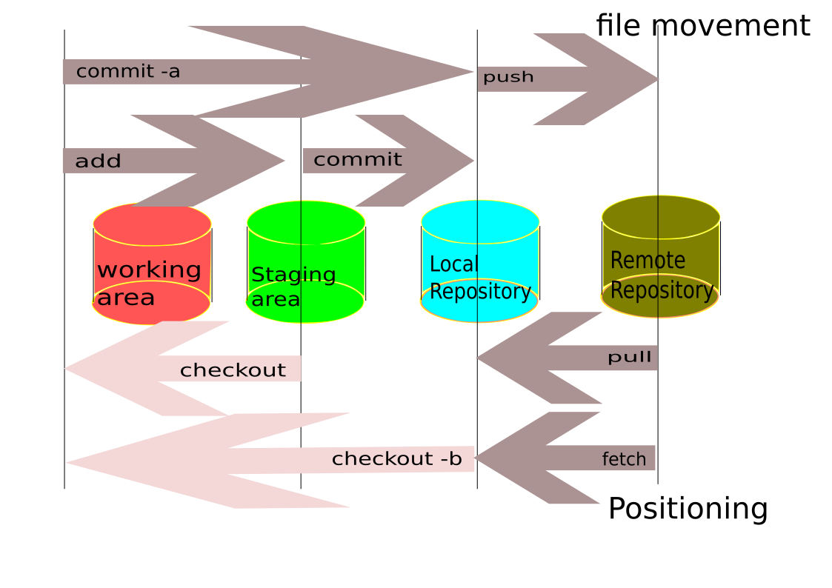
How Git works remote​?

Slide 31
Sync your work with remote
Pull, get the latest changes from remote.
Pull origin <your branch>
Fetch, get a remote branch which does not exists local.
Fetch origin <remote branch>

Slide 32
Pushing branches.
Get your branch to the remote repository for merging.
Avoid merging conflicts, do a pull before push.
<number>
Notes:
<number>

Slide 33
Pull request Never, ever do changes on master.
Lock the master
Enforce pull request
-Needs to be reviewed by other
( four eyes principle)
-Other does the merge with master
Large project, appoint release master.
<number>
Notes:
git-merge - Join two or more development histories together

Slide 34
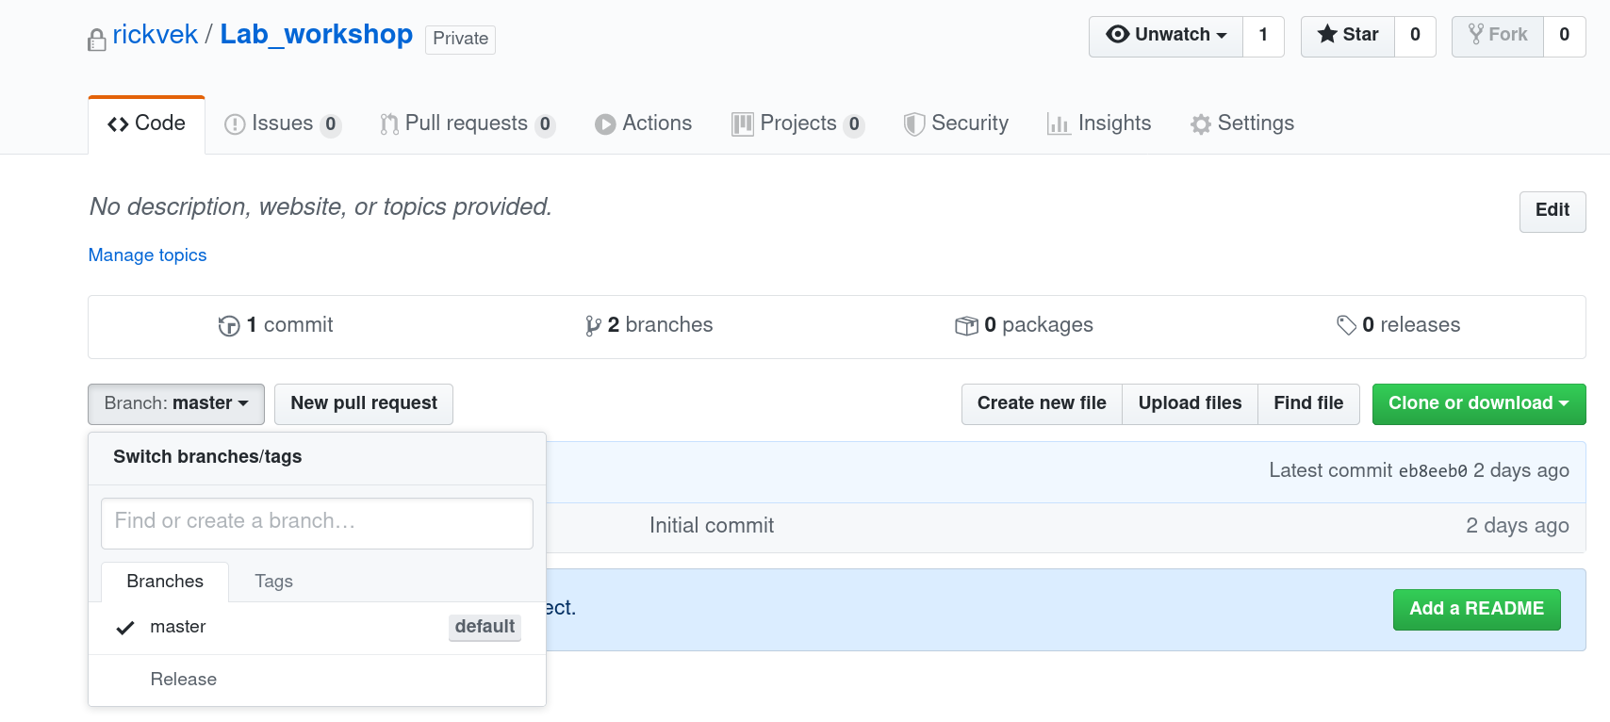
Pull request

Slide 35
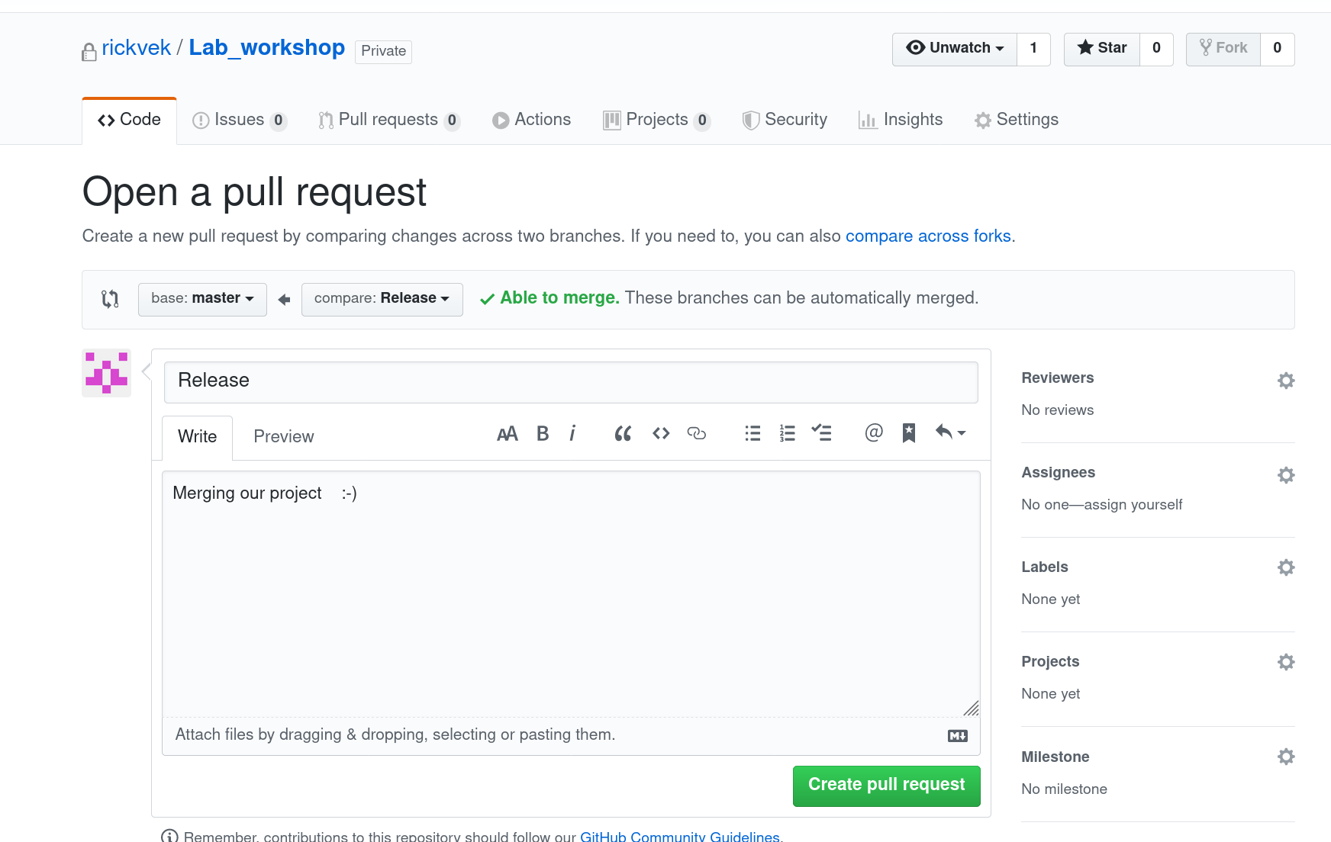
Pull request

Slide 36
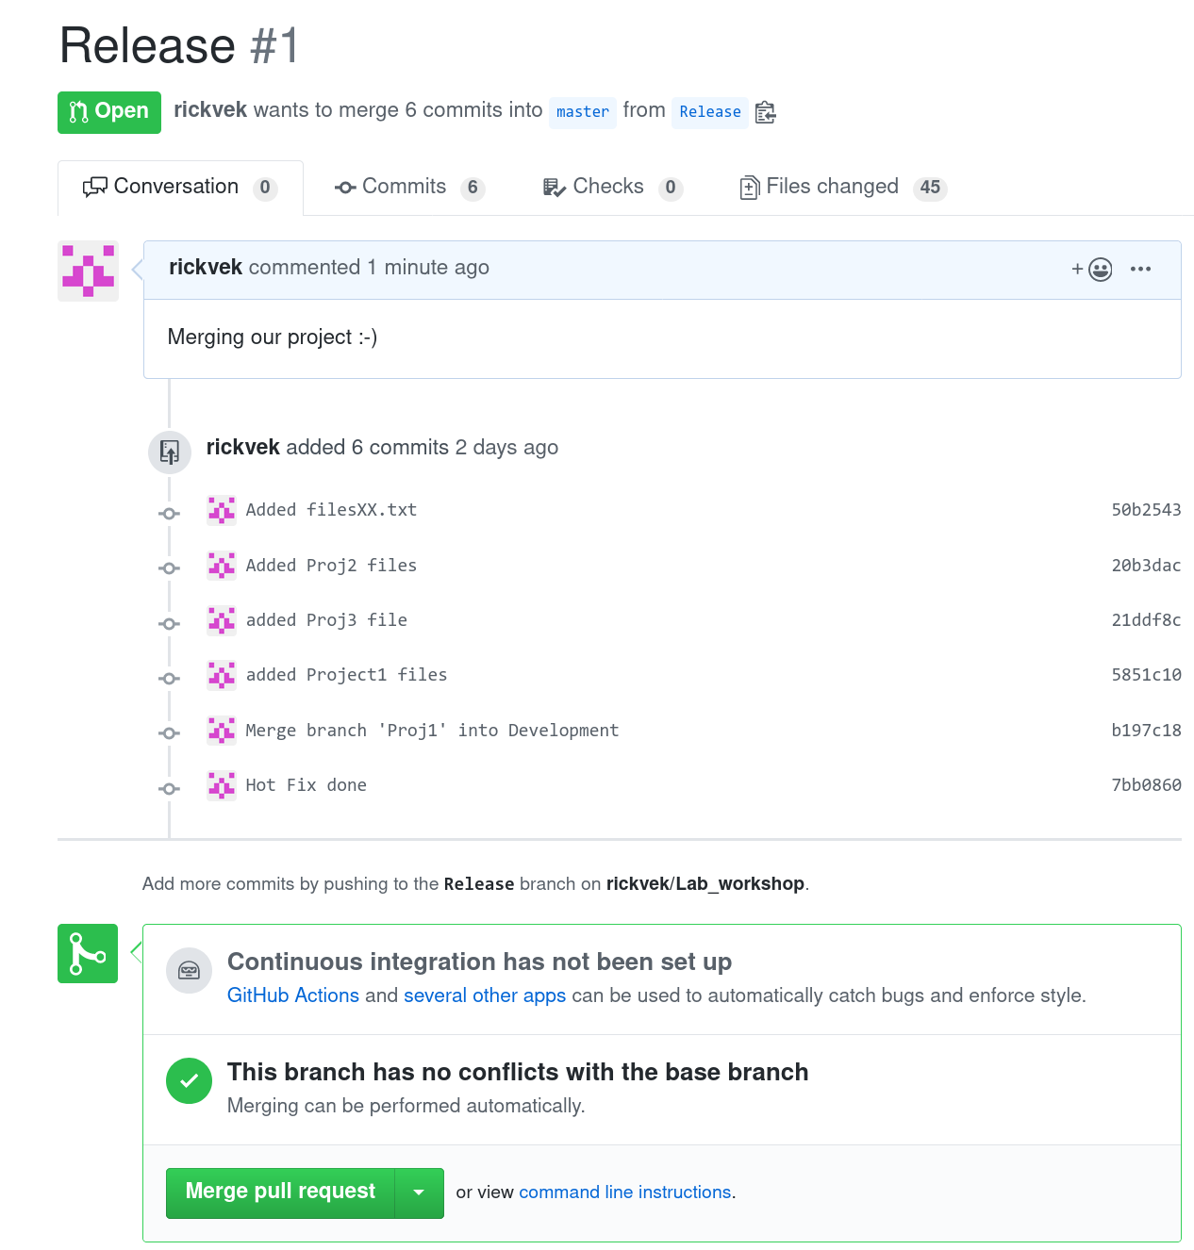

Slide 37
Multi sites
methods to use repository of multiple sites.
<number>
Notes:
<number>

Slide 38
Git submodules 1
Including another project in your project
Name submodule same as the repository
Creates subdirectory with this name
Creates .gitmodules
Contains the names and path to repository
<number>

Slide 39
Git submodules 2
A submodule is a repository embedded inside another repository.
Command :
git submodule <command> [option]
<number>
Notes:
Within projects it can happen that modules from another project is included. To make sure the future changes on these modules are implemented. And can be merged easily, the submodules are designed.

Slide 40
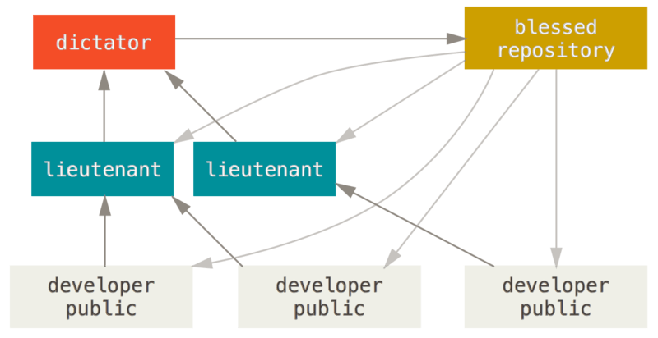
Multi remote repositories.
<number>
Notes:
Dictator and Lieutenants Workflow
This is a variant of a multiple-repository workflow. It’s generally used by huge projects with hundreds of collaborators; one famous example is the Linux kernel. Various integration managers are in charge of certain parts of the repository; they’re called lieutenants. All the lieutenants have one integration manager known as the benevolent dictator. The benevolent dictator pushes from his directory to a reference repository from which all the collaborators need to pull. The process works like this (see Benevolent dictator workflow.):
Regular developers work on their topic branch and rebase their work on top of master. The master branch is that of the reference repository to which the dictator pushes.
Lieutenants merge the developers' topic branches into their master branch.
The dictator merges the lieutenants' master branches into the dictator’s master branch.
Finally, the dictator pushes that master branch to the reference repository so the other developers can rebase on it.

Slide 41
Git client
Linux, Apple & Windows :
https://git-scm.com/download/gui/windows
<number>

Slide 42
Tools with build in git support
sqldeveloper
atom editor
pycharm
eclipse
visual studio (code)
intelliJ
etc.
Available in most developer tools.
<number>

Slide 43
Interesting documentation
Online book
https://git-scm.com/book/en/v2
Same page a pdf version v1 to download
<number>

Slide 44
Tips & Trics
Working on windows
Unix files needs permission set
git ls-files –stage
git update-index --chmod=+x foo.sh
git commit -a -m “Permissions set”

Slide 45
Lab belonging to workshop
Start lab with download:
mkdir lab
cd lab
[lab]$ git clone https://github.com/rickvek/Workshop-GIT.git
Cloning into 'Workshop-GIT'...
remote: Enumerating objects: 99, done.
remote: Counting objects: 100% (99/99), done.
remote: Compressing objects: 100% (56/56), done.
remote: Total 99 (delta 53), reused 79 (delta 41), pack-reused 0
Unpacking objects: 100% (99/99), done.
[lab]$ cd Workshop-GIT/
[Workshop-GIT]$ <find lab document Lab_GIT_Workshop >

Slide 46
Questions ?
<number>
Notes:
<number>

