Slide 1
Project title:
Design & development of an Flight Booking System.
All aspect captured in this presentation is all of what the system will manage to do.

Slide 2
Online Flight Ticketing is a kind of user assistance where customers can reserve tickets for flight in online. This is an easy method which saves a lot of time. This project entitled design and implement of an air ticket reservation system can be applicable to any airlines. The feature of this system will be similar as a common ticketing system.
As a user :
You can view the schedule
You can reserve ticket
You can cancel your reservation
You can confirm your reservation
Can view weather for the next 5 days
Can view the availability of a flight
Recommended hotels for you

Slide 3
Required Software
Windows 7 and Above
Visual Studio Code
Browser: Mozilla Firefox, google chrome ,opera ,internet explorer
Django virtual environment.
Language
HTML
CSS
JavaScript
Python
Bootstrap

Slide 4
Technical Requirements
View schedule /Reserve ticket
Searching flight schedule
Viewing statistics
Uploading Information into the system

Slide 5
Types of User
Admin
Creating a flight
Changing time schedule
Creating a new route
Updating airport information
Registering and managing users
View statistics
user
View flight schedule
Book, confirm/cancel reservation
View flight schedule

Slide 6
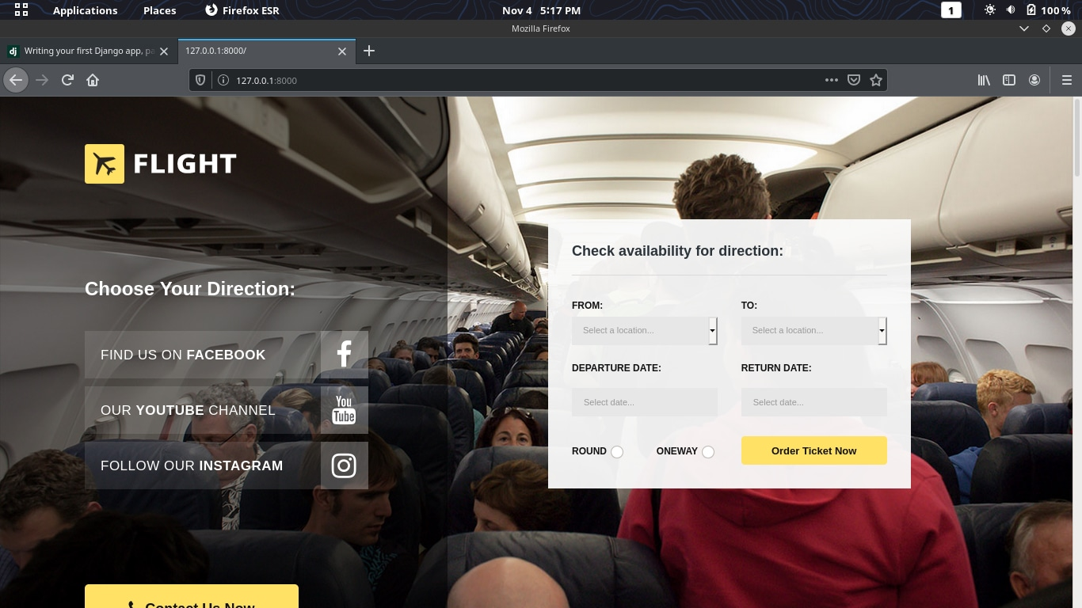
Project Description
Home Page
Home page introduces the site and user can understand that what facility we provide in this system. User can see Availability check, schedule and contact us menu in home page. User can also see the latest offers & update schedule in home page.

Slide 7
Registration and booking Page
For reserve a ticket for flight a user must be registered into the system. A user must use valid email address and valid mobile number during registration. Multiple user can not use the same email and mobile number. User must need to fill up all fields for registration and booking.

Slide 8
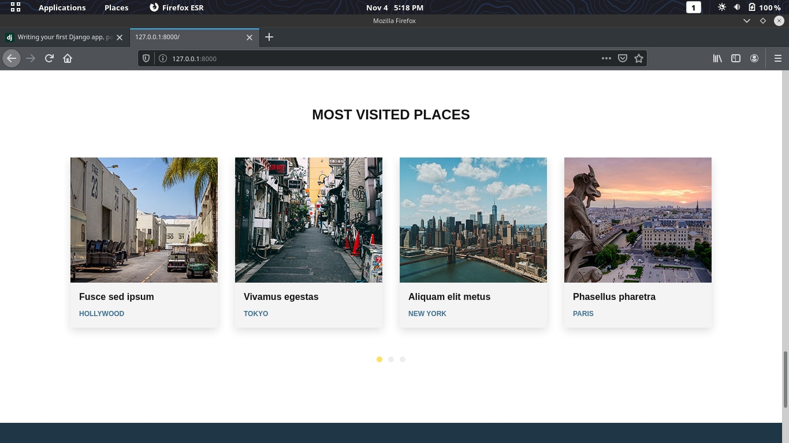
Most visited places
A user is able to see in the home page the most visited places.

Slide 9
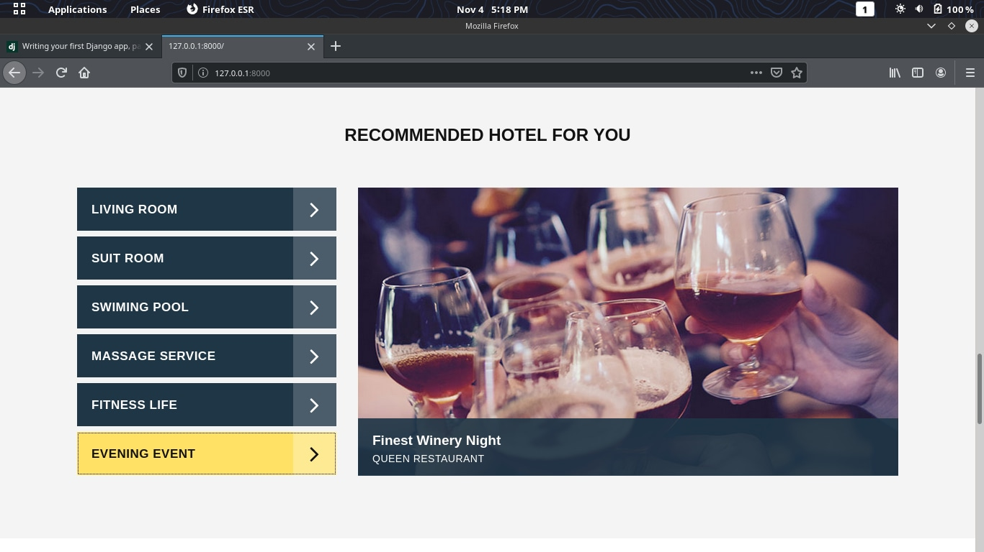
Recommended Hotels for the user

Slide 10
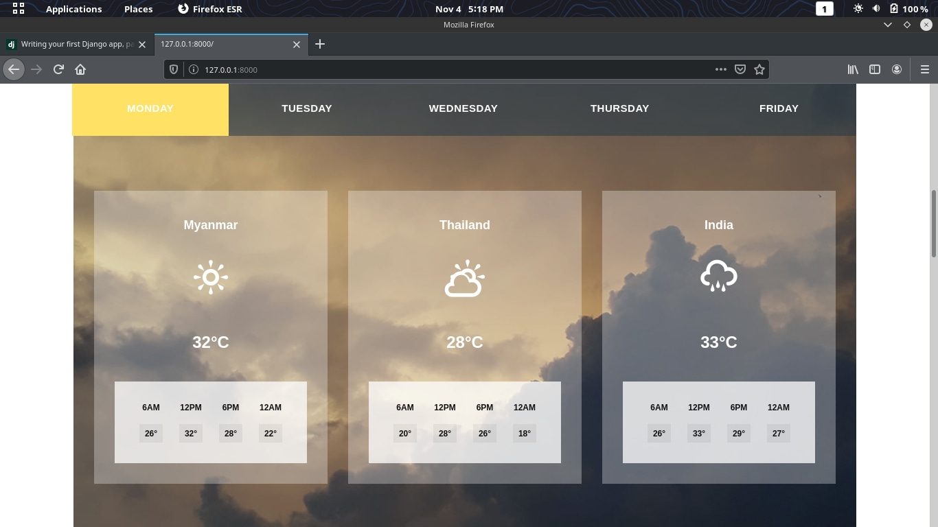
View Temperatures for different locations

Slide 11
Admin page
Admin can add flight schedule here by giving value(Choose flight, Choose Route, Departure time/date).
Admin can view report here about Airport status, Total booking, Total booking cancelled, Flights.
Admin also can access user data and status. Admin can change the status of a particular user by making.

Slide 12
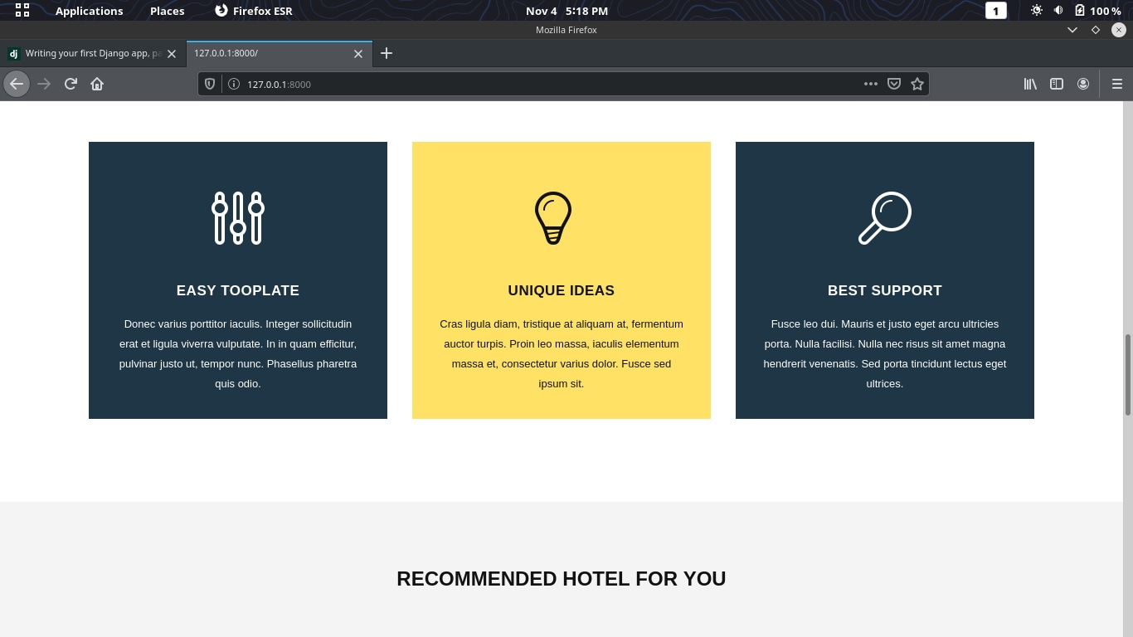

Slide 13
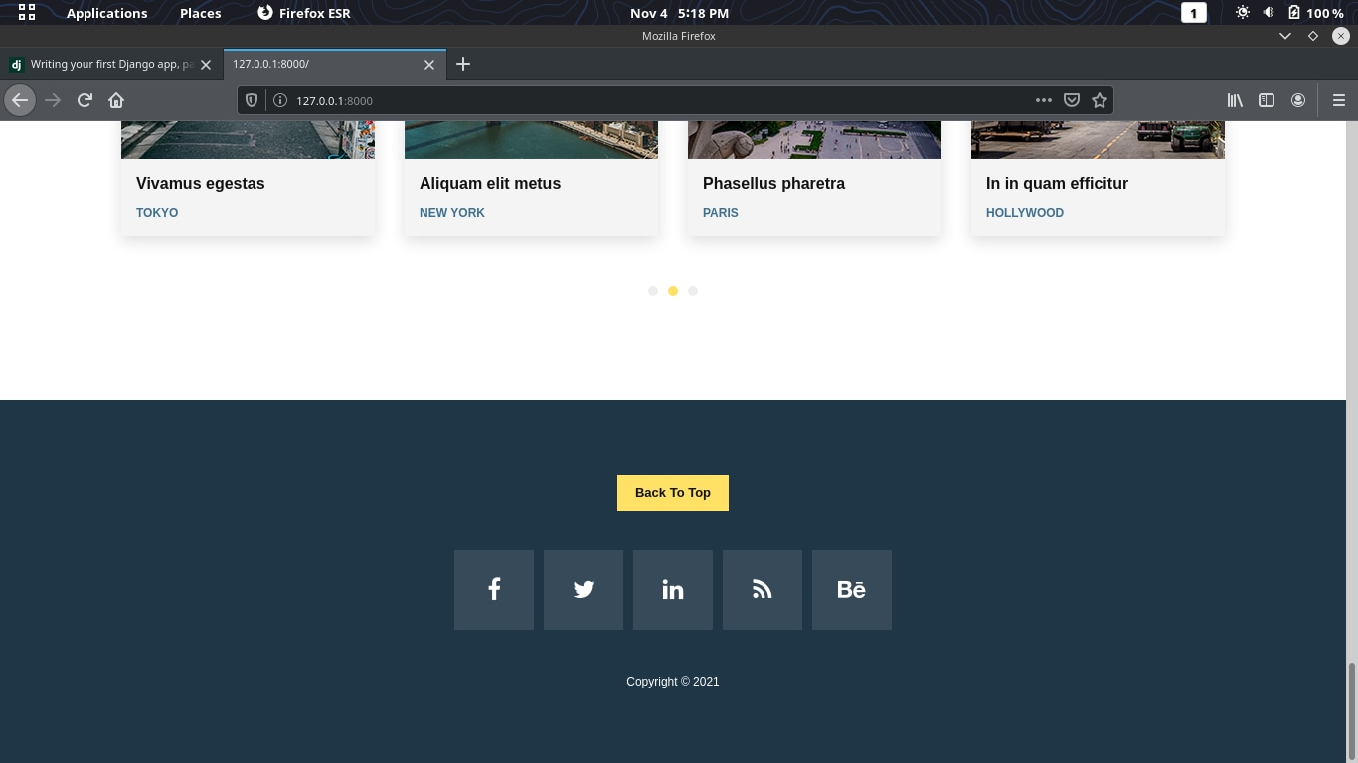
Footer

Slide 14
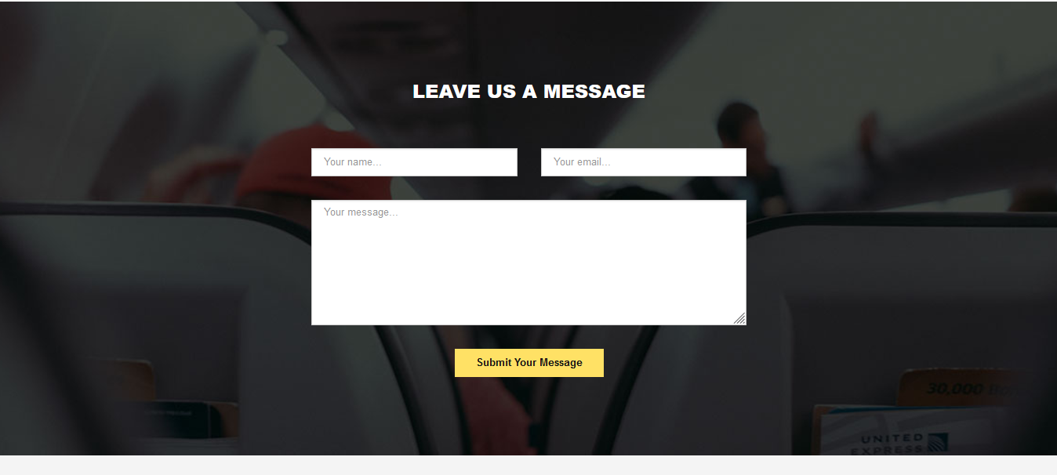
Contact Page
In this page user can contact with admin for any inquiry or suggestion. User can mail admin using his/her email, user name with specific subject.

Slide 15
Thank You

