Slide 1
THE CALL
01 / 08
Invest in clean growth.
Stay selective on coal.
OUR THESIS: Clean expansion can coexist with fossil resilience.
Clean +25.4% vs all fossil +10.3% · 196 fixed countries · 2020–2024
CLEAN ENERGY
COAL
OVERWEIGHT
UNDERWEIGHT
Diversified low-carbon generation
U.S. domestic thermal focus
Participate in growing clean output; assess valuation and financing before security selection.
Consumption fell 14.4% through 2024; the 11.3% rebound in 2025 makes the call conditional.
3-YEAR HORIZON · NOV 2026–NOV 2029 | DASHBOARD: VERIFY → COMPARE → MONITOR
Energy Transition Analyst Team
Industry allocation judgment · November 2026–November 2029 · Evidence E01–E05
Notes:
Slide 1 | Speaker A | 0:00–0:35
Our thesis is that clean electricity can grow without coal disappearing worldwide. Clean generation rose 25.4 percent through 2024, while fossil generation also increased. We therefore favor diversified low-carbon generation over three years. Our coal underweight focuses on U.S. domestic thermal producers: consumption declined through 2024, but the 2025 rebound lowers conviction. We will use the dashboard to test each claim and monitor whether that rebound persists. Security selection still requires valuation and financing evidence.
Delivery cue (not spoken): State both calls and the U.S. thermal-coal scope before explaining the evidence.
Evidence: Industry allocation judgment · November 2026–November 2029 · Evidence E01–E05

Slide 2
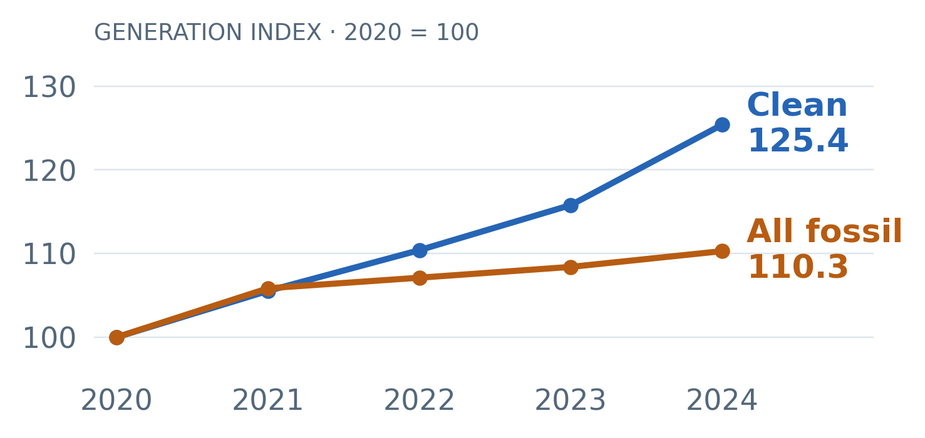
THE EVIDENCE
02 / 08
Clean grew faster.
Fossil output still increased.
2020–2024 · the same 196 countries in every year
+25.4%
Clean generation
+10.3%
All-fossil generation
Clean and fossil generation expanded together.
Ember · fixed 196-country panel, 2020–2024 · E01–E02 · Clean = renewables + nuclear
Notes:
Slide 2 | Speaker A | 0:35–1:25
Start with what the electricity system actually produced. Between 2020 and 2024, clean generation increased 25.4 percent across the same 196 countries. All-fossil generation also rose, by 10.3 percent. Clean includes renewables and nuclear.
The blue line shows faster clean growth, while the orange line shows that fossil volumes remained resilient. A cleaner mix can therefore coexist with more fossil output. We hold country coverage constant so that missing observations cannot create a false decline. Ember supplies this system view; EIA and our third dataset, the Energy Institute, let us examine coal more closely. The aggregate, however, hides different country outcomes.
Delivery cue (not spoken): Point to the two endpoints. Explain that the lines are generation indices, not investment returns.
Evidence: Ember · fixed 196-country panel, 2020–2024 · E01–E02 · Clean = renewables + nuclear

Slide 3
WHY GEOGRAPHY MATTERS
03 / 08
The coal call needs a market context.
Three examples · clean and coal generation changes, 2020–2024
China
United States
Germany
COEXISTENCE
TRANSITION
DEMAND MATTERS
Clean
+50.9%
Clean
+14.1%
Clean
-7.9%
Coal
+18.4%
Coal
-15.6%
Coal
-21.4%
Clean and coal expanded together.
Clean grew while coal generation fell.
Demand also fell; coal decline alone does not establish substitution.
Similar changes in coal can have different investment implications.
2020–2024 · Ember clean generation; EI coal generation · E07–E09 · Three illustrations, not a representative sample
Notes:
Slide 3 | Speaker B | 1:25–2:10
Three examples show why the geographic scope matters. China increased both clean and coal generation through 2024: that is coexistence. The United States combined rising clean output with falling coal generation over the same period.
Germany gives us a useful caution. Coal generation fell there, but clean output and electricity demand also fell. That result alone cannot establish clean-energy substitution. These are observed outcomes, rather than explanations of what caused them. For investors, the implication is to specify the market and business model behind a coal position. The latest year makes that distinction even more important.
Delivery cue (not spoken): Use the three examples as illustrations; do not read a list of countries.
Evidence: 2020–2024 · Ember clean generation; EI coal generation · E07–E09 · Three illustrations, not a representative sample

Slide 4
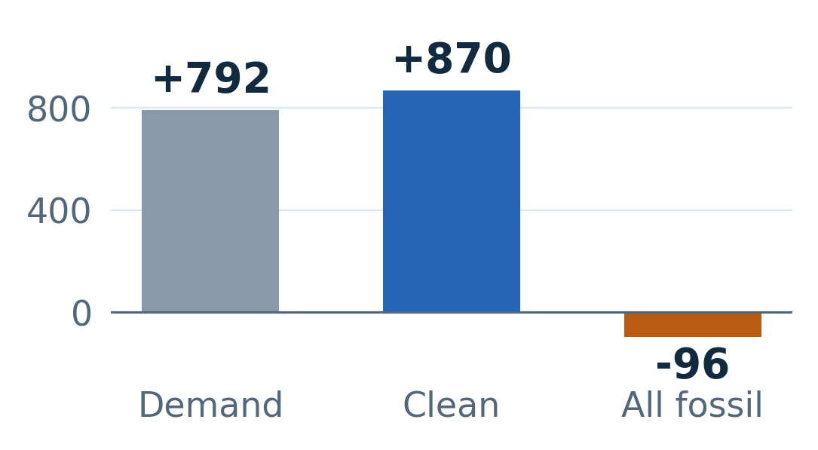
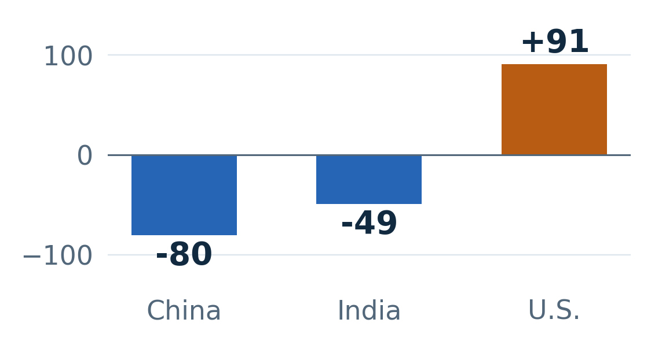
THE LATEST SIGNAL
04 / 08
2025 strengthened clean growth.
Coal moved differently by market.
ELECTRICITY ADDITIONS · 91 COUNTRIES
COAL GENERATION CHANGES · EI
Changes in TWh. The Ember sample represents 93.5% of observed 2024 extract generation, not the entire world.
The latest year supports clean growth and regional divergence.
2024–2025 changes, TWh · Left: Ember, 91 fixed countries · Right: EI coal generation · E06/E11
Notes:
Slide 4 | Speaker B | 2:10–3:05
In 2025, clean-generation additions were about 110 percent of additional electricity demand in our 91-country Ember panel. All-fossil output fell in that sample. This is a consistent comparison, not a full-world estimate: the panel represents 93.5 percent of generation observed in the 2024 extract.
The right panel asks a separate question using EI coal generation. China and India declined, while the United States increased. That supports the case for clean expansion, while showing that coal can move against the broader pattern in individual markets. One annual decline does not establish a lasting global peak. The U.S. increase is the strongest counterargument to our coal underweight.
Delivery cue (not spoken): Explain the left panel, then the right. Keep the two sources and fuel definitions separate.
Evidence: 2024–2025 changes, TWh · Left: Ember, 91 fixed countries · Right: EI coal generation · E06/E11

Slide 5
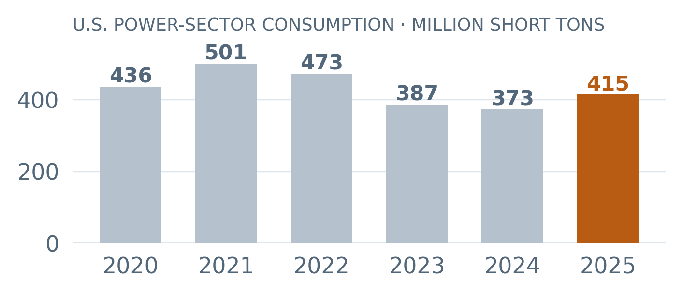
THE COUNTERARGUMENT
05 / 08
U.S. coal recovered in 2025.
Our underweight depends on persistence.
-14.4%
2020–2024 decline
+11.3%
2025 rebound
-4.7%
2025 vs 2020
Second measure: EI U.S. coal generation +91.2 TWh in 2025.
Same upward direction; generation and consumption have different units.
RECONSIDER if consumption stays above 2024 for two further annual releases.
Dashboard: United States → US electric power coal, 2020–2025
Historical decline supports caution; the rebound lowers conviction.
EIA national electric-power sector 98 · E04/E05; EI U.S. coal generation · E11 · Analyst monitoring rule
Notes:
Slide 5 | Speaker C | 3:05–4:00
Our U.S. coal position is conditional. EIA power-sector coal consumption fell 14.4 percent from 2020 to 2024, then rebounded 11.3 percent in 2025. It remained 4.7 percent below 2020. The historical decline supports caution on domestic thermal exposure, but the rebound lowers our conviction.
A second measure supports the direction: EI reports higher U.S. coal-fired generation in 2025. Consumption is measured in short tons; generation is in terawatt-hours. We compare their direction, without treating them as equivalent or identifying the cause.
Our monitoring rule is to reconsider the underweight if consumption stays above its 2024 level for two further annual releases. In the dashboard, open United States and the national consumption history to inspect this risk.
Delivery cue (not spoken): Show the decline, rebound and remaining gap; distinguish EIA short tons from EI TWh. Point to the persistence rule and dashboard route.
Evidence: EIA national electric-power sector 98 · E04/E05; EI U.S. coal generation · E11 · Analyst monitoring rule

Slide 6
THE ALLOCATION
06 / 08
Match the country to the sector.
Then test the investment economics.
UNITED STATES
CHINA
GERMANY
Domestic thermal coal
Low-carbon generation
Utilities & generation
CONDITIONAL UNDERWEIGHT
RESEARCH PRIORITY
RESEARCH PRIORITY
Power coal consumption −14.4% through 2024; +11.3% in 2025.
Clean +50.9%; coal +18.4% through 2024: both expanded.
Clean −7.9%; coal −21.4%; demand −4.6% through 2024.
Check exposure to domestic power demand; monitor rebound persistence.
Diligence on generation owners: contracts, cash flow and financing.
Check demand, electricity trade and revenue exposure before allocation.
China / Germany: diligence priorities, not buy ratings. All exposures need valuation and financial checks.
Favor clean growth; use country evidence to guide sector diligence.
2020–2024 country evidence · E04/E05/E08/E09 · Sector priorities are analyst interpretations, not security ratings
Notes:
Slide 6 | Speaker C | 4:00–4:55
Our broad preference is diversified low-carbon generation. Country evidence then guides which sector exposures deserve closer attention. In the United States, the coal underweight focuses on domestic thermal producers serving power demand. Consumption declined through 2024, but the rebound makes that view conditional.
In China, clean generation rose 50.9 percent while coal rose 18.4 percent. Prioritize diligence on low-carbon generation owners without assuming coal demand immediately disappears. In Germany, clean generation, coal and demand all fell. For utilities and generation owners, investigate demand exposure, electricity trade and revenue contracts before making an allocation.
China and Germany are research priorities, not country buy ratings. Across all three, check valuation, cash flow, financing and the company’s actual revenue exposure before selecting securities.
Delivery cue (not spoken): Distinguish the U.S. underweight from China and Germany research priorities. Link each sector to its observed country pathway.
Evidence: 2020–2024 country evidence · E04/E05/E08/E09 · Sector priorities are analyst interpretations, not security ratings

Slide 7
THE DECISION RULES
07 / 08
What would change our view?
MONITOR
RECONSIDER WHEN…
RESPONSE
Coal recovery
U.S. consumption stays above 2024
for two further annual releases.
Reduce the coal
underweight.
Clean momentum
Two comparable years without clean-share
gains, alongside rising fossil output.
Reassess the clean
overweight.
Investment economics
Weak project returns or financing pressure.
Additional financial data is required.
Review security
selection.
Data limits: changing coverage · source vintages · local EI download provenance
Use observable reversal conditions, and keep the data limits explicit.
Analyst monitoring rules · SOURCES.md and PROJECT_AUDIT.md document source and coverage limitations
Notes:
Slide 7 | Speaker D | 4:55–5:40
We would monitor three things. For coal, reconsider the U.S. underweight if consumption remains above its 2024 level for two further annual releases. For clean energy, reassess the overweight after two comparable years without clean-share gains, alongside rising fossil generation.
For the investments themselves, weak project returns or financing pressure would require another look at security selection. These are analyst decision rules, not fitted forecasts. We also retain the source limitations: incomplete country coverage, differences between data vintages, and an unverified original edition and download date for the local EI file. Those limits constrain the confidence and precision of the recommendation.
Delivery cue (not spoken): Explain the monitoring rules as judgment calls, not forecasts or estimated probabilities.
Evidence: Analyst monitoring rules · SOURCES.md and PROJECT_AUDIT.md document source and coverage limitations

Slide 8
THE DECISION
08 / 08
Own clean growth.
Keep coal exposure selective.
OVERWEIGHT CLEAN ENERGY
Diversified low-carbon generation
UNDERWEIGHT COAL
U.S. domestic thermal focus
THREE-YEAR HORIZON | REVIEW THE POSITION AS THE EVIDENCE CHANGES
Industry outlook judgment · Supporting data, methods and country research remain in the repository and dashboard
Notes:
Slide 8 | Speaker D | 5:40–6:15
Our conclusion is to overweight clean energy and underweight coal over three years, with the coal position focused on U.S. domestic thermal exposure. The evidence supports a growing clean-electricity industry and an uneven outlook for coal.
We would track generation additions, U.S. coal consumption and the economics of the investments available. The position should change when the evidence changes. For now, our recommendation is to participate in clean-power expansion and keep the coal underweight focused.
Delivery cue (not spoken): Finish with the allocation and horizon. Pause after the final sentence.
Evidence: Industry outlook judgment · Supporting data, methods and country research remain in the repository and dashboard

Slide 9
EVIDENCE APPENDIX · DATA & INTEGRATION
A01
Three sources, three distinct measurement roles
CORE 1 · EMBER
CORE 2 · EIA
OPTIONAL THIRD · ENERGY INSTITUTE
1,138 country-year rows · 2020–2025
Demand, clean and all-fossil electricity in TWh.
Clean includes renewables and nuclear.
1,750 year/location/sector rows · 2020–2025
U.S. coal consumption in short tons. National sector 98 is kept separate from state base sectors.
299,320 country/year/variable rows · 1965–2025
Adds coal-specific generation (TWh). Match country/year to Ember; compare U.S. direction with EIA, without equating tons to TWh.
Source: reports/data_quality_report.md; PROJECT_AUDIT.md; data/provenance/energy_institute.json
Notes:
Both core sources matter: Ember tests system growth; EIA tests the U.S. thermal-coal call. EI isolates coal within fossil generation. Normalize geography keys before country/year matching; exclude regional aggregates. The broader Ember/EI geography intersection is 107, not the fixed historical panel. EI's original local edition/download date remains unverified; its publisher catalogue is documented. EI lists Ember as a partner, so this is triangulation rather than three fully independent sources.

Slide 10
EVIDENCE APPENDIX · CLEANING & VALIDATION
A02
Preserve missingness. Prevent false comparisons.
PRESERVE SOURCE VALUES
CONTROL COVERAGE & OVERLAP
CHECK DEFINITIONS BEFORE CALCULATING
Raw files are SHA-256 pinned. No source values overwritten; no duplicate keys found. Missing observations stay missing; explicit zeros remain zeros.
196 fixed countries for 2020–2024; 91 for 2020–2025. Never sum overlapping EIA national, regional and state aggregates. EI world totals use WLD alone.
Validate keys, share ranges and accounting identities. EIA heat-content units are ambiguous: exclude those conversions from the thesis. Delivered price is a fuel cost, not a producer margin.
Source: reports/data_quality_report.md; tests/test_deliverables.py; analysis/verify_pitch.py
Notes:
Ember coverage shrinks from 213 geographies in 2020 to 196 in 2024 and 91 in 2025. A naive annual sum could confuse missing countries with decline. Fixed membership prevents that error but does not remove selection bias. Missing prices cannot be imputed as zero. The pipeline retains flags and source values; its checks cover grain uniqueness, missing versus zero, sector separation and accounting. Show the actual audit outputs if asked; do not claim every reported cross-source number matches.

Slide 11
EVIDENCE APPENDIX · ROBUSTNESS
A03
Faster clean growth survives a different baseline
2020 → 2024 · 196 FIXED COUNTRIES
2021 → 2024 · THE SAME 196 COUNTRIES
WHAT THE CHECK DOES AND DOES NOT SHOW
Clean generation +25.4%
All-fossil generation +10.3%
Growth = (endpoint / baseline − 1) × 100.
Clean generation +18.8%
All-fossil generation +4.2%
Direction persists after moving beyond the 2020 baseline.
The clean-growth lead is robust to this baseline choice. These are unequal-length cumulative windows, not annualized forecasts. The 91-country 2025 panel is a separate comparison.
Source: tables/baseline_sensitivity.csv · E01/E02/E10; tables/2025_watch_evidence.csv · E06
Notes:
We use descriptive accounting because the question asks whether generation expanded together, not to estimate a causal policy effect. Aggregate share is summed clean TWh divided by summed total TWh, not an unweighted country mean. Clean additions divided by demand additions is only meaningful with positive demand growth; it does not prove causal substitution. No confidence interval is fitted to these supplied snapshot totals. Uncertainty comes from revisions, definitions, coverage and the forward-looking allocation judgment.

Slide 12
EVIDENCE APPENDIX · ORIGINALITY & DECISION VALUE
A04
Classify pathways, then make the coal call specific
A TRANSPARENT COUNTRY SCREEN
THE FINDING THAT CHANGES THE DECISION
TURN THE FINDING INTO AN ACTION
Require clean and coal generation above 20 TWh at both endpoints. Apply directional changes beyond ±5% for 2020–2024. Sixteen material markets qualify; thresholds are analyst choices.
China: clean +50.9%, coal +18.4%.
U.S.: clean +14.1%, coal −15.6%.
Germany: clean −7.9%, coal −21.4%; demand also fell.
Favor diversified low-carbon generation exposure. Focus the coal underweight on U.S. domestic thermal producers. Review persistence of the U.S. rebound before extending the call.
Source: tables/material_country_pathways.csv; tables/country_review_all.csv · E07–E09
Notes:
The contribution is a decision framework that separates clean expansion from coal displacement, uses both core sources, and treats the strongest counterexample as a monitoring rule. The sixteen markets are a selected material population, not worldwide frequencies. Threshold sensitivity has not been established; do not call the labels universal. Generation and consumption support an industry outlook, while valuation and project economics are still needed before choosing securities.

Slide 13
EVIDENCE APPENDIX · METHODS · DESCRIPTIVE STATISTICS
A05
Measure growth, scale and the electricity mix
1 · GROWTH RATES & CAGR
2 · GENERATION-WEIGHTED SHARE
3 · FIXED-PANEL COMPARISONS
2020–2024 CAGR: clean 5.8%; fossil 2.5%.
Why: annualize endpoint growth for comparison. Pair rates with TWh to avoid small-base exaggeration.
Clean share: 37.8% → 40.8%
Change: +3.06 percentage points.
Why: sum clean TWh / sum total TWh measures the mix of electricity produced.
Use the same countries and required metrics in every compared year.
Why: changing coverage can create false trends. Keep the 196-country history and 91-country update separate.
Source: tables/method_examples.csv; tables/matched_2020_2024.csv; matched-panel membership tables
Notes:
We use descriptive statistics to distinguish growth, scale and mix. CAGR equals the endpoint-to-baseline ratio raised to one over four years, minus one. Clean CAGR is 5.82 percent and fossil CAGR is 2.48 percent over 2020–2024. These are historical summaries, not fitted forecasts. Clean share rises by 3.06 percentage points. Generation weighting answers how the observed electricity mix changed; an equal-country mean would answer a different question. Fixed panels control changes in membership, but they do not remove coverage bias or establish causal effects.

Slide 14
EVIDENCE APPENDIX · METHODS · ACCOUNTING & TRIANGULATION
A06
Check the explanation against the energy balance
4 · DEMAND-CHANGE ACCOUNTING
5 · BASELINE SENSITIVITY
6 · CROSS-SOURCE TRIANGULATION
2024–2025 · 91 fixed countries
Demand +791.8 TWh
Clean +870.4; fossil -96.0; net imports +17.4 TWh.
Why: reconcile changes before interpreting them.
Recompute growth from 2021 on the same 196-country panel. Clean still grows faster: +18.8% vs +4.2%.
Why: test whether the conclusion relies on pandemic-affected 2020.
Ember tests clean/fossil growth; EI isolates coal; EIA tests U.S. coal consumption.
Why: inspect the recommendation from distinct measures. Keep tons and TWh separate.
Source: tables/method_examples.csv; baseline_sensitivity.csv; 2025_watch_evidence.csv; SOURCES.md
Notes:
The accounting identity is demand equals clean generation plus fossil generation plus net imports, subject to source rounding. In the fixed 91-country update, demand changes by 791.83 TWh, clean by 870.36, fossil by -95.96, and net imports by 17.43. The residual is 0.000 TWh. This checks arithmetic and shows why clean additions can exceed demand additions; it does not estimate what would have happened without clean generation. Baseline sensitivity tests one important choice. Triangulation compares different measures without forcing equivalence; EI and Ember also have a source relationship. With only six annual observations in the core files and no validated financial outcome series, we do not fit a predictive investment model. Our allocation remains a conditional industry judgment.

Slide 15
EVIDENCE APPENDIX · DASHBOARD EVIDENCE TOUR
A07
Trace the recommendation back to the observations
1 · VERIFY THE HEADLINE
2 · TEST THE INTERPRETATION
3 · CHALLENGE AND REPRODUCE THE CALL
Data & evidence → Numbers supporting the presentation. Match E01/E02/E04/E05 to slides 2 and 5. Check source, units and fixed-panel scope before comparing.
World → China, then Germany → expand demand/mix and coal charts. Compare 2020 and 2024. Research → Coal shows EI's world total separately from matched samples.
United States → national consumption and delivered price. Show the 2025 rebound. Return to Data & evidence for coverage, claim references and downloadable observations.
Companion: submission/DASHBOARD_WALKTHROUGH.md · detailed route, narration and claim-to-view mapping
Notes:
Use the dashboard during questions or as a separate demonstration so the timed main pitch stays focused. The year slider changes map/snapshot values; charts retain their historical series. Research's six-year matched sample differs from the main 196-country historical panel. State maps describe consumption locations, not mines. Downloads make observations inspectable; they do not settle causality or prove stock outperformance. The detailed walkthrough explains how each view supports, qualifies or challenges the recommendation.

Slide 16
DASHBOARD READING GUIDE · WORLD · BLUE FILTERS
A08
Blue fill means a higher selected value.
Low → high selected value · read the filter and units first
FILTER
WHAT THE COLOR / SCOPE MEANS
WHAT TO INSPECT NEXT
Clean electricity share · %
Darker blue = higher clean share
Open clean/fossil output and demand; check growth and economics.
Renewable generation · TWh
Darker blue = more renewable output
Check output growth and scale, then project valuation.
Electricity demand · TWh
Darker blue = more electricity demand
Compare demand additions with clean and fossil additions.
Carbon intensity · gCO2e/kWh
Darker blue = higher emissions per kWh
Inspect mix and emissions. Darker here = more carbon-intensive.
Dark blue + red outline can mean a high clean share AND rising coal generation. Inspect both histories.
Missing fill means unreported, not zero. Compare tooltip values: scales change with year and filter.
Source: dashboard/src/data/types.ts; components/Legend.tsx; components/USMap.tsx; viz/layerValue.ts
Notes:
The blue color is a magnitude scale, not an investment rating. Under clean share, darker blue means a higher percentage of clean electricity. Under renewable generation or demand, it means more TWh, which also reflects market size. Under carbon intensity, darker blue instead means higher emissions per kilowatt-hour. Start by reading the selected filter and units. To investigate clean-generation exposure, open the country’s clean, fossil and demand histories, then examine relevant company or project economics. A dark-blue clean-share fill together with a red outline can occur because a high clean share and rising annual coal generation can coexist. Neither color establishes a buy recommendation.

Slide 17
DASHBOARD READING GUIDE · WORLD · ORANGE FILTERS
A09
Orange fill shows coal scale or dependence.
Low → high selected value · read the filter and units first
FILTER
WHAT THE COLOR / SCOPE MEANS
WHAT TO INSPECT NEXT
Coal-fired generation · TWh
Darker orange = more coal electricity
Open coal and demand histories; distinguish size from growth.
Coal share of generation · %
Darker orange = greater coal dependence
Compare coal TWh and clean share; dependence differs from scale.
Coal production · Mt
Darker orange = more coal produced
Check producer exposure; exports require trade evidence.
Coal energy supply (TES) · EJ
Darker orange = more coal energy supply
Inspect energy-system exposure, including non-power uses.
Red outline = coal generation rose vs prior year; blue = fell. Direction prompts research, not a long/short trade.
Missing fill means unreported, not zero. Compare tooltip values: scales change with year and filter.
Source: dashboard/src/data/types.ts; components/Legend.tsx; components/USMap.tsx; viz/layerValue.ts
Notes:
All four orange filters show levels in the selected year. Generation measures coal electricity in TWh; share measures coal dependence as a percentage; production measures coal mined in million metric tonnes; total energy supply measures energy in exajoules. The world outline remains annual coal-generation change in TWh under every filter. A red outline does not mean coal producers are profitable or undervalued, and a blue outline does not establish an attractive short. Check the size and persistence of the change, the company’s domestic versus export exposure, realized prices, costs, contracts and valuation. Production-versus-generation divergence alone does not measure exports. Neutral outlines can indicate little or no change; missing comparisons must be checked in the tooltip.

Slide 18
DASHBOARD READING GUIDE · UNITED STATES · COAL & CLEAN
A10
U.S. coal & clean: national first, then states.
State map: low → high power coal consumption
FILTER
WHAT THE COLOR / SCOPE MEANS
WHAT TO INSPECT NEXT
Generation · TWh
Blue = clean; red = coal
Compare national output histories from Ember and EI.
Share · %
Each source’s reported generation share
Distinguish electricity mix from absolute output.
Priority coal-demand markets
EIA state power consumption, sectors 1+2+3
Rank market size and annual growth; open a state history.
Optional state map & Map key
Darker orange = more coal consumed
Inspect coal customers. No state clean data is inferred.
2025: Texas, Missouri and Indiana lead reported power coal demand and all grew. Prioritize supplier exposure research.
Missing fill means unreported, not zero. Compare tooltip values: scales change with year and filter.
Source: dashboard/src/data/types.ts; components/Legend.tsx; components/USMap.tsx; viz/layerValue.ts
Notes:
The United States now starts with the same national coal-versus-clean comparison as the globe. Choose generation in TWh or generation share in percent. Clean electricity is blue and comes from Ember; coal electricity is red and comes from EI. Next, the state table ranks reported power-sector coal consumption and shows annual change. In the supplied 2025 data, Texas, Missouri and Indiana are the largest markets and all three grew. Within a selective coal allocation, prioritize understanding suppliers serving those markets, while checking persistence of the demand trend. The optional map uses a single orange scale: darker orange means more coal consumed. Gray means no reported data. Annual changes remain in the tooltip, rankings and state history. Expand Map key for the consumption scale. State data covers power coal consumption only; no state clean-generation values are invented. States identify coal customers, not mines, supplier contracts or investment returns. The separate national EIA consumption check uses sector 98 and remains available in an optional disclosure.

