Slide 1
Summary of Acoustic Shadowing Project Progress
Ricky Hu
Dec. 13, 2017

Slide 2
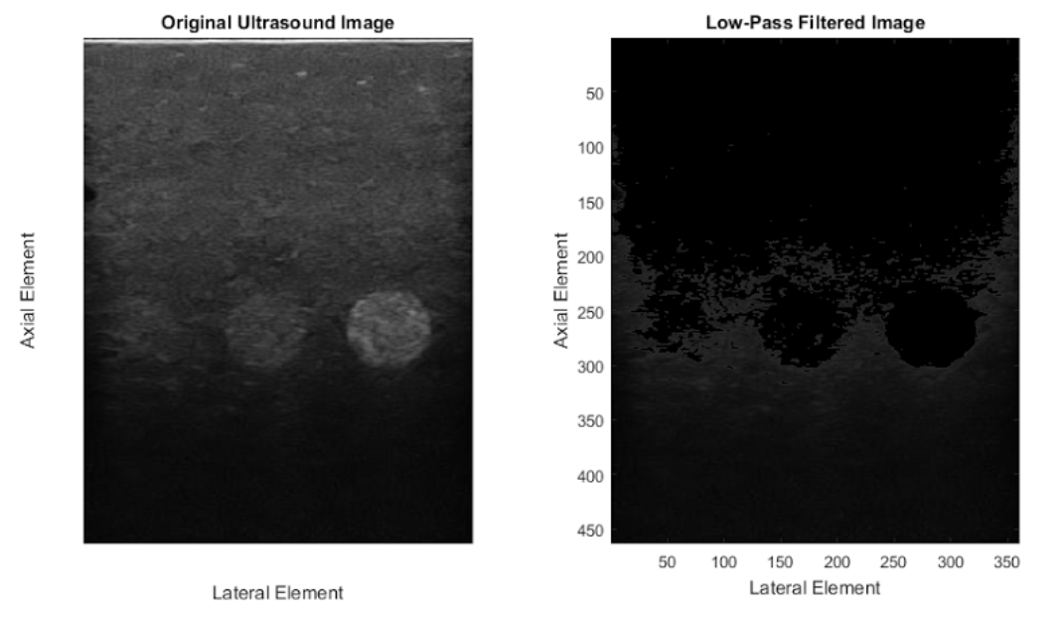
Detection Method
1. Low pass filter image to try and suppress speckle artifacts

Slide 3
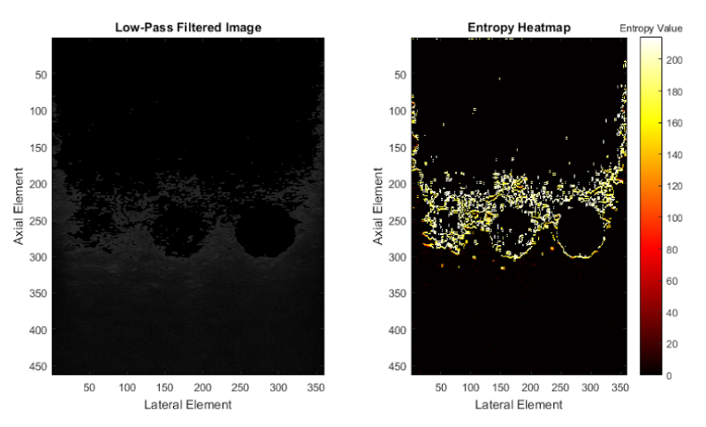

Detection Method
2. Sweep top to bottom of scanline and compute local symmetric entropy of pixel intensity:
S_{i} is the symmetric entropy at pixel i, L is the set of all scanline indices that are not the first or last index, and I(i)is the pixel intensity at pixel i.

Slide 4
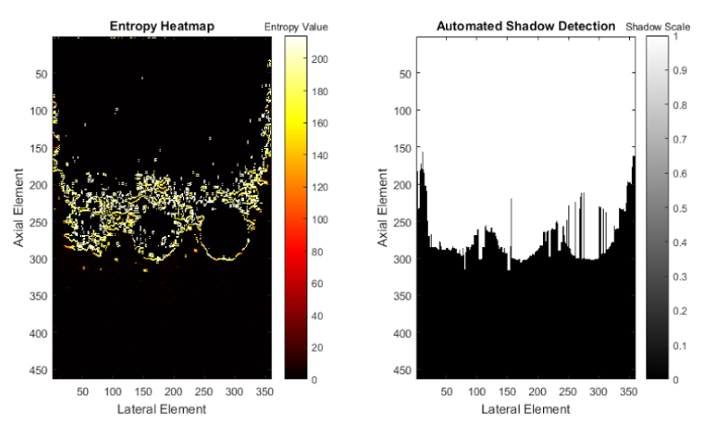
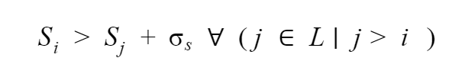
Detection Method
3. Sweep from top to bottom of scanline and flag first pixel with an entropy value greater than one standard deviation of all subsequent pixels
S_{i} is the symmetric entropy of shadow element at pixel i, sis the standard deviation of the symmetric entropy values of the entire scanline, j is a pixel index greater than i, and L is the set of all scanline indices that are not the first or last index.

Slide 5
Validation Method
A user takes the original image and outlines a closed polygon of the shadow region in MATLAB (gold standard)
Every pixel is then tagged as either a shadow or not a shadow by the manual outlining
The manually outlined pixels are then compared to the shadowing pixels detected by the algorithm for sensitivity and specificity

Slide 6
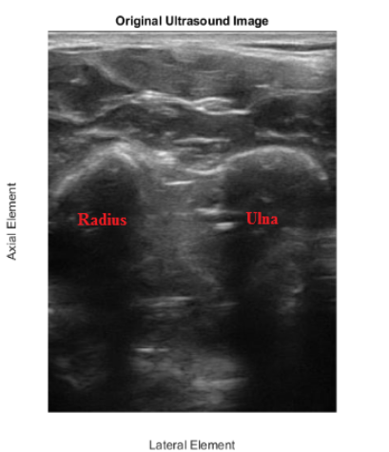
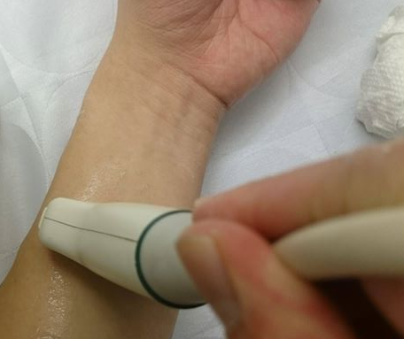
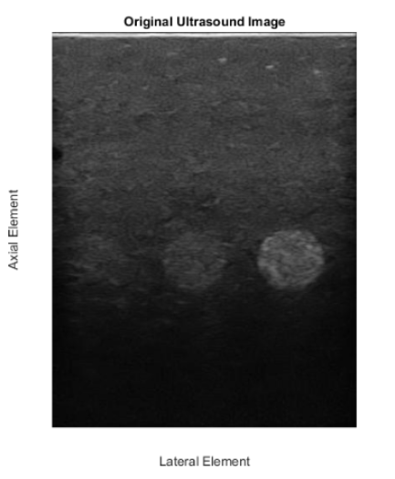
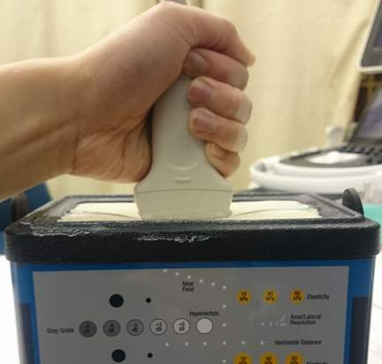
Test Scenarios:
1. Imaging forearm
2. Imaging phantom with embedded objects

Slide 7
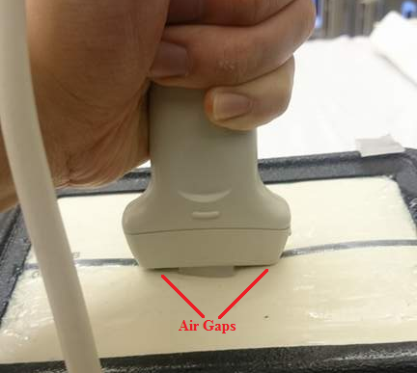
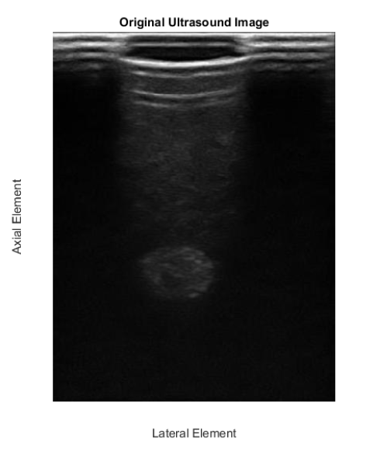
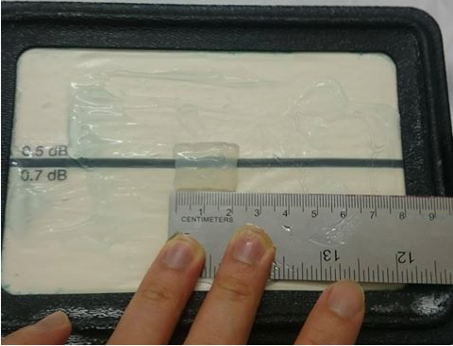
Test Scenarios:
3. Imaging phantom with embedded objects, raised in the middle to create air gaps on side

Slide 8
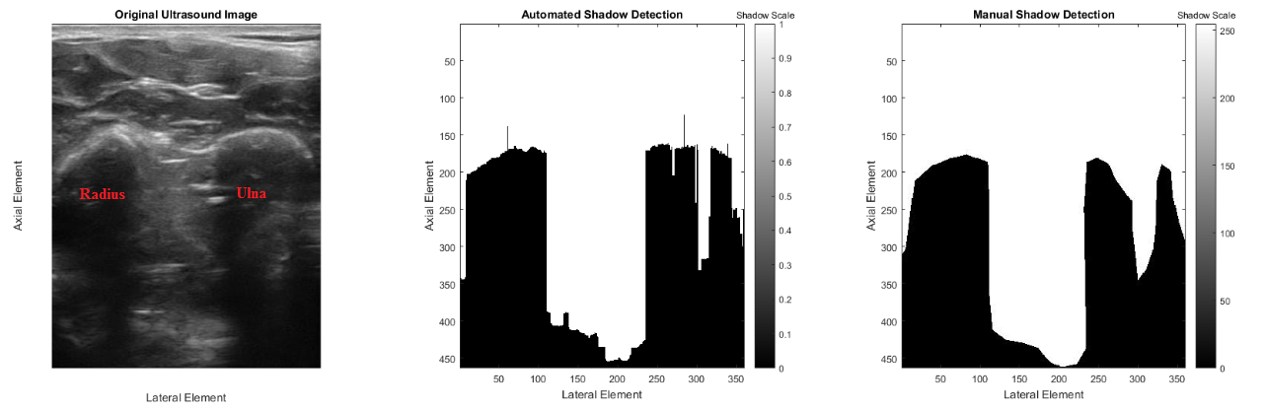
Results:
Algorithm had trouble in this area, probably need to refine algorithm to handle scanlines with more gradual shadowing or high variance in brightness. Algorithm seems to work well when there is a distinct bright-dark jump
Need to investigate why these isolated “peaks” occur, seems like an artifact
 | Sensitivity | Specificity | Positive Predictive Value | Negative Predictive Value
Forearm | 0.9597 | 0.9677 | 0.9615 | 0.9661

Slide 9
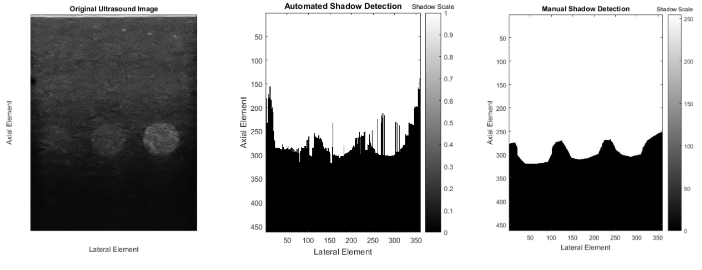
Results:
The sudden “peaks” are more prominent in this image, though this image seems to have more speckle artifacts, need to investigate as to why this happens
 | Sensitivity | Specificity | Positive Predictive Value | Negative Predictive Value
Phantom with embedded objects | 0.9791 | 0.9724 | 0.9781 | 0.9737

Slide 10
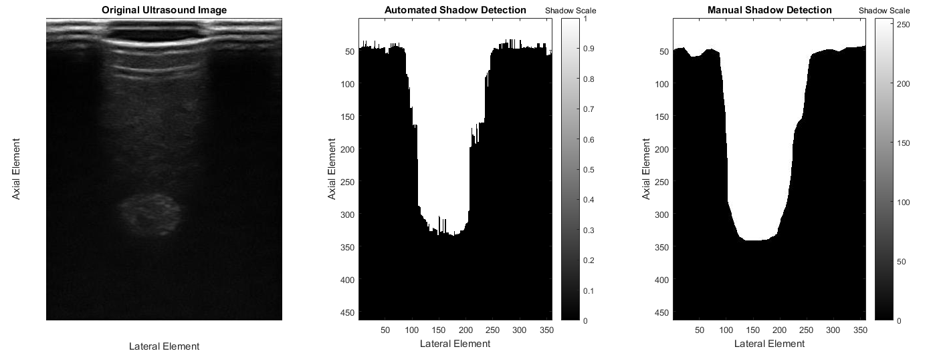
Results:
 | Sensitivity | Specificity | Positive Predictive Value | Negative Predictive Value
Phantom with embedded objects and air gap | 0.9715 | 0.9740 | 0.9690 | 0.9769

Slide 11
Limitations/Future Directions
Could be improved by more higher order statistics, the algorithm used was very simple, but it is within the order of magnitude of other papers’ sensitivity/specificity
Need to test algorithm on less obvious shadow scenarios, like in the arm image of the region pointed by the red arrow
Need more data, possibly with different frequency, depth, and gain settings
Could investigate RF data (not entirely sure what to do other than doing the same statistical analysis and seeing if results are more insightful)

Slide 12
Limitations/Future Directions
Need to use different transducers, other papers mainly used one and one image with many optimized parameters
Get pre-scan data from curvilinear transducers
8bit images were used, should use 16bit next time
“Gold standard” isn’t consistent - I had different sensitivity/specificity values ranging from 0.90-0.97 for different trials in outlining the shadow area manually
For more consistent outlining, would probably have to increase size of MATLAB image to fill entire screen and outline much more slower (I took ~15seconds to outline)

Slide 13
Limitations/Future Directions
Could investigate stats with directionality (top-down sweep vs. bottom-up sweep)
Could try and characterize different shadowing scenarios so algorithm can tell user what type of shadow is detected
Air Gap (quite identifiable since it’s an entire line of darkness)
Bone (more difficult, as bones are not the only high impedance difference boundary, shadows inside body could be due to hematoma, lesions, cirrhosis etc.)

Slide 14
Limitations/Future Directions
Did not find a quantitative definition of when a shadow begins
Not sure what exactly a shadow is defined as other than a bright region followed by a trail of darkness, but is not a discrete bright->dark step - would shadowing start after the brightest point? Or when the brightness fades to become really dark?
Does shadow start here where it is the brightest?
Or here where it starts fading significantly?

