Slide 1
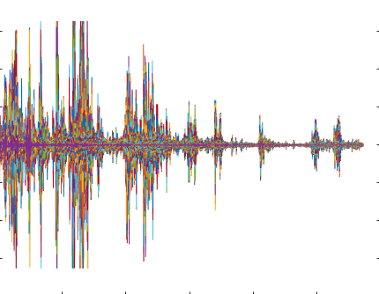
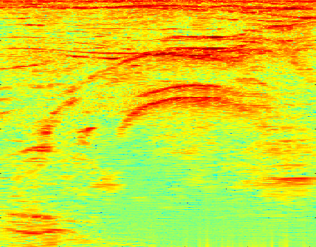
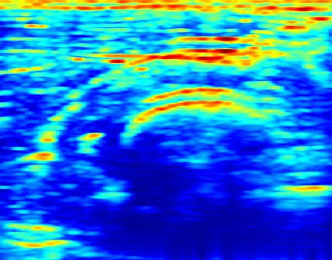
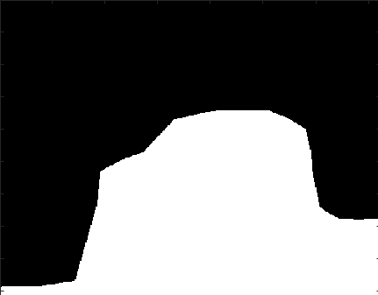

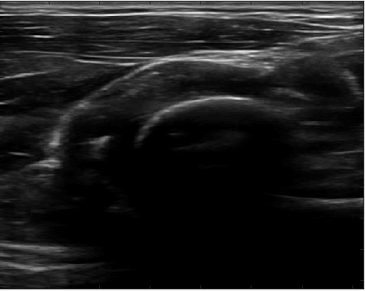
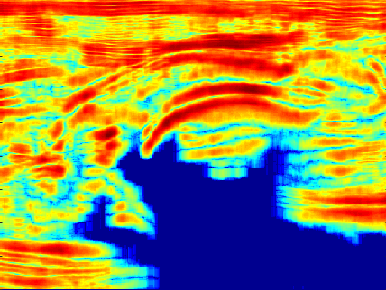

Radiofrequency Shadow Detection
Maximum Likelihood Estimation of Nakagami Parameters
Radiofrequency Data
Hilbert Transform Echo Envelope
Adaptive Thresholding Shadow Detection
Input Data
Entropy Computation on Scanlines
Adaptive Thresholding Shadow Detection
B-Mode Image Data
B-Mode Shadow Detection

