Slide 1
Carotid Ultrasound Machine Learning Project
Mar 2 Update

Slide 2
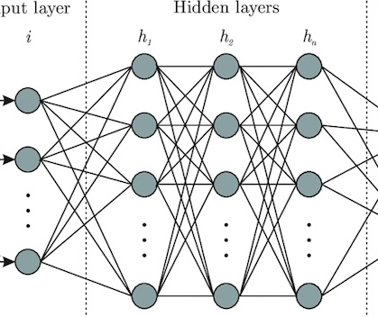
Data Available
Baseline Characteristics
(age, sex, htn…)
“sig CAD”?
(Binary)
Predictive Machine Learning Model
Plaque Parameters (GSM, P40, %Blood…)
Output
(What to Predict)
“angio score”?
(Ordinal)
Input Data
Echos
Cardiovascular Event
(Event + Time to Event)

Slide 3
Existing Work on Carotid U/S + AI
Author | Method | Gaps?
Roy-Cardinal et. al (2019) | RF speckle modelling & elastography -> random forest->predict “stability (?)” | -Only N = 66 -RF data commonly unavailable
Araki et al. (2016) | Carotid morphology features -> PCA to filter features -> SVM->predict “severity of CAD” | -Only 19 patients, used 4004 “images” (frames) -Lots of adjacent frames!!!
Jamthikar et al. (2020) | Baseline characteristics + MPH/TPA/IPN -> SVM/RF/XGB -> predict CAS | -Thorough, not sure if can improve on exact same problem -No images used -Can attempt different task? Predict CAD, use images automatically etc.
Kyriacou et al. (2012) | Carotid U/S gray level stats -> SVM -> predict stroke | -Acc = 77%, great N = 1121 -Did not exhaust modern ML techniques
Acharya et al. (2013) | Extract carotid U/S texture features -> AdaBosst/SVM -> predict symptomatic/asymptomatic | -Weird outcome measure? -Acc = 84%, did not use modern ML techniques
Lekadir et al. (2017) | Base carotid U/S -> CNN -> discriminate lipid core, fibrous cap, and calcified tissue | -Doesn’t go further to predict risk of event of CAD

Slide 4
Existing Work on Carotid U/S + AI
Author | Method | Gaps?
Roy-Cardinal et. al (2019) | RF speckle modelling & elastography -> random forest->predict “stability (?)” | -Only N = 66 -RF data commonly unavailable
Araki et al. (2016) | Carotid morphology features -> PCA to filter features -> SVM->predict “severity of CAD” | -Only 19 patients, used 4004 “images” (frames) -Lots of adjacent frames!!!
Jamthikar et al. (2020) | Baseline characteristics + MPH/TPA/IPN -> SVM/RF/XGB -> predict CAS | -Thorough, not sure if can improve on exact same problem -No images used -Can attempt different task? Predict CAD, use images automatically etc.
Kyriacou et al. (2012) | Carotid U/S gray level stats -> SVM -> predict stroke | -Acc = 77%, great N = 1121 -Did not exhaust modern ML techniques
Acharya et al. (2013) | Extract carotid U/S texture features -> AdaBosst/SVM -> predict symptomatic/asymptomatic | -Weird outcome measure? -Acc = 84%, did not use modern ML techniques
Lekadir et al. (2017) | Base carotid U/S -> CNN -> discriminate lipid core, fibrous cap, and calcified tissue | -Doesn’t go further to predict risk of event of CAD
Most use manual assessment of carotid U/S before feeding into ML model

Slide 5
Which task to solve?
Baseline Characteristics
(age, sex, htn…)
“sig CAD”?
(Binary)
Lots of studies doing this
Plaque Parameters (GSM, P40, %Blood…)
“angio score”?
(Ordinal)
Output
(What to Predict)
Input Data
Echos
Cardiovascular Event
(Event + Time to Event)

Slide 6
Which task to solve?
Baseline Characteristics
(age, sex, htn…)
“sig CAD”?
(Binary)
~7 good studies doing this, some gaps
Plaque Parameters (GSM, P40, %Blood…)
“angio score”?
(Ordinal)
Output
(What to Predict)
Input Data
Echos
Cardiovascular Event
(Event + Time to Event)

Slide 7
Which task to solve?
Baseline Characteristics
(age, sex, htn…)
“sig CAD”?
(Binary)
Plaque Parameters (GSM, P40, %Blood…)
Jas did this
“angio score”?
(Ordinal)
Output
(What to Predict)
Input Data
Echos
Cardiovascular Event
(Event + Time to Event)

Slide 8
Which task to solve?
Baseline Characteristics
(age, sex, htn…)
“sig CAD”?
(Binary)
No one predicted time-to-event?
Plaque Parameters (GSM, P40, %Blood…)
“angio score”?
(Ordinal)
Output
(What to Predict)
Input Data
Echos
Cardiovascular Event
(Event + Time to Event)

Slide 9
Which task to solve?
cardiac outcomes
(Binary)
Baseline Characteristics
(age, sex, htn…)
“sig CAD”?
(Binary)
Few studies
Plaque Parameters (GSM, P40, %Blood…)
“angio score”?
(Ordinal)
Output
(What to Predict)
Input Data
Echos
Cardiovascular Event
(Event + Time to Event)

Slide 10
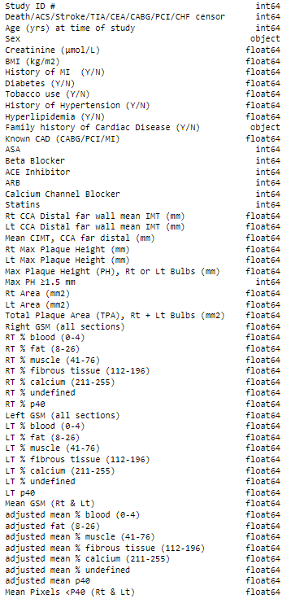

Slide 11
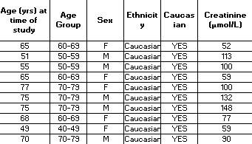
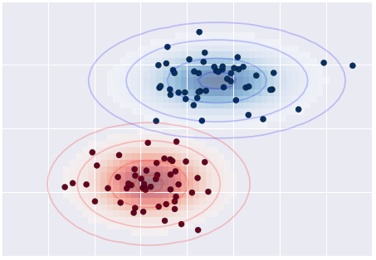
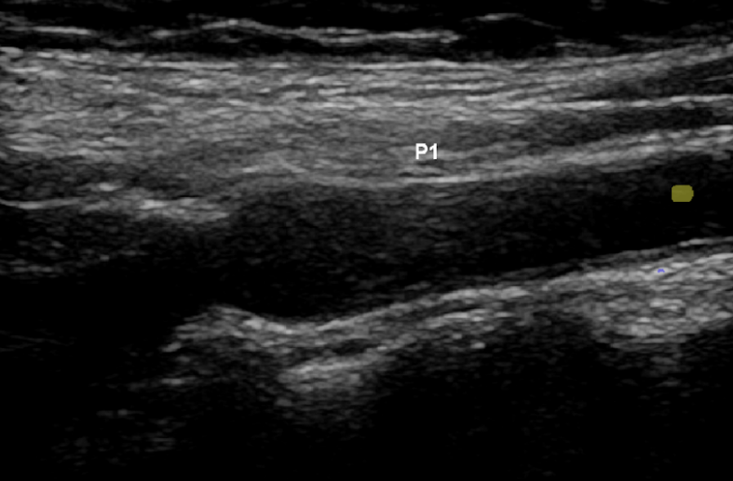
Input Data
Machine learning Model
Predicted Outcome
AUC
Point Data Classifiers (Naïve Bayes, Support Vector Machine)
Chart Data
Death/ACS/Stroke/TIA/CEA/CABG/PCI/CHF
0.64
Convolutional Neural Network
Carotid U/S
Death/ACS/Stroke/TIA/CEA/CABG/PCI/CHF
Left: 0.49
Right: 0.62

Slide 12
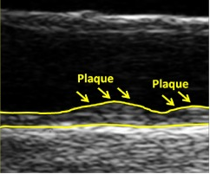
Input Data
Machine learning Model
Predicted Outcome
AUC
Convolutional Neural Network
Segmented Carotid U/S
Death/ACS/Stroke/TIA/CEA/CABG/PCI/CHF
Left: 0.49
Right: 0.73
All: 0.63
Signal exists in clinical data and in right bulb (why?) with more complex neural network
Accuracy predicting outcome lower than Jas’ paper (however they did 10 k-fold cross validation and predicted coronary angio score
Some potential next steps….

Slide 13
 | Data Type |  | Model | Accuracy | F1 Score | AUC | TPR | TNR | PPV | NPV
CNN | Left Bulb Images | Non-segmented Images | CNN(a) | 0.4 | 0.571 | 0.5 | 1 | 0 | 0.4 | nan
 |  |  | CNN(b) | 0.56 | 0.267 | 0.51 | 0.19 | 0.828 | 0.444 | 0.585
 |  | Segmented Images | CNN(a) | 0.43 | 0.564 | 0.51 | 0.917 | 0.111 | 0.407 | 0.667
 |  |  | CNN(b) | 0.567 | 0.133 | 0.49 | 0.083 | 0.889 | 0.333 | 0.593
 | Right Bulb Images | Non-segmented Images | CNN(a) | 0.5 | 0.444 | 0.5 | 0.462 | 0.529 | 0.429 | 0.562
 |  |  | CNN(b) | 0.6 | 0.625 | 0.62 | 0.769 | 0.471 | 0.526 | 0.727
 |  | Segmented Images | CNN(a) | 0.533 | nan | 0.47 | 0 | 0.941 | 0 | 0.552
 |  |  | CNN(b) | 0.733 | 0.692 | 0.73 | 0.692 | 0.765 | 0.692 | 0.765
 | All Images | Segmented Images | CNN(b) | 0.672 | 0.513 | 0.63 | 0.455 | 0.806 | 0.588 | 0.707
MLP | Clinical Data | Original Features | MLP | 0.612 | 0.487 | 0.6 | 0.563 | 0.636 | 0.429 | 0.75
 |  | Reduced Features | MLP | 0.621 | 0.522 | 0.61 | 0.462 | 0.75 | 0.6 | 0.632
 |  |  | Naïve Bayes | 0.65 | 0.545 | 0.637 | 0.462 | 0.813 | 0.667 | 0.65
 |  |  | SVM Classifier | 0.483 | 0.118 | 0.445 | 0.077 | 0.813 | 0.25 | 0.52

Slide 14
Input Data
Machine learning Model
Predicted Outcome
AUC
Convolutional Neural Network
Segmented Carotid U/S
Death/ACS/Stroke/TIA/CEA/CABG/PCI/CHF
Hopefully good

Slide 15
Input Data
Machine learning Model
Predicted Outcome
AUC
Convolutional Neural Network
Segmented Carotid U/S
Death/ACS/Stroke/TIA/CEA/CABG/PCI/CHF
Hopefully good
Unsegmented u/s
Segmented u/s
Clinical data
Normalize
Complex CNN + optimization with supercomputer?
Random forest/optimized multilayer perceptron
Radiomics
Try with reducing confounding outcomes
Need cross validation / leave-one-out CV
Need confidence intervals/error range
Optimize feature selection stage

Slide 16
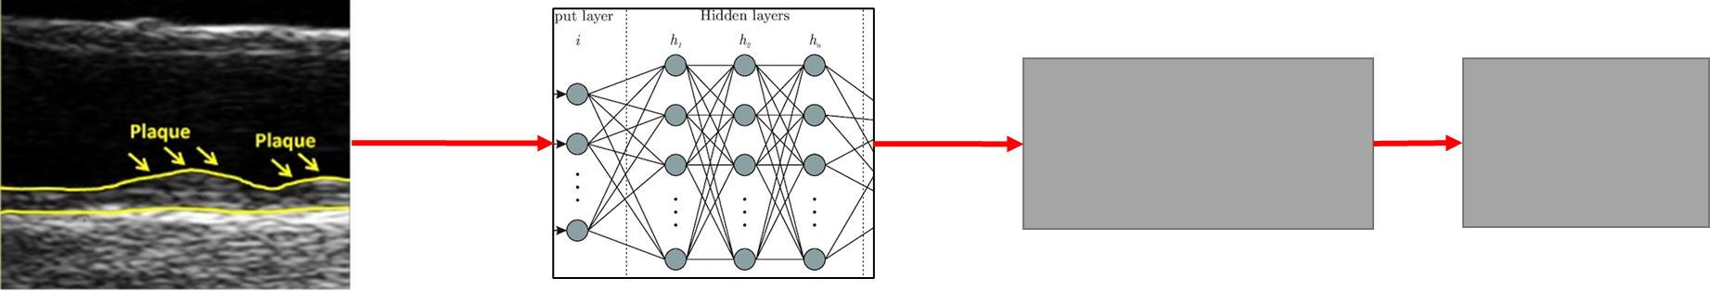
Some Questions:
Is there reason for difference for R/L bulbs? Should we aggregate imgs?
What outcomes to look at? Atm predicting Death/ACS/Stroke/TIA/CEA/CABG/PCI/CHF
Is predicting time to event useful?
Thought on radiomics?
Timeline? (surg blocks starts Jun-Oct for me)
Input Data
Machine learning Model
Predicted Outcome
AUC
Unsegmented u/s
Segmented u/s
Clinical data
Optimize feature selection stage
Complex CNN + optimization with supercomputer?
Random forest/optimized multilayer perceptron
Radiomics
Try with reducing confounding outcomes
Time to event?
Need cross validation / leave-one-out CV
Need confidence intervals/error range

