Slide 1
Carotid Ultrasound Machine Learning Project
Mar 2 Update

Slide 2
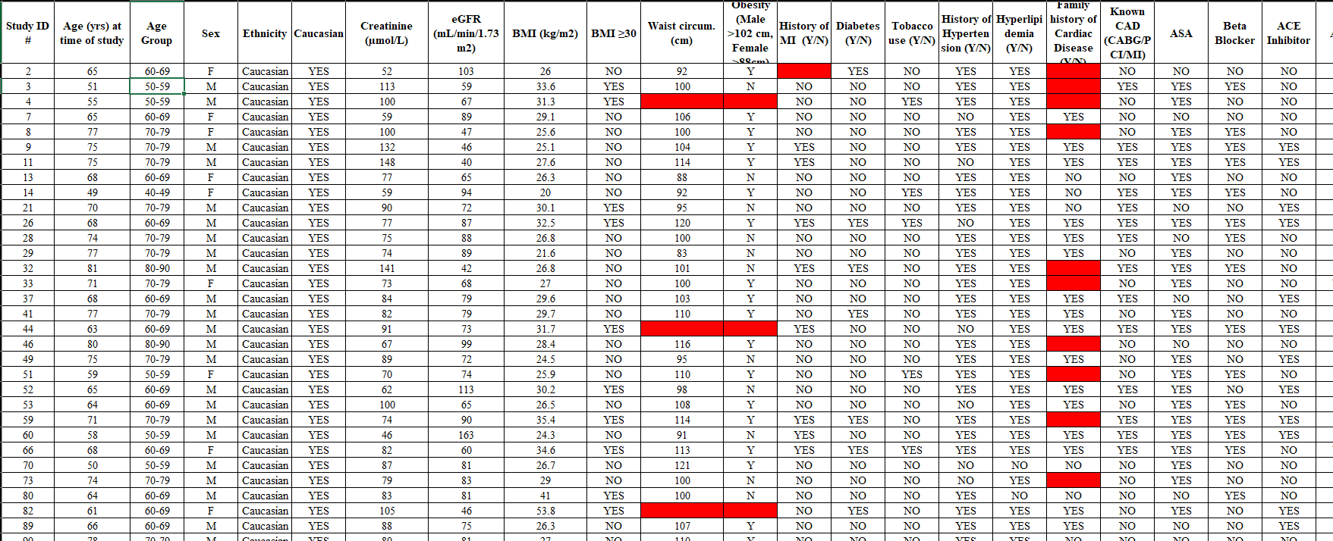
Data Available

Slide 3
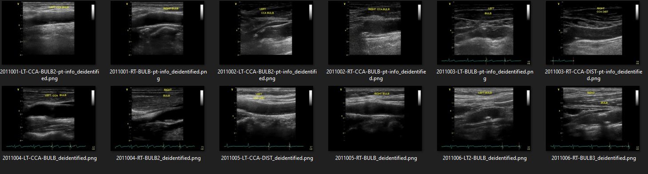
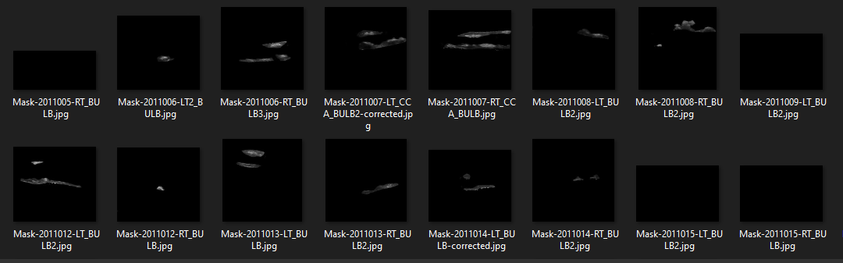
Data Available

Slide 4
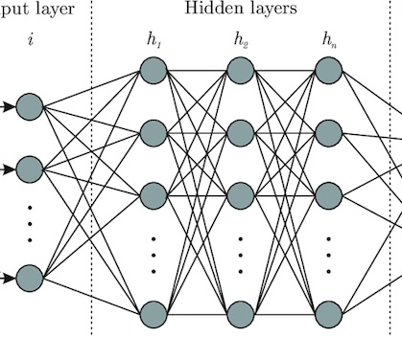
Data Available
Baseline Characteristics
(age, sex, htn…)
“sig CAD”?
(Binary)
Predictive Machine Learning Model
Plaque Parameters (GSM, P40, %Blood…)
Output
(What to Predict)
“angio score”?
(Ordinal)
Input Data
Echos
Cardiovascular Event
(Event + Time to Event)

Slide 5
Existing Work on Carotid U/S + AI
Author | Method | Gaps?
Roy-Cardinal et. al (2019) | RF speckle modelling & elastography -> random forest->predict “stability (?)” | -Only N = 66 -RF data commonly unavailable
Araki et al. (2016) | Carotid morphology features -> PCA to filter features -> SVM->predict “severity of CAD” | -Only 19 patients, used 4004 “images” (frames) -Lots of adjacent frames!!!
Jamthikar et al. (2020) | Baseline characteristics + MPH/TPA/IPN -> SVM/RF/XGB -> predict CAS | -Thorough, not sure if can improve on exact same problem -No images used -Can attempt different task? Predict CAD, use images automatically etc.
Kyriacou et al. (2012) | Carotid U/S gray level stats -> SVM -> predict stroke | -Acc = 77%, great N = 1121 -Did not exhaust modern ML techniques
Acharya et al. (2013) | Extract carotid U/S texture features -> AdaBosst/SVM -> predict symptomatic/asymptomatic | -Weird outcome measure? -Acc = 84%, did not use modern ML techniques
Lekadir et al. (2017) | Base carotid U/S -> CNN -> discriminate lipid core, fibrous cap, and calcified tissue | -Doesn’t go further to predict risk of event of CAD

Slide 6
Which task to solve?
Baseline Characteristics
(age, sex, htn…)
“sig CAD”?
(Binary)
Lots of studies doing this
Plaque Parameters (GSM, P40, %Blood…)
“angio score”?
(Ordinal)
Output
(What to Predict)
Input Data
Echos
Cardiovascular Event
(Event + Time to Event)

Slide 7
Which task to solve?
Baseline Characteristics
(age, sex, htn…)
“sig CAD”?
(Binary)
Some studies doing this but just association metrics
Plaque Parameters (GSM, P40, %Blood…)
“angio score”?
(Ordinal)
Output
(What to Predict)
Input Data
Echos
Cardiovascular Event
(Event + Time to Event)

Slide 8
Which task to solve?
Baseline Characteristics
(age, sex, htn…)
“sig CAD”?
(Binary)
Plaque Parameters (GSM, P40, %Blood…)
Jas did this
“angio score”?
(Ordinal)
Output
(What to Predict)
Input Data
Echos
Cardiovascular Event
(Event + Time to Event)

Slide 9
Which task to solve?
cardiac outcomes
(Binary)
Baseline Characteristics
(age, sex, htn…)
“sig CAD”?
(Binary)
Plaque Parameters (GSM, P40, %Blood…)
“angio score”?
(Ordinal)
Output
(What to Predict)
Input Data
Echos
Few studies
Cardiovascular Event
(Event + Time to Event)

Slide 10
Which task to solve?
cardiac outcomes
(Binary)
Baseline Characteristics
(age, sex, htn…)
“sig CAD”?
(Binary)
Few studies
Plaque Parameters (GSM, P40, %Blood…)
“angio score”?
(Ordinal)
Output
(What to Predict)
Input Data
Echos
Cardiovascular Event
(Event + Time to Event)

Slide 11
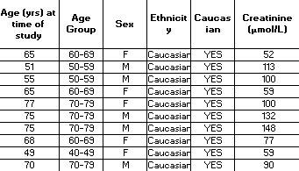
Numerical Data Preprocessing
Input Data
All Patients (N=522)
All Features = 146
Chart Data
Keep only columns with data
Keep only one outcome
All Patients (N=522)
Filtered features = 53 (1 is ID, 1 is outcome)
Remove pts with missing data (28)
Remove pts with “UNKNOWN” (1)
Filtered Patients (N=493)
Filtered Features = 53
Separate to clinical hx and imaging measurement subsets
Clinical History Variables (N=493)
Filtered Features = 18
Imaging Variables (N=493)
Filtered Features = 36

Slide 12
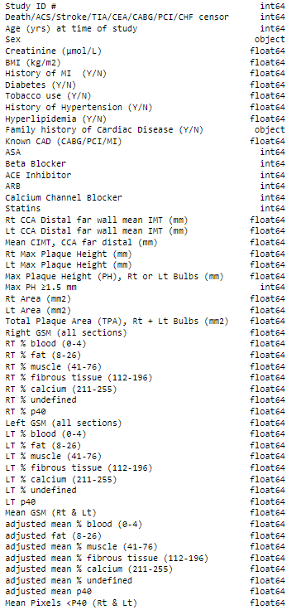
Clinical History Variables (N=493)
Filtered Features = 18
Imaging Variables (N=493)
Filtered Features = 36
Q1: Is this a reasonable split of the features to isolate analysis of imaging vs. non imaging variables?

Slide 13
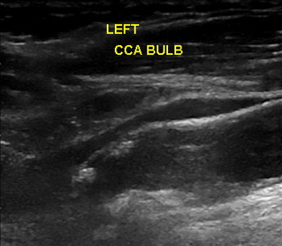
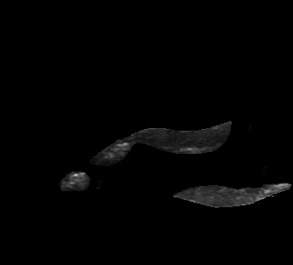
U/S Image Preprocessing
Input Data
Manually Segmented Carotid U/S
Segmented Plaque Mask
Contour/edge detection code

Slide 14
Agnostic “full image” neural network didn’t perform well last time
 | Data Type |  | Model | Accuracy | F1 Score | AUC | TPR | TNR | PPV | NPV
CNN | Left Bulb Images | Non-segmented Images | CNN(a) | 0.4 | 0.571 | 0.5 | 1 | 0 | 0.4 | nan
 |  |  | CNN(b) | 0.56 | 0.267 | 0.51 | 0.19 | 0.828 | 0.444 | 0.585
 |  | Segmented Images | CNN(a) | 0.43 | 0.564 | 0.51 | 0.917 | 0.111 | 0.407 | 0.667
 |  |  | CNN(b) | 0.567 | 0.133 | 0.49 | 0.083 | 0.889 | 0.333 | 0.593
 | Right Bulb Images | Non-segmented Images | CNN(a) | 0.5 | 0.444 | 0.5 | 0.462 | 0.529 | 0.429 | 0.562
 |  |  | CNN(b) | 0.6 | 0.625 | 0.62 | 0.769 | 0.471 | 0.526 | 0.727
 |  | Segmented Images | CNN(a) | 0.533 | nan | 0.47 | 0 | 0.941 | 0 | 0.552
 |  |  | CNN(b) | 0.733 | 0.692 | 0.73 | 0.692 | 0.765 | 0.692 | 0.765
 | All Images | Segmented Images | CNN(b) | 0.672 | 0.513 | 0.63 | 0.455 | 0.806 | 0.588 | 0.707
MLP | Clinical Data | Original Features | MLP | 0.612 | 0.487 | 0.6 | 0.563 | 0.636 | 0.429 | 0.75
 |  | Reduced Features | MLP | 0.621 | 0.522 | 0.61 | 0.462 | 0.75 | 0.6 | 0.632
 |  |  | Naïve Bayes | 0.65 | 0.545 | 0.637 | 0.462 | 0.813 | 0.667 | 0.65
 |  |  | SVM Classifier | 0.483 | 0.118 | 0.445 | 0.077 | 0.813 | 0.25 | 0.52

Slide 15
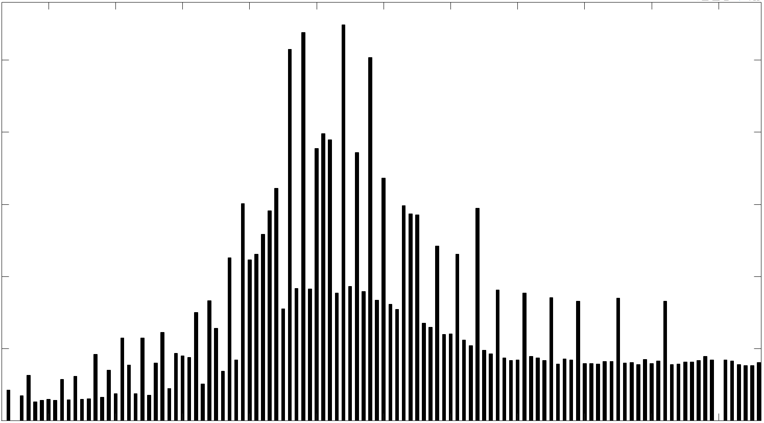
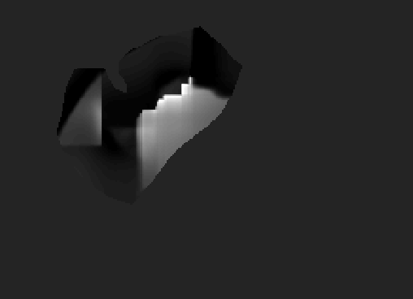
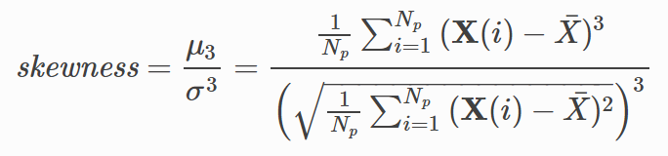
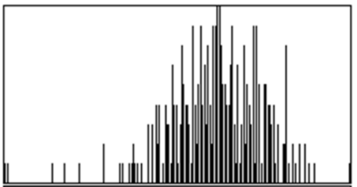
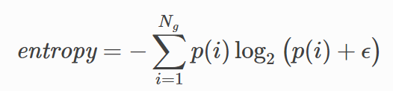
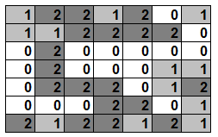
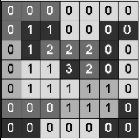
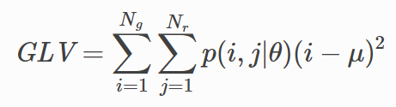
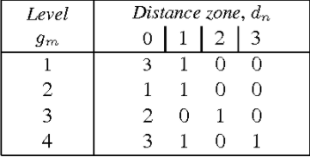
U/S Image Preprocessing - Radiomics
Input Data
Radiomic Feature Definition
Radiomic Feature Computation (108 features)
Segmented Plaque Mask
First-Order Stats
1.
Gray-Level
Co-Occurrence
2.
.
.
.
108.
Shape

Slide 16
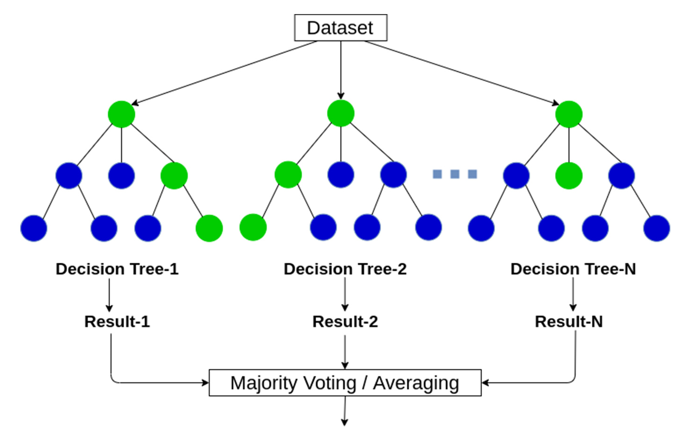

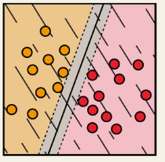
Full Pipeline
Input Data
Feature Selection
Machine Learning
Models
Predicted Outcome
1 of the following 4
(Select top #events/10 features)
1 of 2 algs used (mutual info ranking and RELIEF)
1 of the following 2
Clinical variables only
Random Forest
1
2
3
4
5
6
7
…
N
Death/ACS/Stroke/TIA/CEA/CABG/PCI/CHF
Imaging Variables only
1
2
3
…
M ≤ N
Support Vector
Machine
Clinical + Imaging Variables
Radiomic Variables
Q2: Is this a good outcome to predict? N = 144 positive cases
If only Stroke/TIA/CEA, N<20
4 x 2 x 2 = 16 different models tested

Slide 17
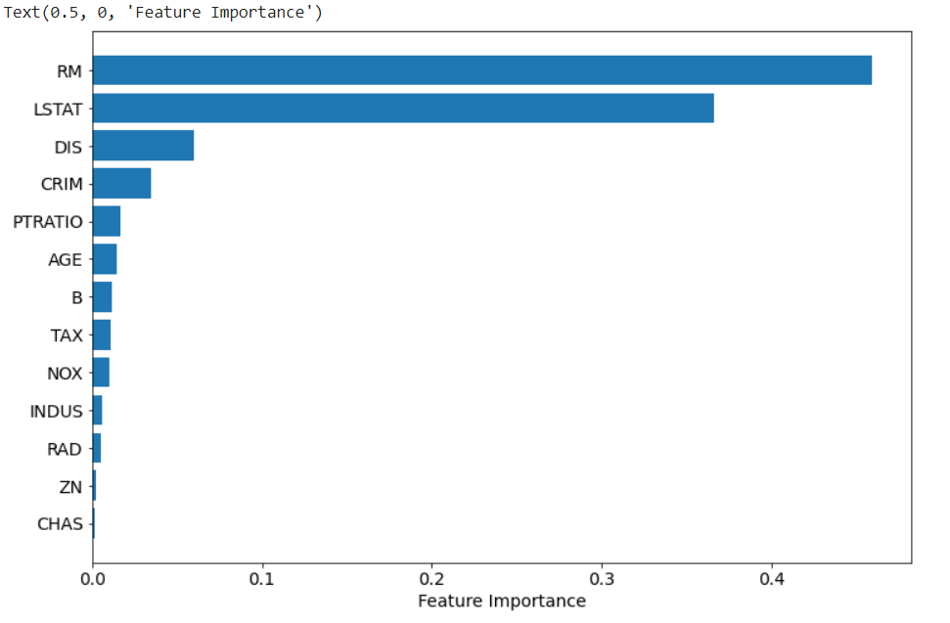
Testing
1. Distribution Differences
2. 5-fold Cross-Validation AUC of Predictions
2-sided T-test, Chi-square
80% for modelling, 20% for testing
1.
Train
Train
Train
Train
Test
2.
Train
Train
Train
Test
Train
3.
Train
Train
Test
Train
Train
3. Feature Importances
4.
Train
Test
Train
Train
Train
5.
Test
Train
Train
Train
Train
model “blinded” to test set
Q3: any other suggested anlayses?

Slide 18
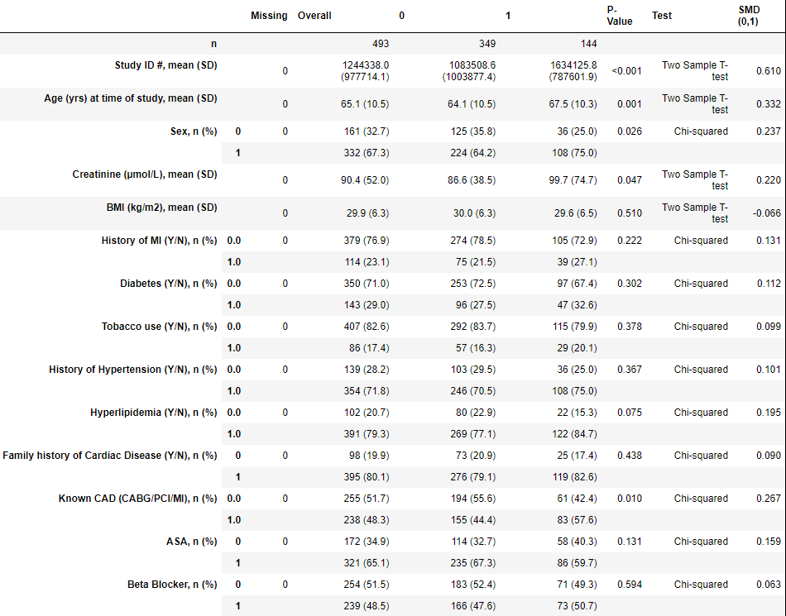
Results – Classic Stats
(much easier to see in the code notebook)

Slide 19
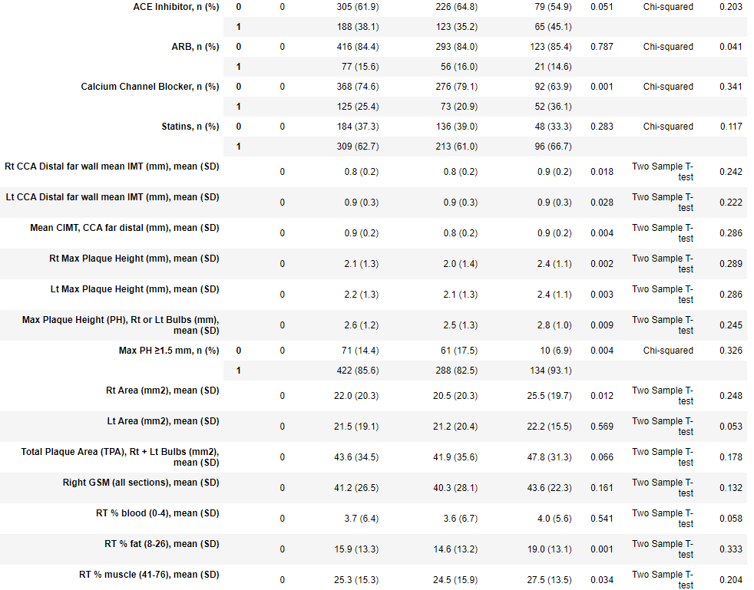
Results – Classic Stats

Slide 20
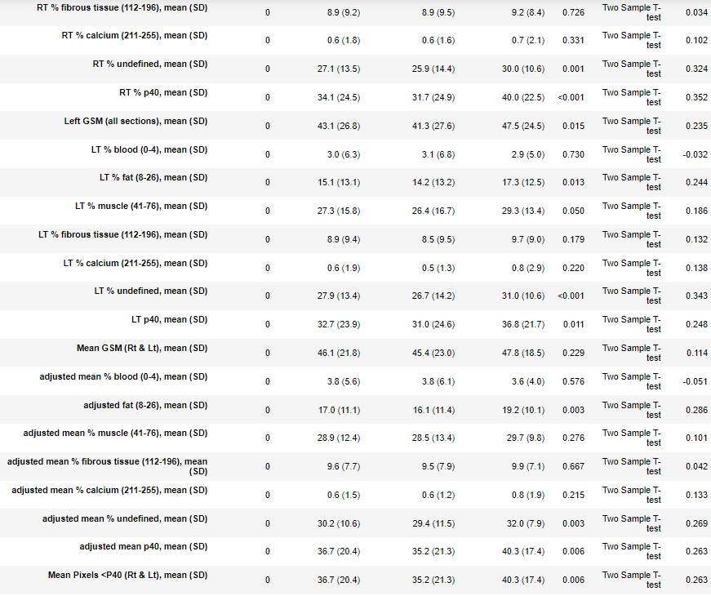
Results – Classic Stats

Slide 21
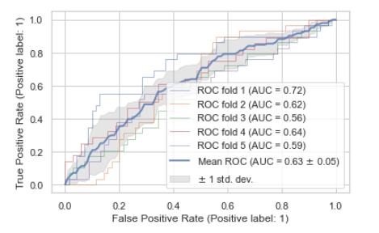
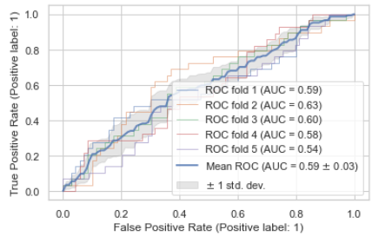
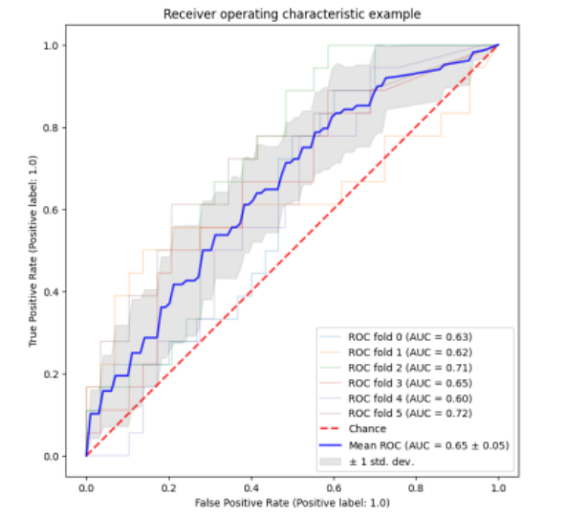
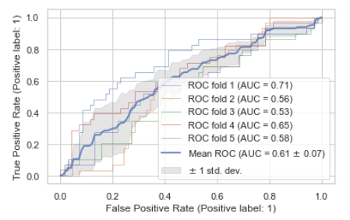
Results – Cross-Validation AUCs
Clinical data only
Manual imaging data only
Clinical + manual imaging
Radiomics data only

Slide 22
There is a “signal”, but not too impressive accuracy Is it because of data imbalance? (Thank to Ramtin) After programming in class balancing…

Slide 23
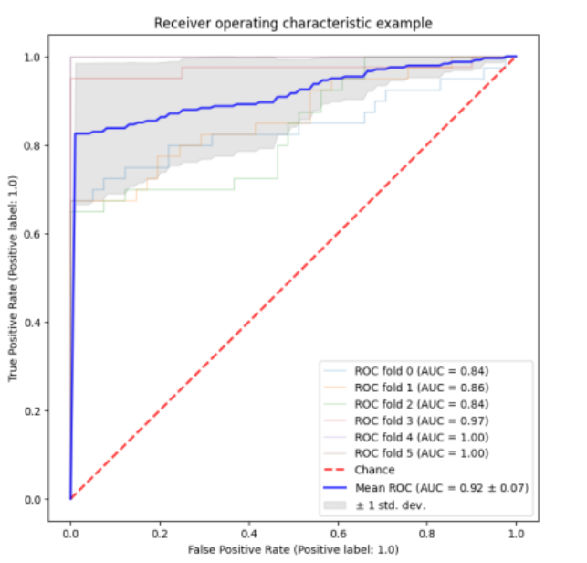
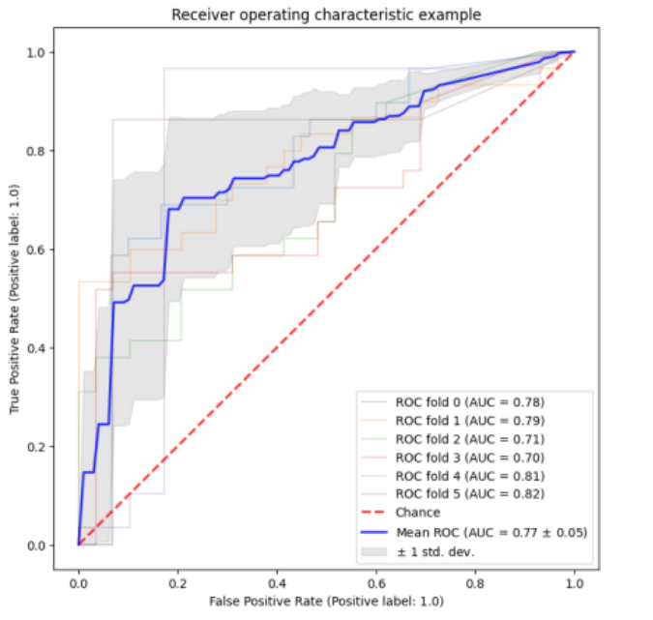
Results – Cross-Validation AUCs
Clinical + manual imaging data
Next step: try: clinical alone, clinical + manual imaging, clinical + rad, manual + rad
Radiomics Data

Slide 24
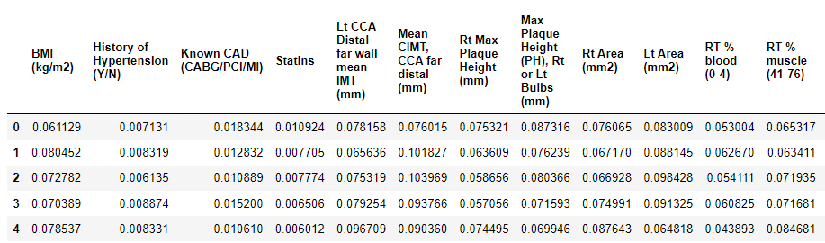
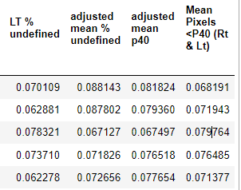
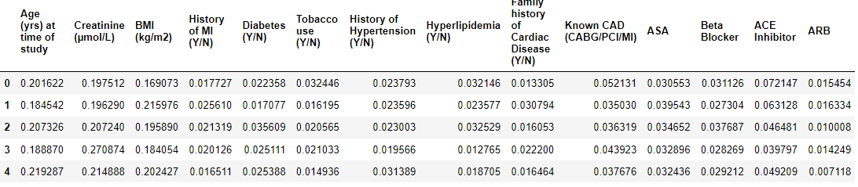
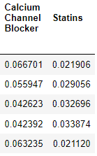
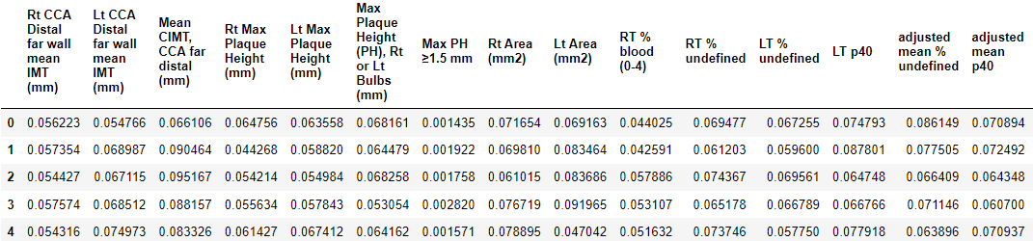

Results – Feature Importances:
This is post-initial filter so most features are thrown out already!
k-fold (5 trials in total)
Clinical + Imaging
Clinical Only
Imaging Only

Slide 25
Next steps
Look at “hard” MACE events (death/acs/stroke/tia/cea instead of death/acs/stroke/tia/cea/cabg/pci)
Only 78 events, probably not enough (ricky)
Multivariate analysis
Correlation ratio heatmap (ricky)
Look at different combinations
Clin hx, clin hx + manual imaging, manual imaging only, clin hx + radiomics, clin hx + manual imaging + radiomics (ricky to send combinations, ramtin to re-run SVM)
Feature importances within cross-validation loop to get avg and standard distribution (ramtin)

