Slide 1




Survival Prediction of Patients High Grade Endometrial Cancer
Nov 18, 2021 Update

Slide 2
Objective
Imaging + Clinical Variables
Predict Survival (Time to Recurrence)
Predictive AI Models

Slide 3
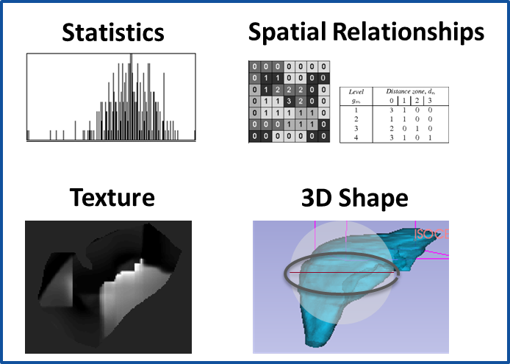
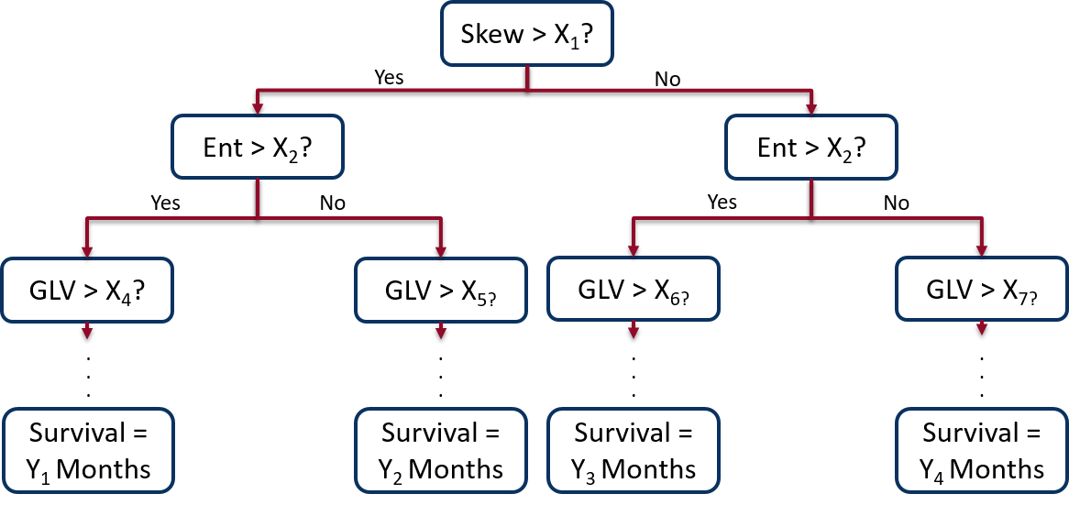
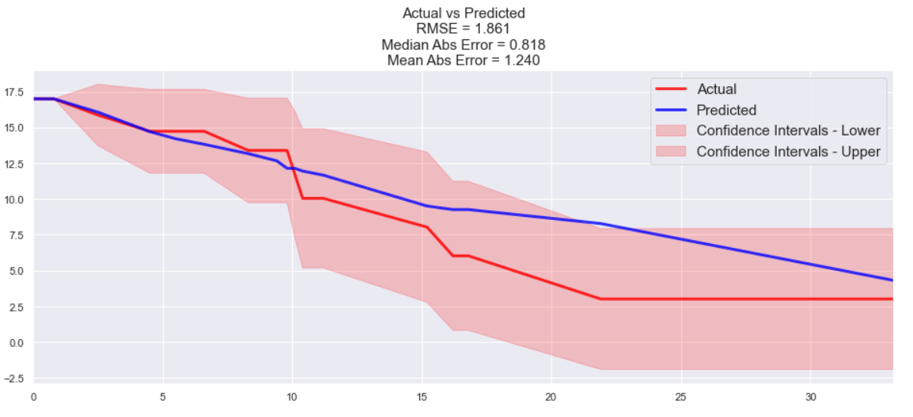
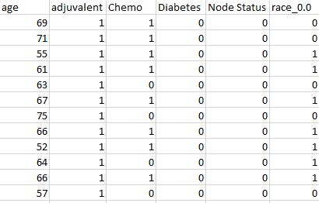
Method
Radiomic Features
Input Image
Random Survival Forest Model
Output: Predicted Survival
Clinical Variables
Input Patient Data

Slide 4
Update
Try subsets clinical data
“Preop Model”
Age, race (Caucasian vs. Not), BMI (<30 or >30), diabetes, hist (endometrioid vs. nonendometrioid)*
“Postop Model”
Preop model + node status
“Complete Model”
Postop model + RT, Chemo
*Couldn’t find label (1=?, 2=?, 3=?, 4=?)

Slide 5
Update
Feature Selection with Cross-Validation
Dynamic (not manually done each time)
Remove high variance inflation variables (VIF >10)
Perform Cox Regression on all data
Pick N highest HR variables (N = floor(Samples / 10))
Use the N variables as input to survival forest
~250 features -> 14 features

Slide 6
Update
Accuracy metric:
Concordance index
R Hmisc subroutine within Python program
Integrated Brier Score
Cross Validation
model “blinded” to test set
1.
Train
Train
Train
Train
Test
2.
Train
Train
Train
Test
Train
3.
Train
Train
Test
Train
Train
4.
Train
Test
Train
Train
Train
5.
Test
Train
Train
Train
Train

Slide 7


Method
Input: Combination of Clinical Variables and Radiomics
Output: Predicted Survival
Feature Selection
Random Survival Forest Model
Preop Variables
Postop Variables
Complete Variables
Radiomics Only
Preop + Radiomics
Postop + Radiomics
Complete + Radiomics

Slide 8
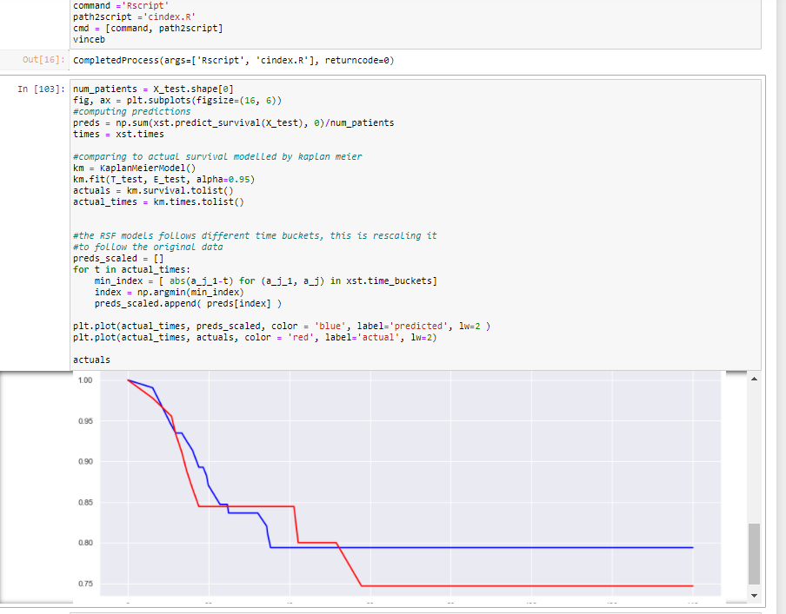
Method

Slide 9
Accuracies
Data | Best Gridsearch CI | CI Avg | CI STD | IBS Avg | IBS STD
preop_vars_only.csv | 0.675010 | 0.633066 | 0.066449 | 0.136771 | 0.008078
postop_vars_only.csv | 0.679063 | 0.625968 | 0.125330 | 0.137664 | 0.016662
complete_vars_only.csv | 0.676695 | 0.641951 | 0.072892 | 0.138241 | 0.007763
radiomics_only.csv | 0.721176 | 0.637281 | 0.113571 | 0.148854 | 0.019319
preop_and_radiomics.csv | 0.727760 | 0.683572 | 0.130478 | 0.161030 | 0.028542
postop_and_radiomics.csv | 0.716317 | 0.669383 | 0.099740 | 0.156362 | 0.028367
complete_and_radiomics.csv | 0.720621 | 0.606240 | 0.096451 | 0.154867 | 0.023168
unfiltered_radiomics.csv | 0.721176 | 0.562598 | 0.044368 | 0.142515 | 0.014279

Slide 10
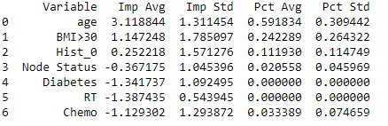
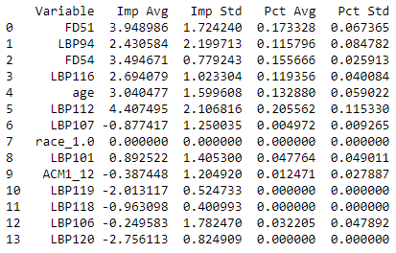
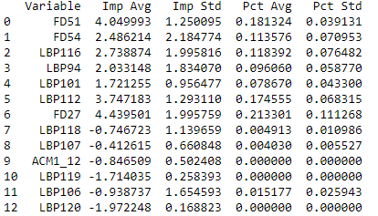
Feature Importances
Complete Clin Vars
Clin Vars and Radiomics
Radiomics Only

