Slide 1




Survival Prediction of Patients High Grad Endometrial Cancer
Aug 3, 2021 Update

Slide 2
Objective
Imaging + Clinical Variables
Predict Survival (Time to Recurrence)
Predictive AI Models

Slide 3
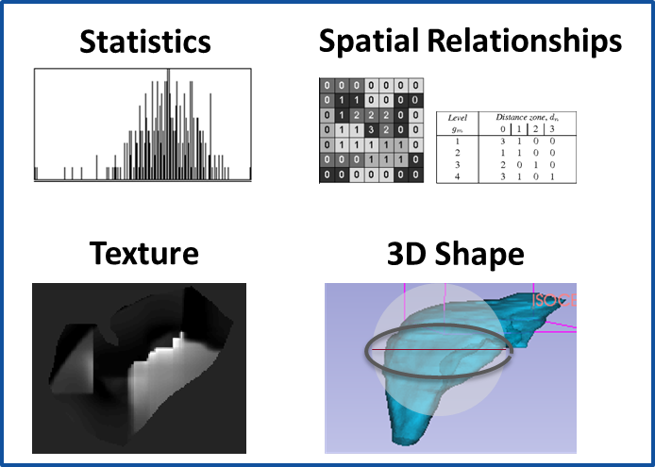
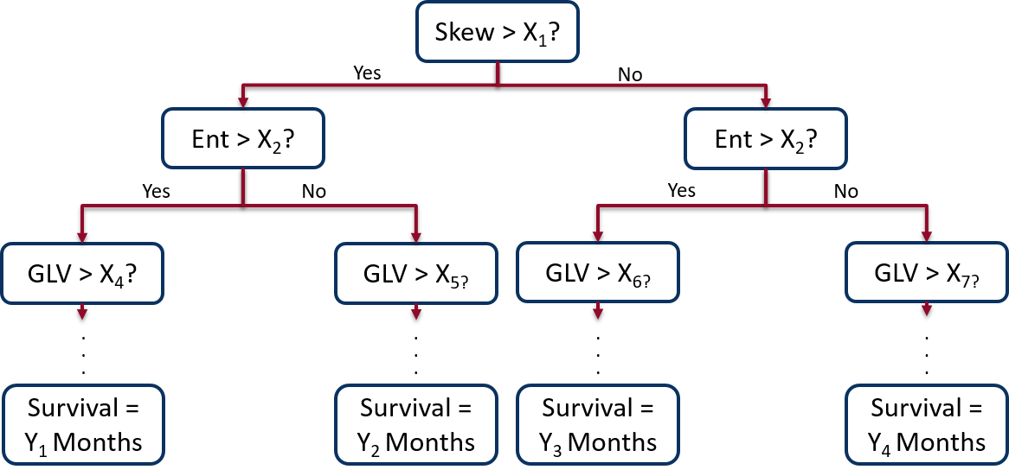
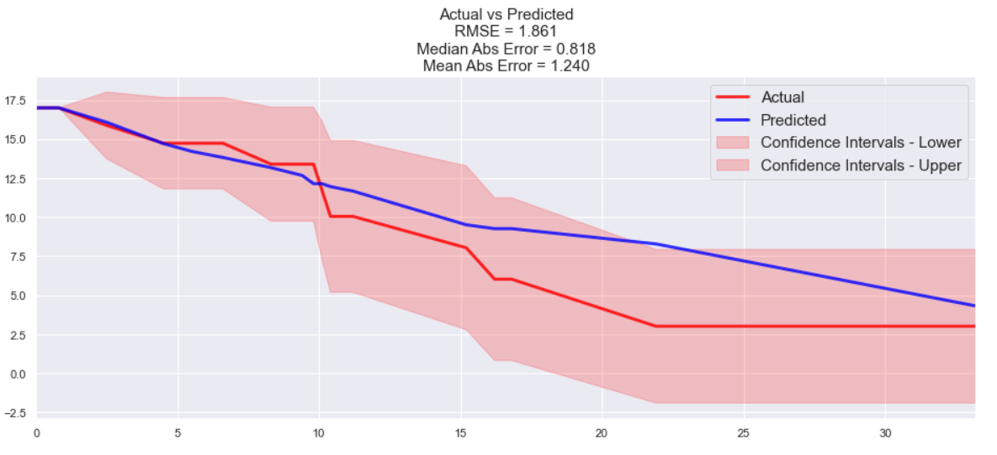
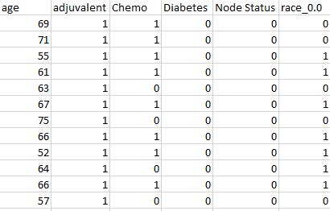
Method
Radiomic Features
Input Image
Random Survival Forest Model
Output: Predicted Survival
Clinical Variables
Input Patient Data

Slide 4
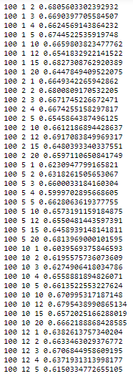
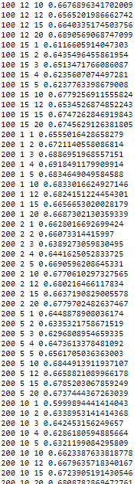
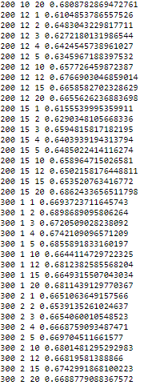
Update
Repeated 100x – accuracies fluctuate up to ± 0.12
Likely overfitting [1]
[1] Liu R, Gillies DF. Overfitting in linear feature extraction for classification of high-dimensional image data. Pattern Recognition, 2016;53:73–86

Slide 5
Update
Feature Selection
Dynamic (not manually done each time) [2]
Perform Cox Regression on all data
Sort by HR
Pick N highest HR variables (N = floor(Samples / 10)) [3]
Use the N variables as input to survival forest
[2] Lin DY, Wei LJ. The robust inference for the cox proportional hazards model. Journal of the American Statistical Association, 1989;84:1074–1078.
[3] Bourgon R, Gentleman R, Huber W. Independent filtering increases detection power for high-throughput experiments. Proceedings of the National Academy of Sciences of the United States of America, 2010;107:9546–9551.

Slide 6
Update
Try subsets clinical data
“Preop Model”
Age, race (Caucasian vs. Not), BMI (<30 or >30), diabetes, hist (endometrioid vs. nonendometrioid)*
“Postop Model”
Preop model + node status, stage (I/II vs III/IV)**
“Complete Model”
Postop model + RT, Chemo
*Couldn’t find label (1=?, 2=?, 3=?, 4=?)
**Couldn’t find in spreadsheet?

Slide 7


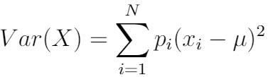
Method
Input: Combination of Clinical Variables and Radiomics
Output: Predicted Survival
Feature Selection
Random Survival Forest Model
Preop Variables
Postop Variables
Complete Variables
Radiomics Only
Preop + Radiomics
Postop + Radiomics
Complete + Radiomics

Slide 8
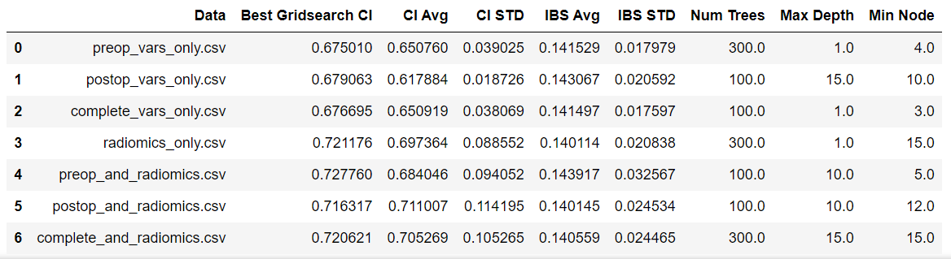
Results – With Some Feature Selection

Slide 9
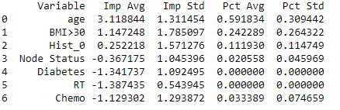
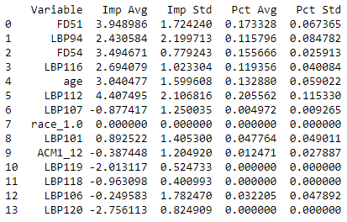
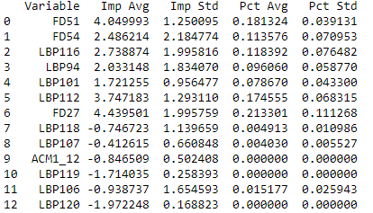
Feature Importances
Complete Clin Vars
Clin Vars and Radiomics
Radiomics Only

Slide 10
Feature Importances
(Table 1 on GitHub)

