Slide 1
Prediction of Local Progression for Colorectal Liver Metastases using a Radiomic Artificial Intelligence Model
Ricky Hu^{1*}, Ishita Chen^{2*}, Jacob Peoples³, Jean-Paul Salameh¹, Mithat Gönen⁴, Paul B. Romesser⁵, Amber L. Simpson^{3,5}, and Marsha Reyngold²
¹School of Medicine, Queen’s University, Kingston, ON
²Department of Radiation Oncology, Memorial Sloan Kettering Cancer Center, New York, NY
³School of Computing, Queen’s University, Kingston, ON
⁴Department of Epidemiology and Biostatistics, Memorial Sloan Kettering Cancer Center, New York, NY
⁵Department of Biomedical and Molecular Sciences, Queen’s University, Kingston, ON

Slide 2
No conflicts of interest to disclose This project was conducted with approval from the Memorial Sloan Kettering Cancer Center Institutional Review Board (ID:16-328)

Slide 3
Motivation
30-50% of colorectal cancer patients develop liver metastases [1]
Prognosis/survival essential to guide management

Slide 4
Motivation
Limitations of current prognostic models:
Limited accuracy (C-Index: 0.443-0.615 for past models [2-11])
Restricted to clinical variables and manual scoring
Cox Regression unable to model nonlinear interdependencies

Slide 5
Objective
To develop and evaluate an automated model to predict tumor progression of colorectal liver metastases with CT radiomics and AI.

Slide 6
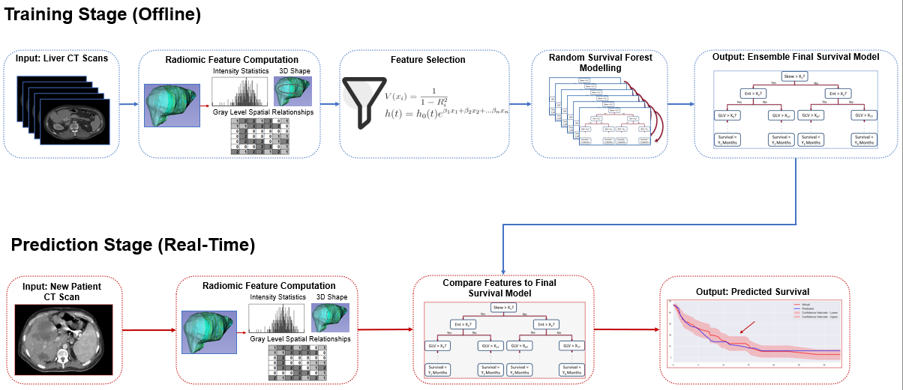
Method – Full Algorithm

Slide 7
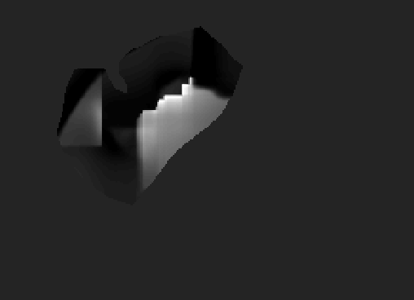
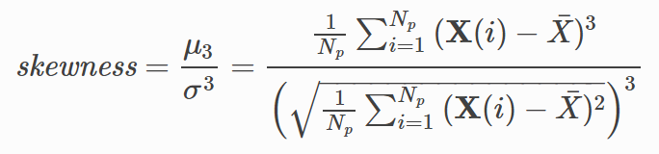
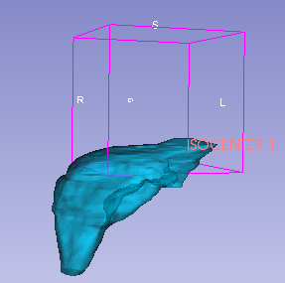
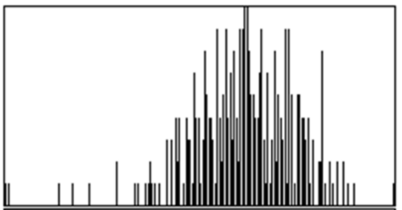
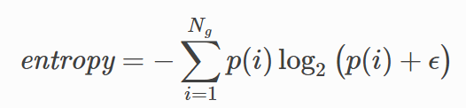
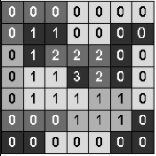
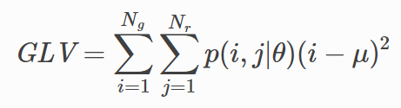
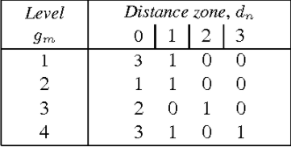
1. Method: CT Feature Extraction
Extracted 108 radiomic features from a CT liver volume:
1.
2.
.
.
.
108.

Slide 8
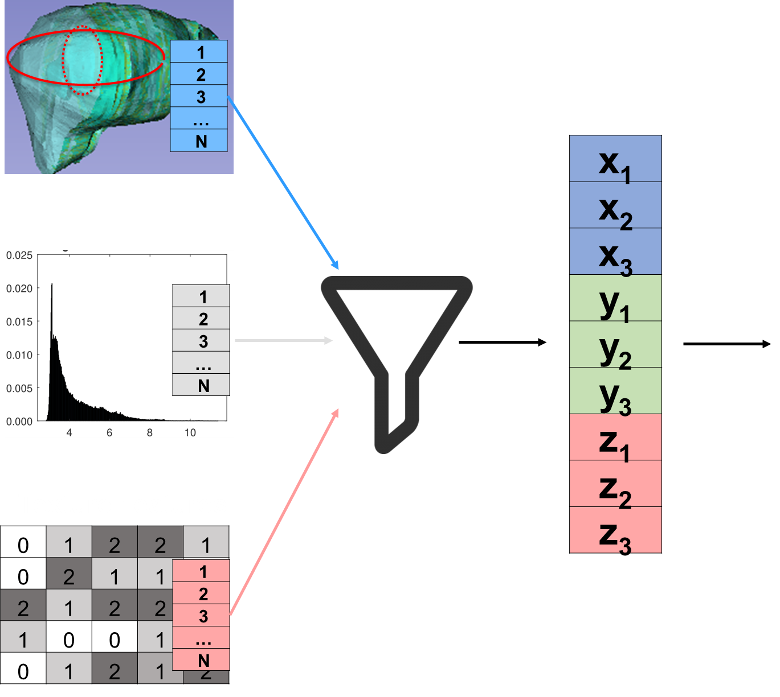
2. Method: Feature Selection
Features filtered using variance inflation factor and Cox hazard ranking

Slide 9
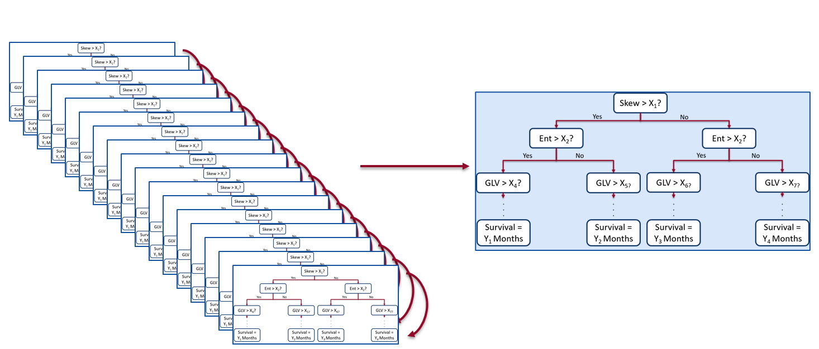
3. Method: Random Survival Forest [12]
Machine learning to create decision tree from radiomic features

Slide 10
4. Method: Validation
N = 97 colorectal liver metastases liver CT scans from Memorial Sloan Kettering Cancer Center
5 fold cross-validation – 80% of data for training, 20% for testing, repeated 5x
Testing repeated with only clinical data used (demographic data, radiotherapy variables, tumor markers) and with classical Cox Hazards Model

Slide 11
Results – Comparing model prediction to outcome data
Input Features | Concordance Index (95% CI) | Integrated Brier Score (95% CI)
With Random Survival Forest Model
Clinical Data Only | 0.62 [0.56, 0.69] | 0.19 [0.16, 0.22]
Radiomics | 0.68 [0.62, 0.74] | 0.20 [0.16, 0.25]
Clinical Data + Radiomics | 0.69 [0.65, 0.74] | 0.23 [0.21, 0.26]
With Cox Proportional Hazards Model
Clinical Data Only | 0.52 [0.50, 0.54] | 0.19 [0.15, 0.23]
Radiomics: Liver Parenchyma + Tumor | 0.41 [0.39, 0.43] | 0.24 [0.20, 0.28]
All Clinical Data and Radiomics from Liver Parenchyma + Tumor | 0.52 [0.50, 0.54] | 0.19 [0.16, 0.22]

Slide 12
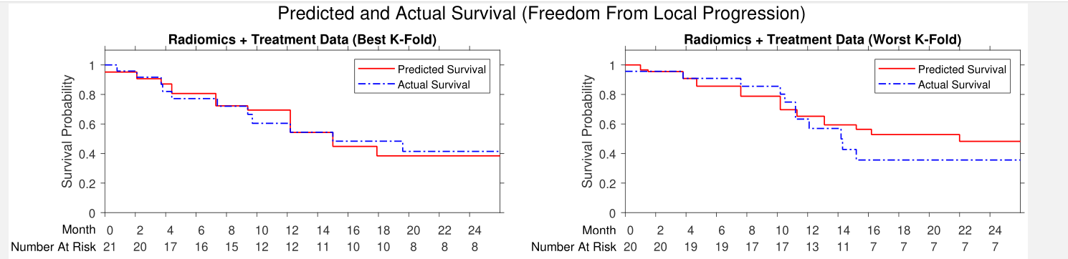
Results – Predicted vs. Actual Survival
Excellent prediction of Kaplan-Meier curve compared to actual survival

Slide 13
Results – Most Predictive Features
Radiomic Feature | Perturbation Importance (95% CI)
Neighborhood Gray Tone Difference Matrix Strength | 3.74 [2.25, 5.22]
Neighborhood Gray Tone Difference Matrix Busyness | 3.32 [2.5, 4.15]
Kurtosis | 1.97 [1.58, 2.37]
Maximum 2D Diameter Slice | 1.45 [0.20, 2.69]
Gray Level Size Zone Matrix Low Gray Level Emphasis | 0.33 [-0.75, 1.42]
NGTDM Strength = loosely related to inhomogeneity
Physiological significance unknown -> motivates future studies

Slide 14
Discussion
Clinical Significance:
Model performs with greater accuracy (C-Index: 0.69) than past studies
Greater accuracy than Cox model -> features need complex modelling i.e. machine learning
Limitations
Likely require more data + from different centres
Require clinical data from other studies for complete comparison

Slide 15
Discussion
Future Implications:
Clinical trials with AI radiomics model
Potential as a physician-assist tool to provide more data for prognostic assessment
(not a physician replacement)

Slide 16


Special Thanks:
Queen’s Computing: Dr. Amber Simpon, Dr. Jacob Peoples
Memorial Sloan Kettering Cancer Center: Dr. Ishita Chen ,Dr. Marsha Reyngold, Dr. Paul Romesser

Slide 17
References
[1] Chow, F. C. L., & Chok, K. S. H. (2019). Colorectal liver metastases: an update on multidisciplinary approach. World journal of hepatology, 11(2), 150.
[2] M. Dominello, J. Bowers, M. Zaki, and A. Konski, “Radiotherapy and radioembolization for liver metastases.,” Ann. Palliat. Med., vol. 3, no. 2, pp. 104–10413, 2014
[3] Y. Fong et al., “Clinical score for predicting recurrence after hepatic resection for metastatic colorectal cancer: Analysis of 1001 consecutive cases,” in Annals of Surgery, 1999.
[4] K. Imai et al., “Nomogram for prediction of prognosis in patients with initially unresectable colorectal liver metastases,” Br. J. Surg., 2016.
[5] S. Iwatsuki et al., “Hepatic resection for metastatic colorectal adenocarcinoma: A proposal of a prognostic scoring system,” J. Am. Coll. Surg., 1999.
[6] R. Konopke et al., “Prognostic factors and evaluation of a clinical score for predicting survival after resection of colorectal liver metastases,” Liver Int., 2009.
[7] I. Nagashima et al., “A new scoring system to classify patients with colorectal liver metastases: Proposal of criteria to select candidates for hepatic resection,” J. Hepat. Pancreat. Surg., 2004.
[8] B. Nordlinger et al., “Surgical resection of colorectal carcinoma metastases to the liver: A prognostic scoring system to improve case selection, based on 1568 patients,” Cancer, 1996.
[9] K. Sasaki et al., “The Tumor Burden Score: A New ‘metro-ticket’ Prognostic Tool for Colorectal Liver Metastases Based on Tumor Size and Number of Tumors,” Ann. Surg., 2018.
[10] M. Rees et al, “Evaluation of long-term survival after hepatic resection for metastatic colorectal cancer: A multifactorial model of 929 patients,” Ann. Surg., 2008.
[11] K. W. Brudvik, G. Passot, and J. N. Vauthey, “Colorectal liver metastases: A changing treatment landscape,” Journal of Oncology Practice. 2016.
[12] Ishwaran, H., Kogalur, U. B., Blackstone, E. H., & Lauer, M. S. (2008). Random survival forests. The annals of applied statistics, 2(3), 841-860.

