Slide 1
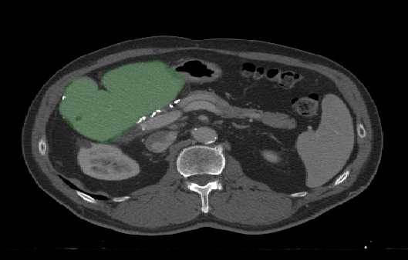
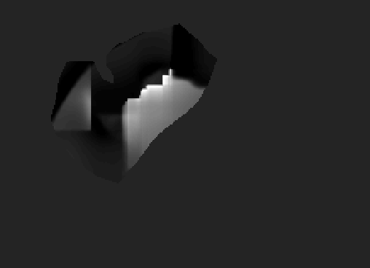
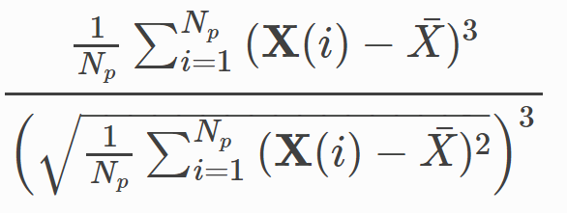
Segmented Liver
Local Skewness Map
Radiomic Computation (e.g. Skewness)

Slide 2
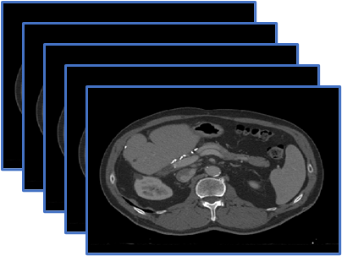
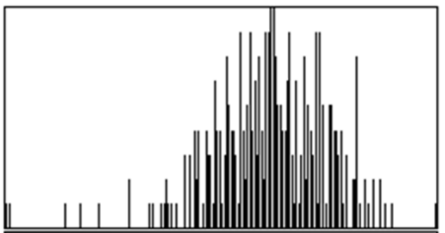
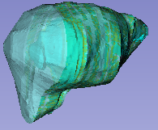

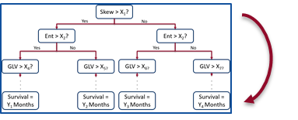
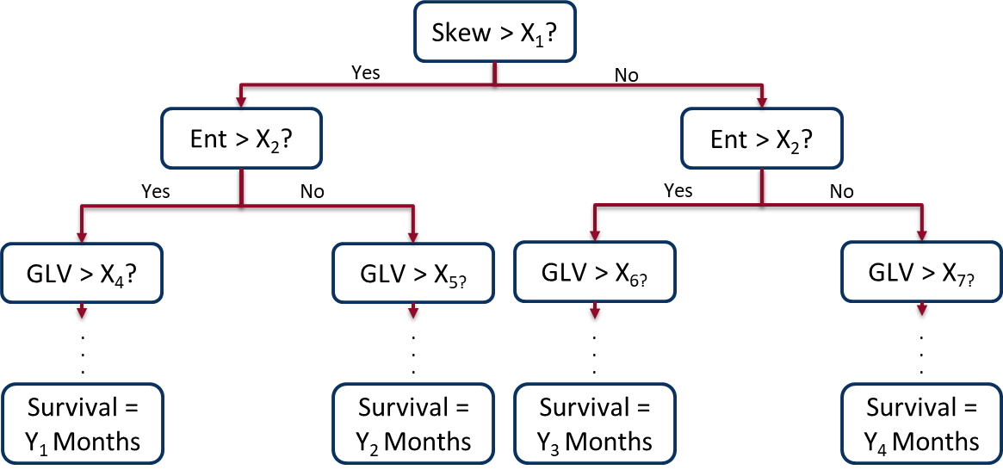


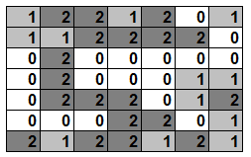
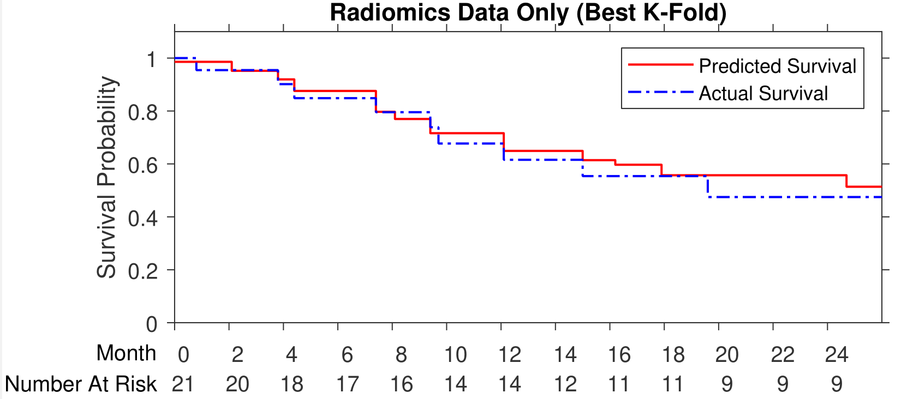
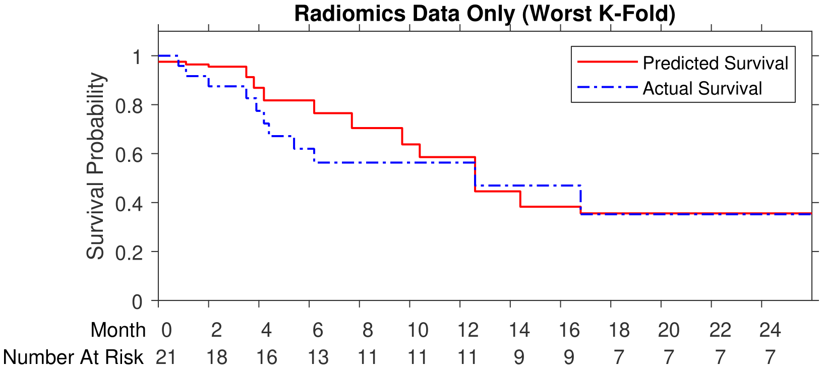
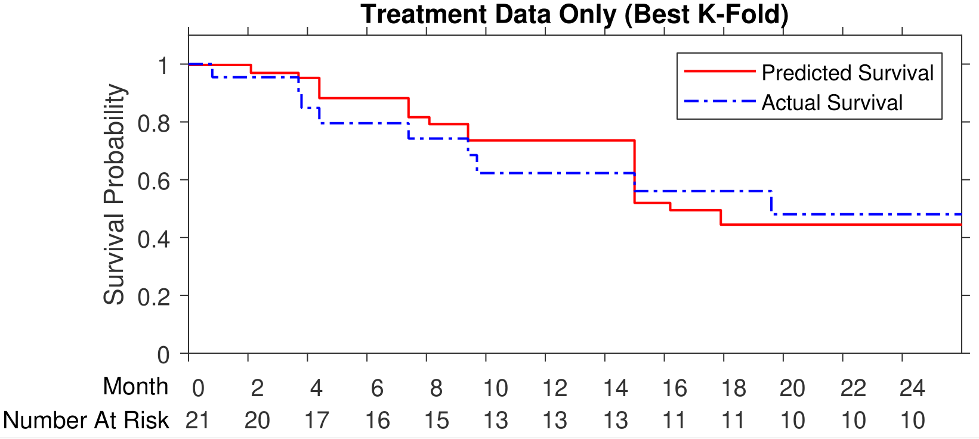
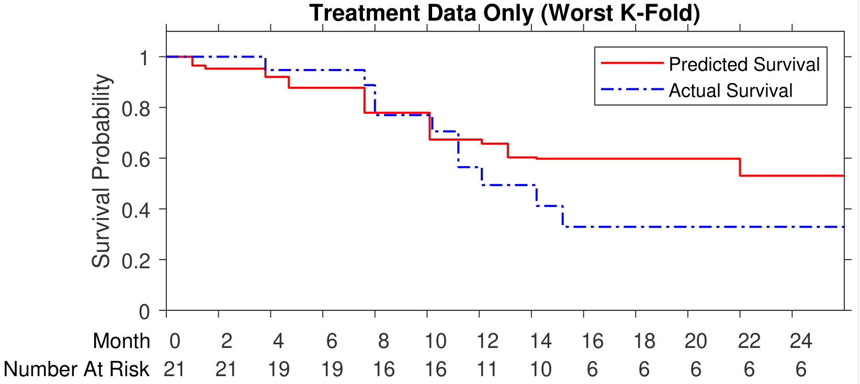
Artificial Intelligence Radiomics Pipeline
Input: Liver CT Scans
Radiomic Feature Computation
Feature Selection
Random Survival Forest
Modelling
Output: Ensemble Final Survival Model
Intensity Statistics
3D Shape
Gray Level Spatial Relationships
Cross-Validation Testing: Predicted Survival Compared to Actual Survival

Slide 3
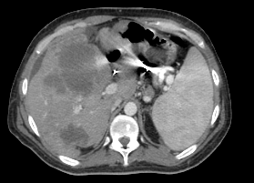
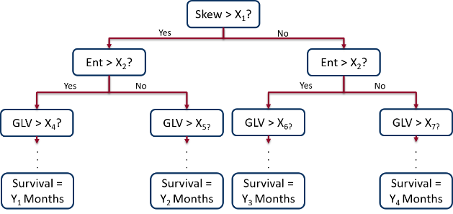
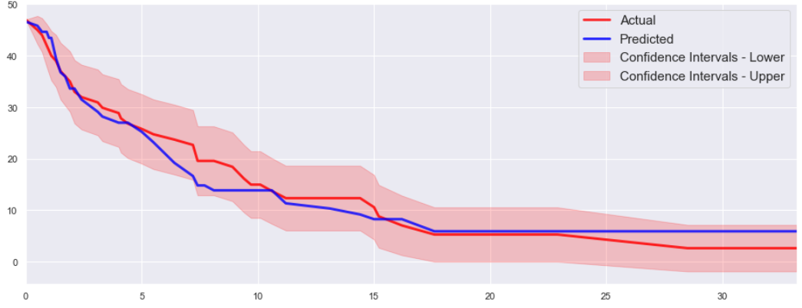
Training Stage (Offline)
Input: Liver CT Scans
Radiomic Feature Computation
Feature Selection
Random Survival Forest
Modelling
Output: Ensemble Final Survival Model
Intensity Statistics
3D Shape
Gray Level Spatial Relationships
Prediction Stage (Real-Time)
Input: New Patient CT Scan
Radiomic Feature Computation
Compare Features to Final Survival Model
Output: Predicted Survival
Intensity Statistics
3D Shape
Gray Level Spatial Relationships

Slide 4
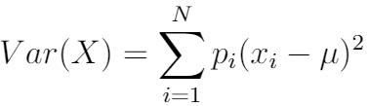
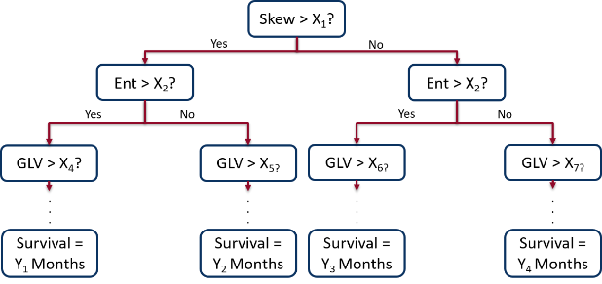
Training Stage (Offline)
Input: Liver CT Scans
Radiomic Feature Computation
3D Shape
Intensity Statistics
Gray Level Spatial Relationships
Feature Selection
A)
Training Stage (Offline)
Training CT Data
Radiomic Feature Computation and Training RSF Model
Final Survival Model
Random Survival Forest Modelling
Output: Ensemble Survival Tree
(Final Survival Model)
Yes
Skew > X₁?
No
Yes
Ent > X₂?
Yes
Ent > X₂?
No
No
GLV > X₄?
GLV > X_{5?}
GLV > X_{6?}
GLV > X_{7?}
. . .
. . .
. . .
. . .
Survival = Y₁ Months
Survival = Y₂ Months
Survival = Y₃ Months
Survival = Y₄ Months

Slide 5
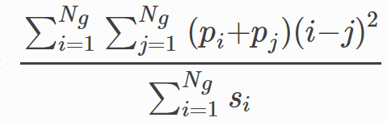
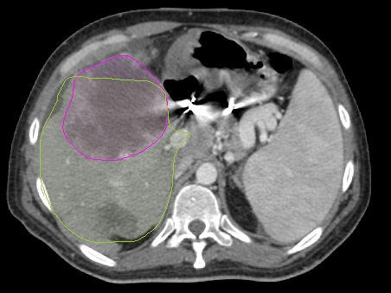
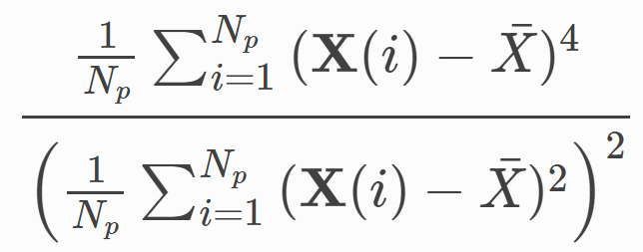
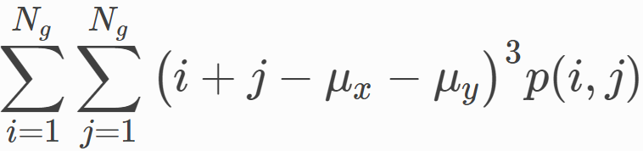
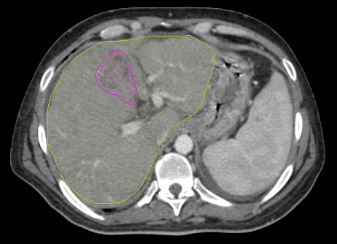
Tumor Segmentation
Liver Segmentation
 | Liver CT and Segmented Tumor
Neighboring Gray Tone Difference Matrix Strength:
0.0271
Skewness:
198.6652
Gray Level Co-occurrence Matrix Cluster Shade:
-955.8940
Outcome: | Time-To-Event:
Local Progression | 8.3 Months
 | Liver CT and Segmented Tumor
Neighboring Gray Tone Difference Matrix Strength:
0.0071
Skewness:
-0.9242
Gray Level Co-occurrence Matrix Cluster Shade:
-452.4516
Outcome:
No Local Progression

Slide 6
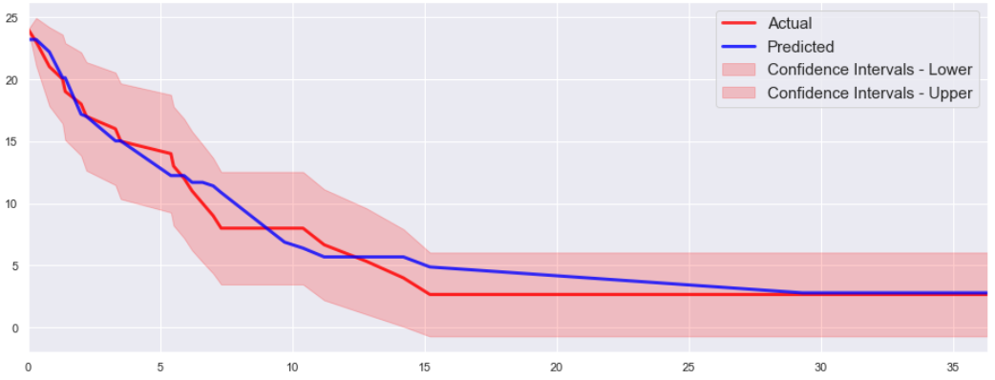
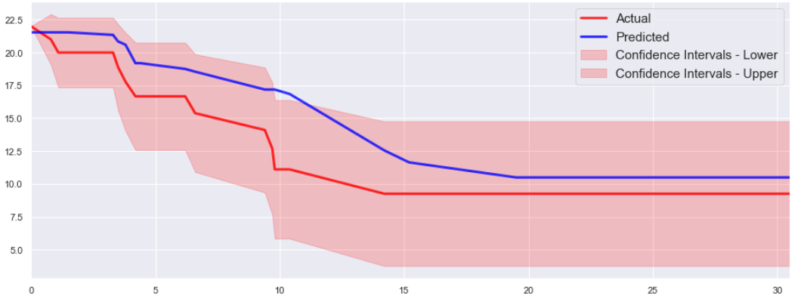
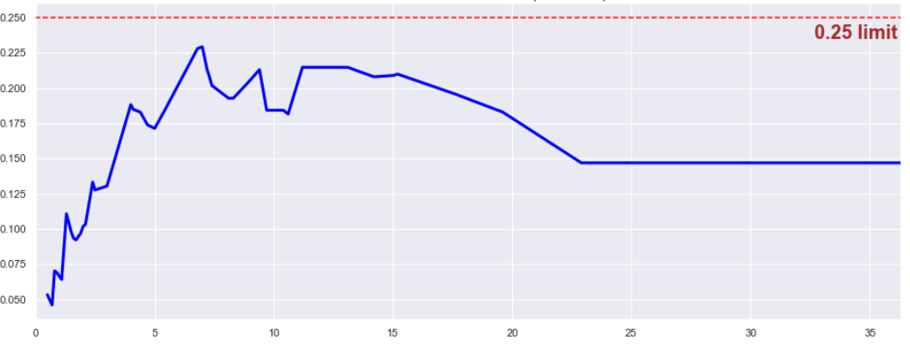
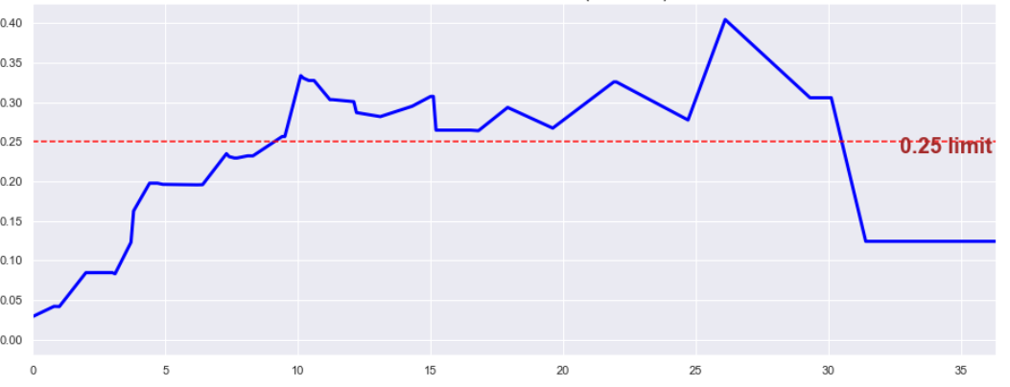
a)
Actual vs. Predicted Survival, Best Case
c)
Actual vs. Predicted Survival, Worst Case
Survivors
Survivors
b)
Months
d)
Months
Integrated Brier Score, Best Case
Integrated Brier Score, Worst Case
Integrated Brier Score
Integrated Brier Score
Months
Months

