Slide 1
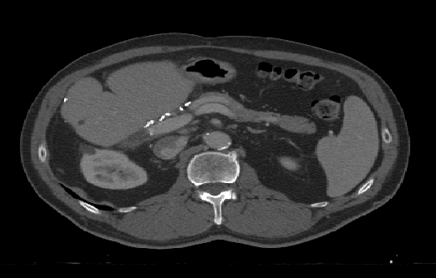
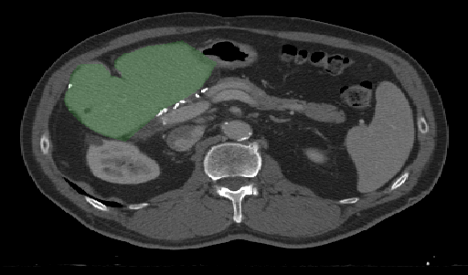
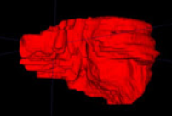
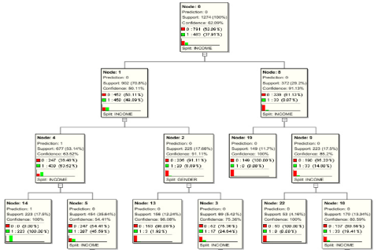
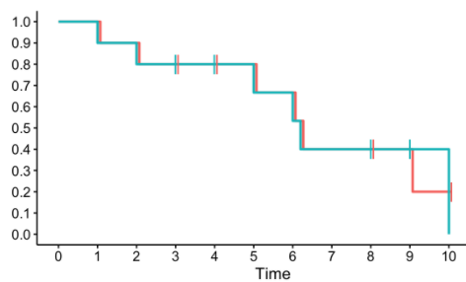
AI Prediction Model Pipeline
Segmentation & Normalization
Radiomic Feature Extraction
Random Survival Forest Optimization
Output: Predicted Survival
Input: CT Liver Image

Slide 2
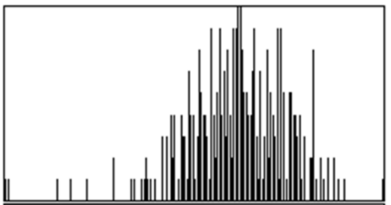
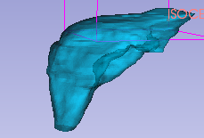
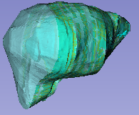
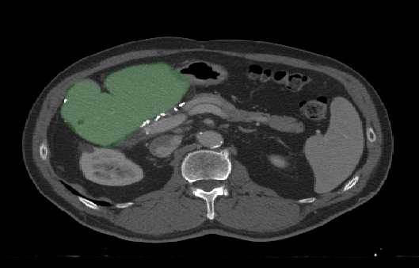
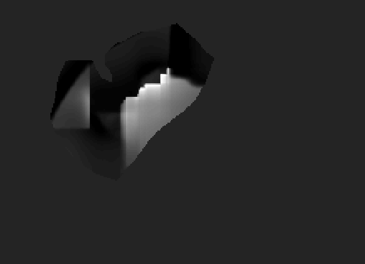
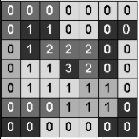
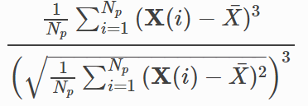
a)
b)
Radiomic Feature Computation
Intensity Statistics
3D Shape
Liver Volume
Segmented Liver
Local Skewness Map
Radiomic Computation (e.g. Skewness)
Gray Level Spatial Relationships

Slide 3
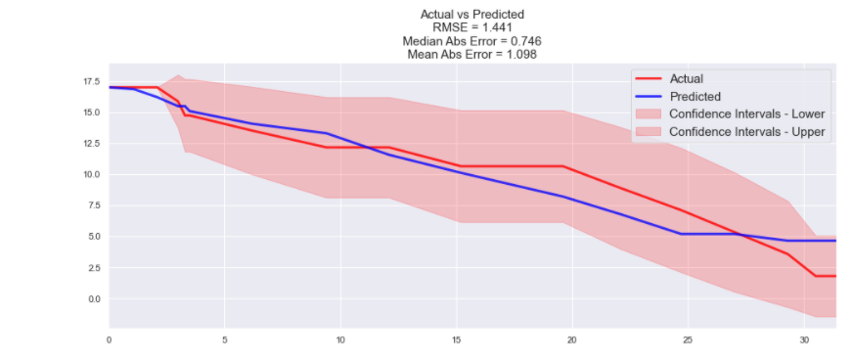
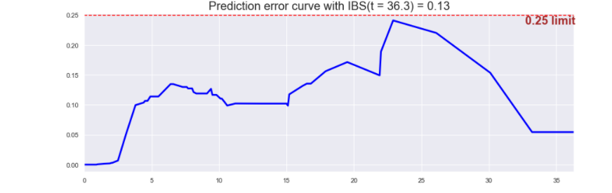
Survival Function (Number of Patients Surviving)
IBS Error
Months
Months

Slide 4
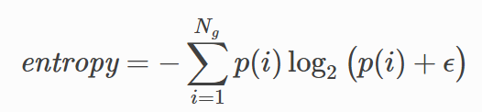
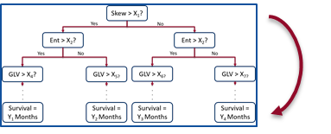
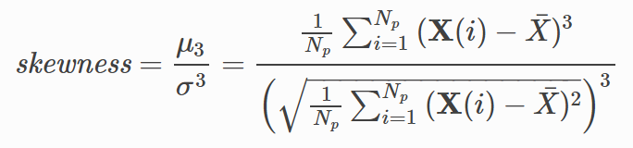


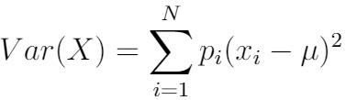
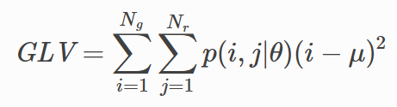
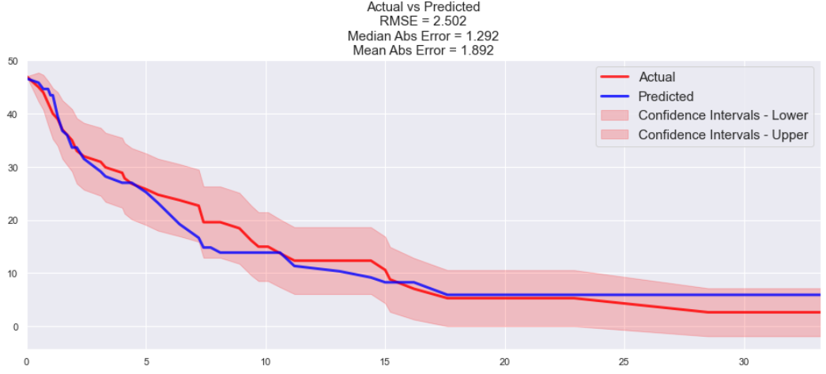
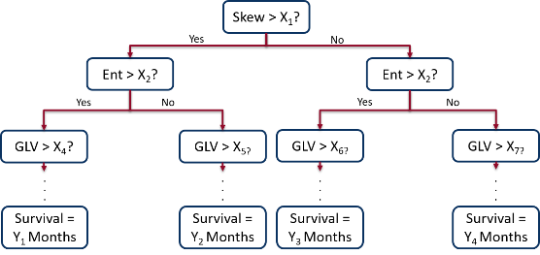
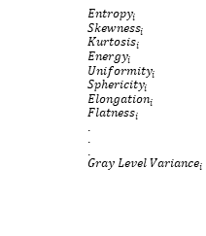
Input: Liver CT
Radiomic Feature Computation
Feature Selection
Random Survival Forest Training
$${Entropy}_{i}$$
$${Skewness}_{i}$$
$${Kurtosis}_{i}$$
$${Energy}_{i}$$
$${Uniformity}_{i}$$
$${Sphericity}_{i}$$
$${Elongation}_{i}$$
$${Flatness}_{i}$$
.
.
.
$${Gray Level Variance}_{i}$$
. .
. .
Output: Predicted Survival and Final Ensemble Survival Tree

Slide 5
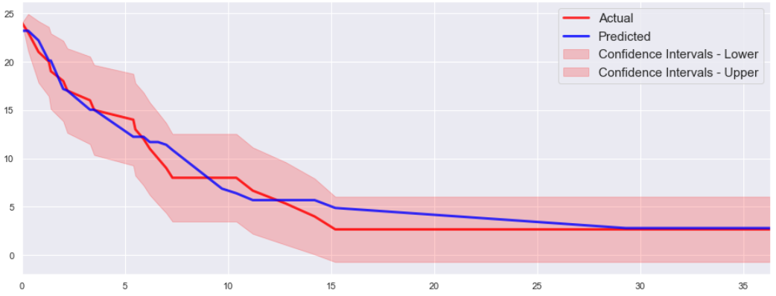
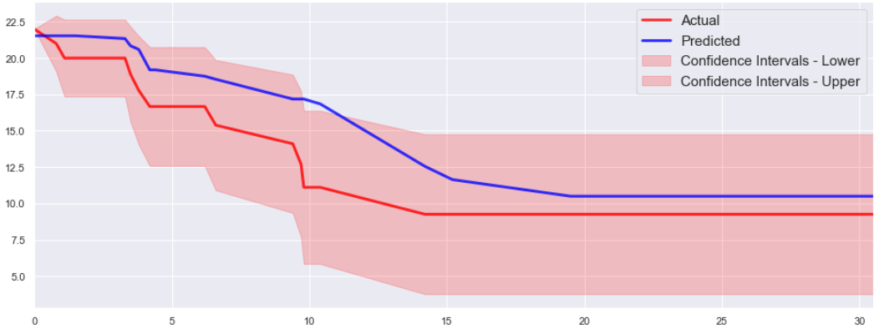
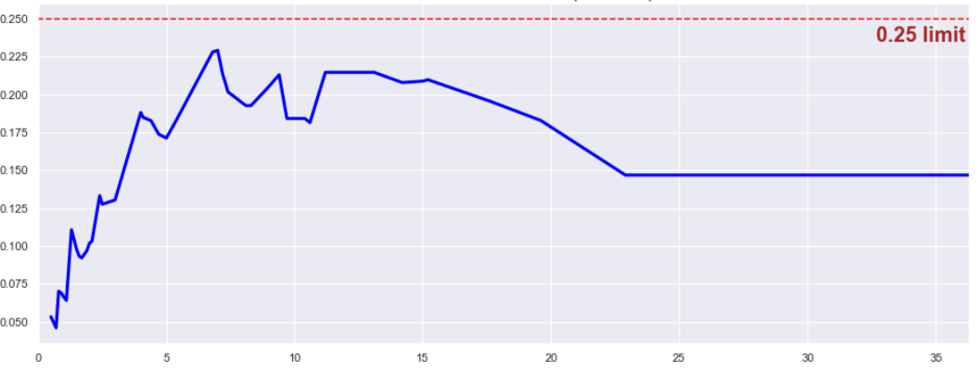
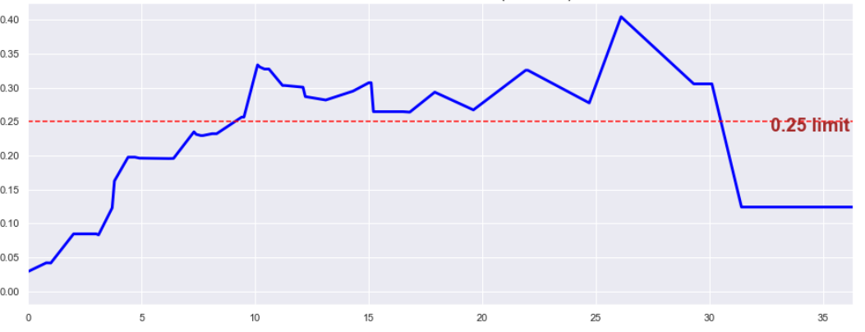
a)
Actual vs. Predicted Survival, Best Case
c)
Actual vs. Predicted Survival, Worst Case
Survivors
Survivors
Months
Months
b)
Integrated Brier Score, Best Case
d)
Integrated Brier Score, Worst Case
Integrated Brier Score
Integrated Brier Score
Months
Months

