Slide 1
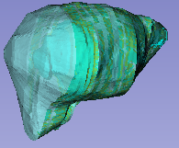
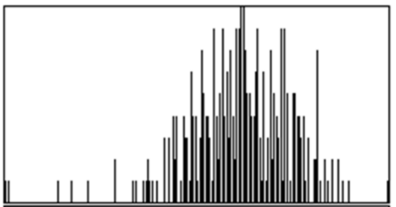
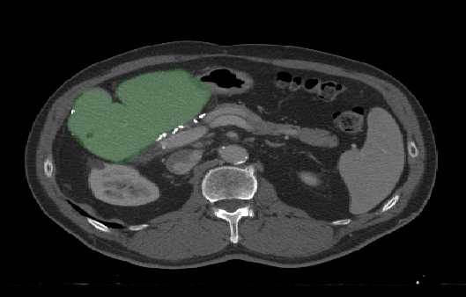
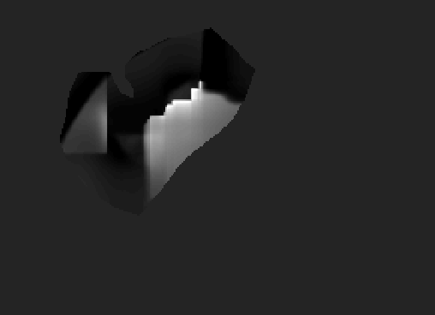
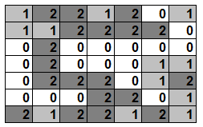
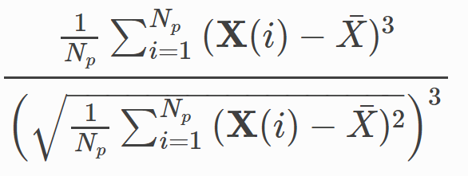
a)
Radiomic Feature Computation
b)
Liver Volume
Intensity Statistics
3D Shape
Segmented Liver
Local Skewness Map
Gray Level Spatial Relationships
Radiomic Computation (e.g. Skewness)

Slide 2
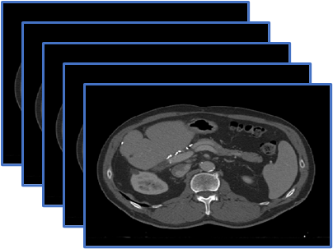
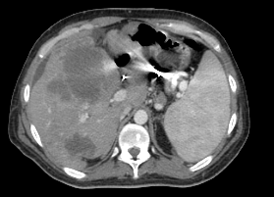
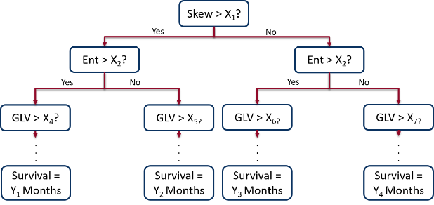
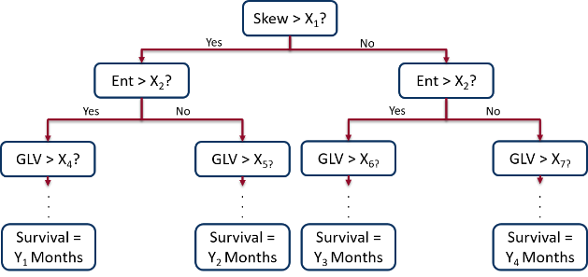
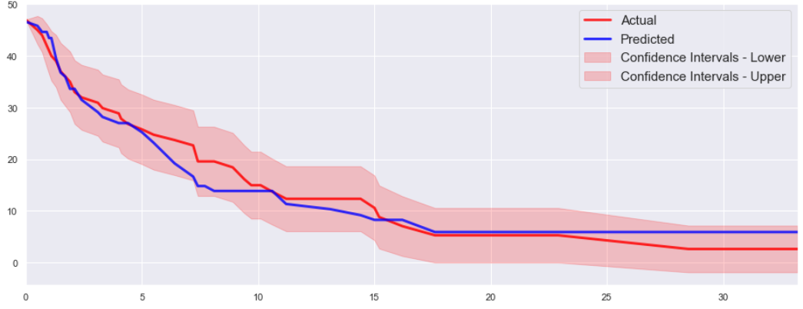
Training Stage (Offline)
Prediction Stage (Real-Time)
Training CT Data
New Patient CT Scan
Radiomic Feature Computation and Training RSF Model
Radiomic Feature Computation
Final Survival Model
Compare Radiomic Features to
Final Survival Model
Output: Predicted Survival

Slide 3


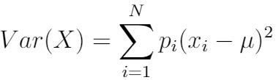
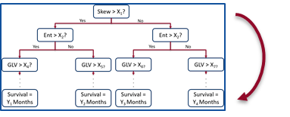
Training Stage (Offline)
Input: Liver CT Scans
Radiomic Feature Computation
3D Shape
Intensity Statistics
Gray Level Spatial Relationships
Feature Selection
Random Survival Forest Modelling
Output: Ensemble Survival Tree
(Final Survival Model)
Yes
Skew > X₁?
No
Yes
Ent > X₂?
Yes
Ent > X₂?
No
No
GLV > X₄?
GLV > X_{5?}
GLV > X_{6?}
GLV > X_{7?}
. . .
. . .
. . .
. . .
Survival = Y₁ Months
Survival = Y₂ Months
Survival = Y₃ Months
Survival = Y₄ Months

Slide 4
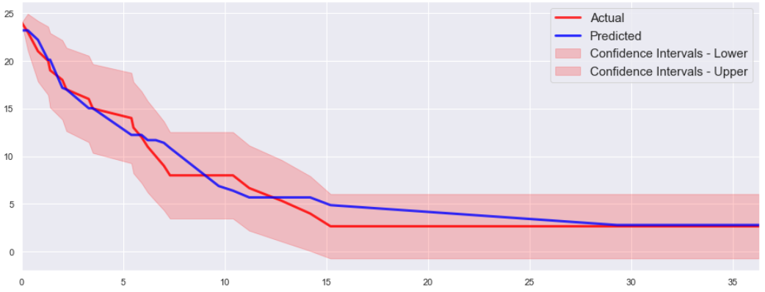
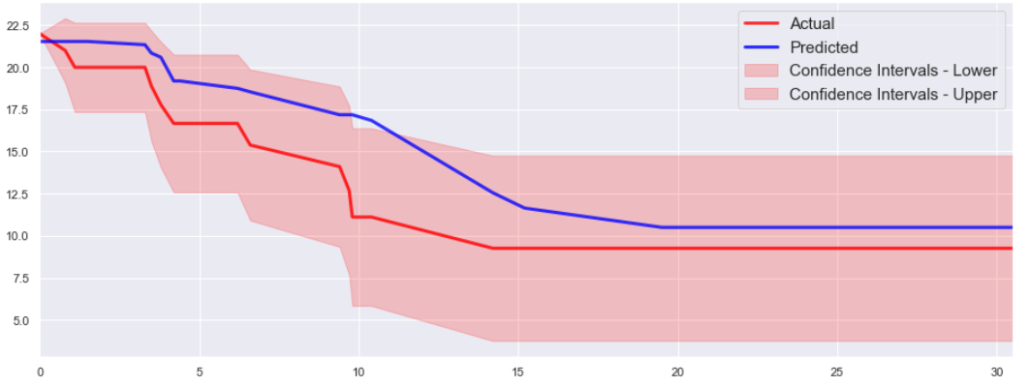
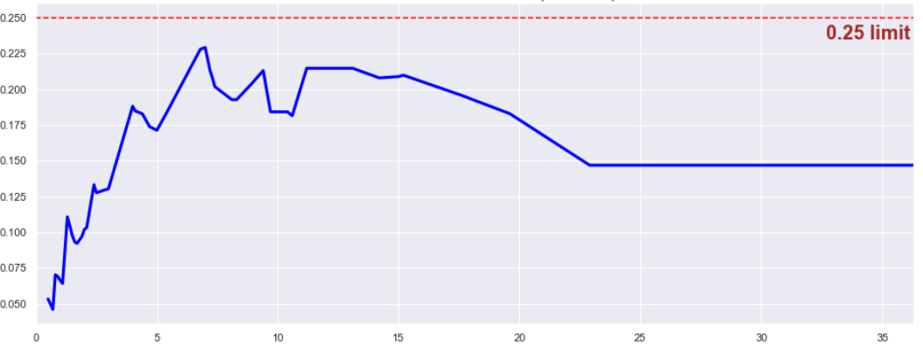
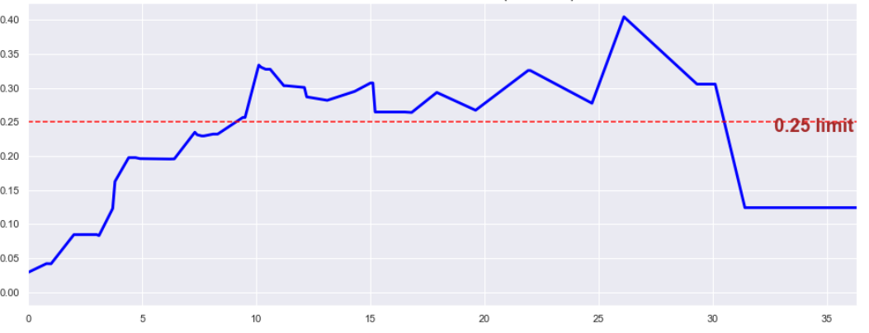
a)
Actual vs. Predicted Survival, Best Case
c)
Actual vs. Predicted Survival, Worst Case
Survivors
Survivors
b)
Months
d)
Months
Integrated Brier Score, Best Case
Integrated Brier Score, Worst Case
Integrated Brier Score
Integrated Brier Score
Months
Months

