Slide 1


High Performance Computation
China University of Geosciences
Chengjun Li

Slide 2
1
A Glance at HPC

Slide 3
Abstract
High Performance Computing (HPC) is an area encompassing among others the various paradigms of parallel programming, their related programming languages and application programming interfaces (APIs), the dedicated software tools, the international specialized conferences, etc.
Loosely speaking, HPC is both the scientific and technical fields of study of “Supercomputers”.

Slide 4
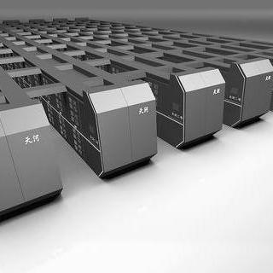
What is HPC?
Not only hardware, but also software.
The list of the top 500 supercomputers is regularly updated and available on the Internet.
In 2014, Tianhe-2 (or MilkyWay-2) is the winner in the list.
It consists of 3.12 million cores.

Slide 5
What is HPC?
It’s overall performance are 54.9 Petaflops, where a PFlops is 10¹⁵ floating-point operations per second.
The electricity cost of this supercomputer is about 1 million dollars per year.

Slide 6
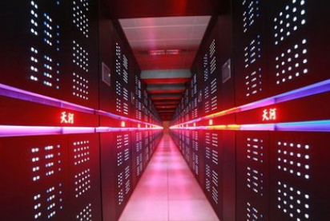
What is HPC? - The definition given by Huawei
A typical architecture of HPC includes infrastructure, computing node, storage file system, network exchange, cluster management, and resource scheduling.
Computing cluster
High-Speed exchanging network
……
Storage cluster
Notes:
HPC发展已经有半个多世纪，早期HPC基于定制计算机，专用于基础科学研究和国防战略等特定领域，随着技术的发展，现在绝大部分HPC基于X86服务器的集群架构进行构建。
HPC计算集群主要由计算服务器、共享存储、高速互连设备以及配套的管理软件、平台软件和应用软件构成。

Slide 7

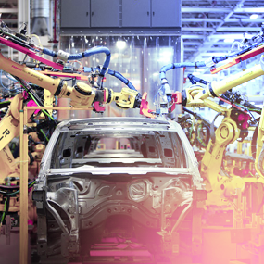

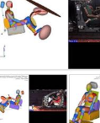
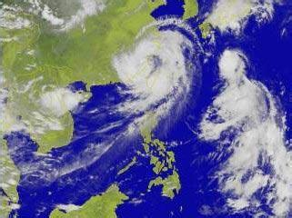


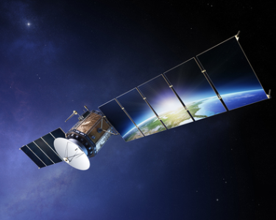
Features of different application of HPC
Different applications have different requirements on computing ability, storage efficiency, network IO, and delay.
High network communication
close coupled
network
Fluid dynamics
Materials simulations
Crash simulation
Seismic professing
Weather forecasting
Astrophysics
Deep learning
Data
light
Data
intensive
Risk simulations
Molecular modeling
Contextual search
Logistics simulations
Animation and VFX
Semiconductor Verification
Metagenomics
Image processing
GIS
Low difficulty on uploading to cloud
loosely coupled network
High storage I/O
Notes:
不同的行业和研究领域在应用高性能计算时，对高性能计算集群有不同的系统要求：
譬如在涉及天体物理或分子动力模拟计算应用场景时，需要处理大模型计算，多处理器、共享大容量内存的配置允许中间数据存储在内存中，CPU可以直接从内存中获取而不需要和硬盘交换数据，可以减少IO频度，明显提高计算速度。
在气象预报应用场景中，计算本身有时效性要求，应用的计算量大、并行要求高，所以强劲的节点计算能力有利于提升整体的计算效率。
在汽车、航空、芯片制造领域借助高性能计算进行产品的CAE仿真设计，需要对复杂的产品几何模型进行求解，各节点在计算过程中有频繁的通讯需求。为了避免CPU等待数据进行计算的情况，因此需要低时延、高带宽的网络来连接大量的计算节点间的数据传输，提升计算效率。
在基因分析场景，序列比对、拼接需要对海量、复杂、多变的数据进行分析计算，单次测序数据量的大幅度提升，在计算过程中会产生大量的数据，因此需要配置高带宽、大容量的共享存储，满足计算节点频繁的数据IO读写请求。

Slide 8
Why Do We Need HPC?
HPC is useful for being faster and being thus more precise overall.

Slide 9
Why Do We Need HPC?
It is too difficult to build (blower or wind tunnel),
or too expensive to build (car/airplane crash test),
or too slow on usual computers (evolution of climate or galaxies),
or too dangerous in practice (nuclear weapons, drugs, pollution, epidemics).

Slide 10
Why Do We Need HPC?
Some results have a time-limited value, like weather conditions, which are only useful to predict in the future!
Tomorrow’s weather is only useful to know if we can predict it before tomorrow!
Similarly, it is interesting to be the first to get the results in order to take decisions as soon as.

Slide 11
Why Do We Need HPC?
HPC also allows one to solve larger problems: simulations can be carried out either on more finely-meshed domains or on bigger data sets (the Big Data trend).
For example, processing big data-sets like genome analytics or families of genomes.

Slide 12
Why Do We Need HPC?
HPC is also very useful for saving energy: indeed, at constant flops performance, we prefer to use more lower-profile processors that consume less overall than high-profile processors which require more energy to work.

Slide 13
Why Do We Need HPC?
HPC is well-suited to some kinds of algorithms that are intrinsically parallel in essence.
For example, algorithms in image or video processing often compute filters that are operations that can be carried out independently in parallel for each pixel .

Slide 14
Big Data: The Four Vs
We can characterize the processing of big data-sets using the four Vs:
Volume,
Variety (heterogeneous data),
Velocity (data obtained continuously from sensors),
Value (not simulation but valuable insights).

Slide 15
Parallel Programming Paradigms: MPI and MapReduce
Nowadays, the two main programming models that are complementary to each other are:
Programming with MPI which has zero tolerance for hardware or network errors, but offers programmers a flexible framework, and
Programming with MapReduce which includes an infrastructure tolerant of errors and hardware failures, but has a rather a limited model of parallel computing compared with MPI.

Slide 16
Granularity
We classify parallel algorithms into three main categories according to their granularity:
Fine-grained parallelism: at the variable level inside the same task.
Fine-grained parallelism can also rely on GPU code snippets of the graphics card.

Slide 17
Granularity
Mid-grained parallelism : at the level of tasks of a same program using threads.
Coarse-grained parallelism : Data transfers are limited, and occur after big chunks of calculations.

Slide 18
Architecture of HPC
SMP（Symmetric Multi-Processor）
UMA：multi-processors connecting to one storage run the same OS and share other resources. Storage interface is the bottleneck of performance.
NUMA, a type of Distributed Shared Memory. NUMA has the only one OS as UMA and is easy to manage. Meanwhile, NUMA has extendibility as MPP.
CC-NUMA, a type of NUMA. CC-NUMA uses cache coherent to keep consistency in hardware manner.
MPP（Massively Parallel Processing）
MPP means tasks are sent to many nodes. When computation is done, results in different nodes are gathered to obtain the final outcome.

Slide 19
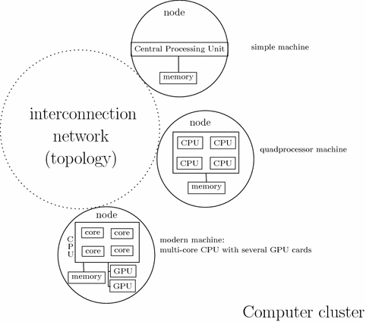
Heterogeneous parallelism
An example

Slide 20
Homogeneous and heterogeneous parallelism
Different computing units, such as CPU, GPU, DSP, ASIC, and FPGA, can be used together to improve computation ability.
heterogeneous HPC technologies can be divided into common ones and specialized ones,
Common technologies include heterogeneous many-core parallelism, CPU+GPU or CPU+MIC.
Specialized technologies mean CPU+FPGA, etc.
Non DSA
Pure CPU
Coupled DSA
+Vector（SVE/AVX）
Tight DSA
+Matrix（MVE/AMX）
Loose DSA
+HAC（SEC/ZIP）
Offline DSA
+DPU（Ascend/GPGPU）
CPU
CPU
CPU
CPU
DPU/GPU/NPU
V
M
HAC
CPU
Lack performance
Instruction level
in-pipeline
sync
Extra context low frequency
Hard scheduling
Instruction block level
co-processor sync,
Extra context low frequency
Hard scheduling
Function level
asynchronous
Heavy context needing 10x boost
Application level
asynchronous
Fully offload

Slide 21
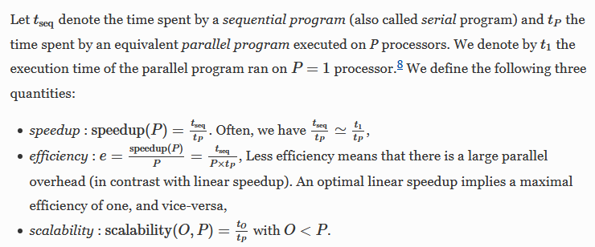
Important concepts

