Slide 1


High Performance Computation
China University of Geosciences
Chengjun Li

Slide 2
3
Topology of Interconnection Networks

Slide 3
Abstract
An interconnection network of computers is modelled mathematically as a graph with vertices representing computer nodes and edges depicting the communication links between those nodes.
If a logical network is different from the underlying physical network, one needs to transpose or embed the logical network onto the physical network.

Slide 4
Static Versus Dynamic Networks
In this chapter, a parallel computer is a computer cluster architecture with distributed memory.
A set of computers interconnected by a network. We shall consider two types of network: static networks that are once for all fixed and dynamic networks that can always be adapted to suit.

Slide 5
Logic Versus Physical Networks
When implementing a parallel we also need to distinguish between the physical network and the logical network .
The physical network is the real-world hardware.
The logical network is an abstraction of a communication network that is independent of the hardware architecture.

Slide 6
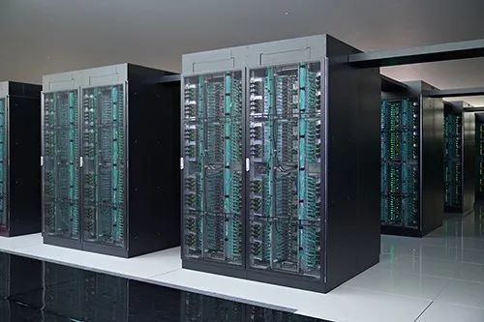
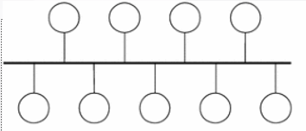
Logic Versus Physical Networks
Of course, we obtain an ideal performance when the physical network coincides with the logical network.
Otherwise, we seek for a transposition or an embedding of the logical network onto the physical network that minimizes the loss of efficiency of communication primitives.
VS

Slide 7
Interconnection Network: Graph Modeling
Let P processors communicate between them (each one with its own independent local memory attached to).
Here, we can either consider
(i) an architecture linking all processors using a shared communication (has to deal with potential messages colliding when messages are simultaneously sent), or
(ii) a point-to-point network linking all pairs of processors using a dedicated link to transmit messages. (this communication design requires O(P²) links)

Slide 8
Topology
Hence, we use many topologies to connect processors.
Topology of a network is described by a graph G=(V,E) .
V: the set of vertices representing processes
E: the set of edges representing communication links between processes

Slide 9
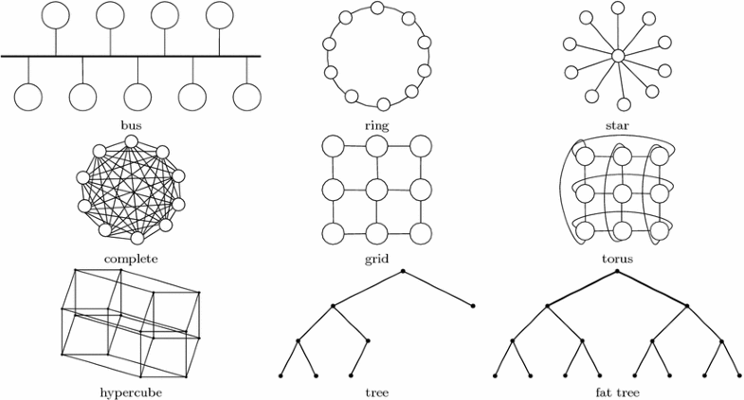
Topology

Slide 10
Topology
In order to build a good topology, we seek to set a trade-off between two opposing criteria:
minimize the number of links in order to decrease the material cost, and
maximize the number of direct communication links (arcs/edges) in order to decrease the communication cost of parallel algorithms.

