Slide 1


High Performance Computation
China University of Geosciences
Chengjun Li

Slide 2
4
Parallel Sorting

Slide 3
Abstract
There exist plenty sequential algorithms to sort n numbers that achieve the optimal time complexity of O(nlogn).
We can sort on parallel architectures with distributed memory by considering the granularity of local sorting.

Slide 4
Quick Review of Sequential Sorting
BubbleSort.
This algorithm is quite naive but very easy to program. Its worst-case complexity for sorting n elements is quadratic, in O(n² ).

Slide 5
Quick Review of Sequential Sorting
QuickSort.
It is a randomized recursive algorithm that chooses an element, called the pivot , and cost O(nlogn) in amortized time.

Slide 6
Quick Review of Sequential Sorting
MergeSort.
The main primitive consists in merging two sorted lists into a sorted list: this can be done easily in linear time, and therefore MergeSort costs overall O(nlogn) time.

Slide 7
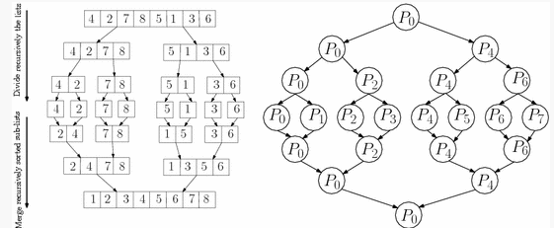
Parallel Sorting by Merging Lists

Slide 8
Parallel Sorting by Merging Lists
By a fine-grained parallelism, we use P=n processes to divide data and merge recursively the sorted sub-lists.
Sequential complexity: t_{seq}= O(nlogn)
Parallel complexity: t_{par}=O(n)
This method is thus inefficient since the obtained speed-up t_{seq}/t_{par}= O(logn).

Slide 9

Parallel Sorting Using Ranks
Can we sort in parallel in O(logn) time?
For each data element X[i], let us compute its rank in the array defined by:R[i]=|{X[j]∈X ∣ X[j]<X[i]}.
Once the rank of every element is given, sorting can be done.

Slide 10
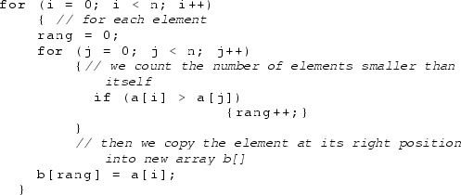
C code
t_{seq}= O(n²)
t_{par}=O(n)

Slide 11
Parallel Sorting Using Ranks
Now, let us consider parallel RankSort with P=n ² processes by using the Graphical Processing Units (GPUs) that are made of thousands of graphics cores.
In this case, R[i] can be computed in parallel as shown in the figure.

Slide 12
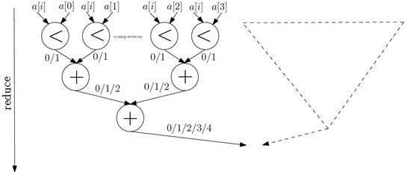
Thus, t_{par}=O(logn)
In particular, the RankSort algorithm with P=n ² processes requires constant time, O(1)

Slide 13
Parallel Quicksort
Based on a pivot value x, we recursively partition data into two arrays: X ≤ and X >.
QuickSort(X)=(QuickSort(X ≤x ),QuickSort(X >x )).

Slide 14
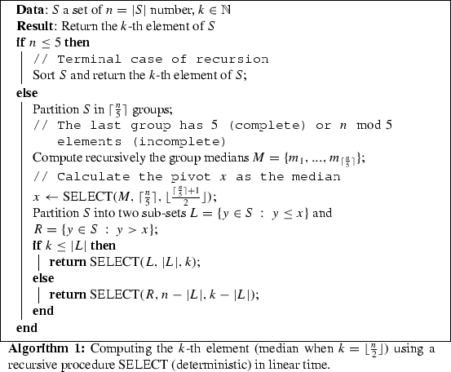
Pseudo-Code

Slide 15
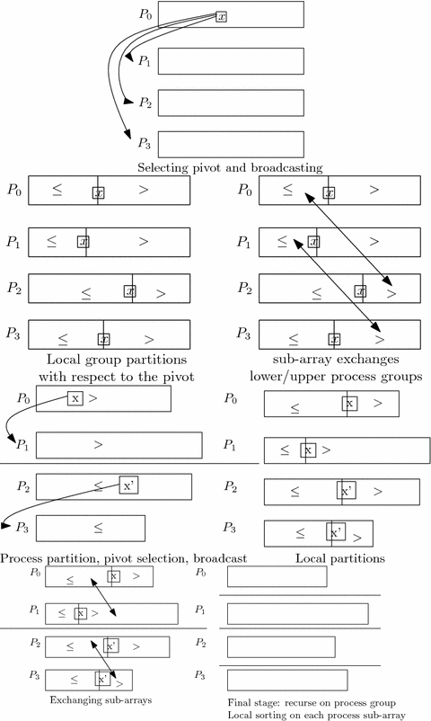

Slide 16
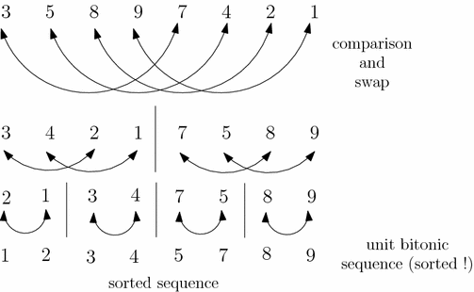
The Bitonic Merge Sort

Slide 17

Notes and References
Sorting in parallel can be executed in a very simple way.

Slide 18
Summary
There exist plenty sequential algorithms to sort n numbers that achieve the optimal time complexity of Θ(nlogn) .
We can sort on parallel architectures with distributed memory by considering the granularity of local sorting.
The QuickSort algorithm chooses randomly its pivot element and can be parallelized straightforwardly, but yields unfair workload on the processes (that is, not a good balancing property).
It is possible that we tune the granularity of the parallelism.

