Slide 1


High Performance Computation
China University of Geosciences
Chengjun Li

Slide 2
5
Parallel Linear Algebra

Slide 3
Abstract
The field of algorithms covering linear algebra implementations is very rich and versatile.

Slide 4
Linear algebra for Data Science (DS)
DS heavily relies on efficient implementation of linear algebra primitives in three main categories.
Clustering. Seeking for homogeneous group in data-sets .
Classification. Given a training set of data labeled with their class, we seek to label new unlabeled data by means of a classifier . That is, we predict a discrete class variable.
Regression. Given a data-set and a function on this data-set, we ask for the best model of the function that explains the data. In general, regression is a mechanism that allows to study the relationship of a variable with another.

Slide 5
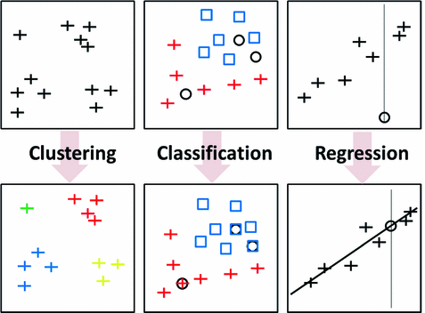

Slide 6
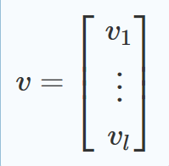
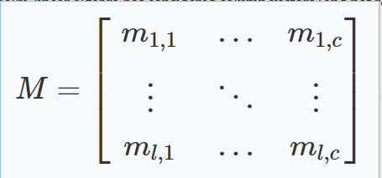
Classic Linear Algebra
Traditionally, linear algebra has considered column vectors and matrices.

Slide 7
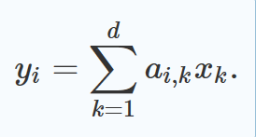
The Matrix–Vector Product
The matrix–vector product computes y=A×x for a square matrix A of dimension d×d and x a d-dimensional column vector.
Each element y_{i} is independent of the others y_{j} , and only depend on the x vector and a single row of A. Thus all y_{i} coefficients can be simultaneously computed independently.

Slide 8
We may partition the problem.
We locally compute the nP scalar products on processes, and then finally combine these results to obtain the y vector.

Slide 9
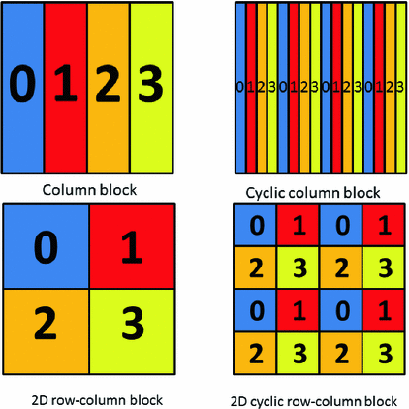
Data Patterns for Parallelism

Slide 10
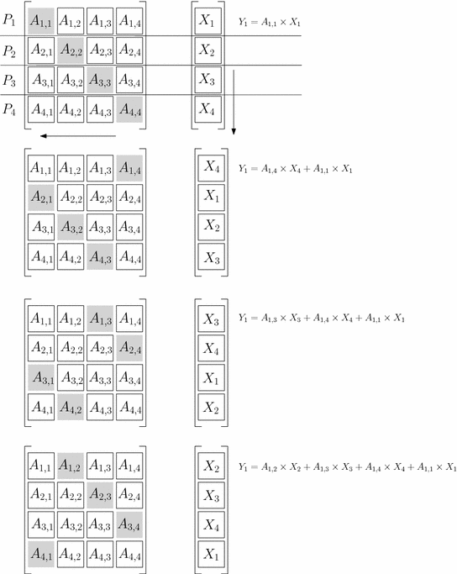

Slide 11
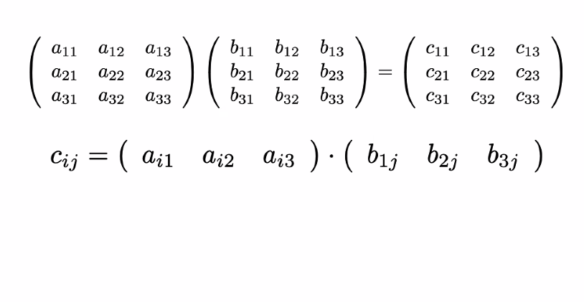

Slide 12
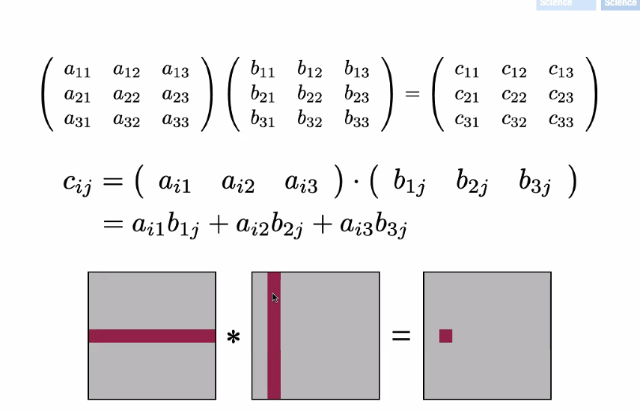

Slide 13
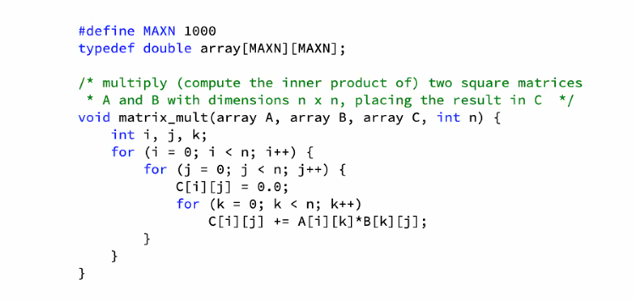

Slide 14
