Slide 1


High Performance Computation
China University of Geosciences
Chengjun Li

Slide 2
6
Partition-Based Clustering with k-Means

Slide 3
Abstract
Nowadays, huge size data-sets are commonly publicly available, and it becomes increasingly important to efficiently process them to discover worthwhile structures in those seas of data.
Exploratory data analysis is concerned with this challenge of finding such structural information without any prior knowledge.
In this case, those techniques that consist in learning from data without prior knowledge are called generically unsupervised machine learning.

Slide 4
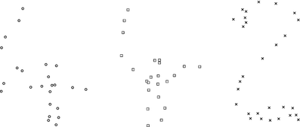
Exploratory Data Analysis and Clustering

Slide 5
Exploratory Data Analysis and Clustering
Exploratory analysis consists in finding intrinsic structures in data sets like groups of data called cluster.
Clustering is a set of techniques that seek to find homogeneous clusters in data-sets.
In this example, the Human eye perceives three well-formed clusters.
In practice, data-sets are living in high dimensions, and thus cannot be visually inspected.

Slide 6
Hard Clustering: Partitioning Data Sets
Partition-based clustering is a hard clustering technique.
Each element belongs to only one cluster.

Slide 7
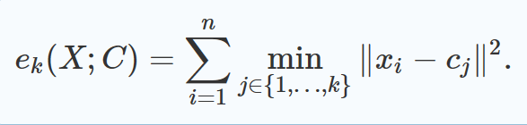
The k-Means Objective Function
The k -means cost function asks to minimize the sum of squared Euclidean distances of data points to their closest prototype centers:

Slide 8
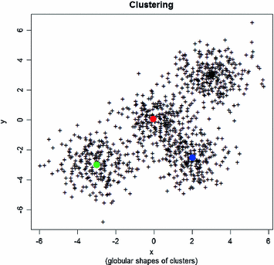
Feature of k-means
Globular-shaped clusters can be obtained by k-Means clustering

Slide 9
Parallel k-Means Clustering on a Cluster of Machines
Here, we consider that each computer has a single processing core (a processing unit).
Those different processors communicate with each other by sending and receiving messages using MPI.

Slide 10
Parallel k-Means Clustering on a Cluster of Machines
Sending a message has a communication cost that is split into two terms: one for the latency of initialization the communication and one that is proportional to the length of the message.
Sending structured data requires first to serialize it into a universal “string” before sending (encoding) at the sender node and to reconstruct it (de-serialize the string to reconstruct the structure) at the receiver node.

Slide 11
Parameters
A k-means clustering problem can be characterized by the number of attributes, the number of data elements n, and the number of clusters, k.

Slide 12
Step of algorithm
At run time, each processor knows the overall number of processors of the cluster, P, by using the function MPI_Comm_size(), and its rank number indexed between 0 and P−1 by using the standard MPI function MPI_Comm_rank().

Slide 13
Step of algorithm
It is the task of processor P0 to initialize the k cluster prototypes and to broadcast them to all other processors using the primitive MPI_Bcast(C, root processor).
Then we loop until convergence:
Each processor Pl computes the labeling of its group of data Xl , and the cumulative sum of the vectors of the k groups corresponding to Pl with the local cardinality of each cluster.

Slide 14
Step of algorithm
Then we aggregate and broadcast all those group cardinals using the MPI primitive MPI_Allreduce.

Slide 15
Given that k-means clustering problem is a NP-Hard computationally intensive problem, a distributed approach seems appropriate.
By dividing up the computation load among many worker nodes, the program can be parallelized and speed up.

Slide 16
The root node reads in the entire dataset and randomly chooses the initial k-means for each cluster.
The root node broadcasts the k-means to each n number of workers.
The root node distributes the dataset among n number of workers. Given its portion of the entire dataset, each worker does computational work against each k-means cluster and returns the result to the root.
The algorithm repeats for X number of iterations.

Slide 17
Notes and References
We have emphasized on the fact that the k-means objective function seek to detect globular-shaped clusters. Although the k-means is often used in practice, it is not (by far!) a universal solution for clustering.

Slide 18
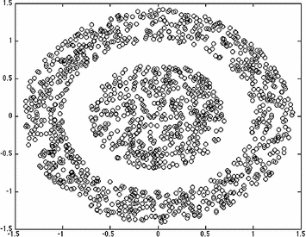
Disadvantage of k-means

