Slide 1


High Performance Computation
China University of Geosciences
Chengjun Li

Slide 2
8
Hierarchical Clustering

Slide 3
Abstract
Agglomerative hierarchical clustering differs from partition-based clustering.
To implement a hierarchical clustering algorithm, one has to choose a linkage function.
A hierarchical clustering is monotonous if and only if the similarity decreases along the path from any leaf to the root, otherwise there exists at least one inversion.

Slide 4
Agglomerative Versus Divisive Hierarchical Clustering, and Dendrogram Representations
Hierarchical clustering is yet another technique for performing data exploratory analysis, an unsupervised technique.
In partition for a data-set, we dealt with flat clustering that delivers a non-hierarchical partition structure of the data-set.
To contrast with this flat clustering technique, we cover in this chapter another widely used clustering technique: namely, hierarchical clustering.

Slide 5
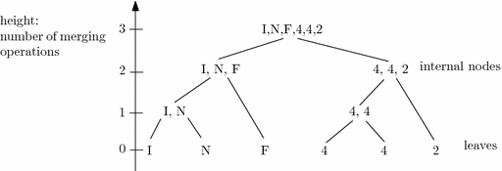
Agglomerative Versus Divisive Hierarchical Clustering, and Dendrogram Representations

Slide 6
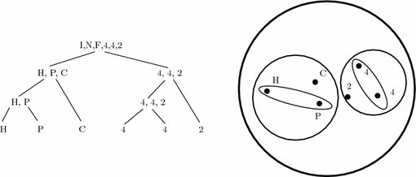
Agglomerative Versus Divisive Hierarchical Clustering, and Dendrogram Representations

Slide 7
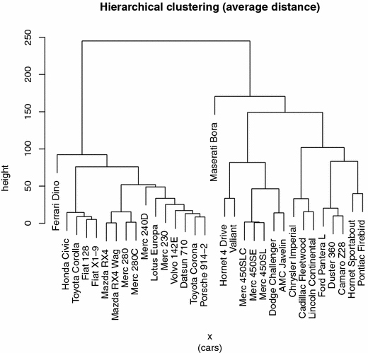
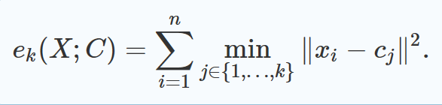
Agglomerative Versus Divisive Hierarchical Clustering, and Dendrogram Representations

Slide 8
Agglomerative Versus Divisive Hierarchical Clustering, and Dendrogram Representations
We have chosen the Euclidean distance D(xi,xj)=∥xi−xj∥ as the basic distance between any two elements of X, and the minimum distance as the linkage distance for defining the sub-set distance Δ(Xi,Xj)=minx∈X,y∈XjD(x,y).
Here is an excerpt of that data-set that describes some features for the car data-set:

Slide 9
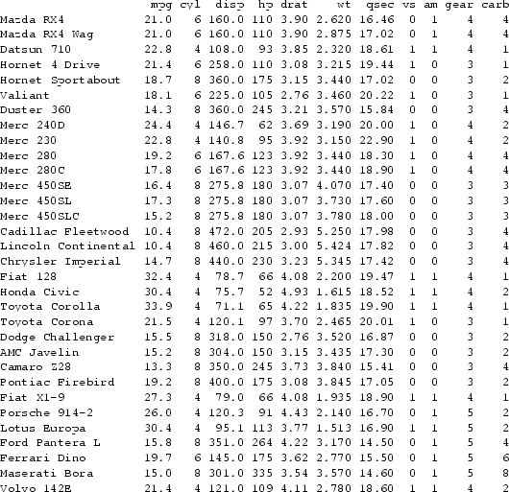

Slide 10
Strategies to Define a Good Linkage Distance
Let D(x_{i},x_{j}) denote the elementary distance between any two elements of X (for example, the Euclidean distance).
In order to select at each stage of the hierarchical clustering the closest pair of sub-sets, we need to define a sub-set distance Δ(X_{i},X_{j}) between any two sub-sets of elements.
When both sub-sets are singletons X_{i}={x_{i}} and X_{j}={x_{j}}, we should have Δ(X_{i},X_{j})=D(x_{i},x_{j}).

Slide 11
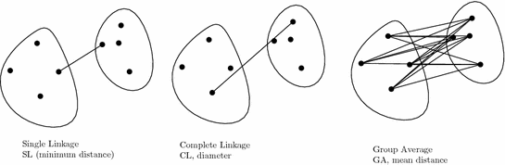
Strategies to Define a Good Linkage Distance
There exist many other sub-set distances Δ that are commonly called linkage distances because they literally allow one to link sub-trees representing the sub-sets in the dendrogram representation.

Slide 12
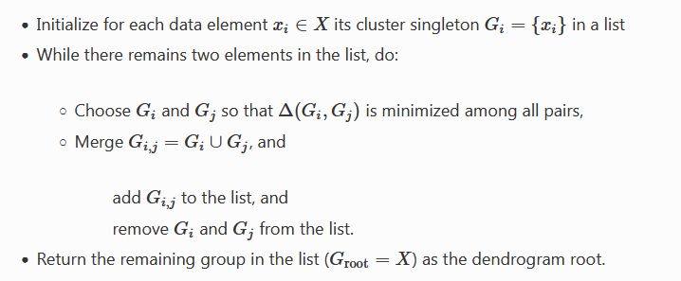
A Generic Algorithm for Agglomerative Hierarchical Clustering
At run time, each processor knows the overall number of processors of the cluster, P, by using the function MPI_Comm_size(), and its rank number indexed between 0 and P−1 by using the standard MPI function MPI_Comm_rank().

Slide 13
A Generic Algorithm for Agglomerative Hierarchical Clustering
Since we start from n=|X| leaves to finish with a root containing the full set X, we perform exactly n−1 merge operations.
A straightforward implementation of this AHC algorithm yields a cubic time complexity, in O(n3).
Depending on the linkage distance, we can optimize this naive algorithm and obtain far better time complexities.

Slide 14

Choosing the Appropriate Elementary Distance Between Elements
The base distance function plays a crucial role on the shape of dendrograms. This distance function is a dissimilarity measure that evaluates how different element x_{i} is from element x_{j} (for any pair of elements).
Beside Euclidean distance, we can also choose other metric distances Footnote 2 like the city block distance:

Slide 15
Choosing the Appropriate Elementary Distance Between Elements
There exist many other distance functions that have been used in a broad panel of applications.
Let us cite the Jaccard distance D_{J}(A,B)=|A∩B|A∪B defined on sets, the edit distance for finding distance between combinatorial structures (like texts or DNA sequences), the cosine distance D_{cos}(p,q)=1−p⊤q∥p∥∥q∥
Very useful when analyzing a corpus of texts with documents represented by a frequency histogram of word occurrences, etc.

Slide 16

Ward Merging Criterion and Centroids
One can also take a sub-set distance Δ according to the centroids of the sub-sets. This criterion allows us to implement a variance minimization process.
This yields the Ward linkage function: to merge X_{i} (n_{i}=|X_{i}|) with X_{j} (n_{j}=|X_{j}|), we consider the following Ward criterion:

Slide 17
Ward Merging Criterion and Centroids
c(X′) denotes the centroid of subset X′⊆X: c(X′)=1|X′|∑x∈X′_{x} .
Observe that the distance between two elements induced from the sub-set distance Δ is merely half of the squared Euclidean distance: Δ({x_{i}},{x_{j}})=D(x_{i},x_{j})=12∥x_{i}−x_{j}∥2.
The figure illustrates visually the difference between the dendrograms obtained from the group average AHC and from the Ward AHC.

Slide 18
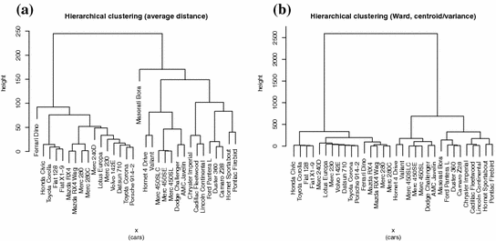
Ward Merging Criterion and Centroids

Slide 19
Ward Merging Criterion and Centroids
Notice that we can always define the similarity S(X_{i},X_{j}) between two sub-sets by defining S(X_{i},X_{j})=−Δ(X_{i},X_{j}).
The merging steps of a path sequence of length l in the tree dendrogram are said monotonous when we have the property that S₁≥S₂≥⋯≥S_{l}.

Slide 20
Ward Merging Criterion and Centroids
A hierarchical clustering is said non-monotonous when there exists at least one inversion, say S_{i}<S_{i}+1, on a path from the leaves to the root of the dendrogram.
The Ward AHC is not monotonous because there can exist inversions.
The single linkage, complete linkage and group average linkage are all guaranteed to be monotonous.

Slide 21
Ward Merging Criterion and Centroids
When we draw the nodes of the merge using a height function defined as the similarity, an inversion in a dendrogram can be noticed graphically by the fact that one horizontal height line can be lower than another horizontal height line for a former merging operation.

Slide 22
Ward Merging Criterion and Centroids
Indeed, this contradicts the fact the nodes on a path from a leaf to the root should be y-monotonous.
Figure illustrates an inversion in a dendrogram.

Slide 23
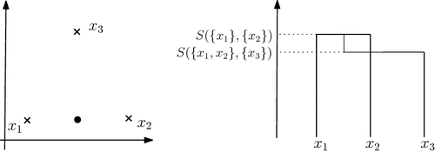
Ward Merging Criterion and Centroids

Slide 24
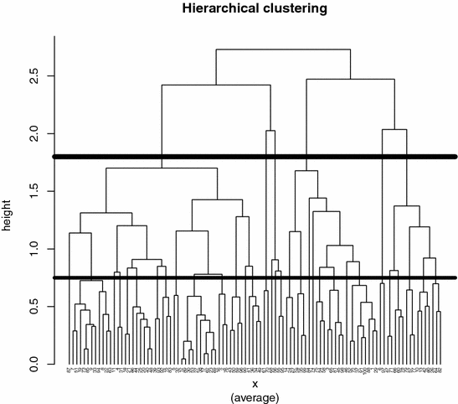
Retrieving Flat Partitions from Dendrograms

Slide 25
Ultra-metric Distances and Phylogenetic Trees
The Euclidean distance and the Hamming distance are two examples of metric distances.
Beware that the squared Euclidean distance is not a metric although it is symmetric and satisfies the law of indiscernibility.

Slide 26
Ultra-metric Distances and Phylogenetic Trees
Indeed, the triangular inequality is not anymore satisfied when we take the square of the Euclidean distance.
The law of indiscernibility can further be split into two sub-axioms: The law of non-negativity D(p,q)≥0, and the law of reflexivity: D(p,q)=0⇔p=q.

Slide 27
Ultra-metric Distances and Phylogenetic Trees
Hierarchical clustering is tightly linked to a class of distances called the class of ultra-metrics.
A distance is said ultra-metric if it is a metric and further ensures that:
D(x,y)≤maxz(D(x,z),D(z,y)).

Slide 28
Ultra-metric Distances and Phylogenetic Trees
Let us now explain the link between ultra-metrics and hierarchical clustering: In evolution theory, species evolve with time, and the distance between species is represented by a so-called phylogenetic tree. Let us write for short D_{i,j}=D(x_{i},x_{j}).

Slide 29
Ultra-metric Distances and Phylogenetic Trees
A tree is said additive if and only if we can attach to each edge a weight so that for each pair of leaves, the distance between them is equal to the sum of the distances of the edges linking them.

Slide 30
Ultra-metric Distances and Phylogenetic Trees
A tree is said ultra-metric when the distance between two leaves, say i and j, and their common ancestor, say k, is equal: D_{i,k}=D_{j,k}.
We can draw an ultra-metric tree by choosing the height distance 12D_{i,j} for visualizing a dendrogram.

Slide 31
Ultra-metric Distances and Phylogenetic Trees
The group average AHC guarantees to produce an ultra-metric tree.
We shall call this hierarchical clustering that embeds the nodes of the tree with its height the Unweighted Pair Group Method using arithmetic Averages algorithm (or UPGMA, for short).

Slide 32
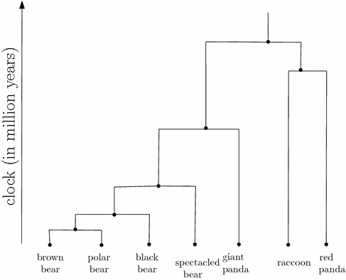
Ultra-metric Distances and Phylogenetic Trees

Slide 33
Notes and References
There exist many hierarchical clustering algorithms. Let us cite SLINK (Single Linkage, 1973), CLINK (Complete Linkage, 1977), and a general survey providing a high-level abstraction of hierarchical clustering.

Slide 34
Notes and References
Although that flat clustering minimizing the k-means objective function is NP-hard (even in the plane), it has been recently proved (2012) that we can extract from a single linkage hierarchical clustering the optimal k-means clustering provided that some stability criterion is satisfied).

Slide 35
Notes and References
The hierarchical clustering that minimizes Ward’s variance criterion and its related criteria have been thoroughly investigated. Various hierarchical clustering algorithms (including SLINK, CLINK and Ward) can be unified in the generic Lance-Williams framework.

Slide 36
Summary
Agglomerative hierarchical clustering differs from partition-based clustering since it builds a binary merge tree starting from leaves that contain data elements to the root that contains the full data-set.
The graphical representation of that tree that embeds the nodes on the plane is called a dendrogram.

Slide 37
Summary
To implement a hierarchical clustering algorithm, one has to choose a linkage function (single linkage, average linkage, complete linkage, Ward linkage, etc.) that defines the distance between any two sub-sets (and rely on the base distance between elements).

Slide 38
Summary
A hierarchical clustering is monotonous if and only if the similarity decreases along the path from any leaf to the root, otherwise there exists at least one inversion. The single, complete, and average linkage criteria guarantee the monotonic property, but not the often used Ward’s criterion.

Slide 39
Summary
From a dendrogram, one can extract many data-set partitions that correspond to flat clustering output.
Phylogenetic trees used to model the evolution of species are ultra-metric trees. Hierarchical clustering using the average linkage guarantees to build an ultra-metric tree when the base distance between any two elements is ultra-metric.

